Slide 1
Scientific knowledge and the citizen
Herwig Schopper
Prof.emer. University Hamburg, Former Director General of CERN
Member, Board of Trustees, World Academy of Art & Science

Slide 2
Knowledge and social power
Since the era of enlightenment scientific knowledge has increased enormously and is now an essential part of general knowledge
as physicist basic science is my field and hence I shall speak about
natural sciences,
Natural sciences (physics, chemistry, biology, geology….) have produced the basis for a new understanding of nature, cosmos and environment
How can this power of knowledge be transformed into social power:
- changing our values
- introducing new technologies
What are the limits scientific power

Slide 3
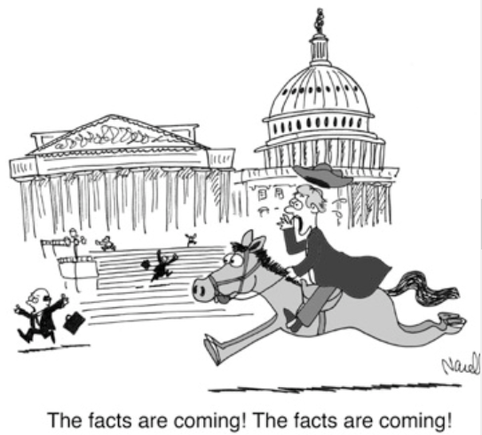
Science as the basis of modern technology has changed the evolution of society during the last 200 years (travel, electricity, communication,…)
But high standards of living, freedom and wellbeing for everybody have not been attained
Hence Science and technology are blamed for many of the problems leading to crisis of society
Era of post-enlightenment?
Rationality is replaced by emotions?
Political decisions neglect often scientific facts,
‘perceptions are facts’
Scientific issues do not bring votes
(see American presidential campaign!)
Nevertheless many political decisions need scientific input

Slide 4
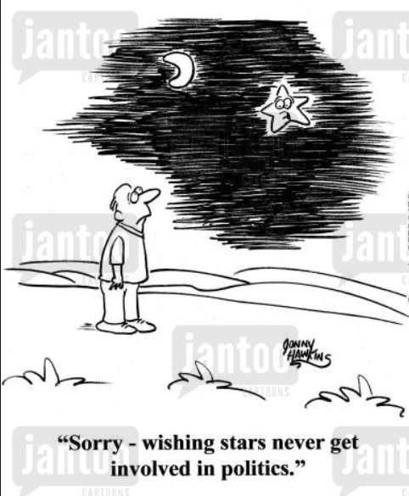
How to improve the situation ?
How to transfer Knowledge power into social power?
Explain better to people (including politicians):
- What science is, how it works,
The relations between Science and Technology and Society
Science and human values
- Clarify misunderstandings about science
(due to media and over-ambitious scientists)

Slide 5
What is ‘science’?
By ‘science’ I mean here ‘natural sciences’ (Naturwissenschaften) (physics, chemistry, biology, geology,….) which are the basis of technologies
not humanities (Geisteswissenschaften), nor economics.
Differences will be discussed later
Problem of languages,
(in science words are exactly defined, poetry lives from ambiguities of words)
Two cultures Still exist!
Sciences are not liked by most people! (physics at schools! Awfull!)

Slide 6
How does science work?
Two wrong extremes presented by media:
- science represents the absolute eternal truth
science is a social activity and hence depends on historical conditions, contingencies and is therefore untrustworthy.
Both not true, progress of science is more complicated

Slide 7
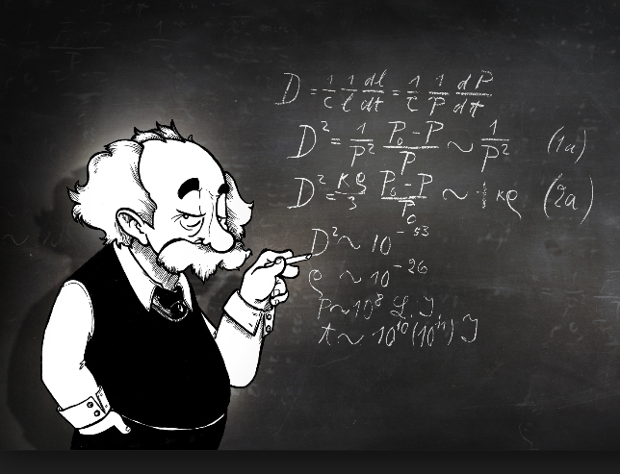
Two Phases
Phase: Human approach
the researcher is choosing his method of work
either in a more systematic way or by trial and error.
loose contacts with other scientists is essential to form new ideas.
theorists - experimentalists!
The image of the lonely genius solving all the riddles in his study by thinking deeply is completely wrong. Media and public prefer human heroes, Theorists favoured
Even Einstein, the most outstanding example of the solitary mastermind, depended on interactions with other colleagues, knew the Lorentz transformation (special relativity) and he learned from Riemann’s geometry of curved space (general relativity)
Usually only after many wrong trials and many useless detours ‘final’ results emerge. (may be questioned by the results of others and only continuing work may eventually lead to definite solutions).
Intuition is helpful, but alone not sufficient.
Science is hard often tedious work

Slide 8
2. phase: consolidation and verification of results
provides the ‘cleaned’ contents of textbooks and handbooks. There everything looks logical and straightforward and all the detours are forgotten
(which may give the wrong impression that science is boring since no surprises and intuition).
Konsolidation of experimental facts
Theory is compared with facts (experiments = numbers).
Falsification of theories is essential for progress of science (not interesting for media)
Requires strong collaboration between theory and experiment.
Progress is made mainly in small steps and seldom in a few breakthrough discoveries. Example: Unified electromagnetic theory by Maxwell’s equation: he added one final element including varying electromagnetic fields, based on many results from others: M. Faraday, H. Ch. Øersted, Heinrich Hertz)

Slide 9
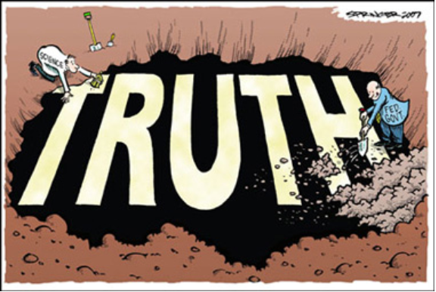
What means ‘Truths’ in science ?
Main difference between the natural sciences and other human actions
is the definition of ‘truth’ :
in science a result is recognised as ‘true’ only
if it can be reproduced everywhere at any time.
The ultimate authority is nature and not human authorities.
reproducibility provides confidence for results of science and technology.
When social scientists occasionally claimed that all results of science are uncertain since they are dominated by social conditions, I asked them whether they trust a bridge which they cross or an airplane which they board.
all the interesting philosophical discussions about reality and objectivity are very interesting from a philosophical point of view but as a practising physicist I have to ignore them as long as I am in the laboratory and want to do good science.
Relations with Truth in other areas of human activity will be considered later

Slide 10
Interpretation of scientific data
Scientific data are numbers with two kinds of uncertainties:
Systematic ‘errors’: due to imperfections of equipment:
experimental art → keep them small and estimate their size.
Statistical errors: single measurements can give accidental results
(coin flip or dice throwing, quantum mechanics)
Statistical laws: the deviation from expected probabilities depends on number of trials (proportional to square root).
the statistical error can be reduced by repeated measurements.
Scientific results have no meaning without quoting their error
Not respected in public surveys.
In public polls, about 1000 persons are interviewed → statistical error of about 3%.
Results differ often by not more than this, hence have no relevance.
Usually not mentioned and completely neglected.

Slide 11
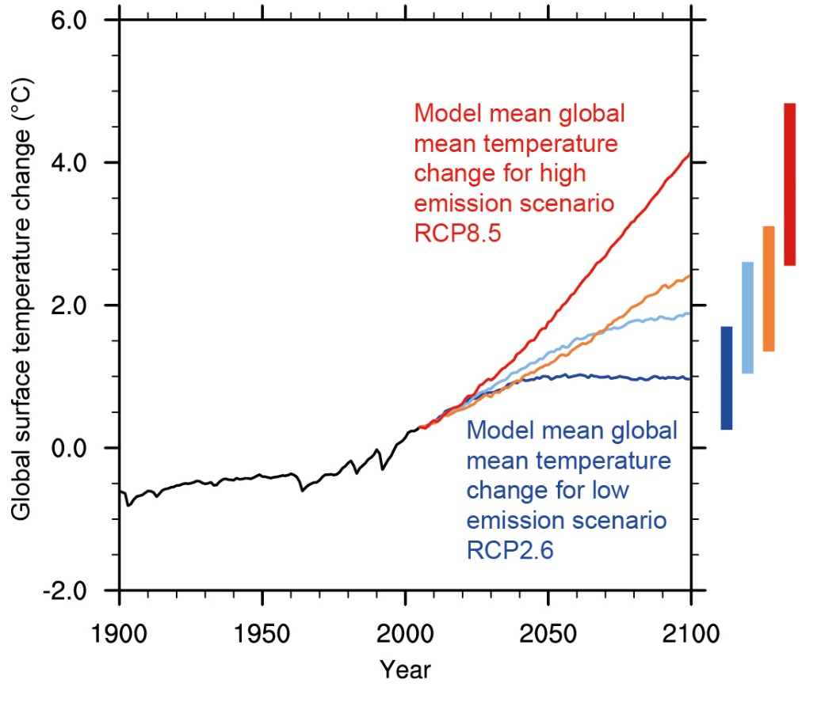
Scientific predictions and political decisions
The importance of errors is even more crucial for predictions.
Every scientific model is based on certain assumptions depending on the present state of knowledge, different assumptions lead to diverse results.
Predictions without quoting errors are ambiguous!!
One example climate warming.
Facts are: CO₂ and temperature are raising,
urgent measures are necessary, but which ones and how fast? Some parts of the complicated climate system are not yet sufficiently understood, for example the influence of clouds or the interaction between oceans and atmosphere. Predictions with different assumptions led to the official 2º C adopted by IPCC .
Uncertainties attached to this value are never mentioned
For political and psychological reasons this is justified
but certainly it is not a rational use of scientific knowledge for detailed decisions (how fast and which measures to take)

Slide 12
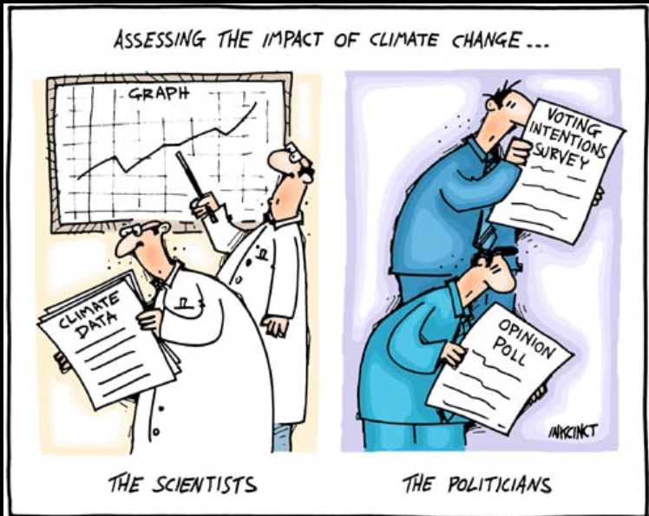
Scientific knowledge and its perception by society
Scientific knowledge changes during history, but not by invalidating old systems but rather by restricting their domains of application.
(e.g. quantum physics has not invalidated Newtonian physics)
(media like REVOLUTIONS).
Misunderstanding of the progress of science might have the consequence that a large part of the population might lose the confidence in science since they might get the perception that science is not reliable
How can one achieve that difficult political decisions on scientific-technical issues (energy production and use, climate change, nuclear energy, water and food supply, etc.,)
can be put on more rational arguments instead of being strongly influenced by emotional disputes?

Slide 13
Education and political decisions
Every citizen should have a minimum understanding of basic science in order to
understand natural disasters (thunder, lightning, earthquakes etc.) as natural phenomena and not as expressions of the anger of gods)
But astrology is still a much appreciated topic in some journals.
be able to participate in political decision
Hence education should include not only reading and writing
but also a certain understanding of the fundamental laws of nature.
This should be the main task for primary and secondary schools.
How to make it attractive???
But basic knowledge not sufficient for taking decisions on modern extremely complex technological developments. Not all citizens can become scientists
(a few clicks in the WEB cannot replace a training of many years)
Hence technical scientific specialists are needed,
they have a high social responsibility – how to use it?

Slide 14
Should all citizens have the same power in taking ‘technical’ decisions?
Maybe yes - All people are equal !? Wrong interpretation of democracy
Some people are stronger, more beautiful or more intelligent than others.
Democracy: the chances should be equal for all, but not the final achievements.
Hence we should not expect that the critical power of judgement
can be the same for all citizens and hence also the responsibilities.
Should citizens with different degrees of (scientific) education have different degrees of influence on social decisions?? If so- but how? –
- experts cannot take decisions alone in a democracy.
but they have a higher responsibility
Popular votes? do not guarantee the most reasonable technical decision
Unsolved Problem of democracy.

Slide 15
Science and human values
Understanding of science by the citizen is also important for the formation of human values
Enlightenment has liberated us from superstition.
Supernatural powers take not a direct influence on human destiny.
Kings and emperors are not installed by the grace of god
Science has changed the relationship between science and faith.
Formulations in holy scripts should be interpreted symbolically, not taken literally
age of the earth about 4 billion years and not about 4000 years;
evolution of species including man is a result of evolution.
Does modern science lead necessarily to atheism? Is God dead ? (F.Nietzsche)
famous scientists express themselves in this way
Wrong: science and faith are compatible!

Slide 16
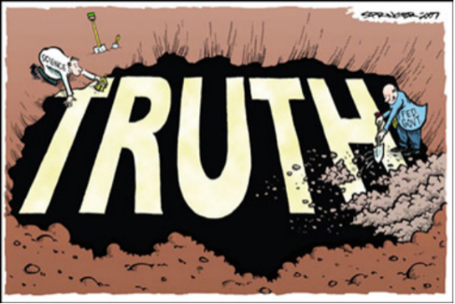
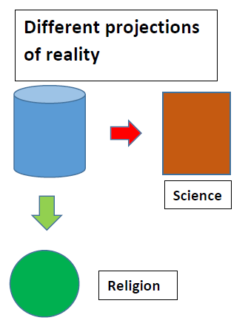
What is ‘truth’?
in science is based on reproducible observations anytime and anywhere
in religion it depends on revelation,
normally not repeatable at will
no scientific statements concerning miracles (not repeatable!)
Hence science and faith are compatible,
not in conflict
Different ways of perceiving the same world,
even if seem to contradict each other
Science cannot make any statements on religion
Nor on aestethics or ethics

Slide 17
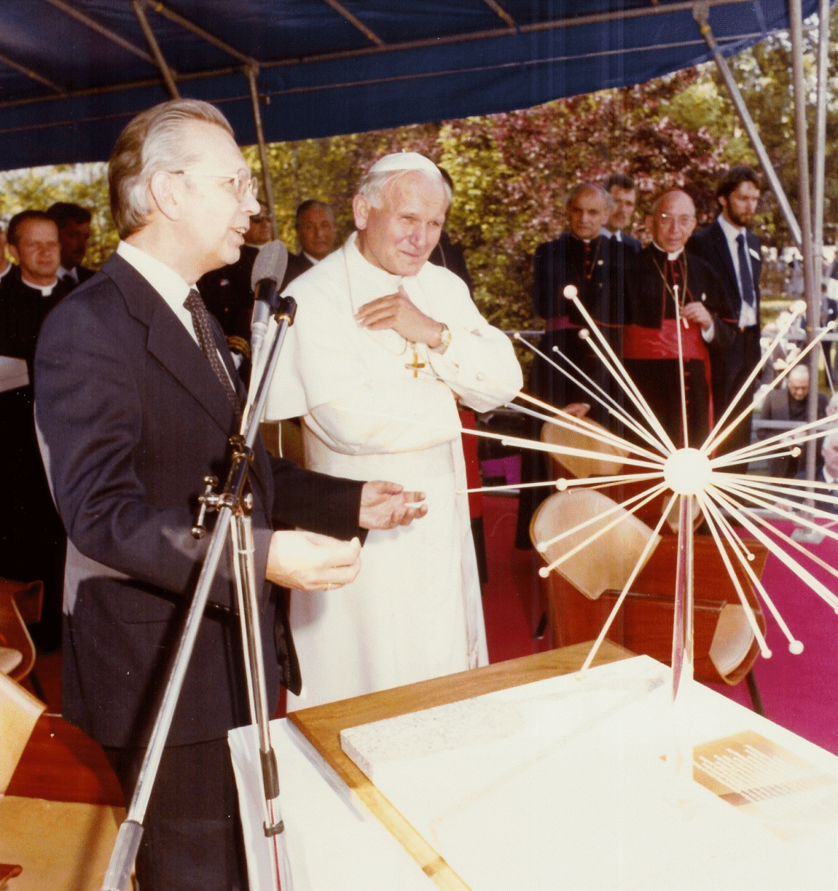
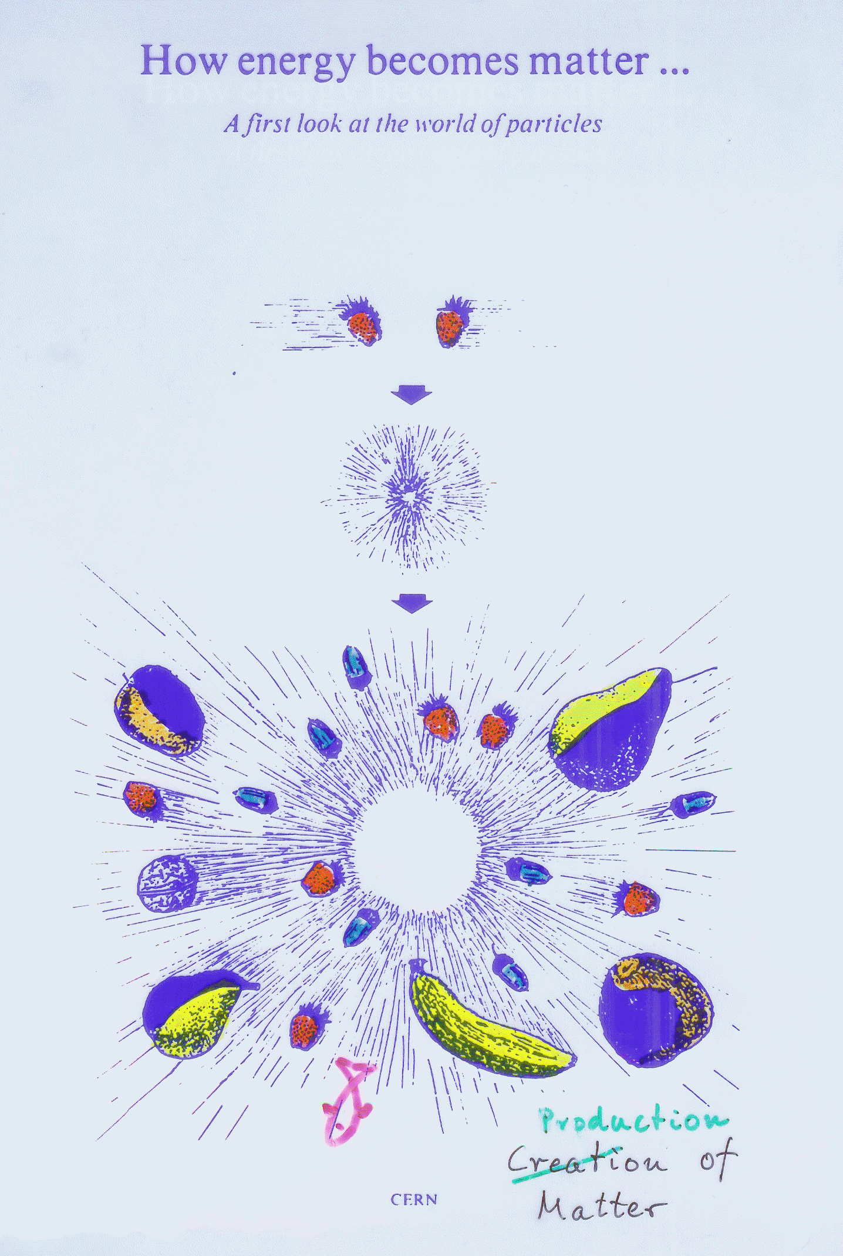
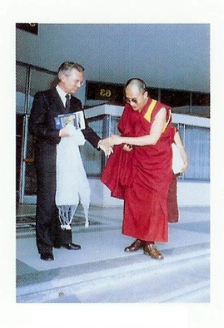
Pope Johannes Paulus II visited CERN in 1983,
In discussion we agreed fully on this argument.
My question: what then about Galileo Galilei
Answer: no document signed against him by a pope,
only inquisition, matter of discipline
a few years later Galileo was vindicated by the Vatican.
Dalai Lama at CERN:
same conclusion.
When I expressed my surprise that he fully agreed with the Pope he answered that he had dinner regularly with the Pope where they discussed such questions.
Original graph shown to Pope

Slide 18
Whom could citizens trust when it comes to technical decisions?
individual Scientists?
have their ambitions, are proud of their own achievements and
are after all human beings with their prejudices.
For every dispute on a technical problem concerning society one will be able to find individual scientists who are in favour or against.
In the past some outstanding scientists had managed to acquire sufficient confidence and their messages had a certain weight. Unfortunately this happens much rarer today
Politician and media prefer beauties or footballers who are much more popular than scientists.
The media are often not neutral, influenced by economic or political pressures.

Slide 19
The role of Scientific Academies or learned societies
Play a useful role in informing the public
Can be trusted if the studies, analysis and recommendations are not biased politically, ideologically or economics-wise.
Trivial but not easy to achieve.
A few organisations come close to this ideal, like Club of Rome, National Academy USA, the Royal Society UK or the Leopoldina in Germany.
But their influence on governments, media and on the public is still rather limited and in most cases restricted to national problems.
Could WAAS play a greater role, in particular as far as global issues are concerned?

Slide 20
Summary
Many open questions
Talmud: ‘La réponse est le malheure de la question’
The answer is the misfortune of the question

Slide 21
Thank you

Slide 22
In natural Science facts are based on measurements which can be put in numbers, in formulae and finally in mathematically formulated theories which not only reproduce all measurements but also allow predictions. This is one of the mysteries: nature prefers mathematics as a language! Considering the history of science we state that a first step was the penetration of physics by mathematics. Combined with quantum mechanics this helped us understand the structure of the atom, then the atomic nucleus and most recently, the structure of elementary particles and the forces acting between them. Of course always being guided and confirmed by experiments! Chemistry was in the beginning like all sciences, a purely empirical activity, (starting with the alchemists) and later became a real science only around 1920 when, thanks mainly to Linus Pauling, physics helped us understand the chemical bonding and reactions on the basis of the atomic structure. Molecular Biology is presently in a transition from empiricism to theoretical understanding, whereas genetics or neuroscience are still restricted to certainly remarkable but still empirical successes.

Slide 23
Science and spirituality
human beings need in addition to rational thinking a metaphysical ‘narrative’.
Can sciences contribute at least indirectly to establish such a narrative and the ensuing human values?
Maybe, maybe not!
Some general principles accepted in sciences may provide some hints.
As far as we know today the laws of nature are universally valid—everywhere on earth, in the whole observable universe and at all times.
Should one endeavour to find similar general laws for human ethics? Are ‘Human Rights’ as defined by the United Nations at least an approximation of such general laws?
At least in science, one of the most noble and most universal expression of human existence, we have learned that non-discrimination of races, faiths and mentalities and tolerance in general, are positive values for the development of society.

Slide 24
Unification or multitude?
In sciences we aspire to explain the multitude of phenomena by a ‘theory of everything’ based on as few assumptions as possible.
The search for unification seems to be one of the fundamental aspirations of human existence. It allows us to put the multitude of phenomena into a logical scheme and may be the basis for logical thinking. However, in physics we have learned that there will never be a complete theory of everything,
developing new concepts based on empirical observations new realms of nature can be opened to research.
Exploring nature is not unveiling a completed picture!
The understanding that there will never be a theory of everything in the natural sciences might perhaps be a lesson for other human actions.

Slide 25
Does the public trust scientists?
Fundamental science (answering questions and satisfying human curiosity) because of its deep cultural value should be free to choose its targets for research and should not be limited by political or ideological ideas—a message that should be transferred to the citizens.
But The results of science and technologies concern the better or worse of society. To decide which technologies should be developed and which to ban is not the responsibility of the scientists alone, it is a decision to be taken by the democratic representatives after listening to the citizen
Problem
Democracy assumes that the ‘politically educated citizen’ (‘der mündige Bürger’ in German) would be able to form his own judgement. This is an illusion. Certainly the educational systems have made it possible for practically every citizen to understand better our environment and the public networks allow everyone to obtain immediate information on whatever topic is of interest. However, a few clicks on internet pages cannot replace many years of specialised studies.

