Slide 1
Knowledge and social power
During last 200 years most of new knowledge was produced by natural sciences (physics, chemistry, biology, ….)
provocative statement by me as physicist
everybody will agree that at least our lives have been changed enormaouls by technologies based on the scientific know-how
The general relations between scientific knowledge and social power will be covered in more general terms in my talk Scientific Knowledge and the Citizen
Here only one specific topic will be considered:
International scientific cooperation and creation of trust

Slide 2
How can Modern science depending on international collaboration contribute to the creation of trust? in two ways
- On individual level promoting better understanding
between scientists of different nations, mentalities, histories, faiths
- Radiates into lower and higher politics

Slide 3
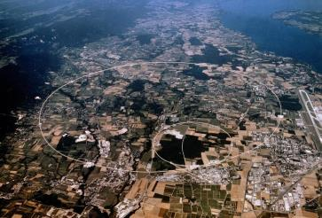
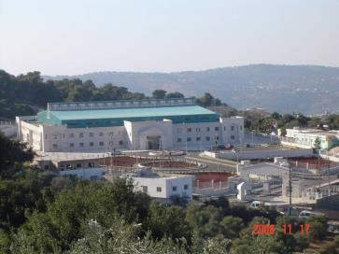
‘SCIENCE for PEACE’
Two organisations created under the umbrella of UNESCO:
CERN in Geneva
Conceived late 1940s , after WW II with two aims:
Enable construction of a facility beyond means of individual states
Foster cooperation between peoples recently in conflict in Europe Presently 22 Member States
SESAME in Jordan (child of CERN)
Conceived late 1990s with the same two aims for MENA:
Members: Bahrain, Cyprus, Egypt, Iran, Israel, Jordan, Pakistan, Palestinian Authority, Turkey
Scientific programme will start in 2017
In both organisations government representatives are in Council

Slide 4
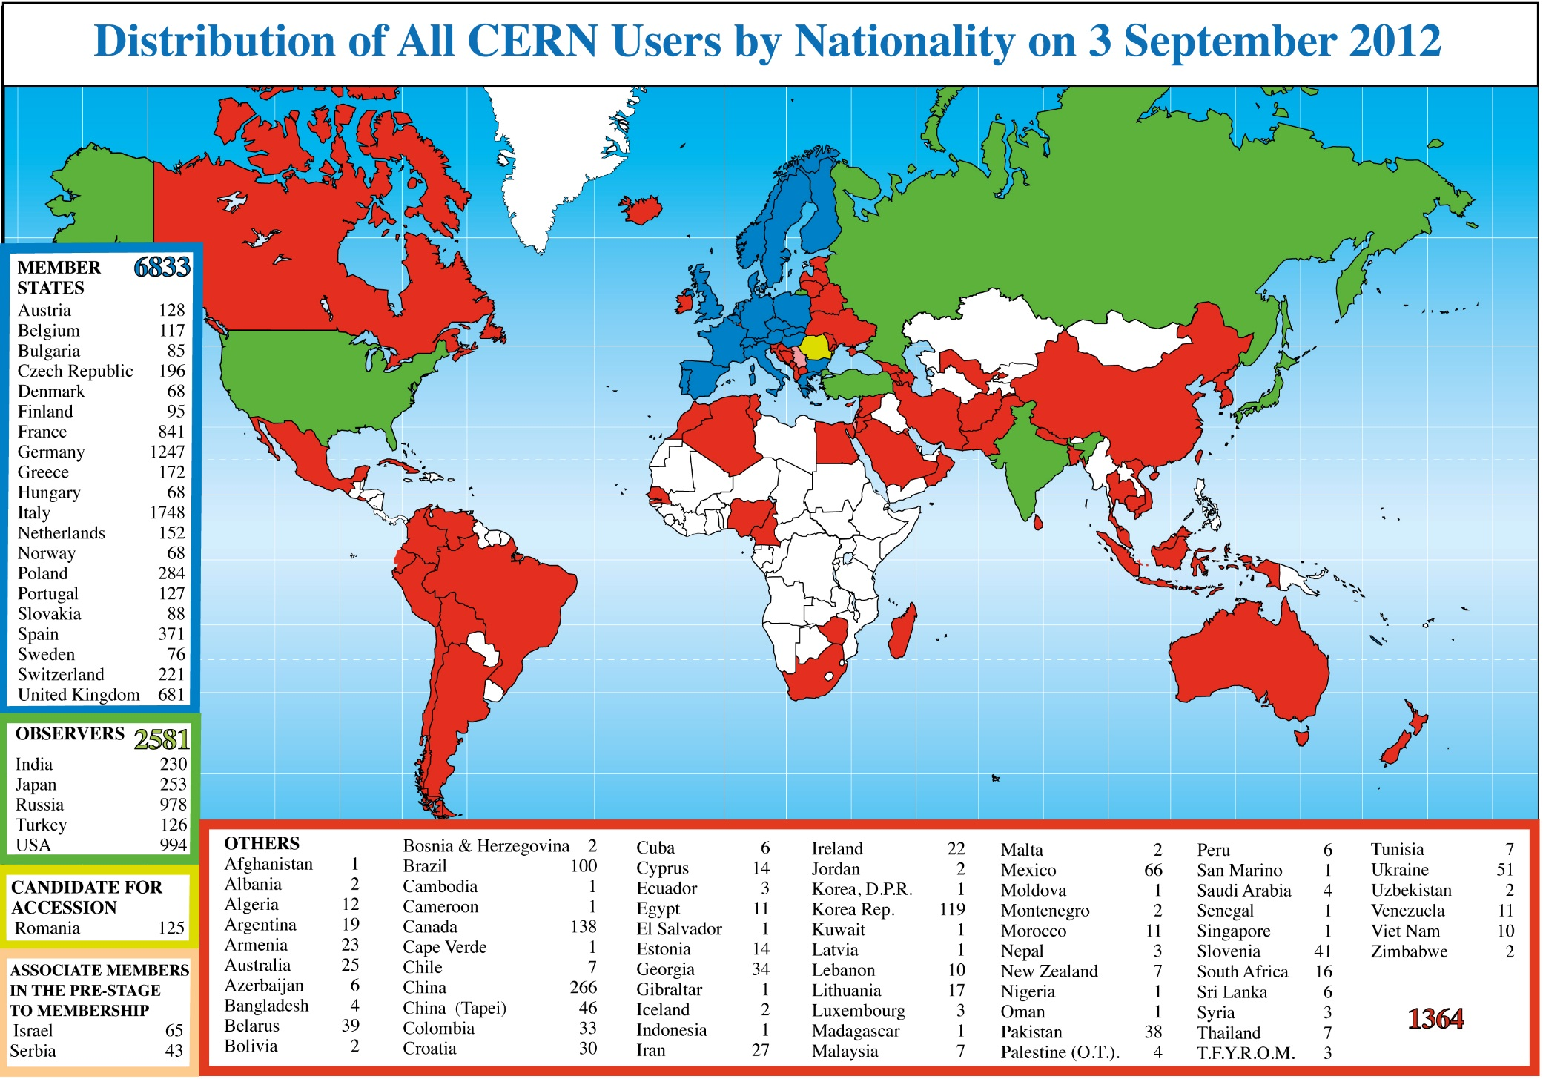
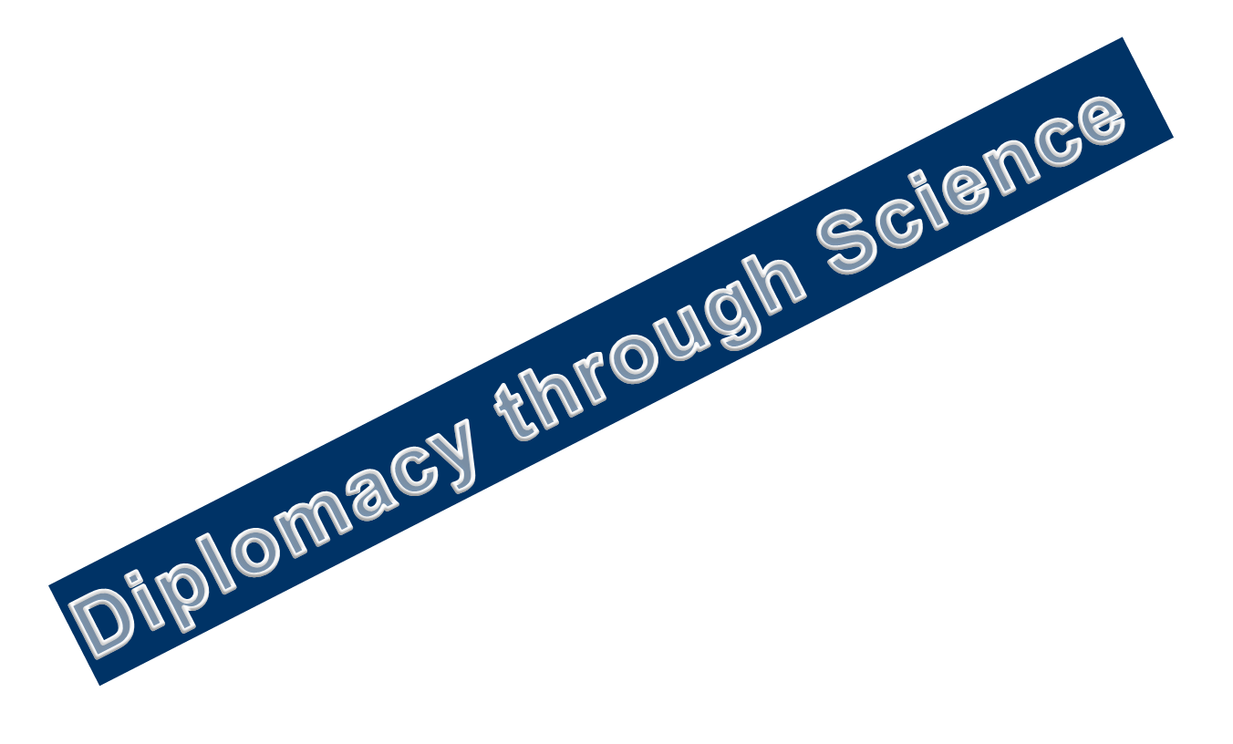
Science is getting more and more global
About 12000 users

Slide 5
CERN large ‘Experiments’ Model for global cooperation
Large Projects at LHC each involving about 3000 scientists from many countries and universities
Independent Budgets of several billion $ independent of CERN
Democratic leadership: cooperation committee decides, elects spokesperson, no legal CEO
Can it be a model for other global projects??
Discussion at UN Geneva in cooperation with WAAS in 2015

Slide 6
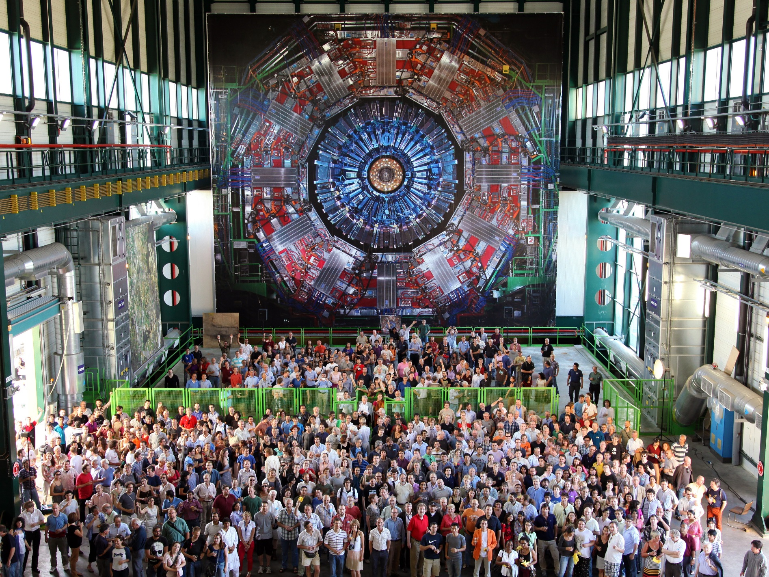
The CMS experiment at CERN is one of the largest international scientific collaborations in history, involving more than 3500 scientists, engineers, and students from 194 institutes in 43 countries

Slide 7
Scientific cooperation Brings people together with different traditions, mentality, political systems and religion for better understanding Promotion of human values like rationality, honesty and tolerance
e.g. Chinese physicists from PR China and Taiwan first time in same LEP experiment (1990ies)

Slide 8
Cooperation in large scientific projects requires also administrative and political efforts on “lower level” which irradiate into different and even highest political levels.
CERN – IHEP (Soviet Union) agreement in 1968 only scientific agreement during hot cold war became model for IHEP- Stanford (USA) agreement and later for model for USA- Soviet Union agreement (Breshnev-Ford)
Disarmament meeting at Geneva in 1980ies when in deadlock private meeting at CERN unblocked it (Director of DOE Trivelpiece asked for dinner)
SESAME : Peaceful cooperation Israel-Palestine, Iran-Israel, Cyprus-Turkey including politicians

Slide 9
SESAME intergovernmental organization in Jordan
Governing Body Council
Each Member one vote
SESAME Statutes are ‘copy’ of CERN Convention
Members of SESAME
Observers
BAHRAIN
CYPRUS
EGYPT
IRAN
ISRAEL
JORDAN
PAKISTAN
PALESTINIAN AUTHORITY
TURKEY
France
Germany
Greece
Italy
Japan
Kuwait
Portugal
Russia
Sweden
UK
USA

Slide 10
Scientific Programme
Very strong light source for Interdisciplinary research
Research in the domains :
Physics (mainly condensed matter)
Material science
Nanotechnology
Molecular biology
Archaeology
Environmental studies
Medical research

Slide 11
H.M.King Abdullah II and UNESCO DG Matsuura unveiling marble plate, Groundbreaking January 2003
SESAME will start scientific programme in spring 2017

Slide 12
First users‘meeting, January 2003 at Amman Financed mainly by Japan

Slide 13
In time where relations between some nations are characterised by hatred and violence it is gratifying that scientific cooperation can bring together politicians and scientists to work peacefully together
A concrete way of transforming knowledge power into social values
Small light in dark times

Slide 14
Thank you

