Slide 1
World Academy of Art & Science & World University Consortium Trans-disciplinary Course on Individuality & Accomplishment IUC Dubrovnik August 25-31, 2014
LECTURE SCHEDULE – AUGUST 25, 2014
TOPIC | FACULTY | CET
High Achieving Individuals | Garry Jacobs | 9.00 – 10.30 AM
Society & Social Power | Janani Harish | 11.00 – 12.30 PM
Social Construction of Knowledge and Reality | Alberto Zucconi | 2.00 – 3.30 PM
Role of Human Relationships & Networking in Individual and Social Development | Ljudmila Popovich | 4.00 – 5.30 PM

Slide 2
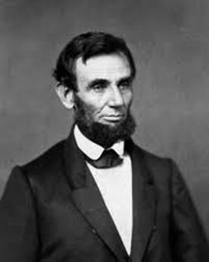
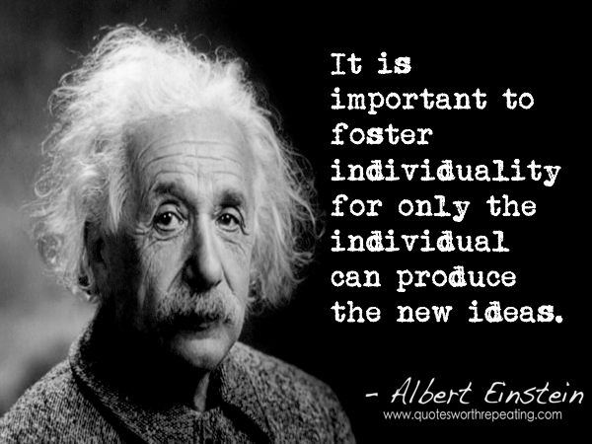
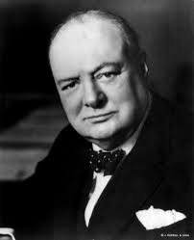
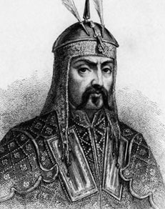
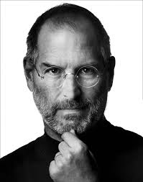
Trans-disciplinary Course on Individuality & Accomplishment IUC Dubrovnik August 25-31, 2014
Garry Jacobs
World Academy of Art & Science
World University Consortium
The Mother’s Service Society

Slide 3
1984

Slide 6
Job’s dream was to create a unique, revolutionary product that would change the world

Slide 7
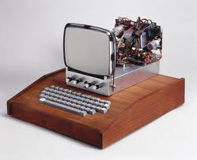
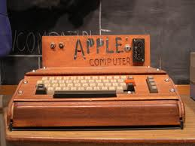
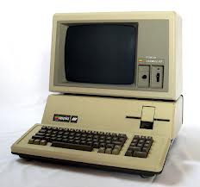
APPLE COMPUTERS
1976: $5000 investment, 2 employees

Slide 8
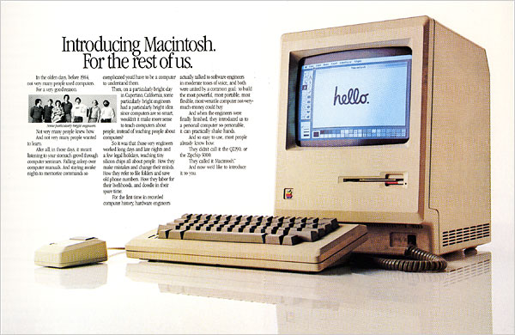
1984 Macintosh

Slide 9
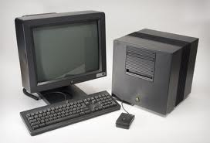
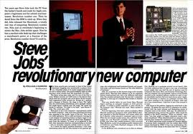
1988 What NeXT?
1988: Invested $7M
Sold only 400 a month
1998: Sold for $400 M

Slide 10
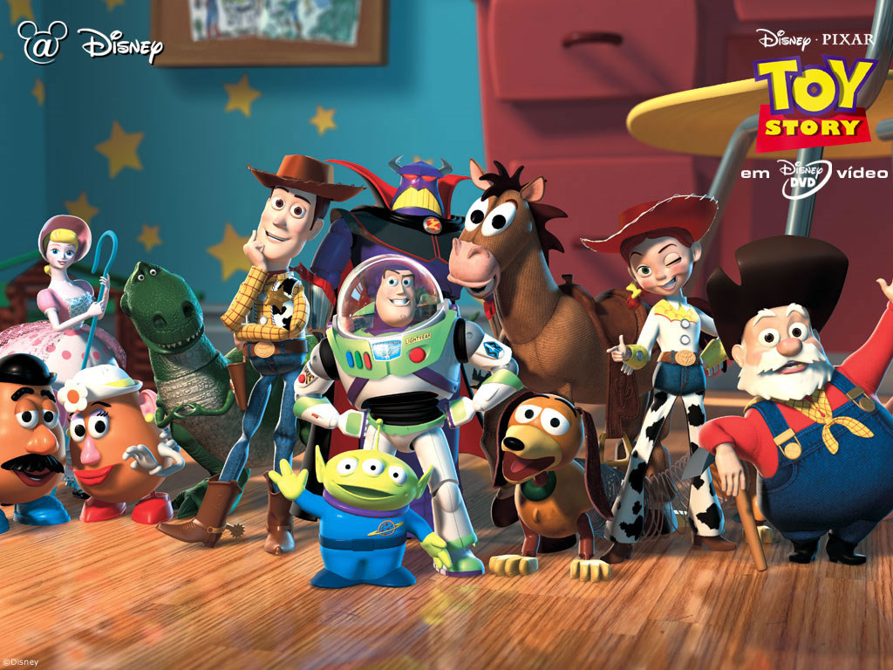
1991 Pixar & Toy Story 1995
1986: Jobs invested $10 million, raised to $50 M
1988: Tin Toy – Academy Award
1995: Toy Story revenues $362 million
1995: IPO for $1.2 billion
1999: Toy Story 2 revenues $485 million
2006: Pixar sold to Disney for $7.4 billion

Slide 11
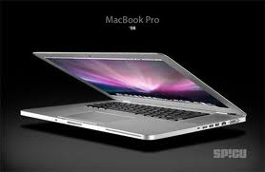
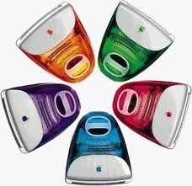
1998 iMAC
Sold 800,000
in five months
for $1 billion

Slide 12
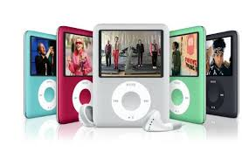
2001 iPOD
2005: Sold 20M, 45% of Apple revenue
2012: iTunes Store sold its 25 billionth song

Slide 13
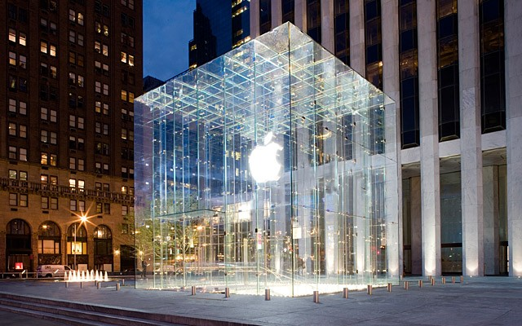
2001 APPLE STORES
2014: 425 stores, total sales +$10 billion
Revenues -- $475,000 per employee
-- $3000 per square foot
-- double that of Tiffany’s

Slide 14
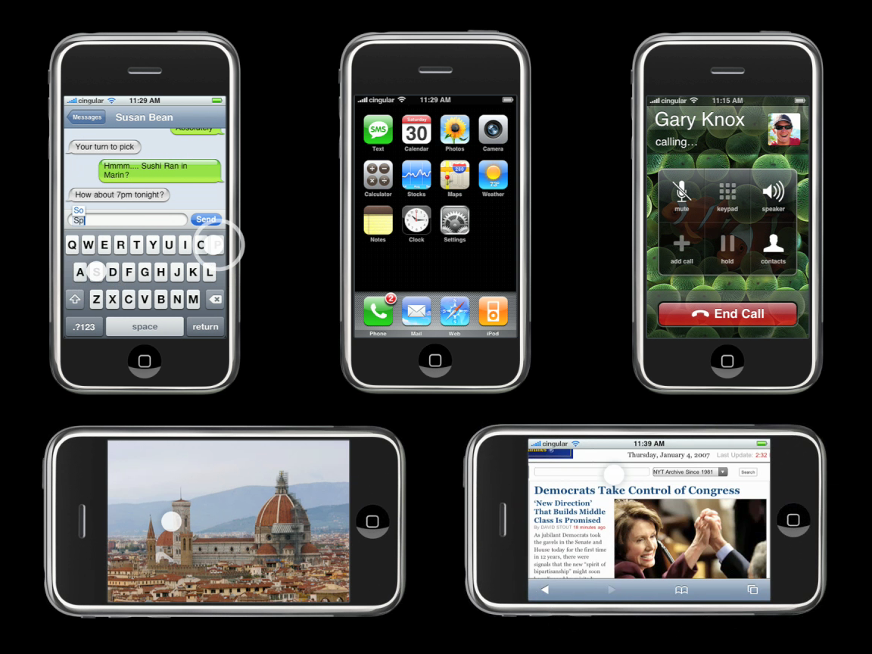
2007 iPHONE
2007: Launch, sales 5 million
2013: iPhone sales cross 150 million units

Slide 15
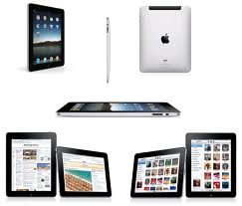
2010 i-PAD
2010: Launch, sales 7.5 million
2012: sales 57 million
2013: sales 71 million units

Slide 16
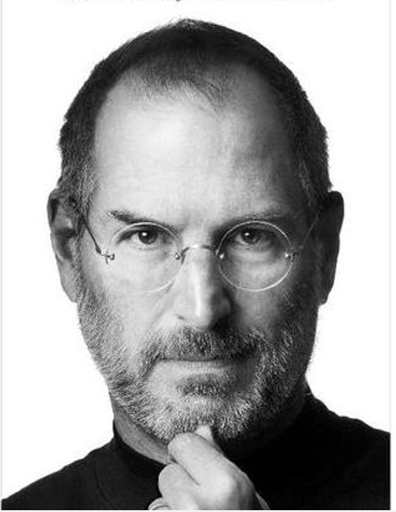
Apple Computers
2013: $171 billion sales
2014: 98,000 employees
Today: World’s most valuable company with market cap of $600 billion

Slide 17
Human Accomplishment
Human beings strive to achieve at multiple levels throughout their lifetimes and beyond
Survival – maintaining what we have
Growth – expanding whatever we have and do
Development – raising organized individual & social capacity to higher levels
Evolution – continuously extending the range and limits of our power and capabilities as a species

Slide 18
Historical Record
Discovery of knowledge
Acquisition of skills
Development of tools & technologies
Creation of art forms
Organization and evolution of social systems and institutions
Development of social aggregates
Development of its individual members

Slide 19
What is Accomplishment?
Accomplishment is a process of conscious purposeful human initiative leading to objectives sought after
Success, Wealth, Status, Power
Peace, Prosperity, Harmony, Well-being
Knowledge, Truth, Beauty, Love
Self-realization and Spiritual Fulfilment

Slide 20
KNOWLEDGE OF ACCOMPLISHMENT
Numerous specialized sciences tell us how to
Organize people and work
Acquire specialized skills
Design, produce & use specialized technologies
Develop specialized institutions
Conduct specific operations
Notes:
Family, village, cities, nation states, farms, factories, markets, virtual networks
Constructing houses, temples, skyscrapers
Cooking, gardening to medicine and internet security specialists
Fly planes, write code, repair Rembrandt

Slide 21
Is Accomplishment a Science?
Are their common underlying principles applicable to accomplishment in all fields?
Is all human accomplishment the expression of common processes?
What is the relationship between accomplishment at the level of the individual, the organization and society?

Slide 22
What do we know about human Accomplishment?

Slide 23
Accomplishment & Knowledge - 2 Processes
We achieve first, then we understand how
We learn largely by doing
We accumulate our learning and codify it
Later consciously transmit it to others as education, so they can learn before they act
Knowledge First, Then Accomplishment
Accomplishment First, Then Knowledge
Most Accomplishment and Learning combine the two processes

Slide 24
VARIETIES OF ACCOMPLISHMENT
FIELDS – Science & Art to Business & Politics
SPATIAL – Local to Global
TEMPORAL – Short term to Perpetual
LEVELS – Physical, Social, Artistic, Mental, Spiritual
STAGES – Survival, Growth, Development, Evolution

Slide 25
Contributing Factors
Accomplishment is a product of interactions between different levels of our existence
INDIVIDUALS
Capacities, Intentions & Actions
ORGANIZATIONS & GROUPS
Formal & Informal
ENVIRONMENT
Geography & Spatial Relationships
SOCIAL & CULTURE MILIEU
Ideas, Beliefs, Values, Attitudes & Ideals
LIFE EVENTS IN SPACE & TIME

Slide 26
AMERICAN SOCIETY IN JOBS’ YOUTH
Baby-boomers generation born after WWII
Abounding Social Energy made America prosperous
A period of high aspirations and faith in the future
American self-confidence & can-do attitude
Unprecedented Social Freedom
Physical & Mechanical Proficiency is an American Tradition

Slide 27
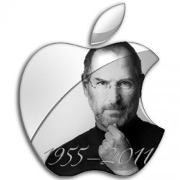
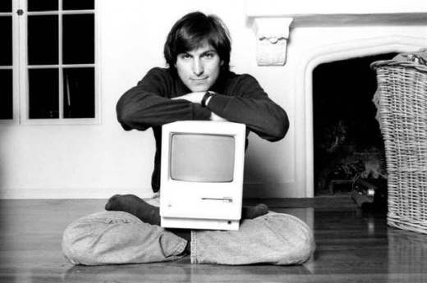
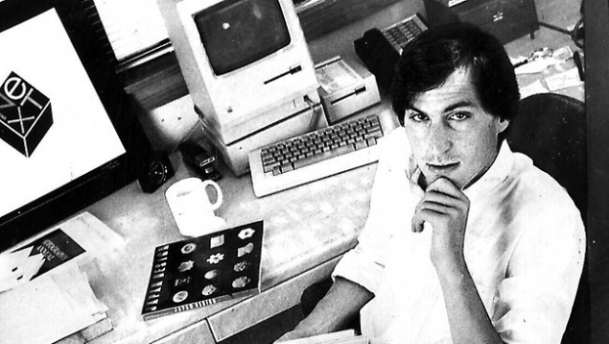
Jobs’ Life Circumstances
He felt abandoned by his real parents – may account for his rebelliousness
He was raised in a working class family by an adopted father who was craftsman who taught him the importance of perfection in work
He lived in a uniquely designed housing colony which taught him the value of good design
He dropped out of college and was not an engineer

Slide 28
RIGHT TIME + RIGHT PLACE = LUCK?
Electronic technology became a popular hobby in early 1970s after discovery of the micro-processor
California’s educational system – Stanford & UCB
Environment for applied R&D – Xerox Park
Entrepreneurial climate of Silicon Valley – Intel, HP
Anti-war protests and Hippy Movement rejected authority and conformity
Anxiety over the increasing mechanization of life

Slide 29
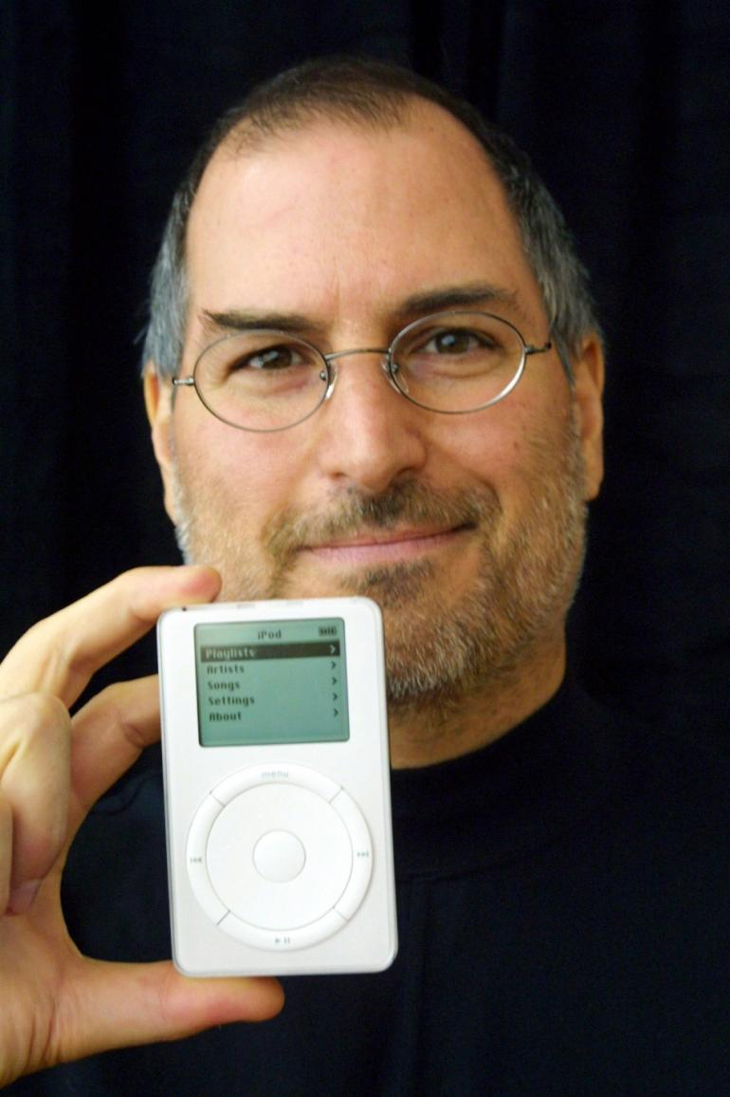
Steve Jobs’ Personality
High Energy
Physicality – he related to things more than people or ideas
Incapacity for emotional relationships
Extreme self-confidence and conviction of a pampered child
Highly competitive, self-centered
Non-conformist
Selfish but not after money
Indifferent to the opinions of others
Unreliable & unscrupulous

Slide 30
Steve Jobs – the Entrepreneur
Combined interests in technology, design, craftsmanship, marketing, and end user satisfaction
Genius for identifying, developing, empowering and inspiring talented people to give their best
Conscious identification with emerging aspiration for individuality made him a powerful marketer

Slide 31
Steve Jobs – the Leader
Ideals – empowering & liberating the individual
Love of design calligraphy and music
He made products he himself loved
Value of simplicity, elegance & ease of use
Drive for perfection – extraordinary physical sensitivity
Intuition – impact of Indian experience

Slide 32
LESSONS JOBS LEARNED IN LIFE
Failure is essential for greater success
Organization is as necessary as inspiration
Capacity to identify, motivate & empower creative individuals

Slide 33
The Individual is the most complex form in the entire universe
Constantly seeking to transcend Nature’s limits
Notes:
Science has discovered the Complexity of Nature down to the infinitesimal unpredictability of subatomic participles

Slide 34
Questions about Accomplishment
What is the source of the energy for human accomplishment?
Is there a common process of human accomplishment?
What is basis for humanity’s extraordinary power of accomplishment?
What are the limits to human accomplishment?

Slide 35
Questions about Individuality
What is individuality? Its characteristics? Varieties? Sources?
What is it that makes each of us similar, different and unique?
How does individuality differ from behaviour? character? personality? self-centered individualism? rebellion?
How does individuality develop?
What is the relationship between individuality and creativity?
Is the human capacity for individuality evolving?

Slide 36
QUESTIONS ABOUT INDIVIDUALITY & ACCOMPLISHMENT
What is the source of the remarkable power which enables some individuals to achieve 100 or 1000 times more than others?
What is the contribution to accomplishment of challenges, opportunities, chance, luck and circumstance?
What is the place of the individual in the accomplishments of the collective?
What is the role of the collective in the development of the individual?
What practical insights can we draw applicable to personal accomplishment in our own lives?

Slide 37
Goals of this Course
To investigate the nature and relationship between Individuality and Accomplishment
To explore the true nature of the relationship between the individual and the collective
To synthesize subjective and objective dimensions of social reality to reunite and reconcile inner and the outer realities
To introduce greater humanness into the human sciences
To acquire knowledge that carries with it a greater power for accomplishment in life – individually, organizationally and socially

Slide 38
Sources of Data
Scientific research
Contemporary events
Biography
Case studies
Testimony of high achievers
History
Philosophy and traditional wisdom
Literature

Slide 39
Accomplishment is an Integrated Field of Study & Action
Individual Psychology
Organization Dynamics
Social Context & Evolution
Natural Environment
Life Events in Space & Time

