Slide 1
www.annafoundation.com

Slide 2
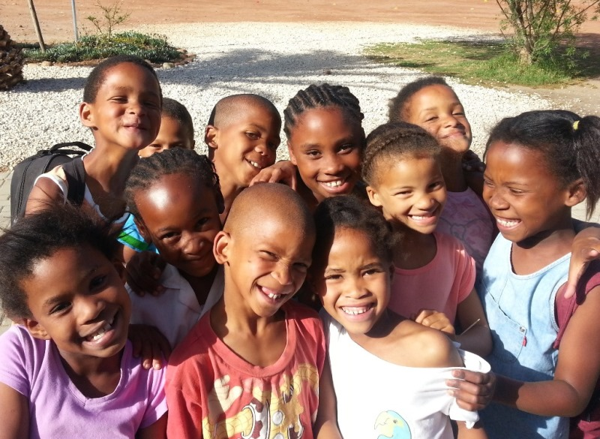
Holistic after-school support for rural children
Education
•
Sports
•
Life Skills
Lifelong learning in order to build positive self-worth and self- respect

Slide 3
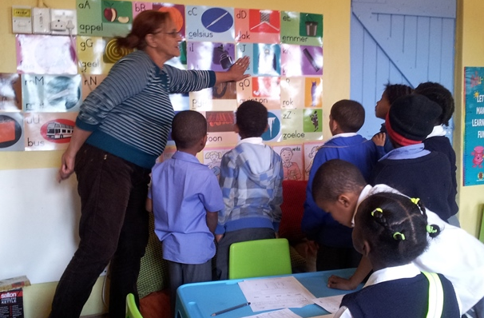
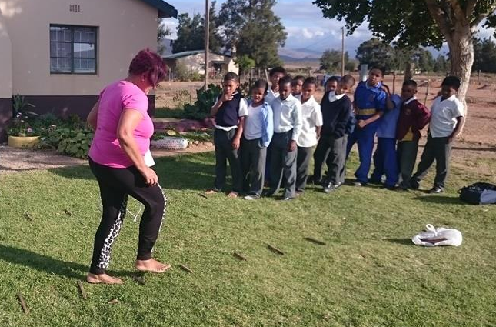
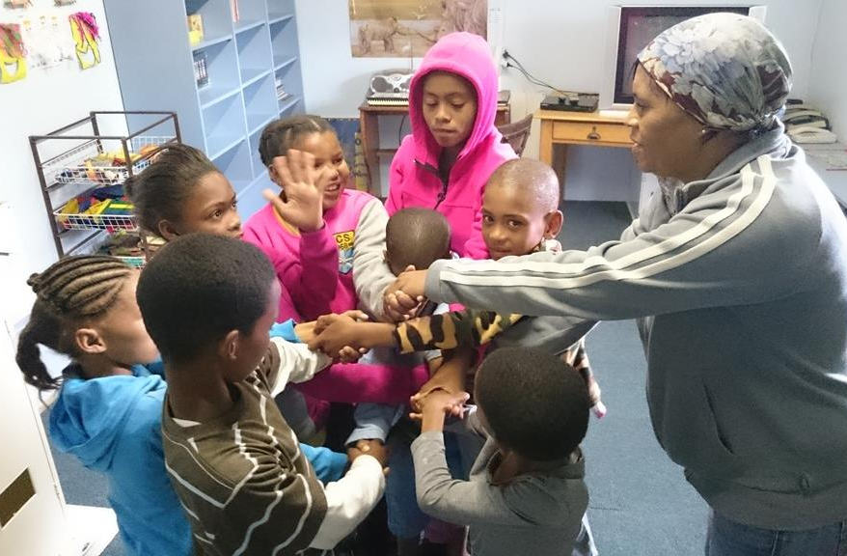
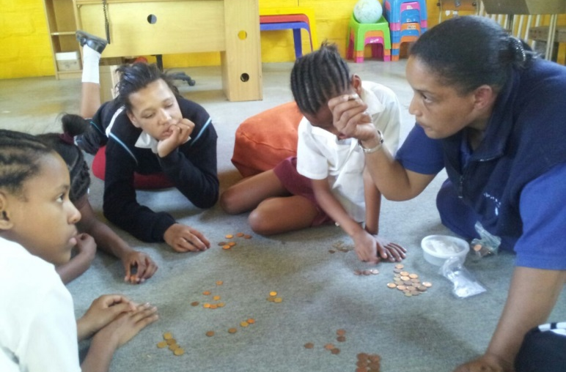
Skill and train local rural women
from within each community
Sustainability of the programme

Slide 4
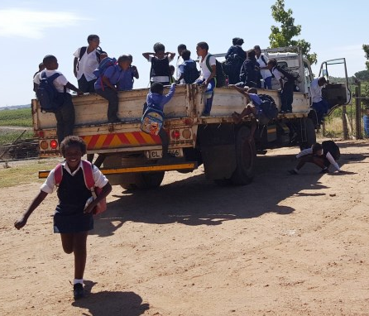
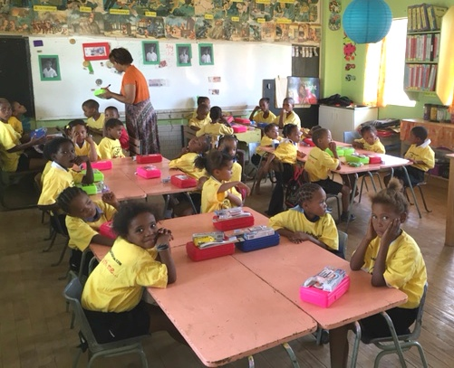
How Does It All Work?
At the end of the school day, children…
return to the farm
OR
remain at the school
A Typical Afternoon…
14h00 = Facilitator training / lesson prep
14h30 = Nutritious meal (Lunchbox Fund)
15h00 = Homework and academic programme
16h00 = Sports or Drama
17h00 = Home
* 3 R’s Programme
* Children participate in ALL 3 R’s!

Slide 5
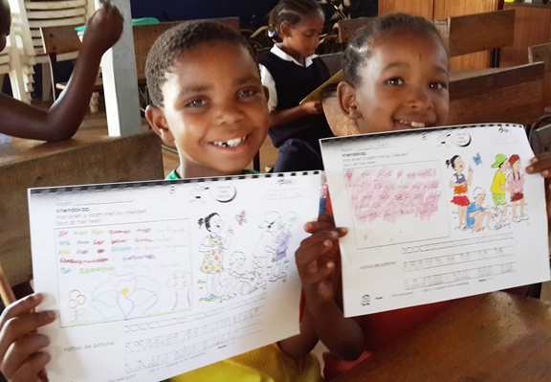
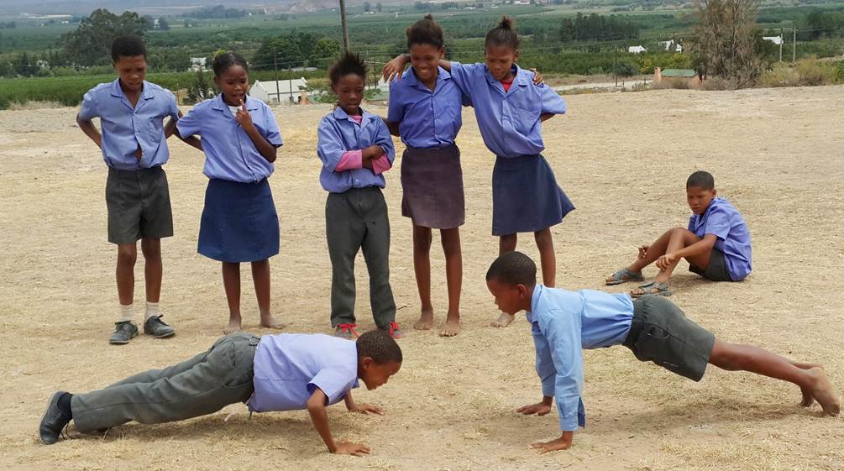
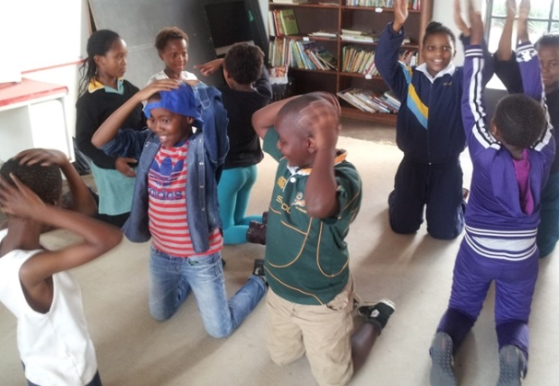
3 R’s Programme:
Reading
Running
Right-ing

Slide 6
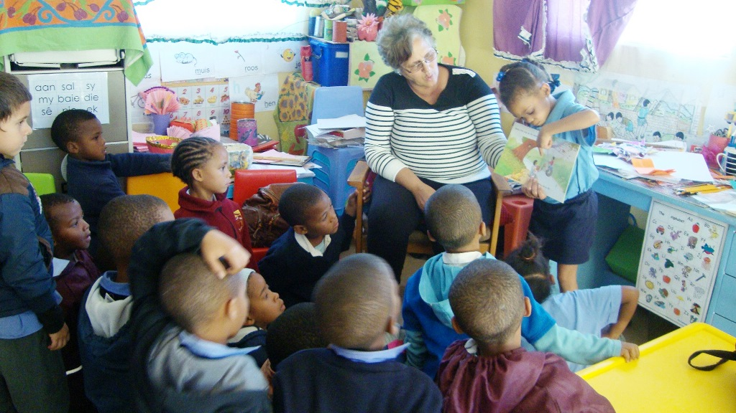
Reading
Running
Right-ing

Slide 7
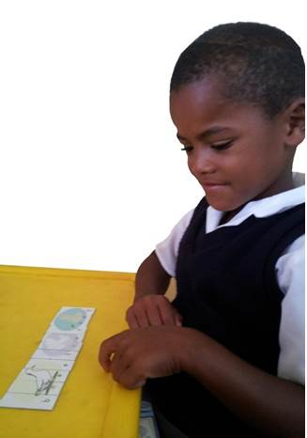
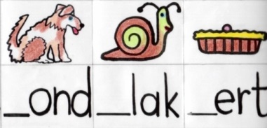
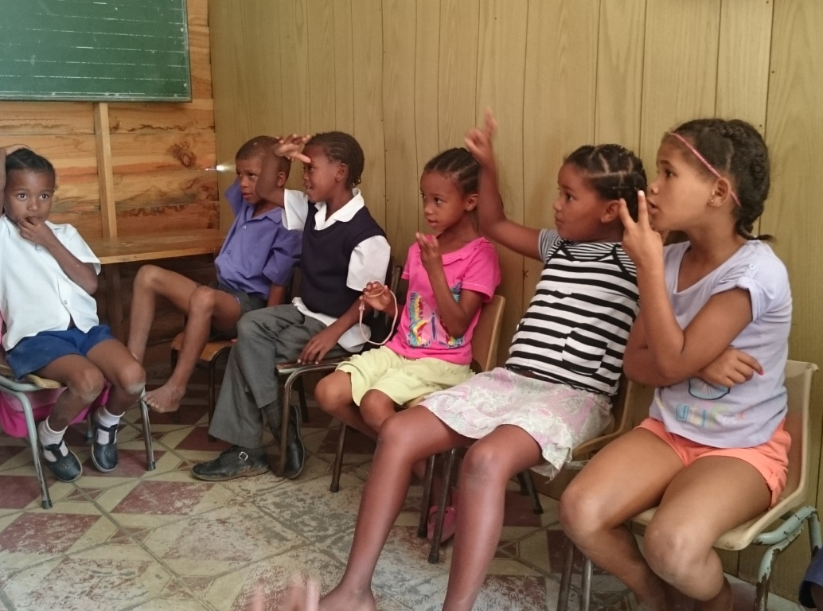
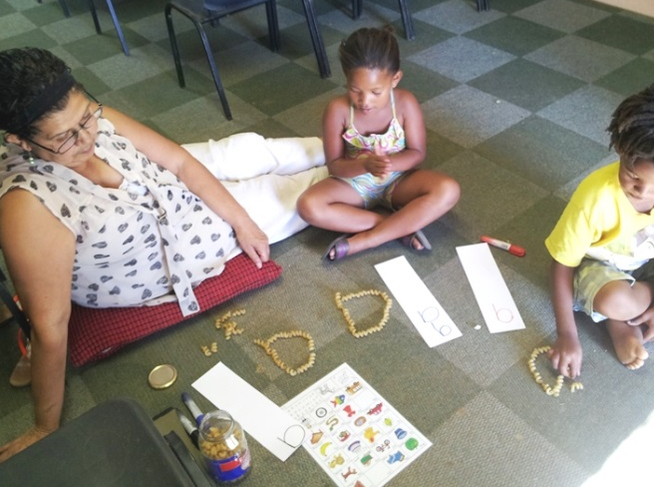
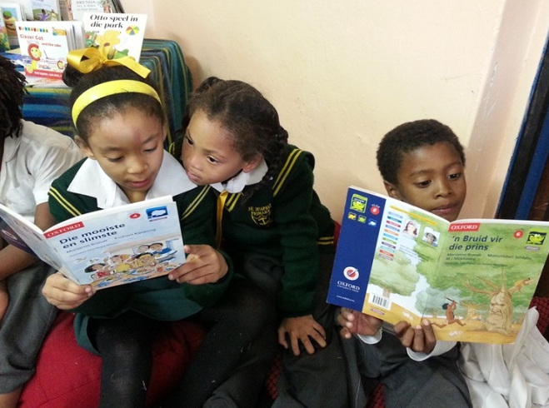
Reading:
Literacy/Numeracy
Grade-specific worksheets
Afrikaans literacy/language development for each grade
In alignment with S.A. Department of Education’s national curriculum
Additional Reading and Maths programmes
Remedial/Support work for specific learners with barriers
Homework support
3 R’s: Reading

Slide 8
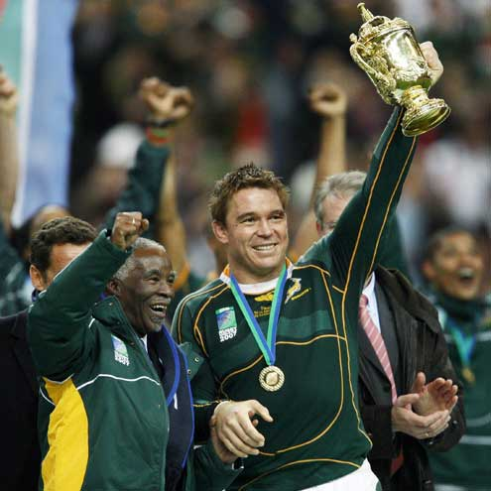
Worksheet Example
(Grade 5)
Theme = Leadership
Grammar (literacy)
Maths (numeracy)
Reference to Edupeg exercises (numeracy) or Readers (literacy) for once worksheet is complete
3 R’s: Reading

Slide 9
Reading
Right-ing
Running

Slide 10
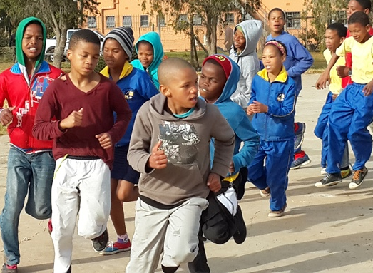
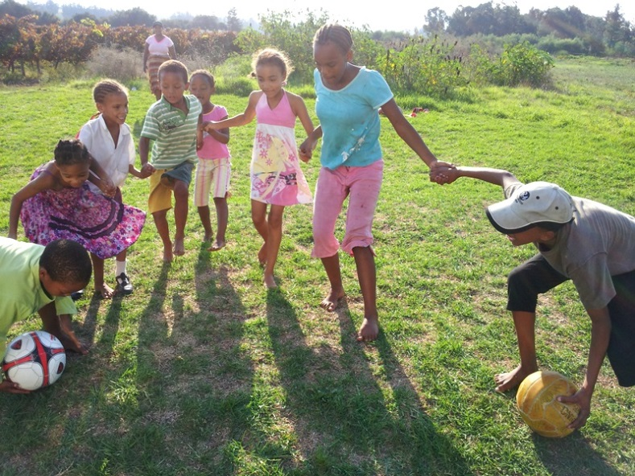
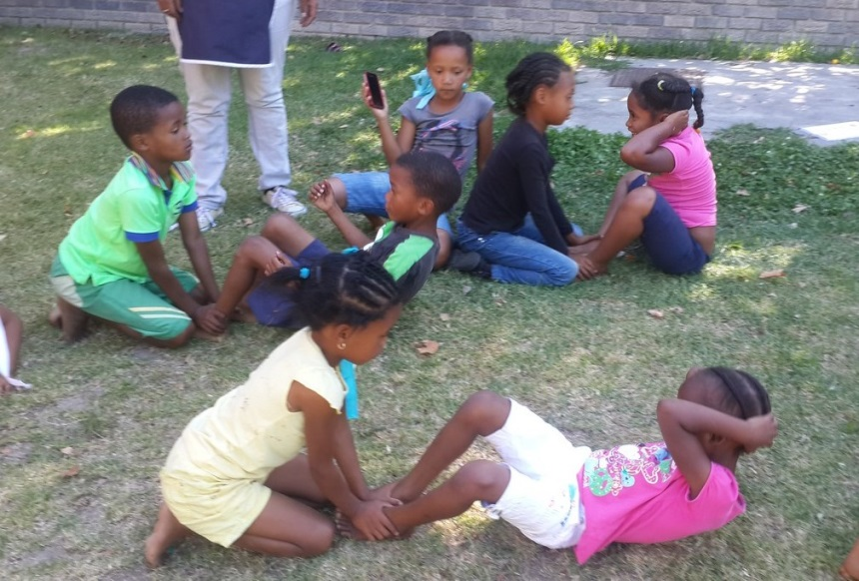
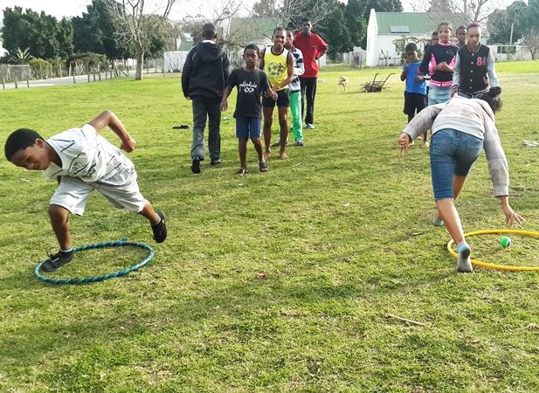
Running:
Focus on Physical Development and Wellbeing
INCREASED FITNESS
TEAM WORK
MOTOR SKILLS
PLAY
3 R’s: Running

Slide 11
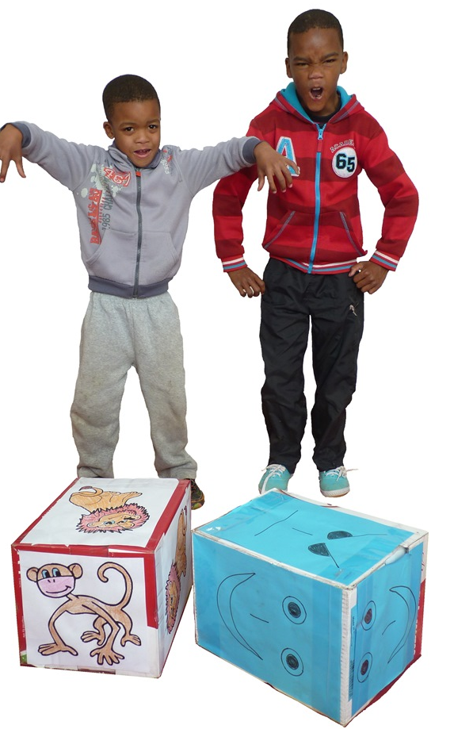
Reading
Running
Right-ing

Slide 12
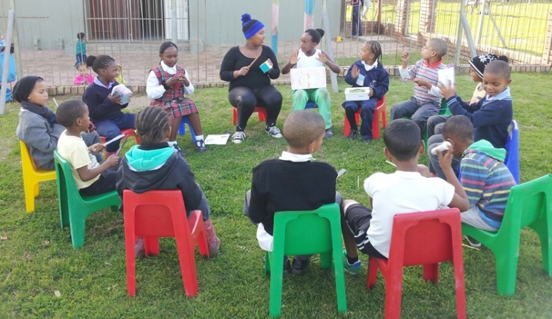
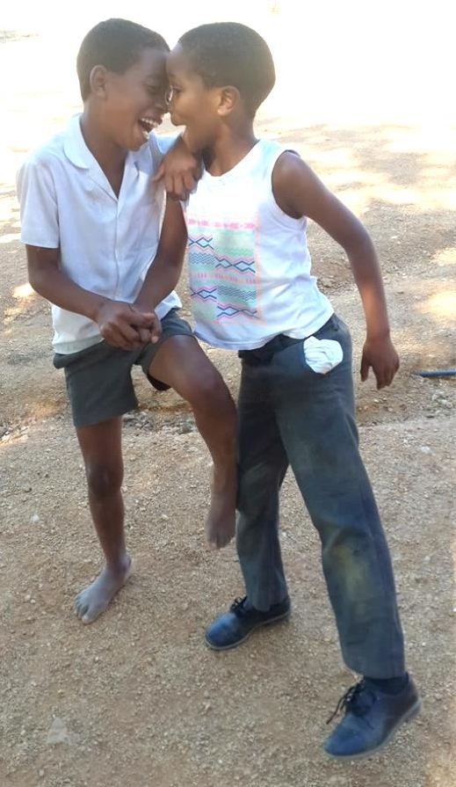
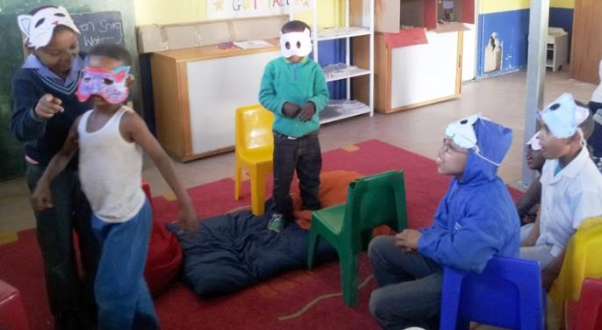
Right-ing:
Focus on “Right” Living
Right Choices • Right Attitude • Right Behaviour • Right Lifestyle
Life Skills taught through Drama Games
with the aim of building Self-Worth
Communication
Positive Self-Esteem
Confidence
Problem-Solving
Emotions and Empathy
Creativity
Coping Mechanisms
Imagination
3 R’s: Right-ing

Slide 13
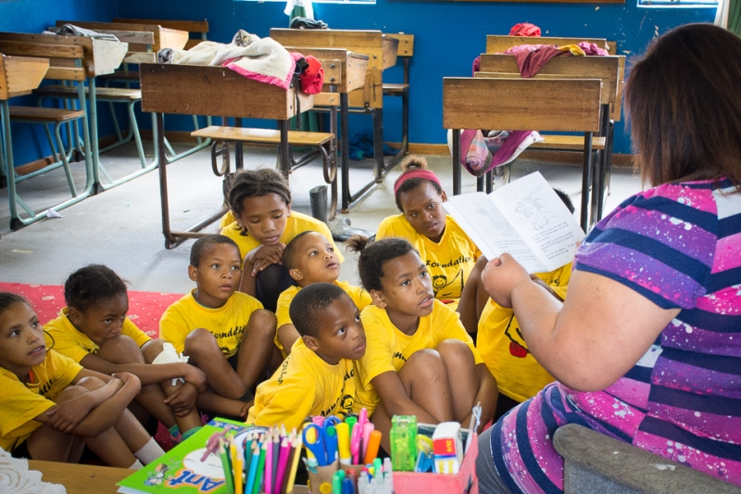
Our 3 R’s Facilitators

Slide 14
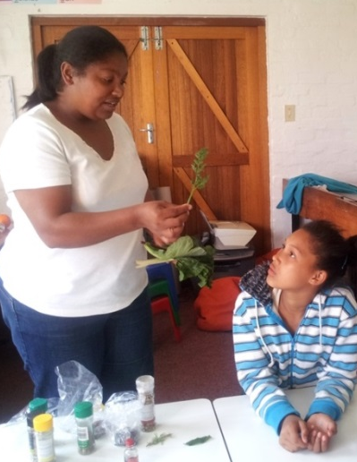
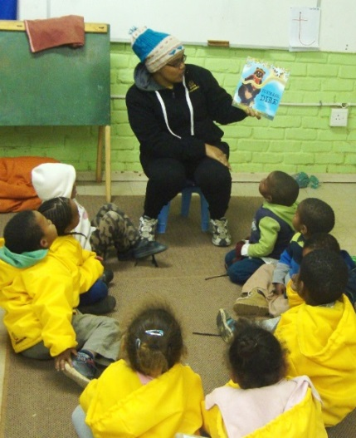
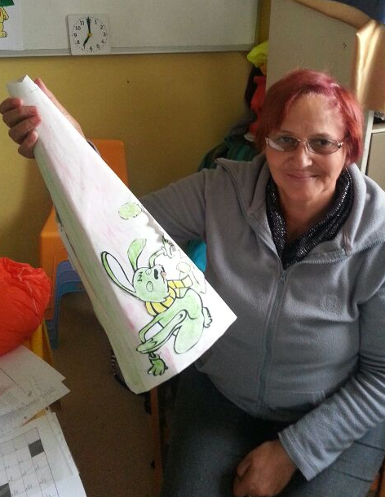
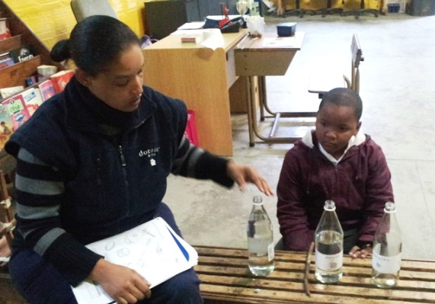
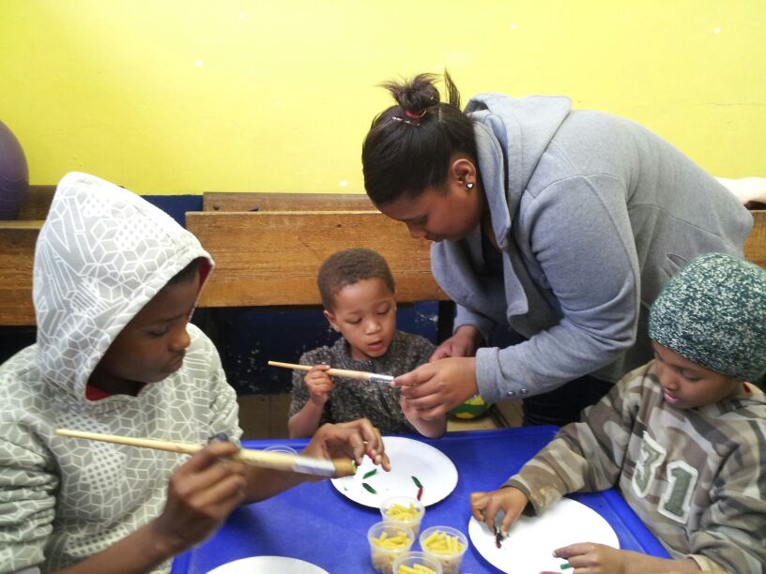
Facilitators: Who are they?
From within farming and rural communities
Not teachers by profession
Skills development and empowerment
for rural community members

Slide 15
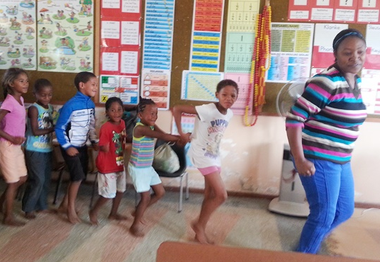
The Role of the 3 R’s Facilitator
Fulfils different roles at the after-school:
Teacher Sports Coach Drama Teacher Mentor Role Model
Support for children within their community
Sustainable intervention / investment in the community

Slide 16
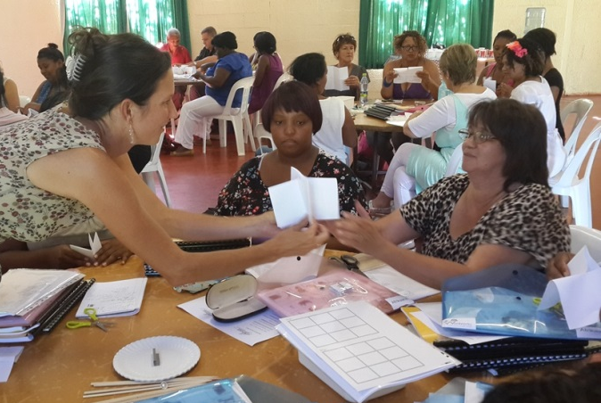
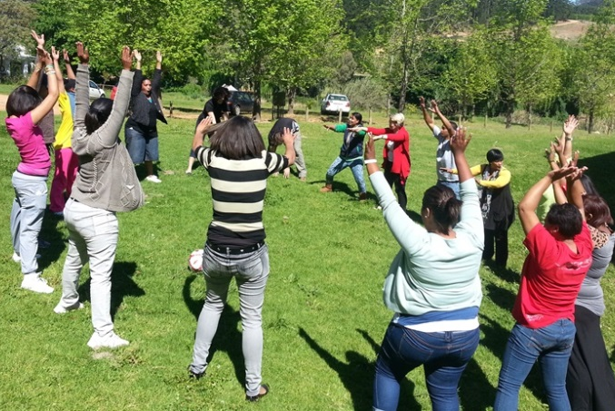
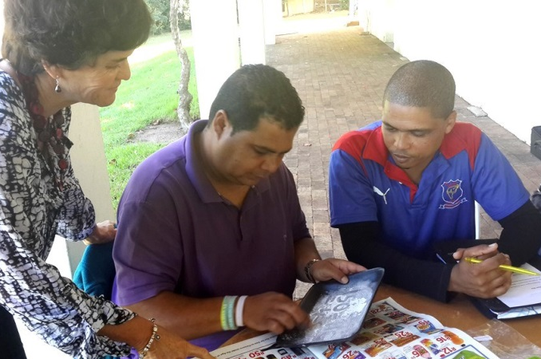
Monthly Training
Group Session
All 3 R’s Facilitators attend this training
Hosted by Anna Foundation staff
Training covers 3 R’s work for upcoming month for all Grades
Outsourced training to enhance skills development

Slide 17
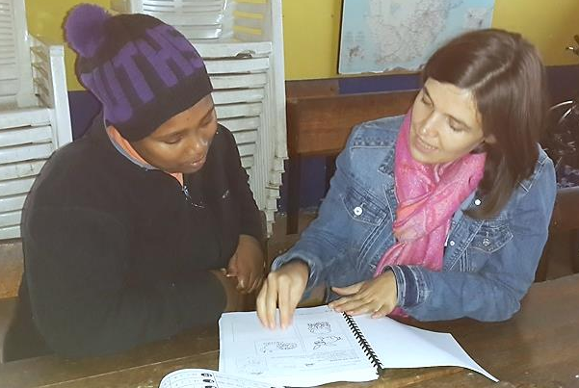
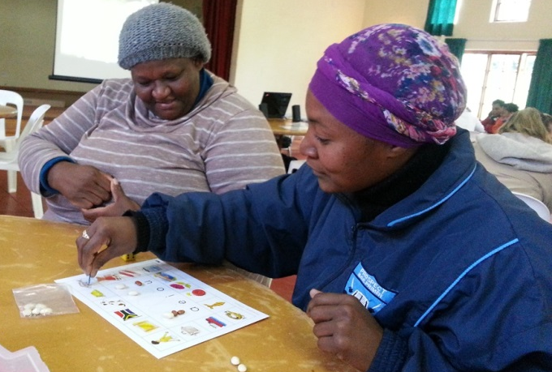
On-site Training
One on one Training with Project Manager
Curriculum Revision
Project-specific needs / challenges
Specific, tailor-made training (eg. computers, maths)

Slide 18
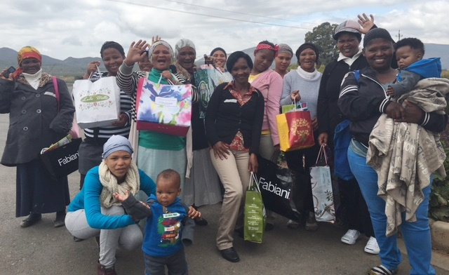
Investing in Rural Communities

Slide 19
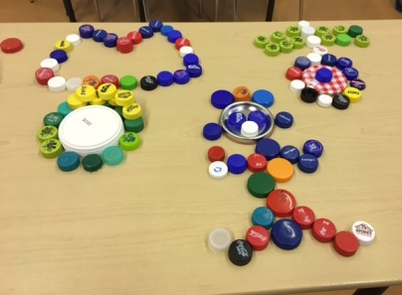
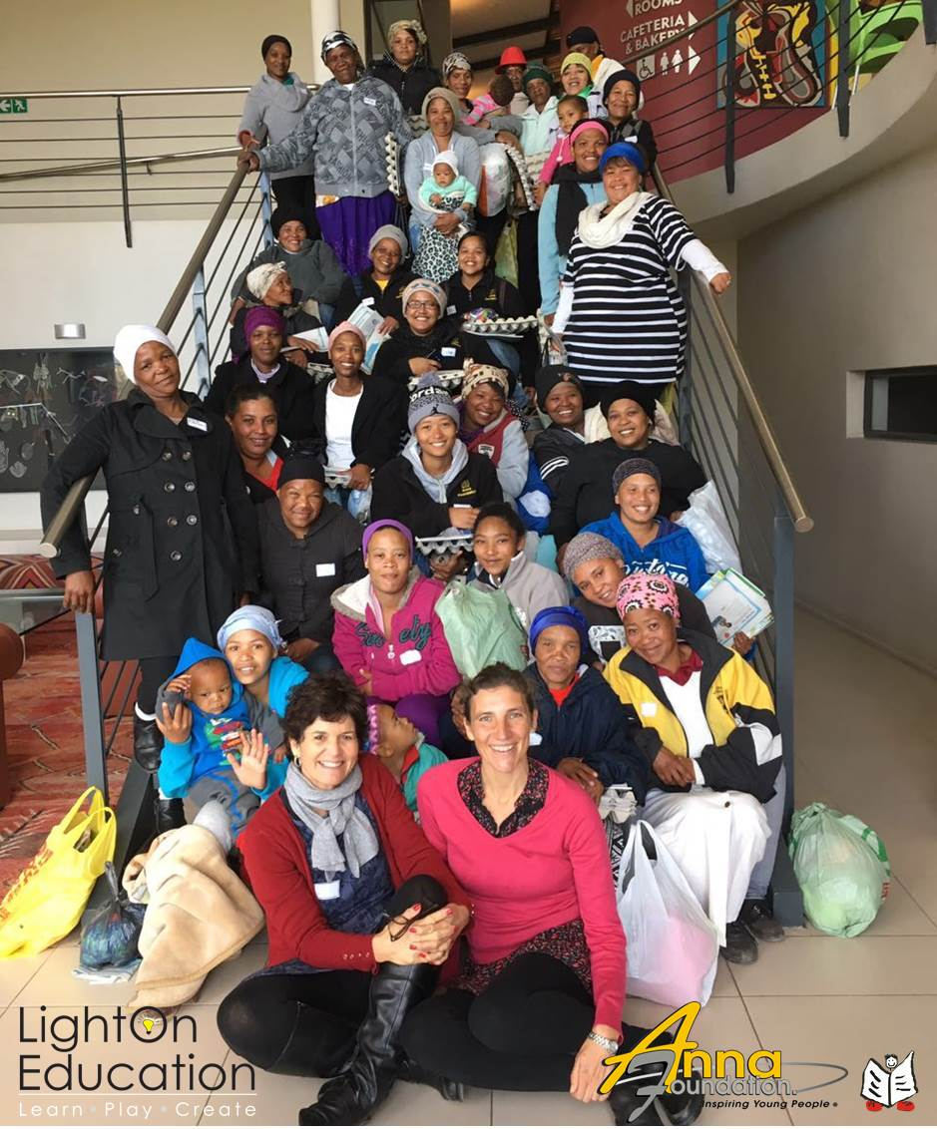
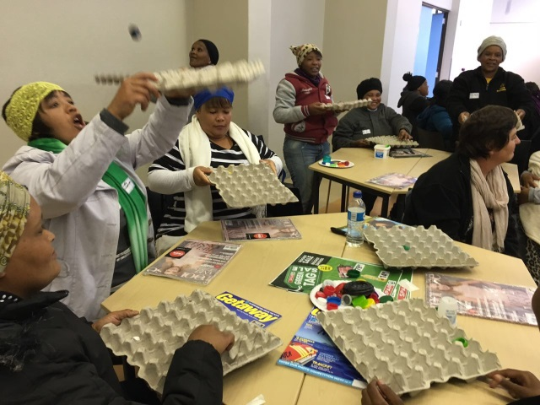
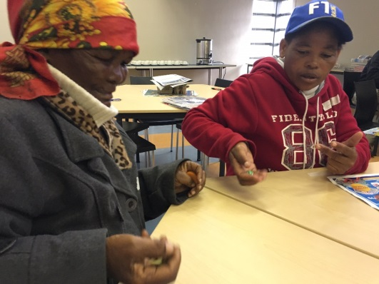
Parent Workshops
Teach parents how they can add value, stimulate and nurture their child’s development from an early age at home
Using recyclable material for enriched learning
TOPICS: Discipline issues, Reading, Letters, Counting, Shapes and many more!
Hand-eye coordination games
Dice games (maths)

Slide 20
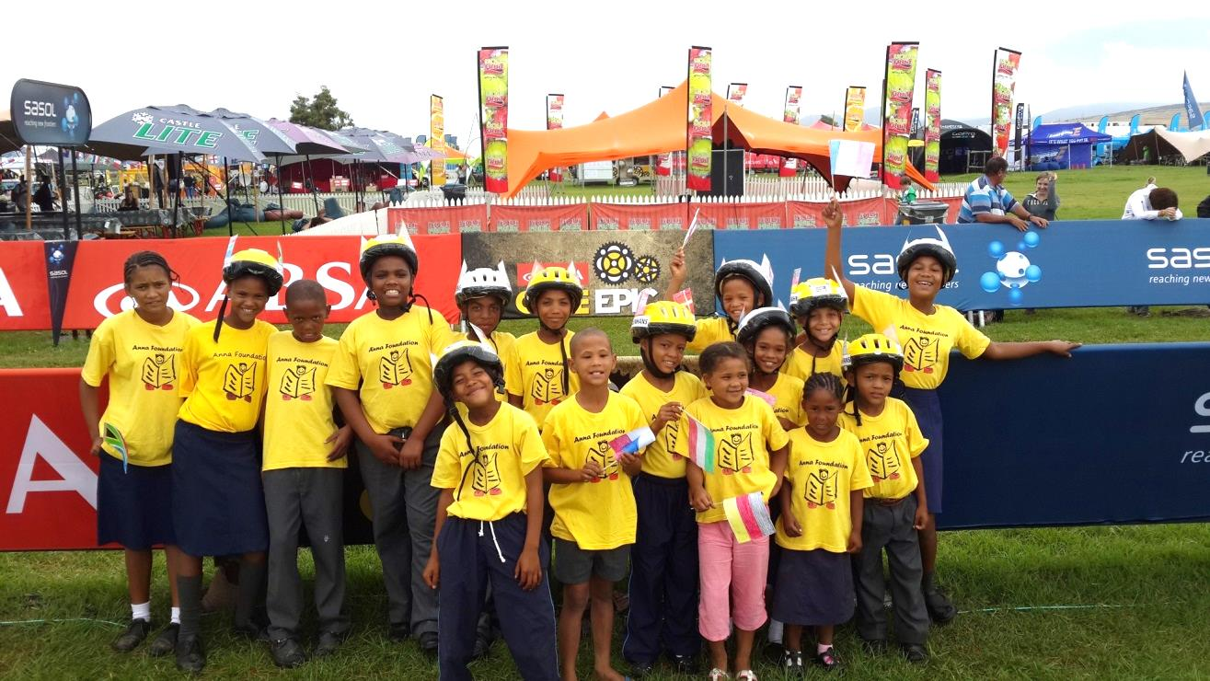
Programme Incentives

Slide 21
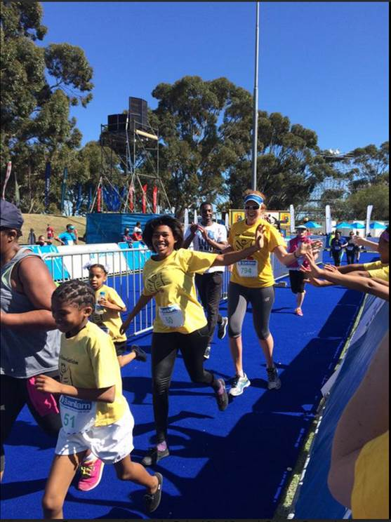
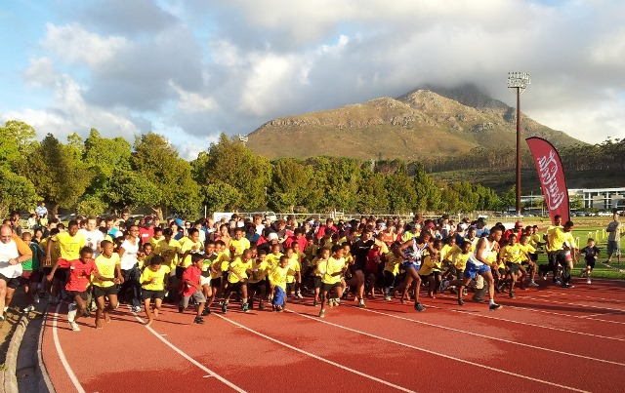
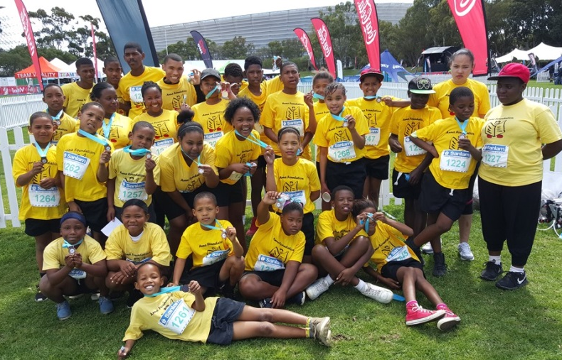
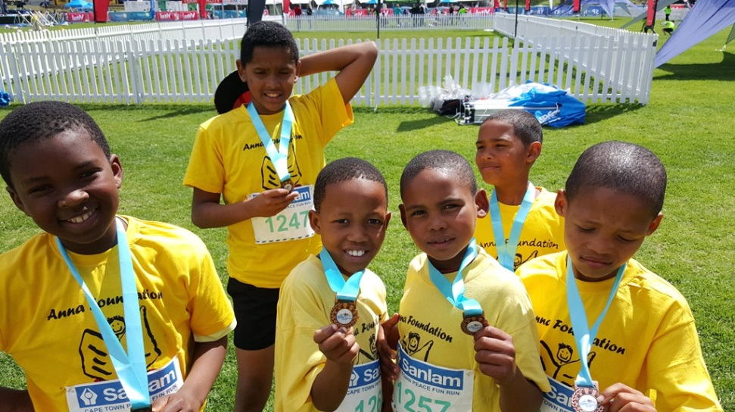
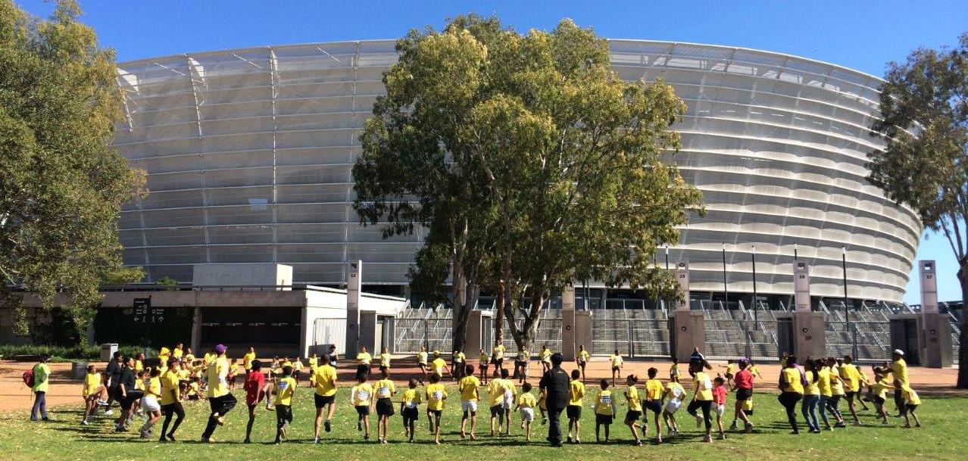
Fun Runs

Slide 22
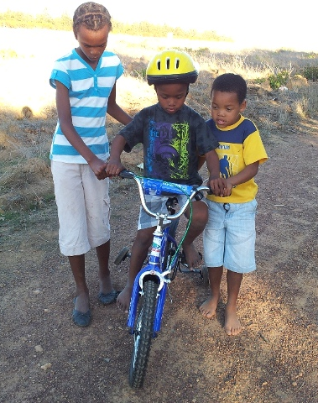
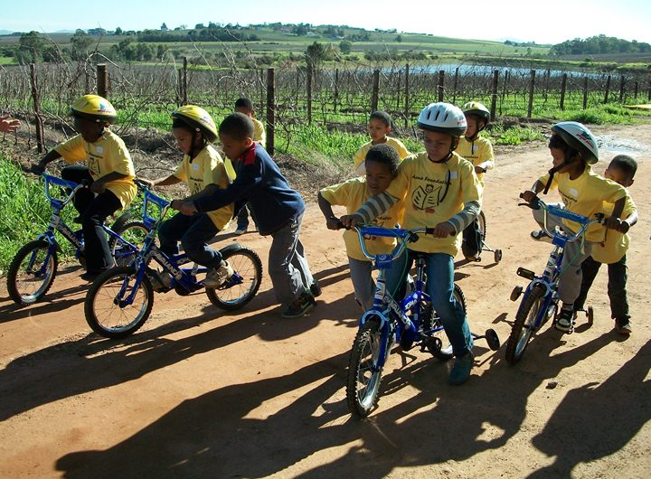
3 R’s + 1 = Riding!
New Pump track!
PHOTOS: © Photoartthomas

Slide 23
Other Incentives
NEW,
AFRIKAANS
Reading Books
Computers
Cultural Outings

Slide 24
Where do we Work?
WESTERN CAPE

Slide 25
Current Operations
19 After-School Projects
780 Child Beneficiaries (Grade R - 12)
60 Rural Women Trained
5 Children in our Scholarship Programme

Slide 26
Holistic Development…
Helping rural children to develop positive self-worth and self image is the CORE of what the Anna Foundation is all about

Slide 27
www.annafoundation.com
info@annafoundation.com

