Slide 1


Panel B: Social Power
Economic changes and social power
António Mendonça
Professor of Economics
ISEG-Lisbon School of Economics & Management
Universidade de Lisboa
CESA-Centre for African, Asian and Latin American Studies

Slide 2
ECONOMIC CRISIS AND PARADIGM CRISIS
(Normal/Cyclical crisis)
Institutions
Economic Policy Management
Regulation Model
WORLD ECONOMY
Economic Dynamics
Theoretical Hegemony
Economic, Social and Political Legitimation

Slide 3
ECONOMIC CRISIS AND PARADIGM CRISIS
(Structural crisis)
Institutions
Economic Policy Management
Regulation Model
WORLD ECONOMY
Economic Dynamics
Theoretical Hegemony
Economic, Social and Political Legitimation

Slide 4
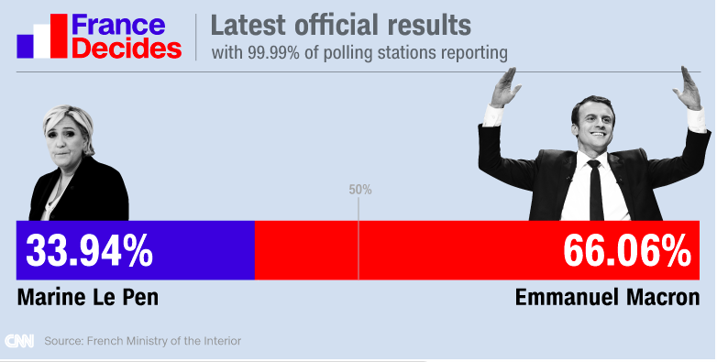

Slide 5
MACRON’S PROPOSALS FOR EUROPE:
  Federalism
  Common budget
  Common minister of finance
  Some debt mutualisation
SCHAEUBLE REACTION:
  Stronger Europe: Yes
  Common budget and common minister of finance: Not applicable in current situation

Slide 6
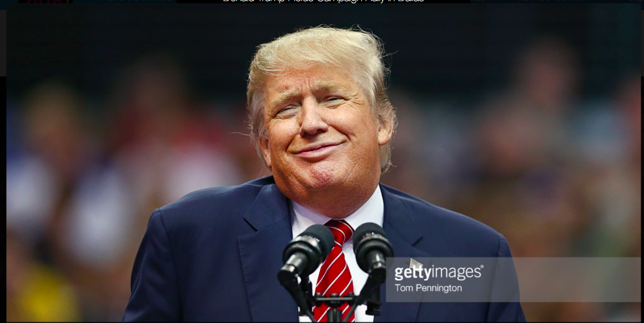

Slide 7
On the same day, I will begin taking the following 7 actions to protect American workers:
  * FIRST, I will announce my intention to renegotiate NAFTA or withdraw from the deal under Article 2205
  * SECOND, I will announce our withdrawal from the Trans-Pacific Partnership
  * THIRD, I will direct my Secretary of the Treasury to label China a currency manipulator
  * FOURTH, I will direct the Secretary of Commerce and U.S. Trade Representative to identify all foreign trading abuses that unfairly impact American workers and direct them to use every tool under American and international law to end those abuses immediately
  * FIFTH, I will lift the restrictions on the production of $50 trillion dollars' worth of job-producing American energy reserves, including shale, oil, natural gas and clean coal.
  * SIXTH, lift the Obama-Clinton roadblocks and allow vital energy infrastructure projects, like the Keystone Pipeline, to move forward
  * SEVENTH, cancel billions in payments to U.N. climate change programs and use the money to fix America's water and environmental infrastructure

Slide 9
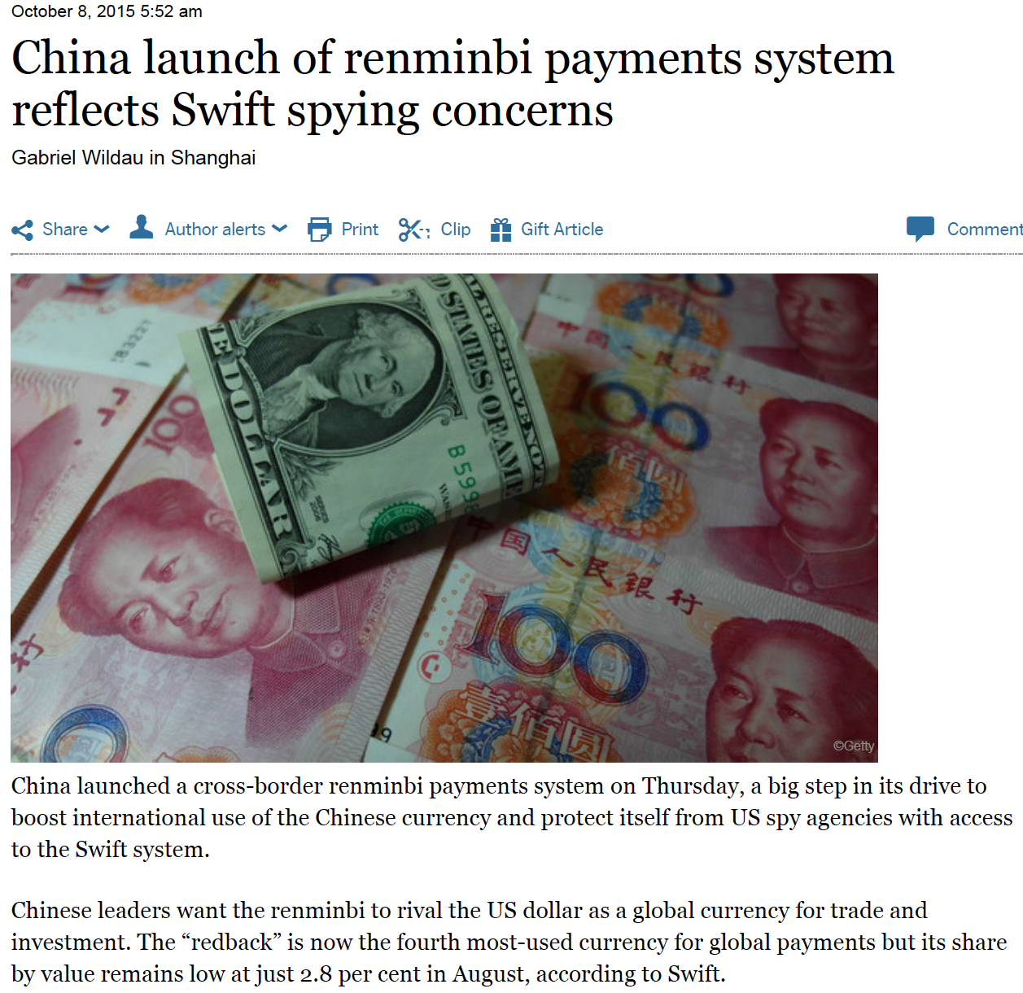

Slide 10
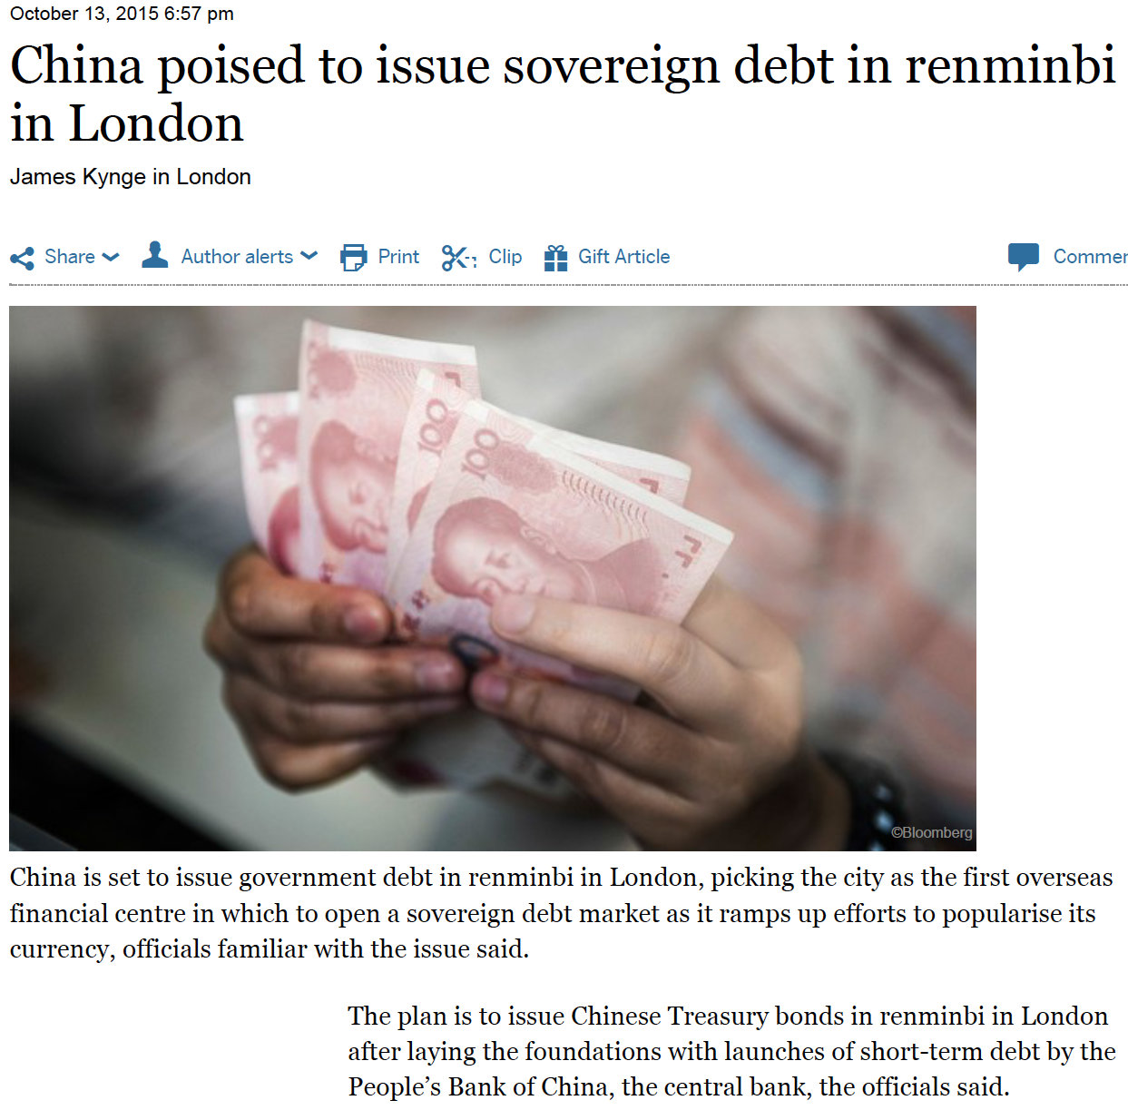

Slide 11
Real GDP: average annual growth rates
Periodes: 1961-1974; 1975-1985; 1986-1998; 1999-2017
(2016 e 2017: Projections)
Source: AMECO

Slide 12
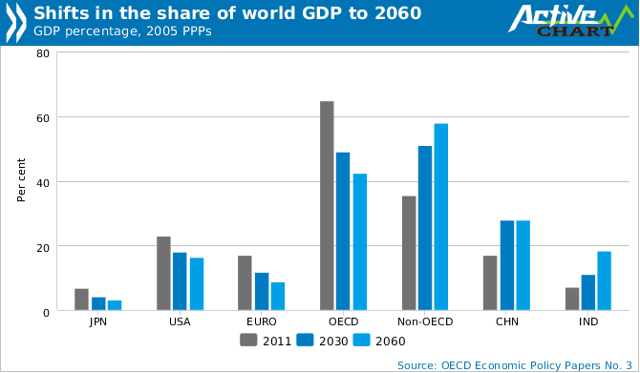

Slide 13
WORLD GDP DISTRIBUTION (PPP)
CRISE
CRISE
CRISE
IMF, World Economic Outlook Database, April 2015

Slide 14
WORLD GDP DISTRIBUTION (PPP)
Unit: %
IMF, World Economic Outlook Database, April 2015

Slide 15
INVESTMENT: SHARE ON GDP
IMF, World Economic Outlook Database, April 2015

Slide 17
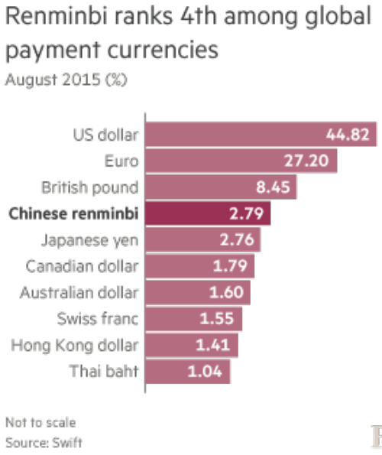

Slide 18
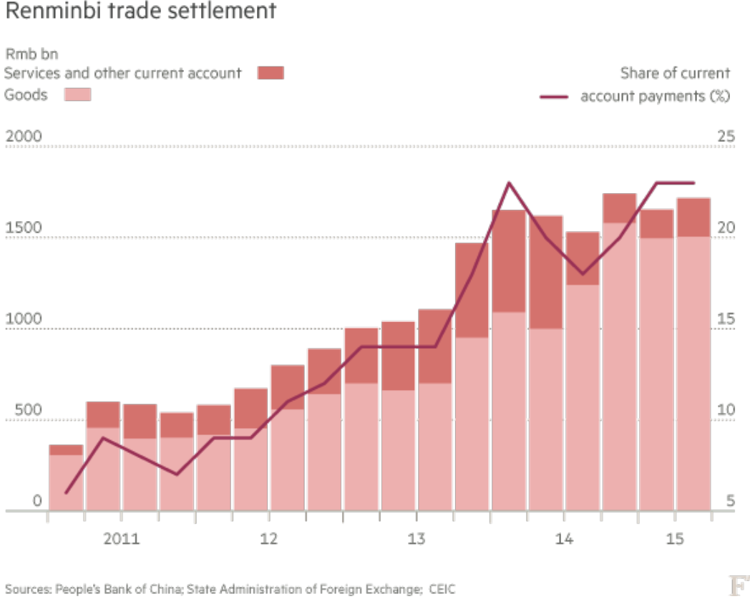

Slide 19
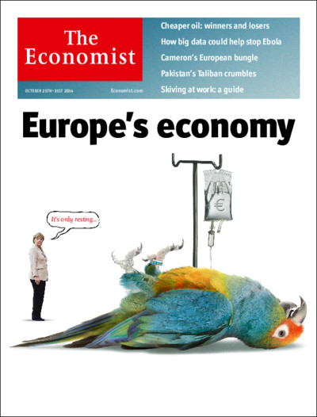

Slide 20
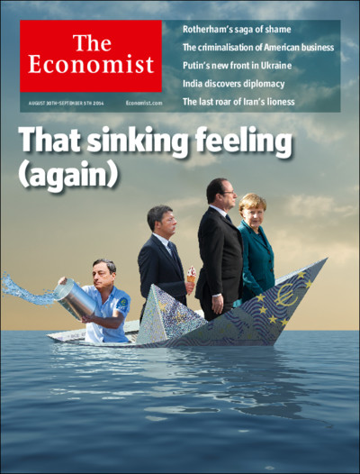

Slide 21
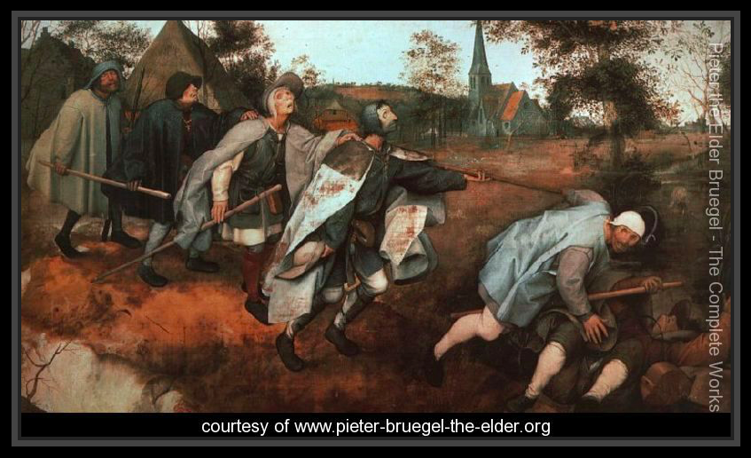
PARABLE OF THE BLIND LEADING THE BLIND
Pieter the Elder Bruegel (1525 – 1569)

Slide 22
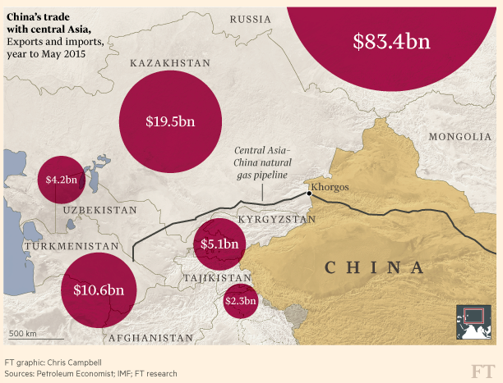

Slide 23
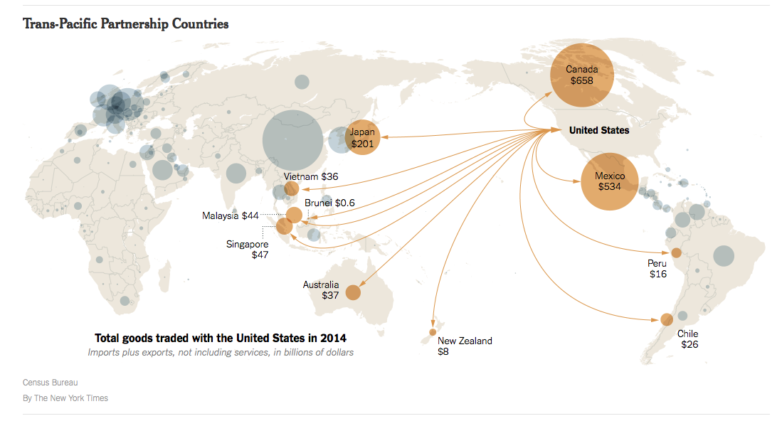
Constituição: 5 de Outubro de 2015. 10 anos de negociações.
Países: 12. Produtos: 18 000.
PIB: $28 biliões (40% do PIB mundial).
A China, até agora, tem estado de fora.
Integra aspetos relacionados com a internet.
Ainda necessita da aprovação do Congresso.
Prevê mecanismos de gestão macroeconómica,
designadamente a nível das taxas de câmbio.

Slide 24
GERMANY: CURRENT ACCOUNT
(% of GDP)
IMF, World Economic Outlook Database, April 2014

Slide 25
GERMANY: CURRENT ACCOUNT
(BILLIONS US$)
IMF, World Economic Outlook Database, April 2014

Slide 26
CURRENT ACCOUNTS
EURO AREA (Less germany) and GERMANY
UniT: Billions $US
IMF, World Economic Outlook Database, April 2014

Slide 27
GERMANY AND CHINA CURRENT ACCOUNTS
(Billions US$)
IMF, World Economic Outlook Database, April 2014

Slide 28
CURRENT ACCOUNTS OF THE EUROZONE COUNTRIES (12)
WITH THE REST OF THE WORLD
Unit: billions ECU/EURO
Source: AMECO

Slide 29
CURRENT ACCOUNTS
EUA AND CHINA
Unit: Billions US $
Estimates
Source: IMF, WEO Database, April 2015

Slide 30
CURRENT ACCOUNTS
EUA AND CHINA
UniT: % GDP
Estimativas
Source: IMF, WEO Database, April 2015

Slide 31
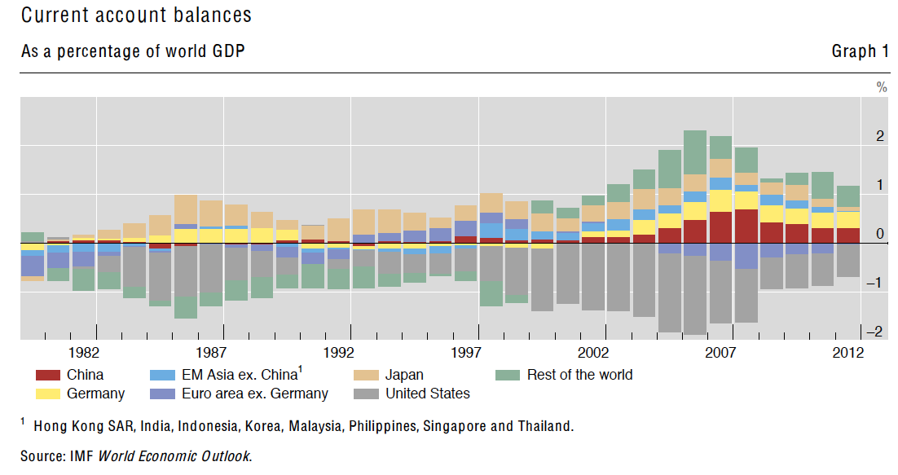
The USA were the great creators of international liquidity

Slide 32
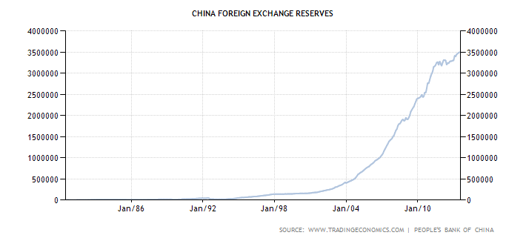
Unidade: US$ Milhões

Slide 33
Bretton Woods II System
Dollar Peg
China and Asian Economies Growth
Dollar reserves accumulation
American deficits
American economy growth
American deficits financing
American domestic demand growth

Slide 35
UNITED KINGDOM: SOME DATA

Slide 36
Crise
Source: AMECO

Slide 37
Euro
Crise
Source: AMECO

Slide 38
Euro
Crise
Source: AMECO

Slide 39
Euro
Crise
Source: AMECO

