Slide 1
The Knowledge Bank
How to Finance Human Capital and Promote Development
Neantro Saavedra-Rivano
Professor Emeritus, University of Tsukuba
Paper presented at the XIV International Colloquium
Sustainability Institute, Stellenbosch, South Africa
May 10-12, 2017

Slide 2
What do we see when comparing countries?
The size and characteristics of the land, including geographic features
Accumulated wealth, including physical infrastructure, public and private assets, and monetary holdings
Natural resources
Intangible assets of cultural and historic nature
Its people and the knowledge incorporated in them

Slide 3
Who benefits and what is the purpose of these resources?
Populations under colonial regimes or absolutist monarchies work mainly to the benefit of others
In other countries, with an endogenously generated system of government, the whole of population is the sole and primary beneficiary of all wealth generated in the country
An interpretation: the nation/society as a large economic system whose operation has as its principal final output population and its welfare

Slide 4
How this system works?
As any economic system, its final output (population and its welfare) requires primary as well as intermediate inputs
Capital accumulation is necessary for economic growth (and its obsolescence to be avoided).
Types or components of capital: physical capital (including infrastructure), human capital, social capital, land
Human capital has a central and leading role
In an extreme interpretation the system becomes fully endogenous and population welfare (its output as well as an input) becomes the main target of optimization

Slide 5
Important issues highlighted under this perspective
Environmental preservation
Income and wealth distribution
The relevance of material goods for happiness
Human capital investment

Slide 6
How this system works in respect to human capital formation?
Human capital investment follows a “dynastic” pattern: investment flows take place primarily within families
The second largest source of human capital investment is the State through its subsidies for education and public health
Almost all investment flows related to human capital are transfers: intra-family grants and, in the case of investments from the State, direct and indirect income transfers

Slide 7
Problems associated with the current method of human capital formation
The “dynastic” method is inefficient and ignores the social nature of human capital
The economic system operates below capacity (this is under-development)
Income and wealth disparities are amplified, and this has well known negative effects for the system operation
The “altruist” character of intra-family grants does not offer incentives for human capital accumulation and carries the risk of leading to a demographic contraction

Slide 8
Some elements to deal with these problems
Savings from the economically active population can be used to finance education of the young
This promotes efficient inter-generational financial flows, which will ensure the human capital formation needed to take the economy into its next cycle
The system to be designed in order to achieve this result will use the tools of modern finance
In conclusion: investment flows are socialized and become loans rather than grants

Slide 9
The proposal: securitization of human capital
Main elements
Automatic issue of securities associated with the expenses due to the upbringing of new individuals (investment in HC)
Active adult population purchases these securities through the financial markets and these become their savings for old age
After reaching adult age the new entrants into the labor market redeem the securities previously issued, which are bought back, again through the financial markets, from the old (the previous or “parent” generation); the proceeds of those transactions fund the consumption of the old
Principal characteristics
A broad interpretation of the concept of human capital
Use of the modern financial instruments and markets
Shared risk (“anonymization” of securities)
The state in a supervisory and coordinating role

Slide 10
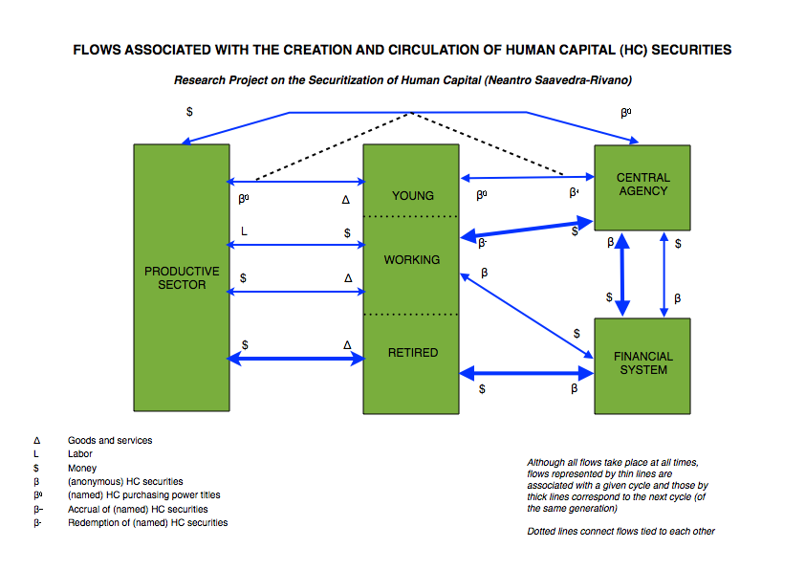

Slide 11
Advantages of this proposal
Effect in economic development
It creates favorable conditions for taking full advantage of the country’s potential and stimulates economic growth
The centrality of human capital to economic development makes it conducive to a systematic approach to developmental issues
Positive effects on economic and social disequilibria
It establishes a trend towards the equalization of opportunities, making them independent of regional environment and family background
It contributes to the reduction of income and wealth disparities
Other effects
A potential tool for the correction of negative demographic trends
Allows for an effective planning of development aid
An integrated approach to issues on international migration

Slide 12
Challenges of implementation
One first remark: the scheme has highly positive effects while at the same time it transforms social, political and even family relations
Its implementation requires important micro and macro economic adjustments
The financial system will need to adapt to the influx of these new securities, which have the potential of becoming dominant assets
Three options for the implementation and interpretation of this proposal
“modular” implementation
gradual implementation
limited implementation
The dimensions of “parametrization”

Slide 13
Final comments
Positive elements for developed and developing countries as well
The fundamental concept: to recognize and re-establish the social function that HC investment plays, while at the same time accepting the mediation of the markets
The operating principle: an institutional transformation positively affecting the behavior economic agents (“mechanism design”)
The proposal in the context of the current crisis: opening a discussion on new modalities of social and economic organization

