Slide 1
The Political Economy of the transition to Sustainability
Presented at: XIV INTERNATIONAL COLLOQUIUM
Cape Town (South Africa), May 10-12, 2017
Warren Manuel
wmanuel@mosselbay.gov.za

Slide 2
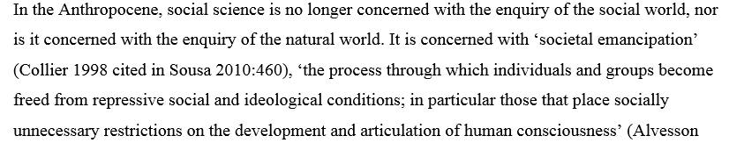
Introduction
Required is a return to integrated analysis of human behaviour and well-being, which characterised classical political economy (Martins 2012; Putnam & Walsh 2012).
Cambridge revival of Political economy: fair distribution of surplus, embedding economy in society; expanded notions of self-interest.

Slide 3
Heuristics relevant to formulation of Human Centered Socio-economic system
Entanglement of Fact/value/convention (Putnam & Walsh 2012; Quine 1959)
Triple Level Embeddedness Framework (Geels 2014)
Expanded Sustainable Development model (Seghazzo 2013; Allen 2009; Bodin & Tengo 2012; Kiesling et al 2012)
Keynes + Schumpeter Economic growth models (Dosi et al 2014)
???
Un-ravelling the subjective neoclassic theory of value (Putnam & Walsh 2012) & the subordination of macro economics to the restrictive episteme/ methodology of microeconomics (Fine 2016) by expanding the informational base used in economic reasoning (Sen 1999; 2009)

Slide 4
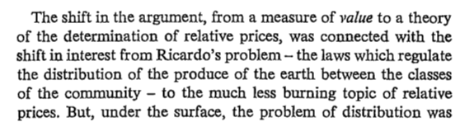
Neo-classic subjective theory of value
Misuse of Invisible Hand (Blauq 2007)
Classic Political economy
Marginalist Revolution
Formalist Revolution
Neo-classic / Mainstream (Fine 2016)
Robinson 1962:36
Robbins (1932) removal of values from economics
‘the tacit preference utilitarian morality lurking in neoclassical economics…a crude form of ordinal utility based consequentialism as the pervasive moral substructure of neoclassical economic’ (Putnam & Walsh 2012:65)

Slide 5
Entanglement of Fact / Value / Convention: & exploration of Quine’s (1950) ‘attack’ on positivism.
Re-constructing Social Structure of knowledge Production (Giddens 1986, Kuhn 1962, 2012).
All knowledge subjective need to re-construct intellectual communication (Gulbenkian report 1996)
More than methodological plurality i.e. reductionism (Swilling & Annecke 2012) or nationalism (Ings 2012) re-opening of fundamental ontological questions (Heidegger 2006; Putnam & Walsh 2012)
Epistemological history of Neo-liberalism linked to critique of classic sociology (Nicholas 2014)
Epistemological inquiry of the moral philosophy of classic political economy (Sen in Putnam & Walsh 2012).
Critique of methodological individualism & fuller description of an economic agent i.e. expanded notions of self-interest, well-being, rationalism & choice (Martins 2012, 2013; Putnam & Walsh 2012; Sen 1999, 2009)
Value
Convention
Fact

Slide 6
Second wave of the Cambridge Revival of Classic Political Economy
1st Wave: Misappropriation of Ricardo’s theory of value by marginalist economists (Robinson 1962)
2nd Wave: What does the critique of methodical individualism & choice i.e. the micro-foundations of economics mean for macro-economics? (Putnam & Walsh 2012)
Consideration of Embedding the economy in society (Kaup 2015; Krippner & Alvarez 2007)

Slide 7
Why the need to Embed the Economy in Society?
Neo-classic subjective theory of value
No real theory of a Firm (Coase 1935; Splash 2017)
Economic growth theory: separated from macro-economics, dependant on production function (Fine 2016)
Methodological individualism & Rational choice
Polanyi’s conception of embeddness:
Posed at macro level.
Problem of the analytically autonomous economy and its integration into society (Krippner & Alvarez 2007)
Granovetter's concept of embeddness:
Micro & meso levels.
Problem of atomisation and relational bases of social action in economic systems (Krippner & Alvarez 2007)

Slide 8
Geels (2014) triple level Embeddness
Draws on:
Evolutionary economics
Neo-institutional economics
Economic sociology
Aim: new framework to understand the co-evolution and bi-directional interactions between industries and their environments.

Slide 9
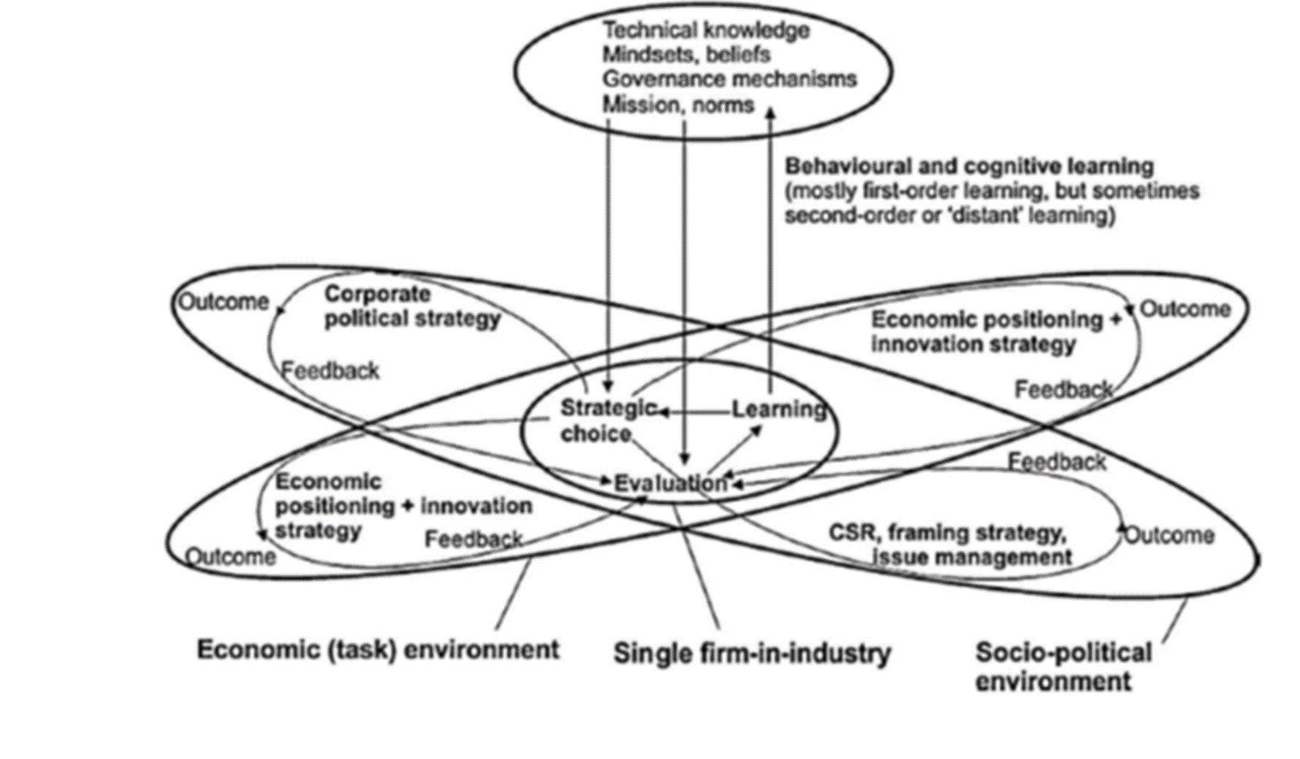
Geels (2014): Triple level embeddness shows how Firms-in-Industries shape environments
Schumpeterian notion of innovation problematic (Perez-Luno 2007) discursive effect of labour saving technologies + creative destruction
Role of State: innovation within Socio-political systems to lever state provision of infrastructure to effect change

Slide 10
Expanded Sustainable Development Concepts
Expanded Information Base
Innovation: better modelling to improve understanding the diffusion process (Kiesling et al 2012)
Entanglement Fact/value/convention: consideration of values and how they are formed mean that need to reconsider abstract concepts of time, place, persons (Seghazzo 2013)
Access to Ecosystem Services: Modelling of asymmetric access to ecosystem services (Boding & Tengo 2012) to inform states provision of infrastructure
Embed intergenerational equity & intra-generational equity (Seghazzo 2013)

Slide 11
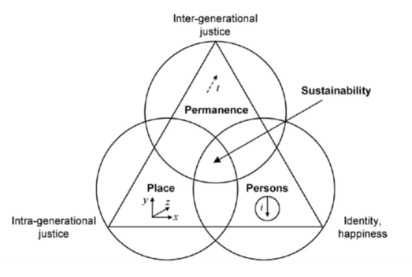
Sustainable Development
Place (three dimensions): Places are a source of facts, identities and behaviours. Place is, to a certain extent, a social construct t
Permanence: Not only maintenance of present conditions, it includes changes and improvements. Permanence could be seen as the main realm of intergenerational equity as it is concerned with inter-temporal morals.
Persons: Represents recognition that an individual ‘person’ exists within each human being, each being similar yet entirely different from those around them.build a sense of belonging
Seghazzo (2013)
Allen (2009)

Slide 12
Keynes plus Schumpeter Economic Growth Model (Dosi et al 2012)
Keynes + Schumpeter | Critique
Agent Based Models | Existing mainstream economic model is a synthesis of Keynes (Fine 2016).
Synthesis between Keynes (aggregate demand) & Schumpeter (technology) policies | Developmental state literature suggests that focus on aggregate demand and technological innovation may have stifled theorising on the importance of Social Policy (Mkandawire 2007, 2015)
Supplement Schumpeter’s incomplete conception of how to deal with creative destruction | Return to foundational Keynes may be required to move beyond Walrasian price theory (Heise 2016)

Slide 13
References
Allen, A. 2001. Urban sustainability under threat: The restructuring of the fish industry in Mar de Plata, Argentina. Development in Practice, 11(2&3): 152–173.
Allen, A. 2009. Sustainable cities or sustainable urbanisation?; Taken from the Summer 2009 edition of ‘palette’, UCL’s Journal of Sustainable Cities.
Bodin, O. & Tengo, M. 2012. Disentangling intangible socio-ecological systems. Global Environmental Change, 22: 430–439.
Dosi, G., Napoletano, M., Roventini, A. & Treibich, T. 2014. Micro and Macro Policies in the Keynes + Schumpeter Evolutionary Models. LEM Working Paper Series No. 2014/21.
Geels, F.W. 2014. Reconceptualising the co-evolution of firms-in-industries and their environments: Developing an interdisciplinary triple embeddedness framework. Research Policy, 43: 261–277.
Granovetter, M. 1985. Economic action and social structure: The problem of embeddness. American Journal of Sociology, 91(3): 481–510.
Inglis, D. 2014. What is worth defending in sociology today? Historical vision and the uses of Sociology. Cultural Sociology, 8(1): 99–118.
Kaup, B.Z. 2015. Markets, Nature, and Society: Embedding Economic & Environmental Sociology. Sociological Theory, 33(3): 280–296.
Kiesling, E., Gunther, M., Stummer, C. & Wakolbinger, L.M. 2012. Agent-based simulation of innovation diffusion: A review. Central European Journal of Operations Research, 20(2): 183–230.
Krippner, G.R. & Alvarez, A.S. 2007. Embeddness and the intellectual projects of economic sociology. Annual Review of Sociology, 33(2): 219–240.
•Lizardo, O. 2014. Beyond the Comtean Schema: The sociology of culture and cognition versus cognitive social science. Sociological Forum, 29(4): 983–989.
•Martins, N.O. 2012. The Cambridge Revival of Political Economy, New York: Routledge. [Online]. Martins, N.O. 2013. Classic surplus theory and heterodox economics. American Journal of Economics and Sociology, 72(5): 1205-1231
Nicholas, G. (2014) Sociology and neo-liberalism: a missing history. Sociology, 48(6): 1092–1106.
Perez-Luno, L., Cabrera, R.V. & Wiklund, J. 2007. Innovation and imitation as source of sustainable competitive advantage. Management Research, 5(2): 71–82.
Putnam, H. & Walsh, V. (eds). 2012. The End of Value Free Economics. London: Routledge.
Seghazzo, L. 2013. The five dimensions of sustainability. Environmental Politics, 18(4): 539–556.
Sen, A. 1999. Development as Freedom. New York: Knopf.
Sen, A. 2009. Capitalism beyond the crisis. The New York Review of Books, 56(5): 1–8.
Swilling, M. & Annecke, E. 2012. Just Transitions: Explorations of Sustainability in an Unfair World. Cape Town: UCT Press.

