Slide 1
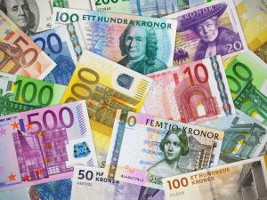
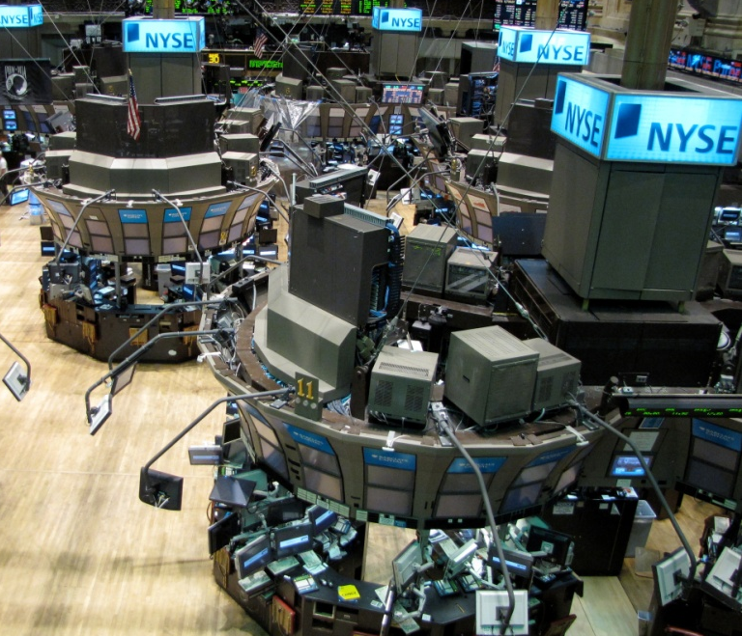
Social Power of Money
Garry Jacobs, CEO, World Academy of Art & Science
INTERNATIONAL COLLOQUIUM
Cape Town (South Africa), May 10-12, 2017
Sustainability Institute, Stellenbosch University

Slide 2
Human relationships create social power
Increases the number, frequency, reach, volume, intensity of collaborative human relationships has the potential to generate higher levels of human security, wealth, welfare and well-being

Slide 3
Money is a social institution
Money is a catalyst for human relationships
Money is a networking device like language, markets and internet
Money has the power to convert social potential into social power
Money has no value outside society

Slide 4
Subjective basis for Money
Money is a proxy for trust-based personal relationships
The value of money is a function of the trustworthiness it conveys
What is done with money can be done without money wherever there is full trust

Slide 5
Money is Evolving
Trust in an object of physical utility – cow, tobacco
Trust in a material object of value to other people – precious metals
Trust in symbols issued by trusted organizations – grain receipt, goldsmith receipts, bank notes, governments
Trust in the productive capacities and potentials of government – national or international currency
Trust in the ultimate value of the human being and human dignity – basic minimum income

Slide 6
Money is a symbol of power
Money is a symbol with no inherent value of its own
Power of a symbol is that it can represent anything or everything
Primary power – a symbol for access to all products and services
Secondary power – symbol for access to other forms of social power
Tertiary power – symbol for political-social-psychological power of the human ego – status, prestige, privilege – to dominate over other people
The tertiary power of money is greatest when it can be exercised without being consumed

Slide 7
Power of Money for the Collective & Individual
Like monarchy and nuclear weapons, the tertiary power of money for the individual is maximum when no one else possesses it.
Like language, education and internet, the power of money for society is maximum when everyone has it.
The underlying motive for restricting access to money is the tertiary power & privileges it bestows on those who ALONE possess it

Slide 8
Implications
Money is a powerful instrument for converting social potential into social capacity
The maximum benefit to society issues when all citizens equitably share the primary, secondary and tertiary social powers of money
Equitable distribution of tertiary social power is human dignity
Any amount of money can be created that is used to convert unutilized social potential into higher levels of well-being for all

