Slide 1
Building Sustainable Urban Energy Democracies: reflections on transdisciplinary research in the REIPPPP
Megan Davies
PhD Researcher | Coordinator Renewable Energy for Transitions
Centre for Complex Systems in Transition | Stellenbosch University
megandavies@sun.ac.za

Slide 2
Background
REIPPPP launched in 2011 to secure additional renewable energy generation capacity for South Africa’s national electricity grid
At the onset the procurement framework stipulated 7 socio-economic considerations: local content, ownership, socioeconomic development, enterprise development, job creation, preferential procurement, management control
Climate change and development targets integrated in a novel public private partnership, where private sector takes a lead role in ‘development’
Integrated expenditure targets in an effort to drive socio-economic (SED) and enterprise development (ED) in designated beneficiary communities
Portion of revenue must be committed to SED and ED each quarter within 50 km of RE plant
Community ownership targets included – around 100 trusts have been set up

Slide 3
Background
6422 MW of electricity has been procured from 112 RE IPPs in 7 bid windows (large and small scale)
2902 MW of electricity generation capacity from 54 IPP projects connected to national grid
Investment to the value of R201.8 billion, of which R48.8 billion is FDI
Socio-economic development contributions of R298.8 million to date
Enterprise development contributions of R94.6 million to date

Slide 4
Civil Society
Community development practice
Industry
Social performance
Community – company relations
RE4T research perspectives
Sustainability transitions
Political economy of energy

Slide 5
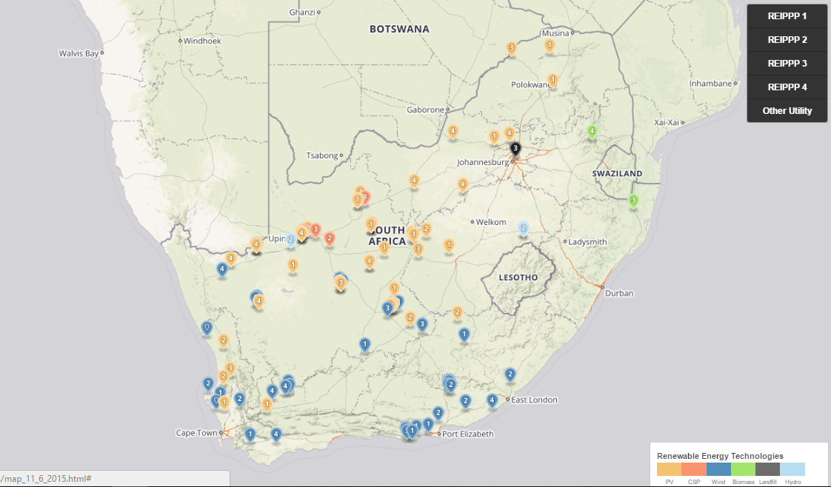
Geographic dispersion of IPPs across South Africa – hotspots in Western, Northern &Eastern Cape
http://www.energy.org.za/

Slide 6
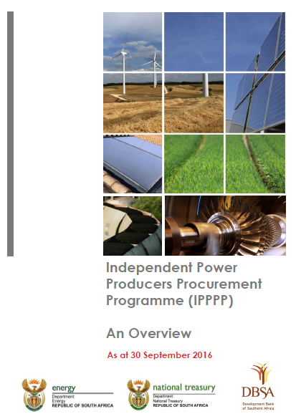
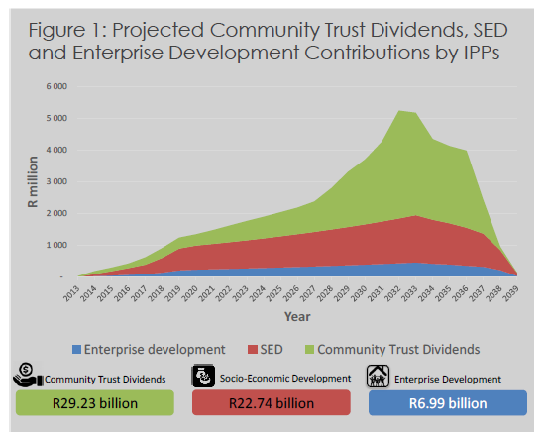
Significant place-based investments in communities for the duration of the programme
https://www.ipp-projects.co.za/Publications

Slide 7
Renewable Energy for Transitions (RE4T)
Investigating the developmental impacts of REIPPPP from a ‘just transitions to sustainability’ perspective
Urban and spatial implications of RE infrastructure
Techno-infrastructure for a RE economy is distributed across a vast number of localities
Implications for socio-spatial dynamics of economic and political power
Engaging in transdisciplinary research – from science for society, to science with society
‘Emergent transdisciplinary design’ (van Breda & Swilling, forthcoming)
Emergent and iterative nature of co-design research processes that cultivate transformative knowledge

Slide 8
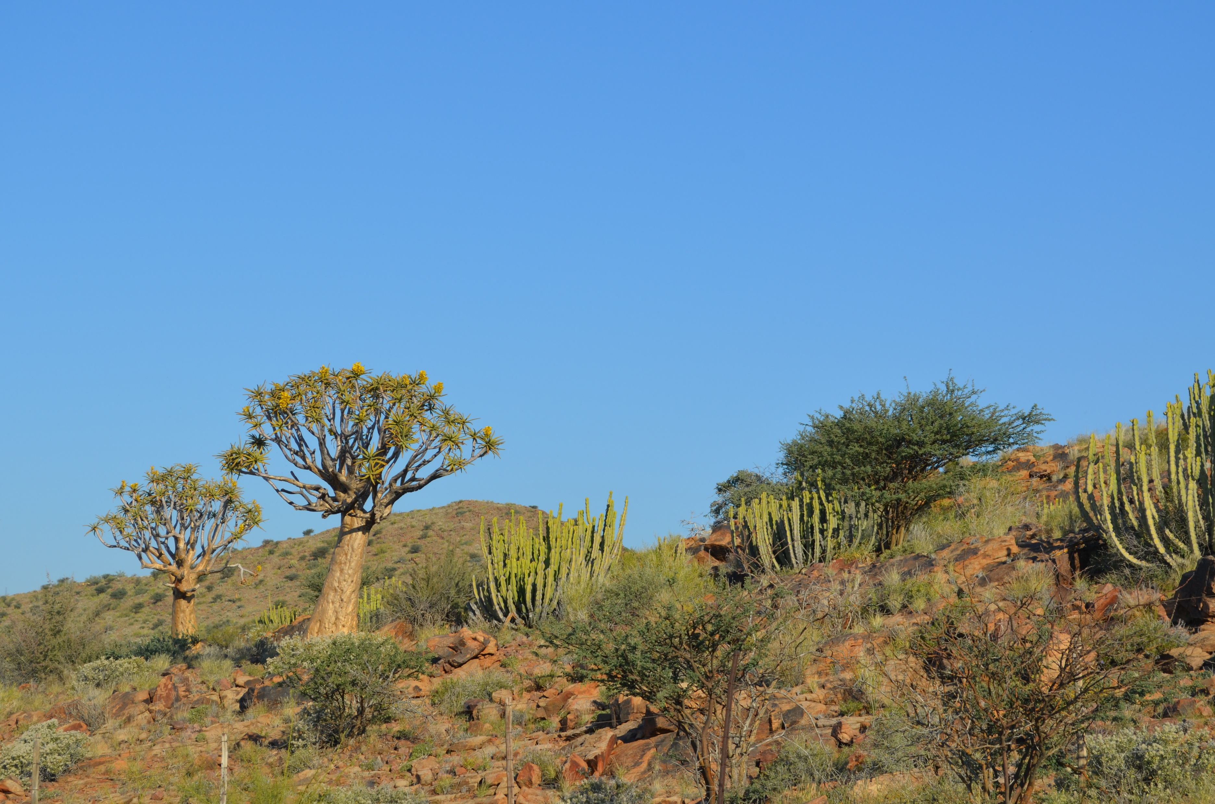

Slide 9
“A wild plant renowned for its drought tolerance and longevity, the quiver tree migration is a irrefutable reminder of the very real, very visual signs of the effects of climate change.”
http://treesoftheplanet.com/stories/quiver-trees-tell-the-story-of-climate-change/

Slide 10
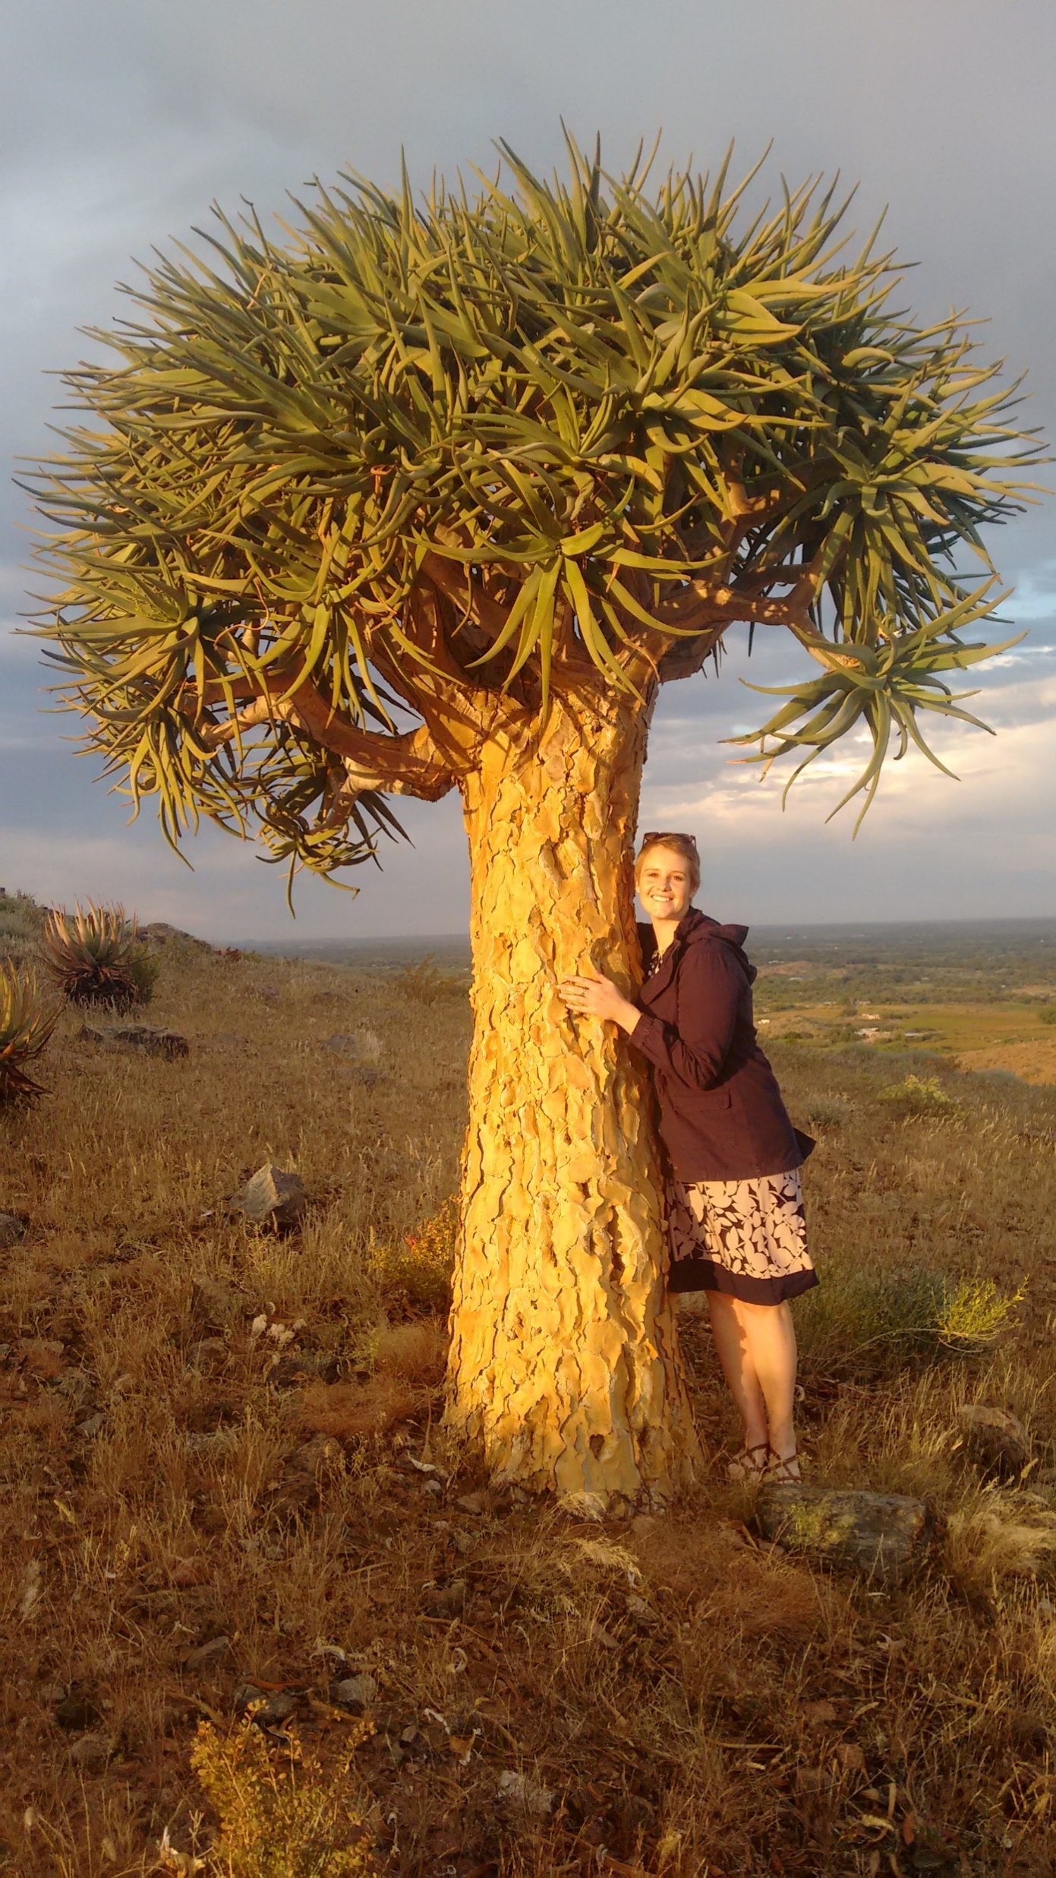
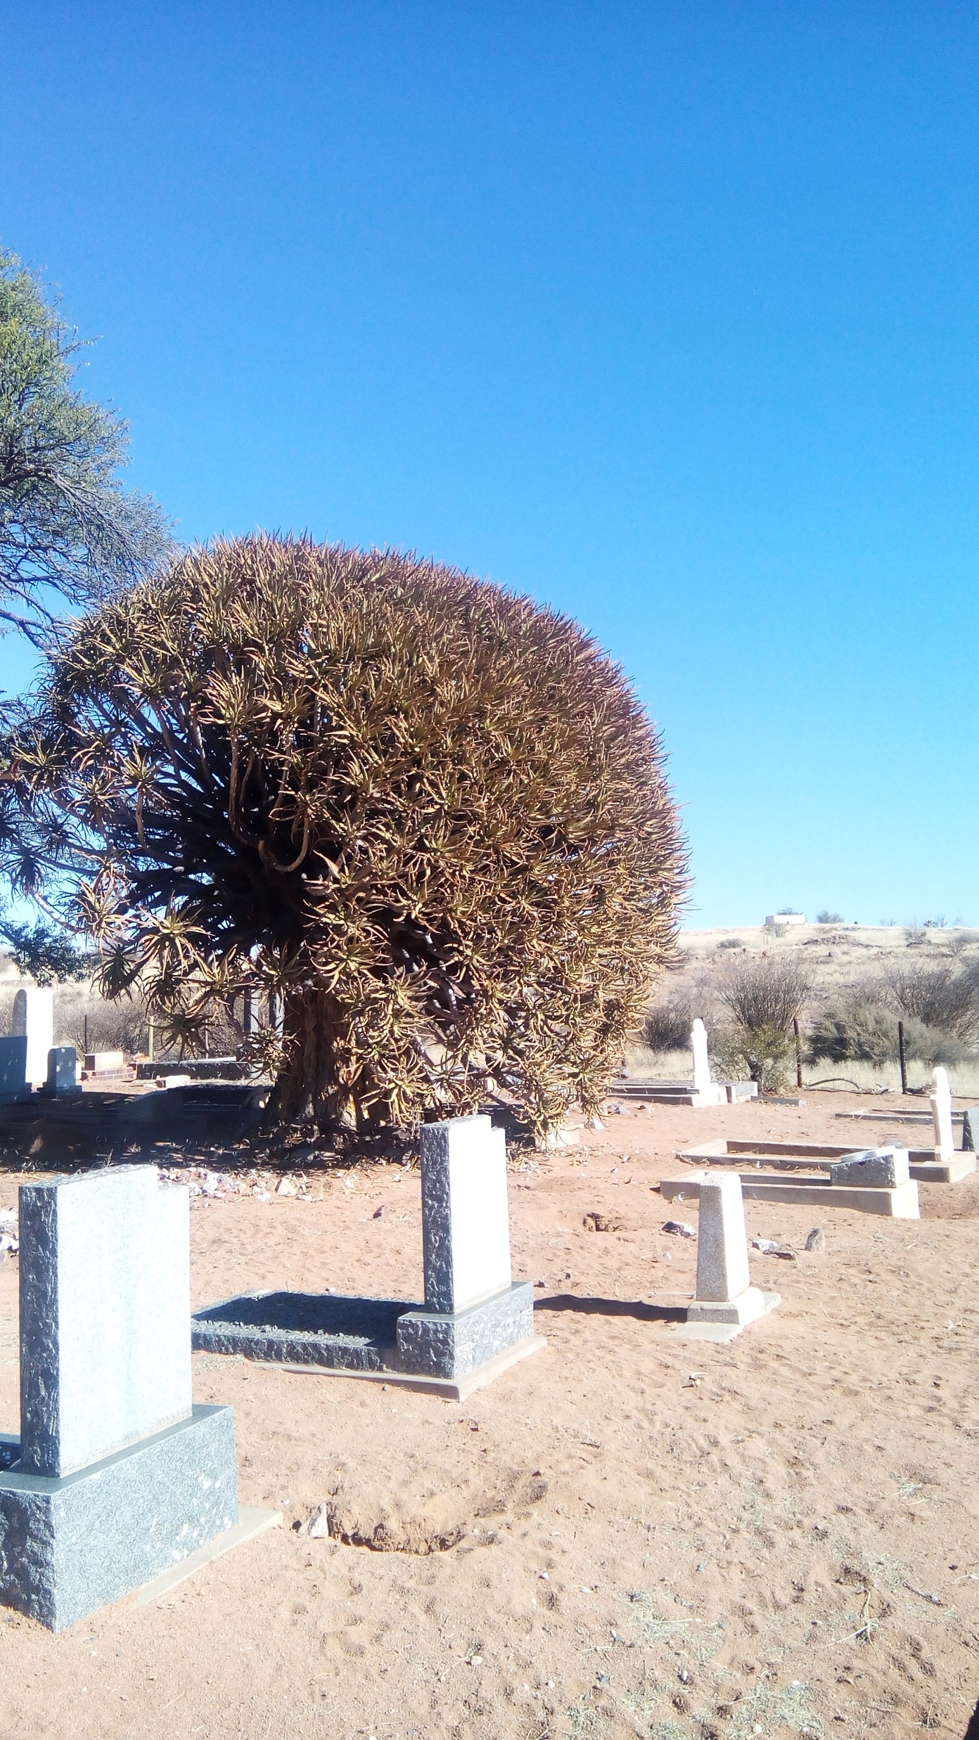

Slide 11
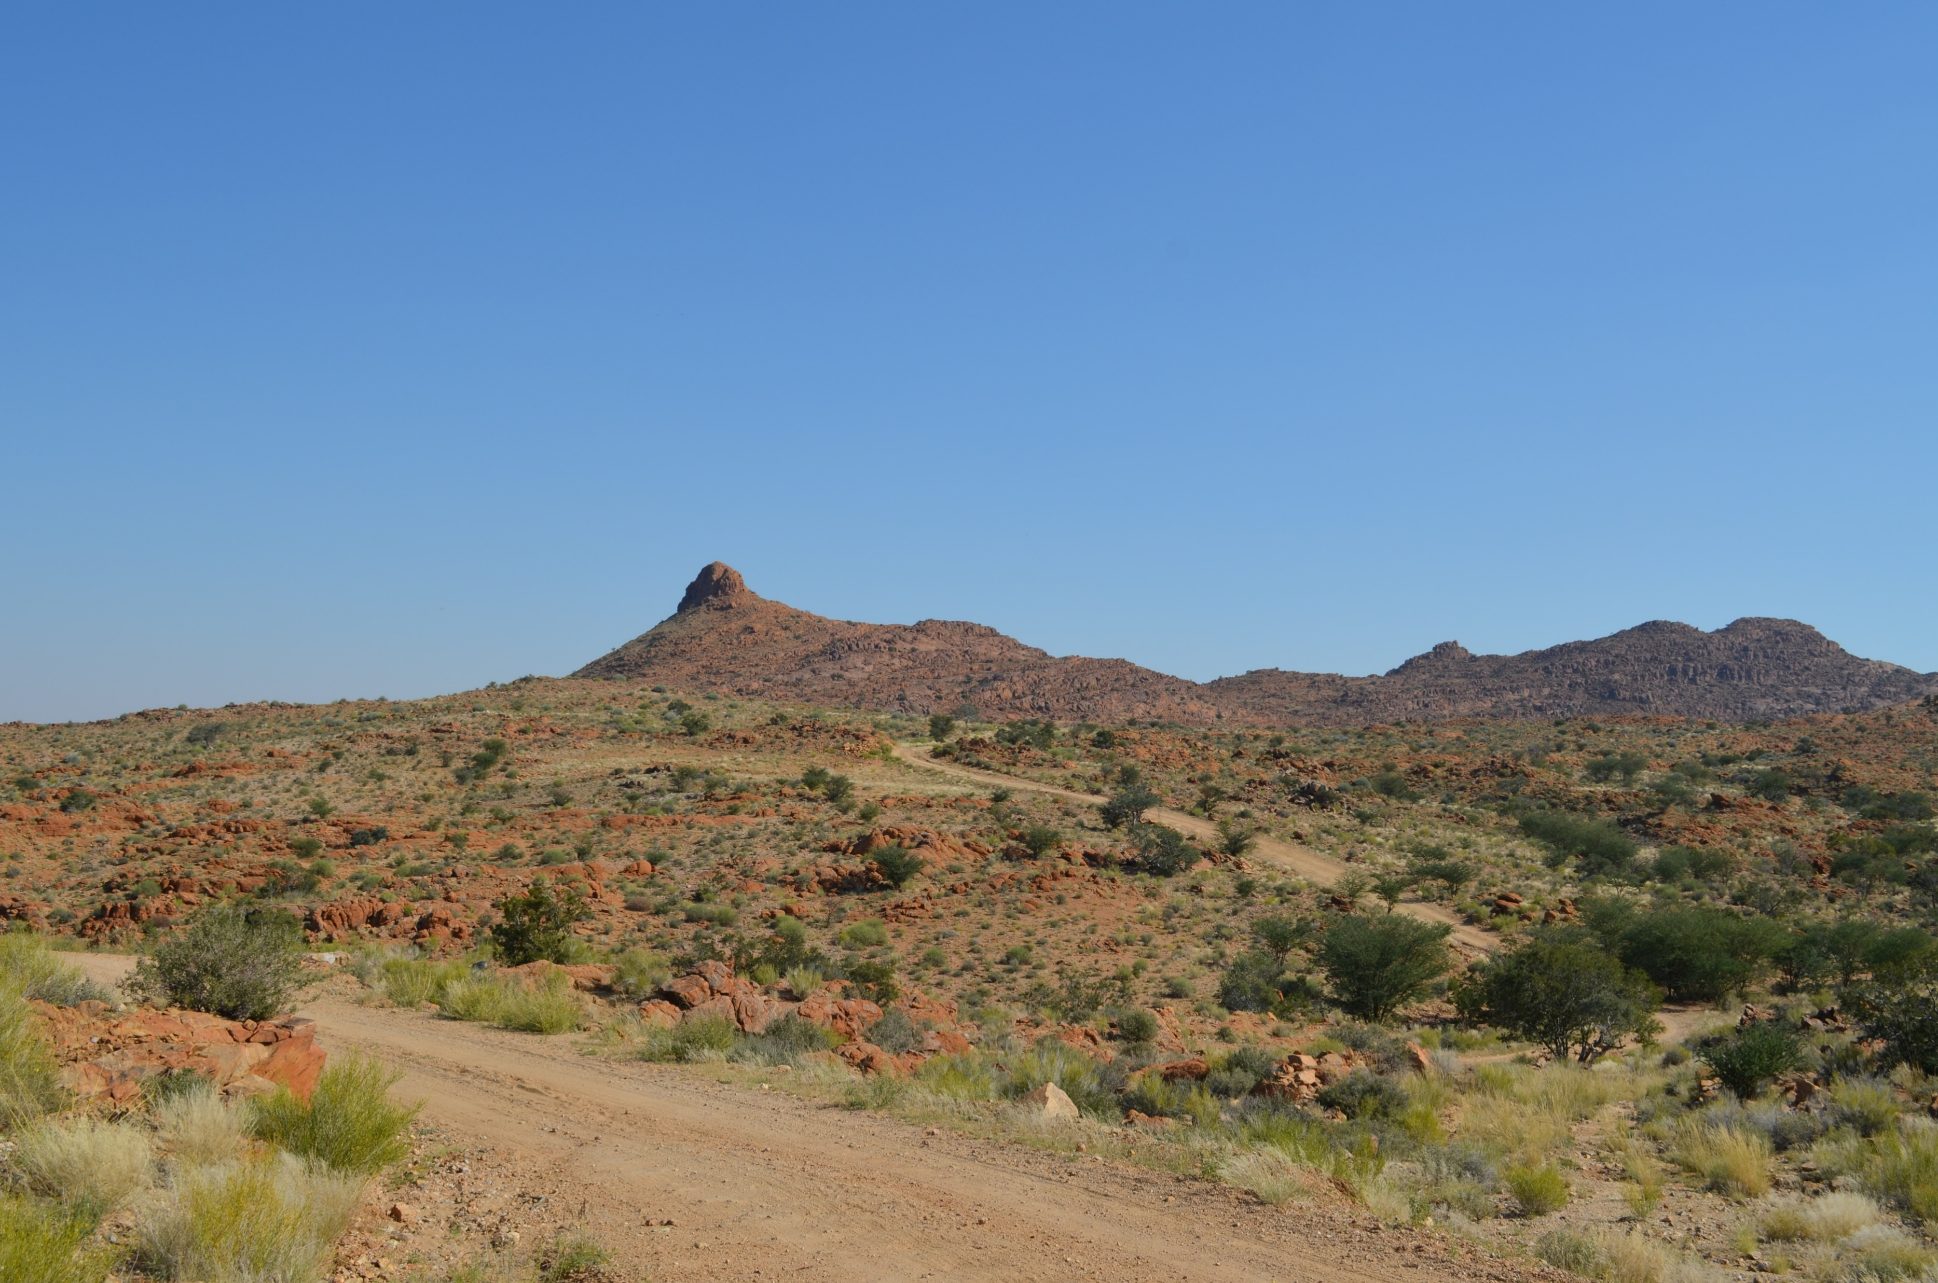
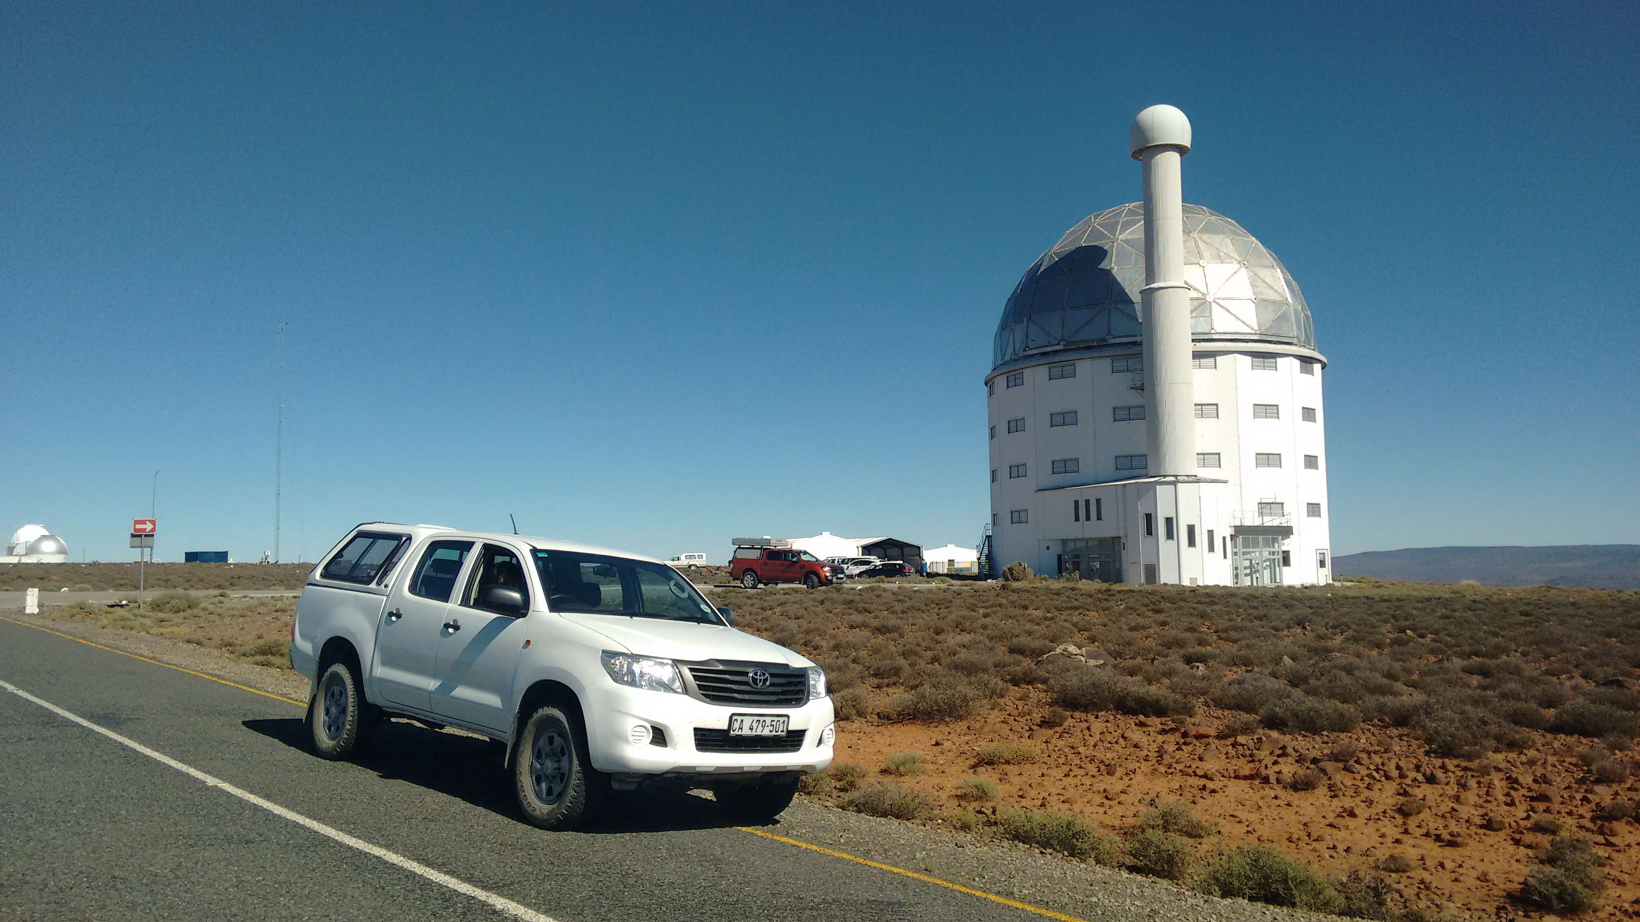
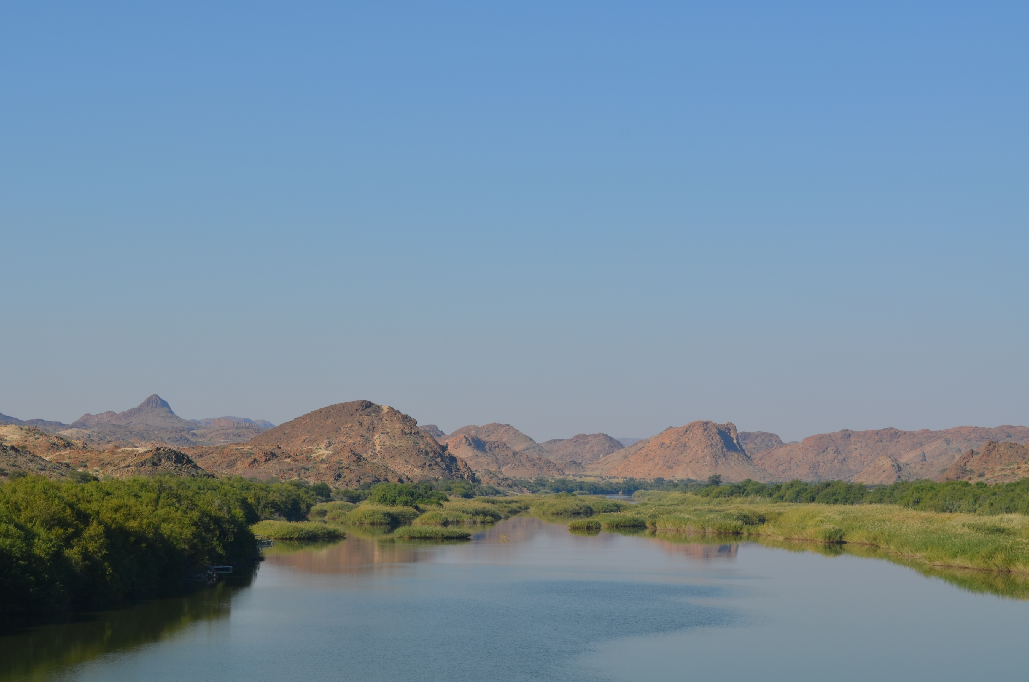
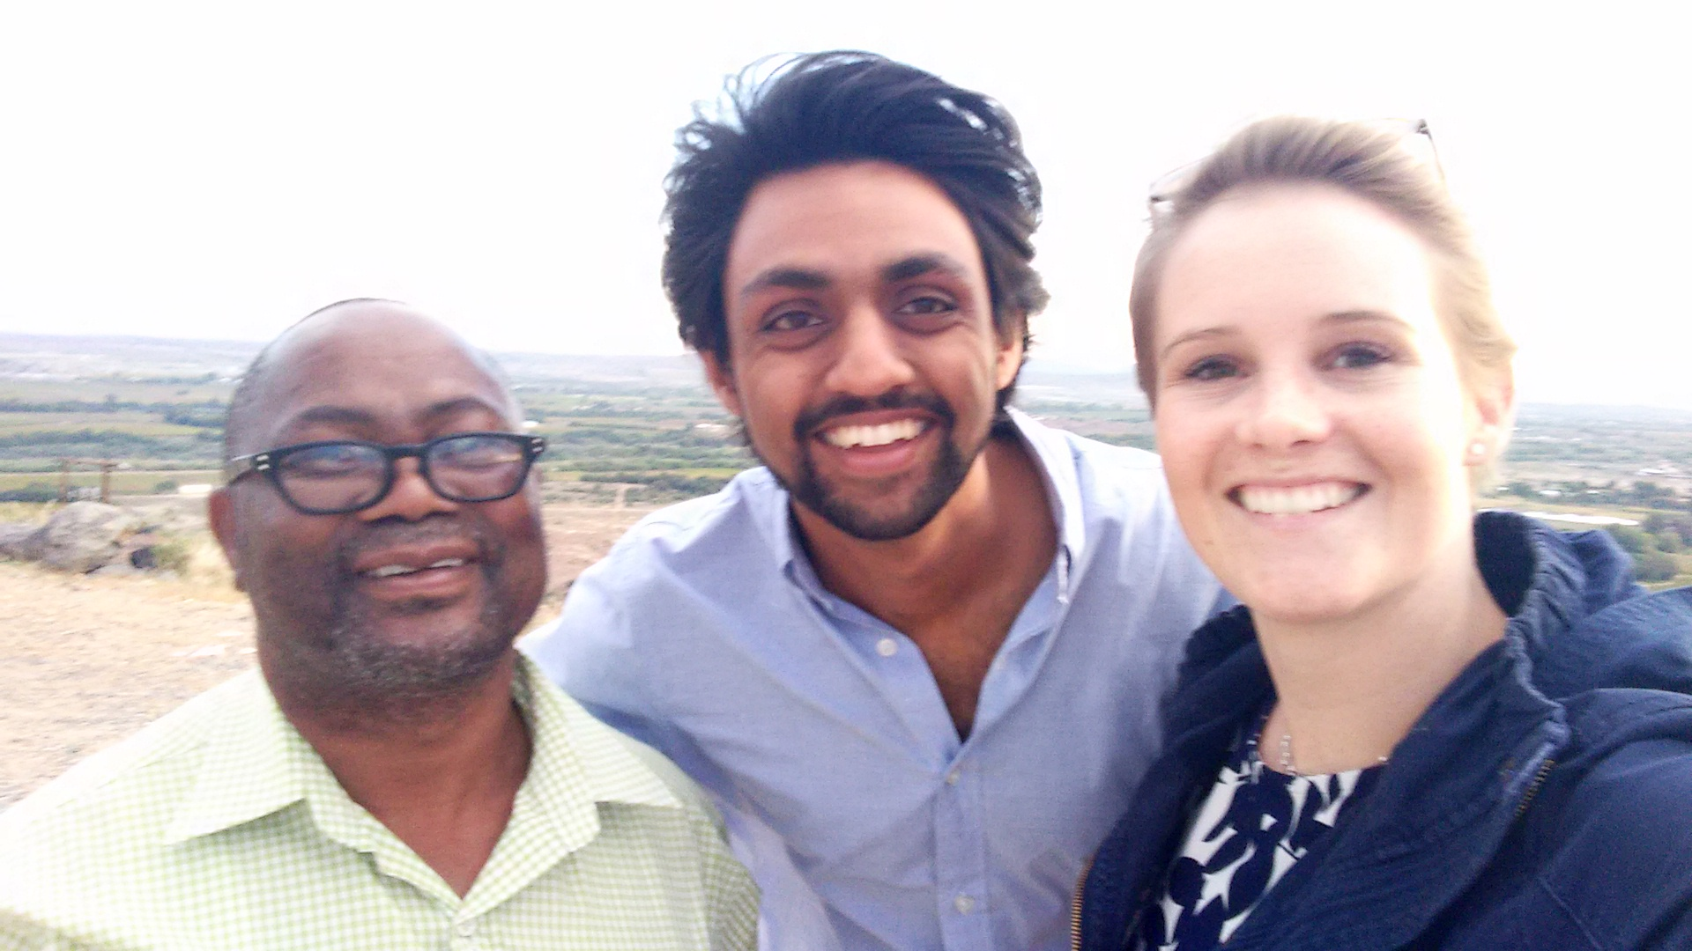

Slide 12
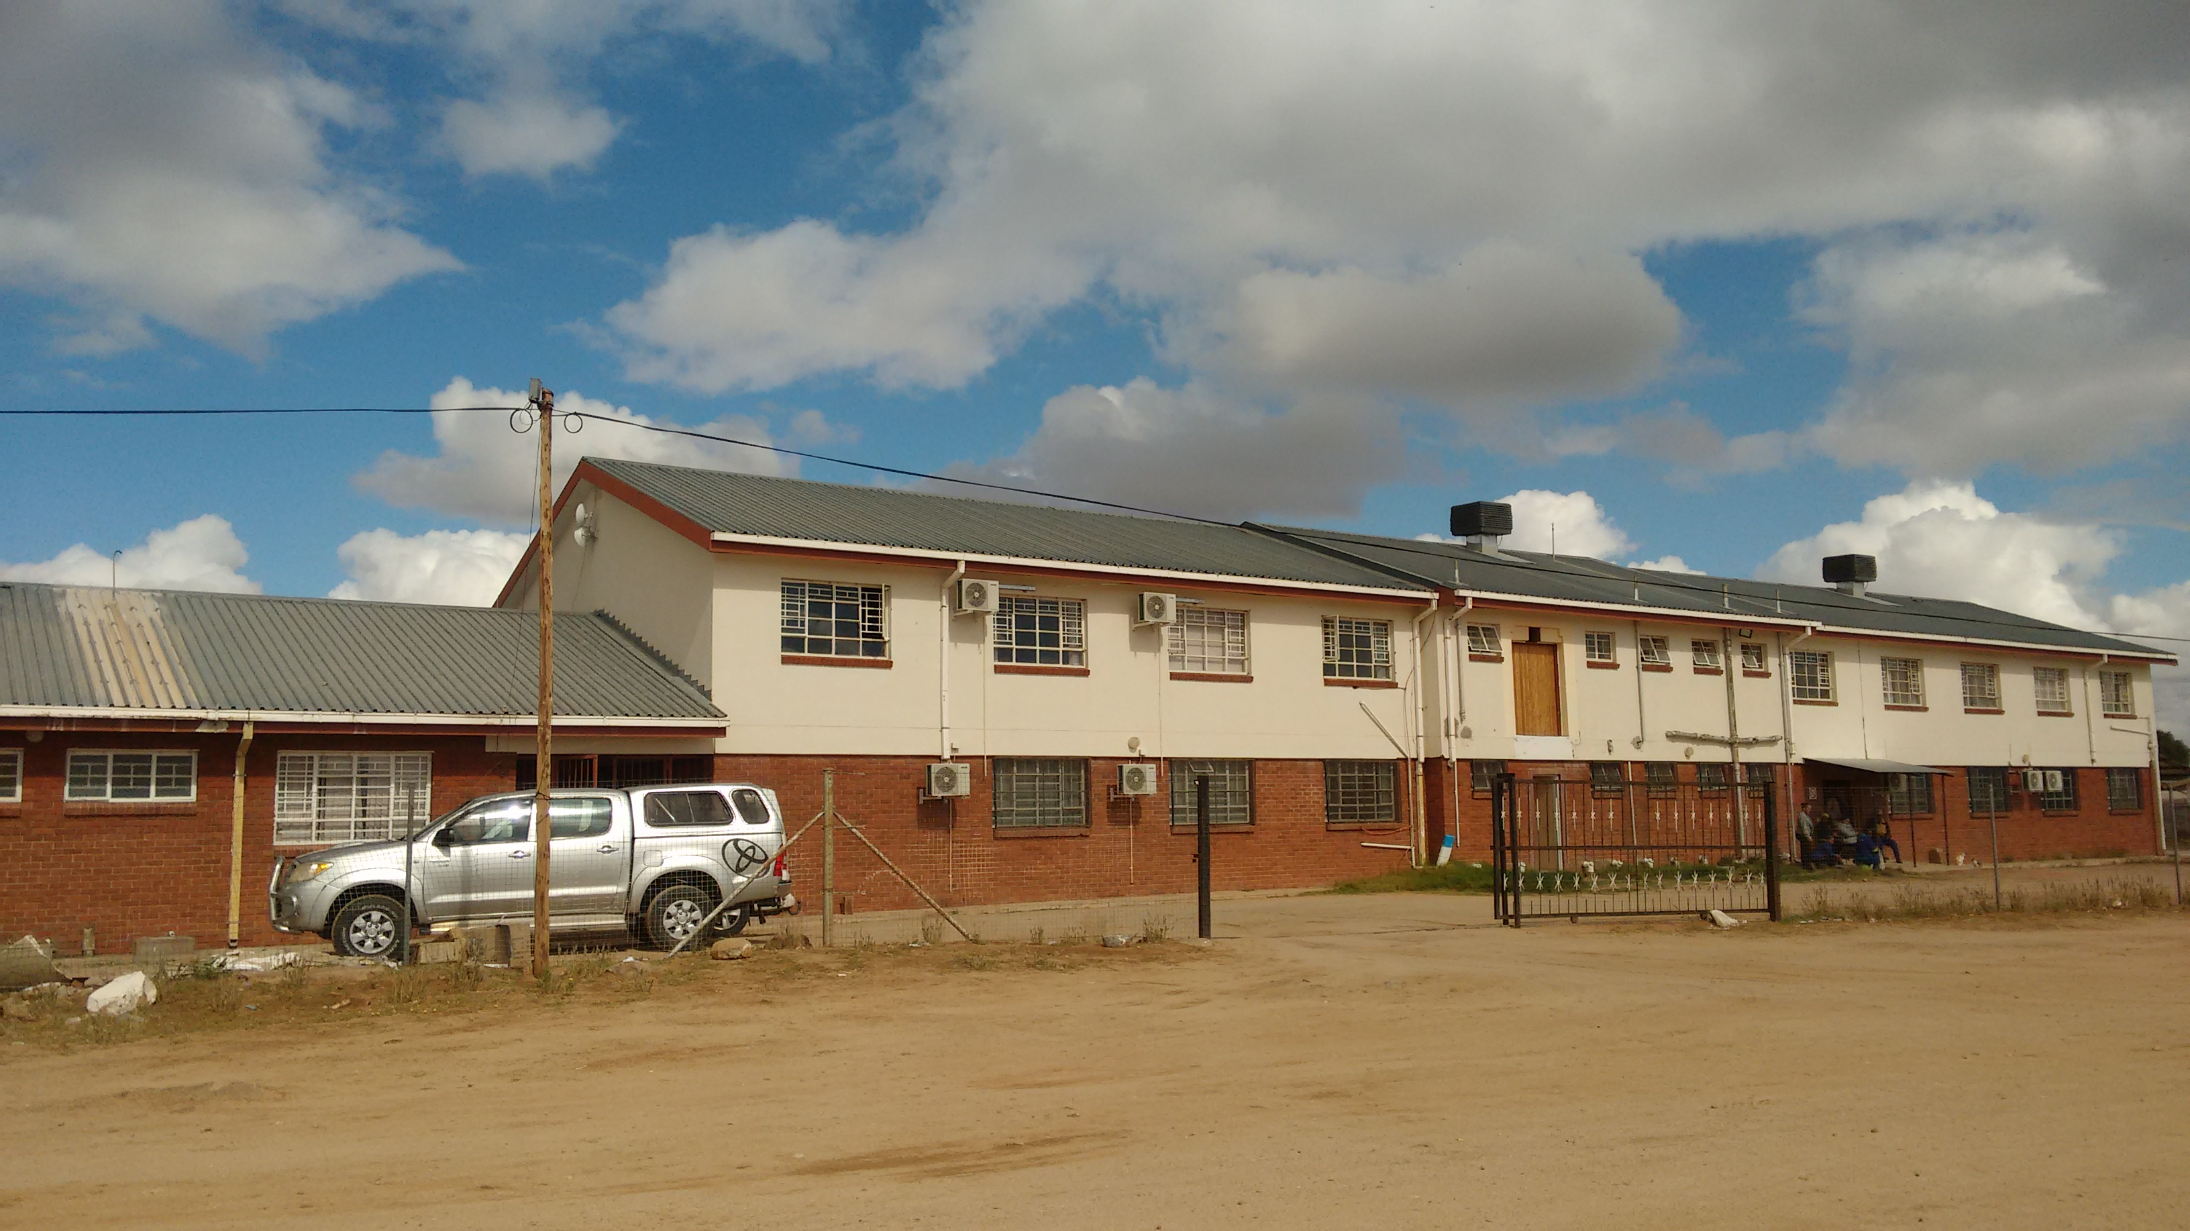
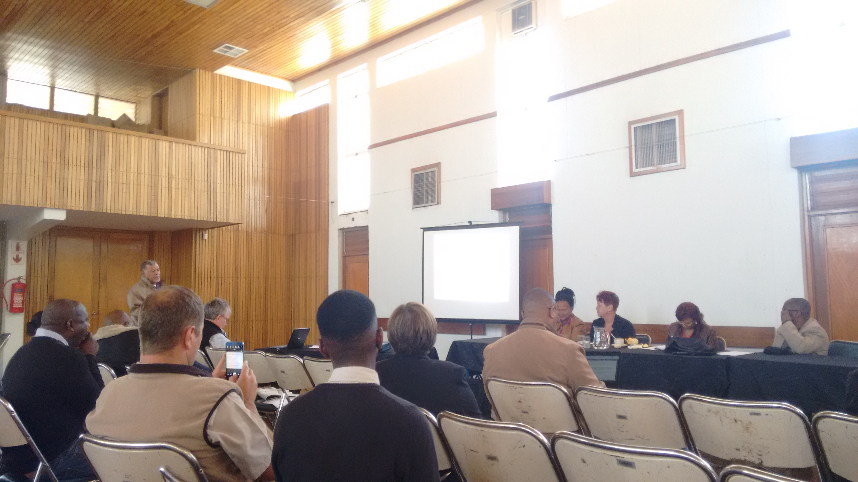
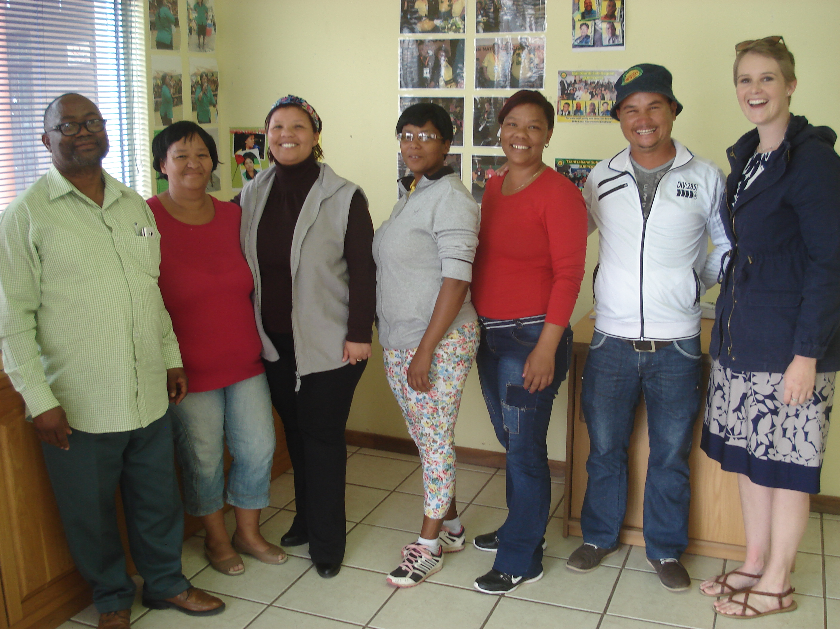
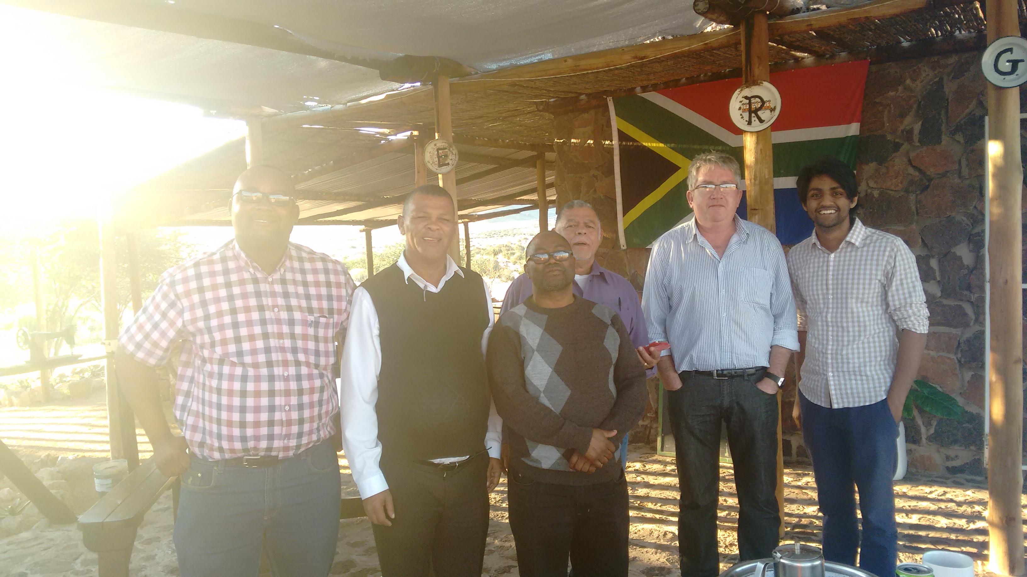
Fieldwork experiences in 2016

Slide 13
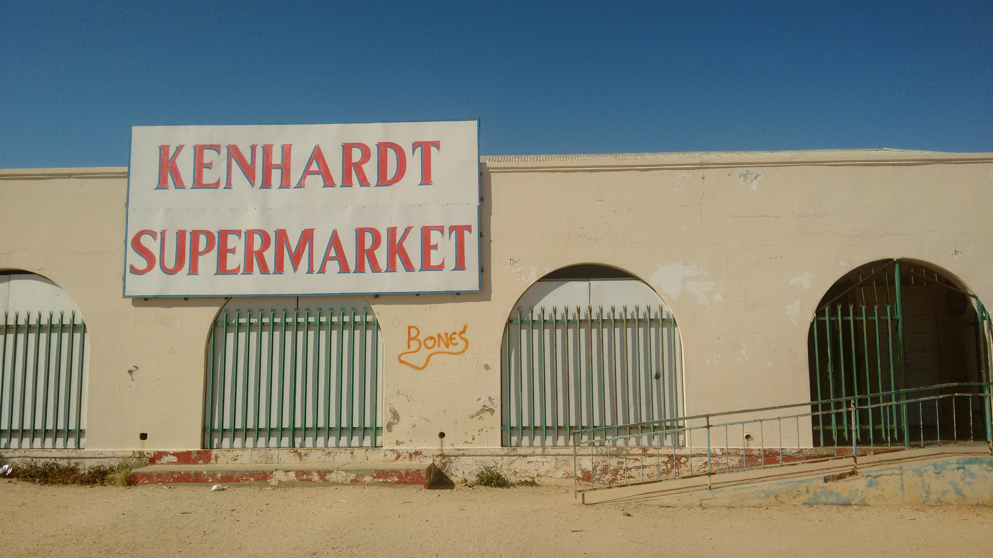
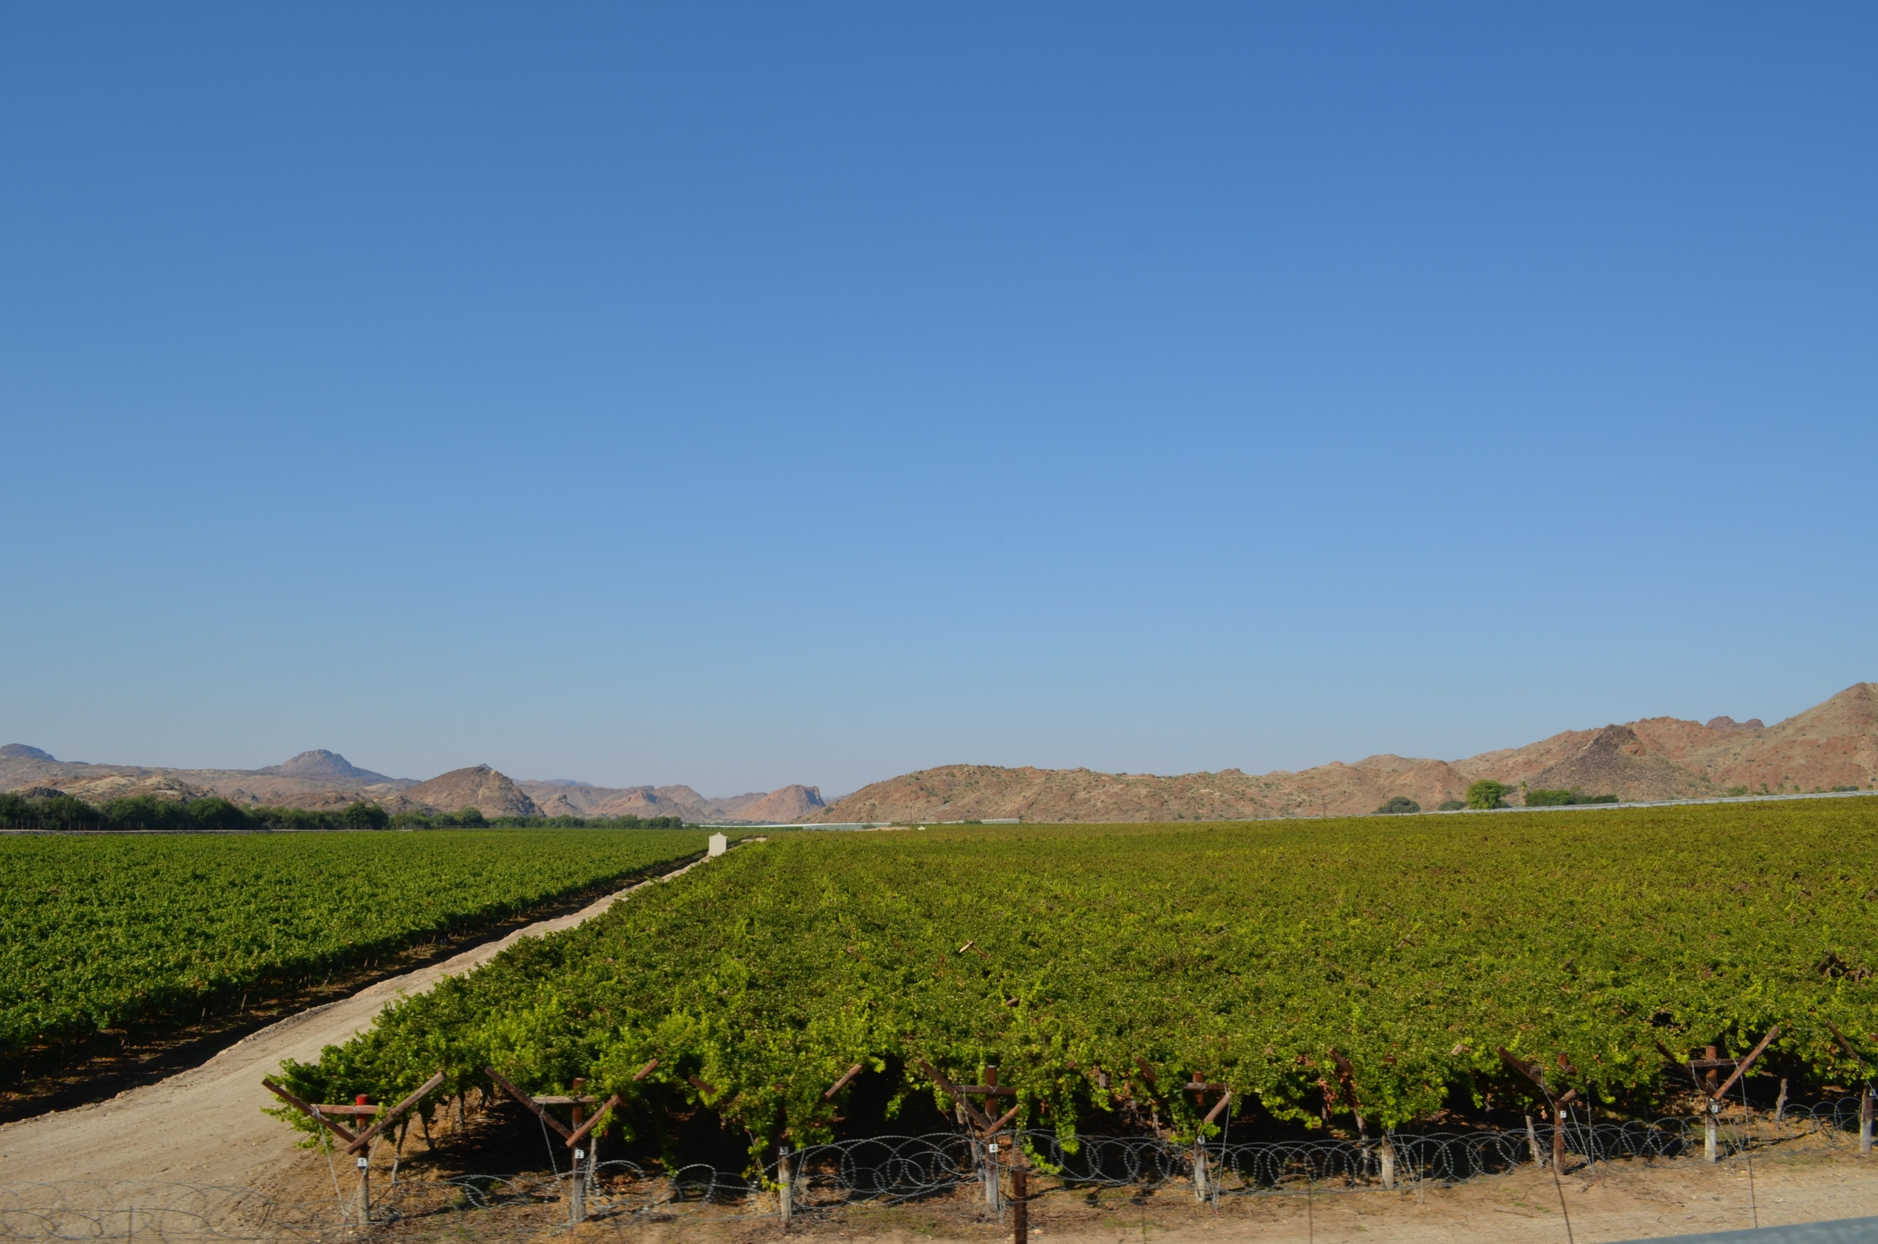
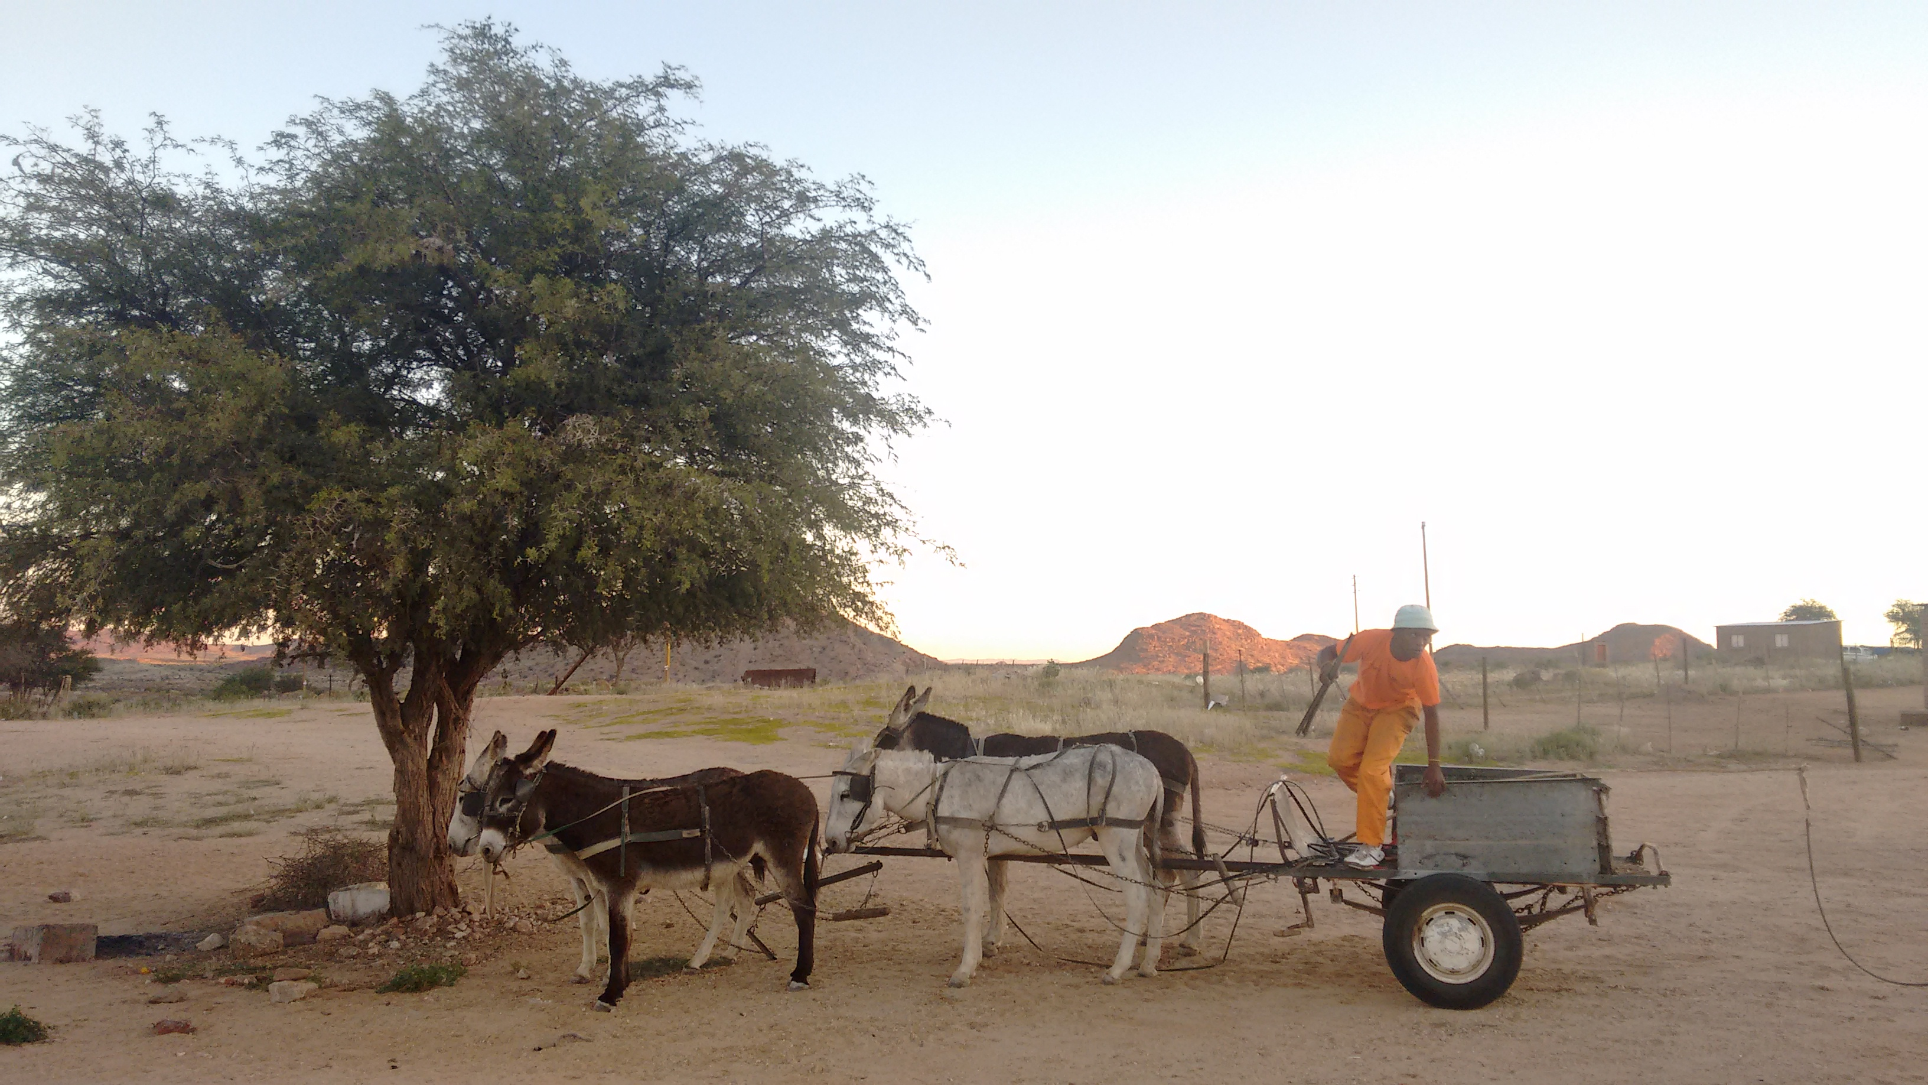
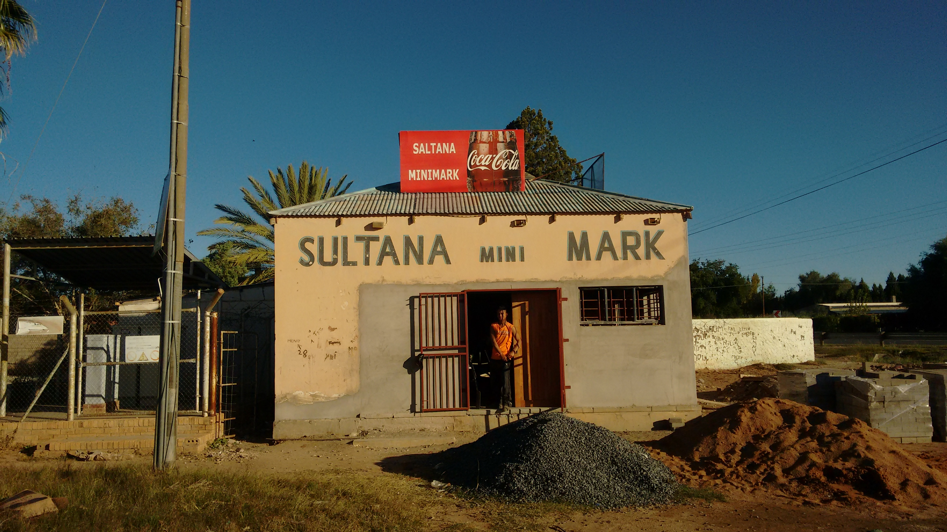
Northern Cape – IPPs located in remote areas with limited economic activity or opportunity for sustainable livelihoods

Slide 14
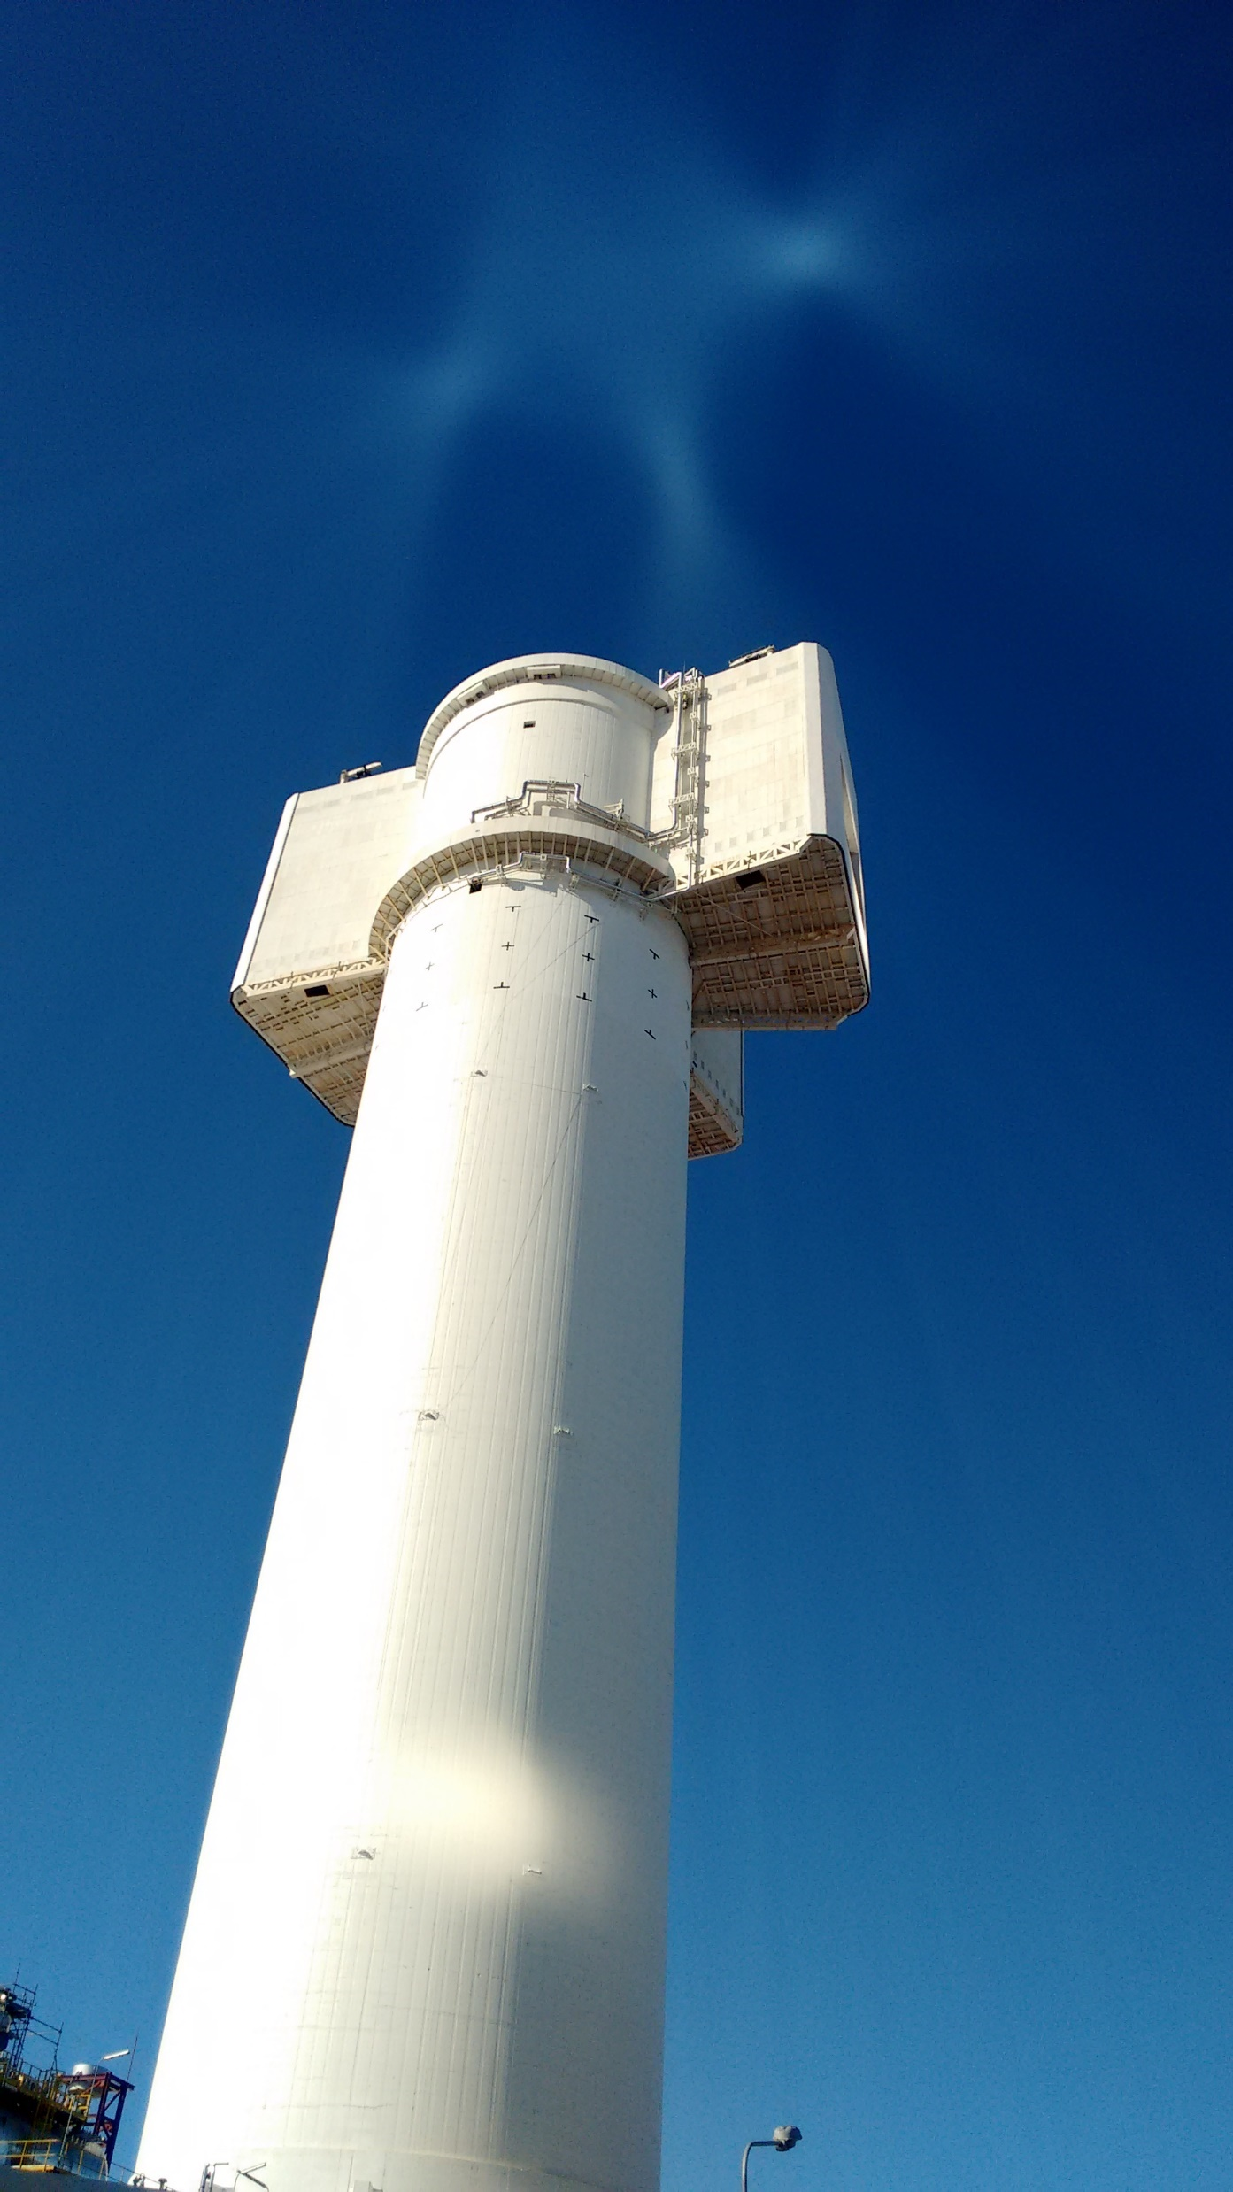
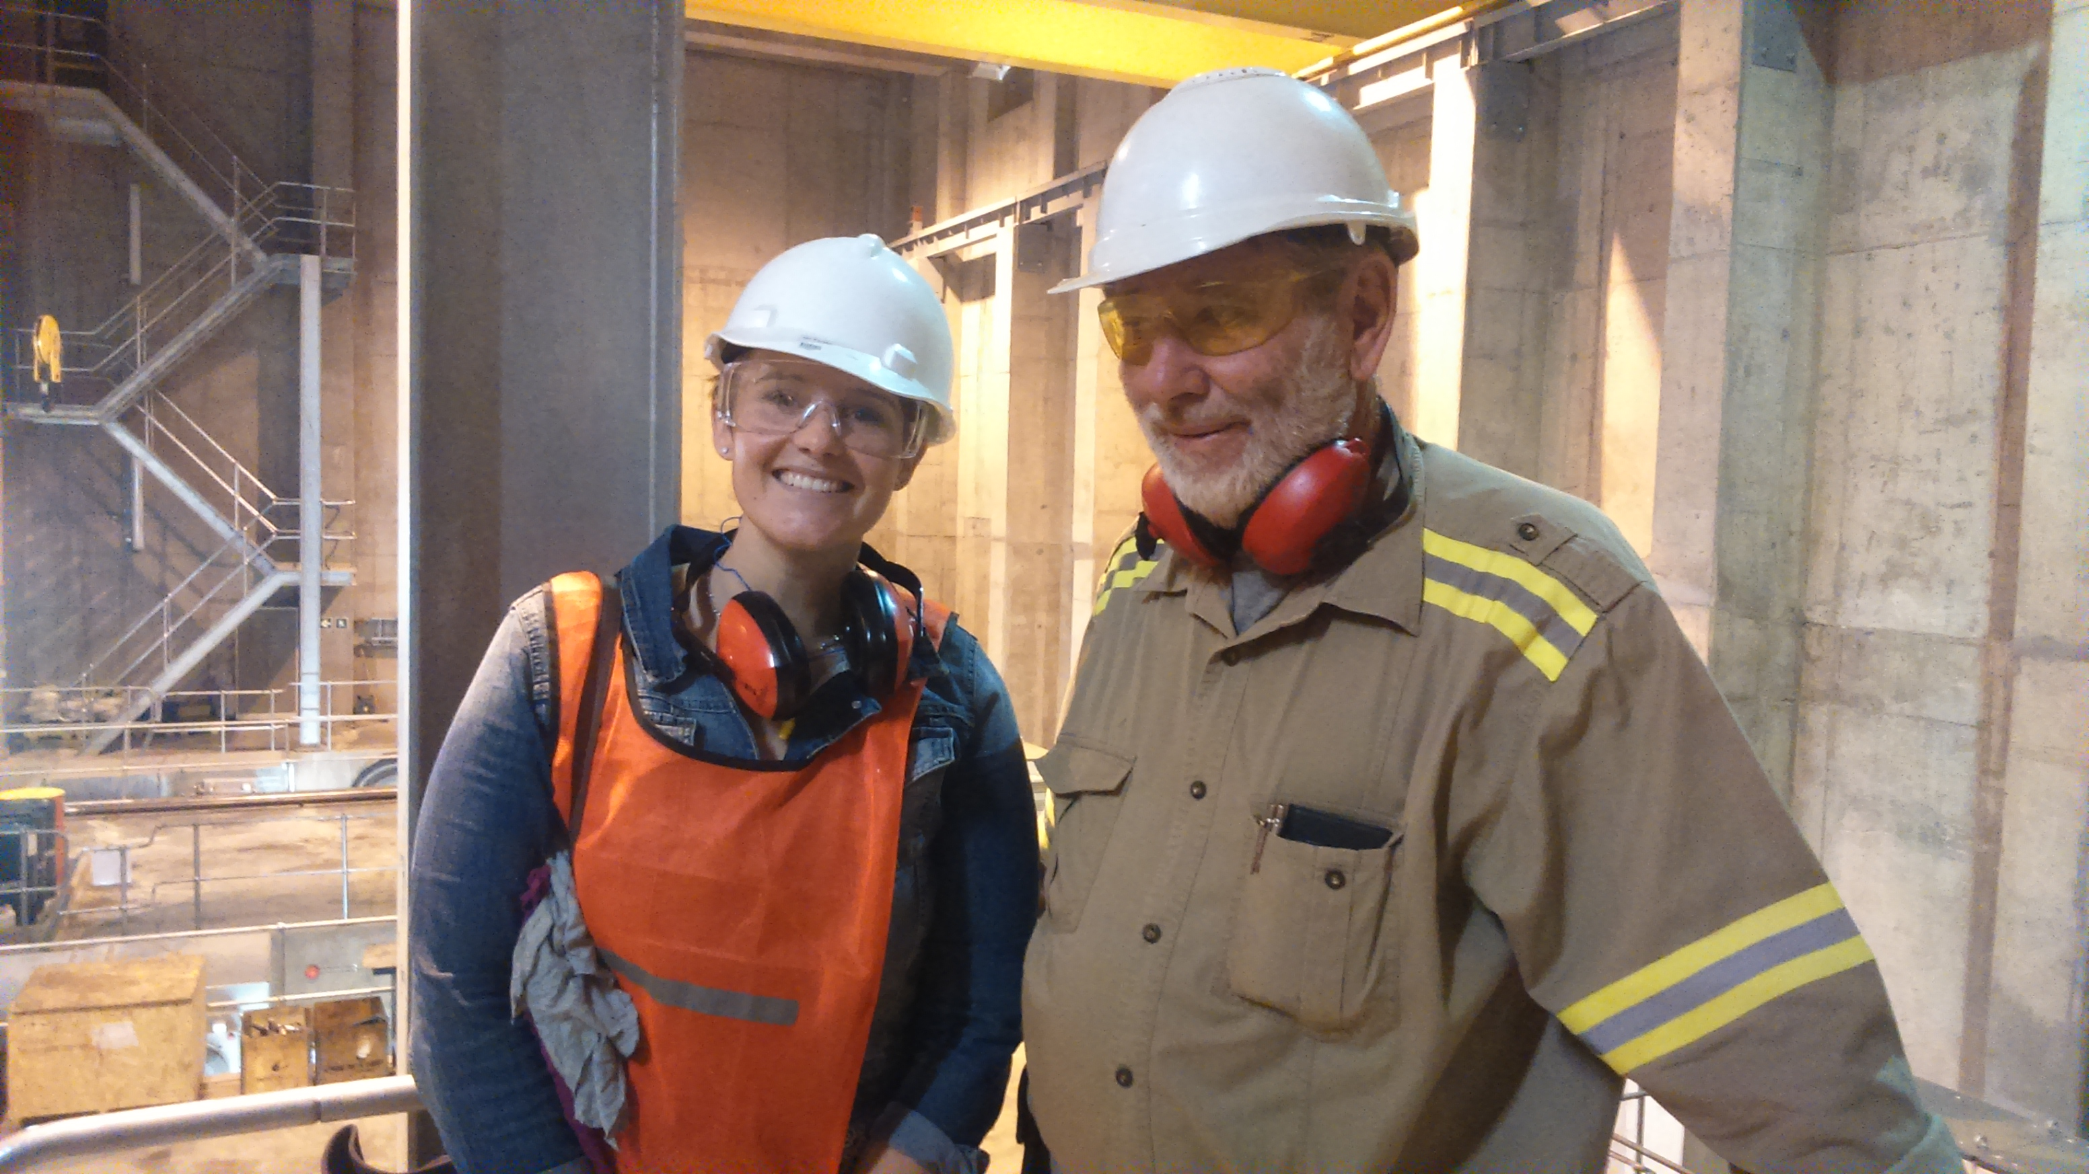
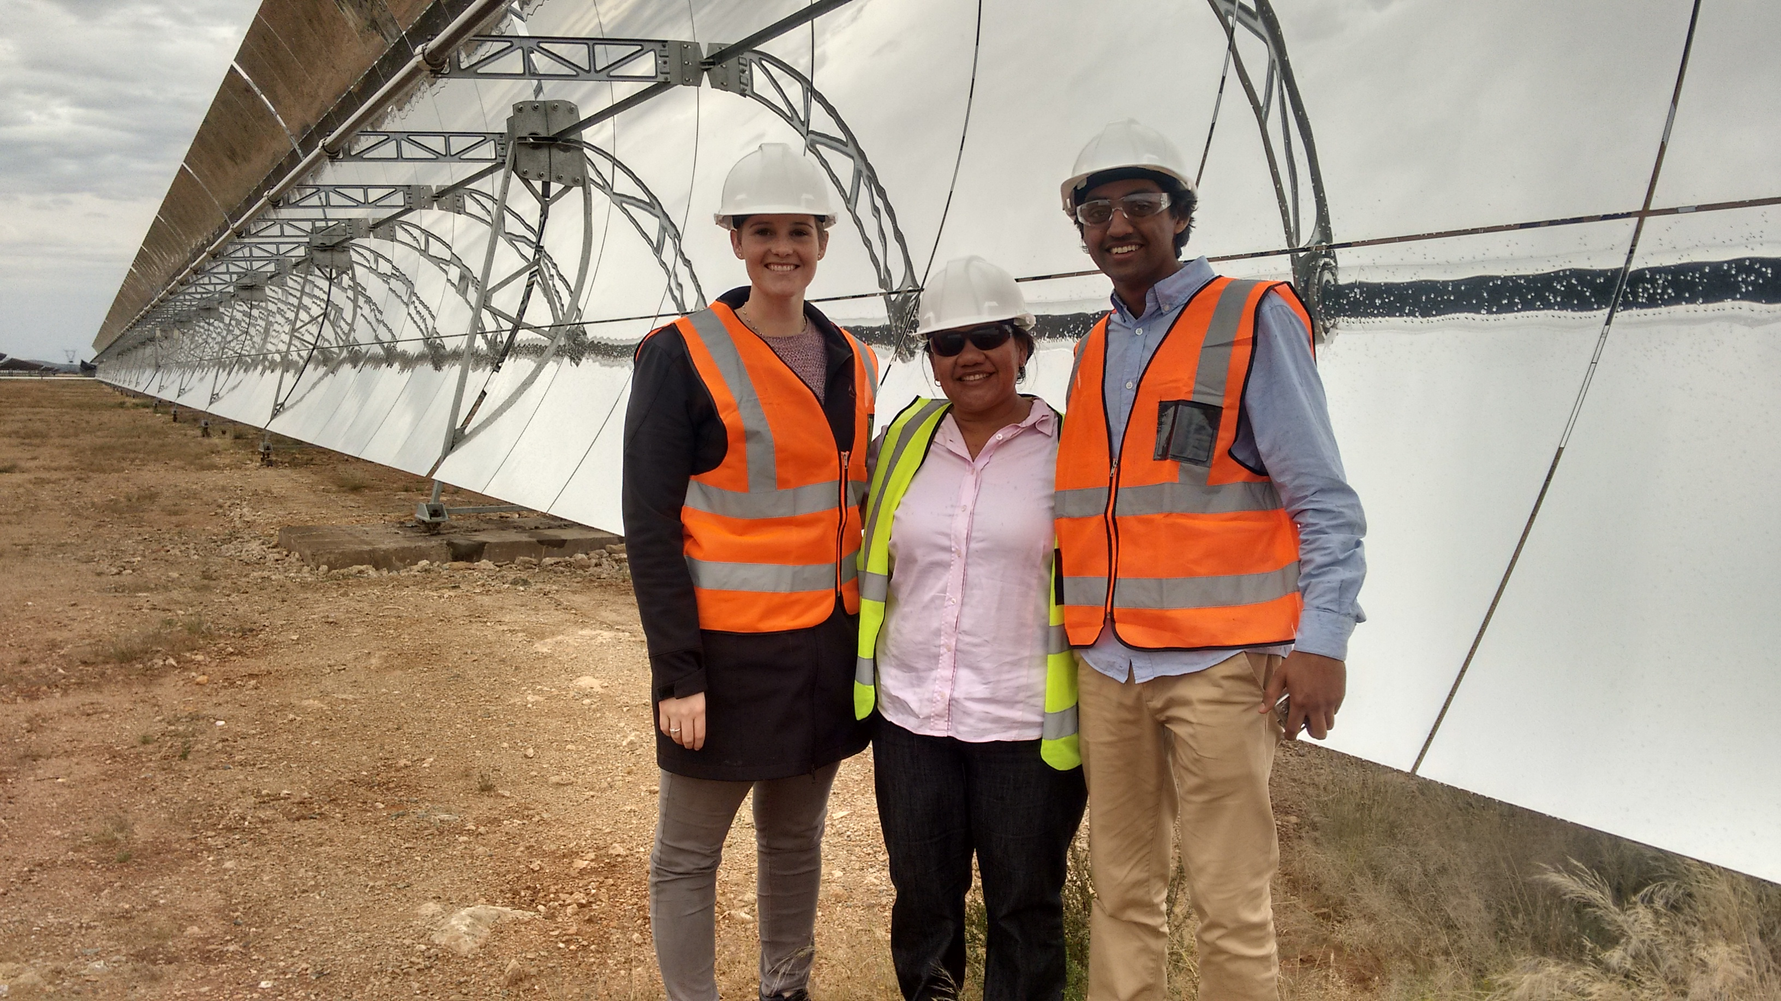
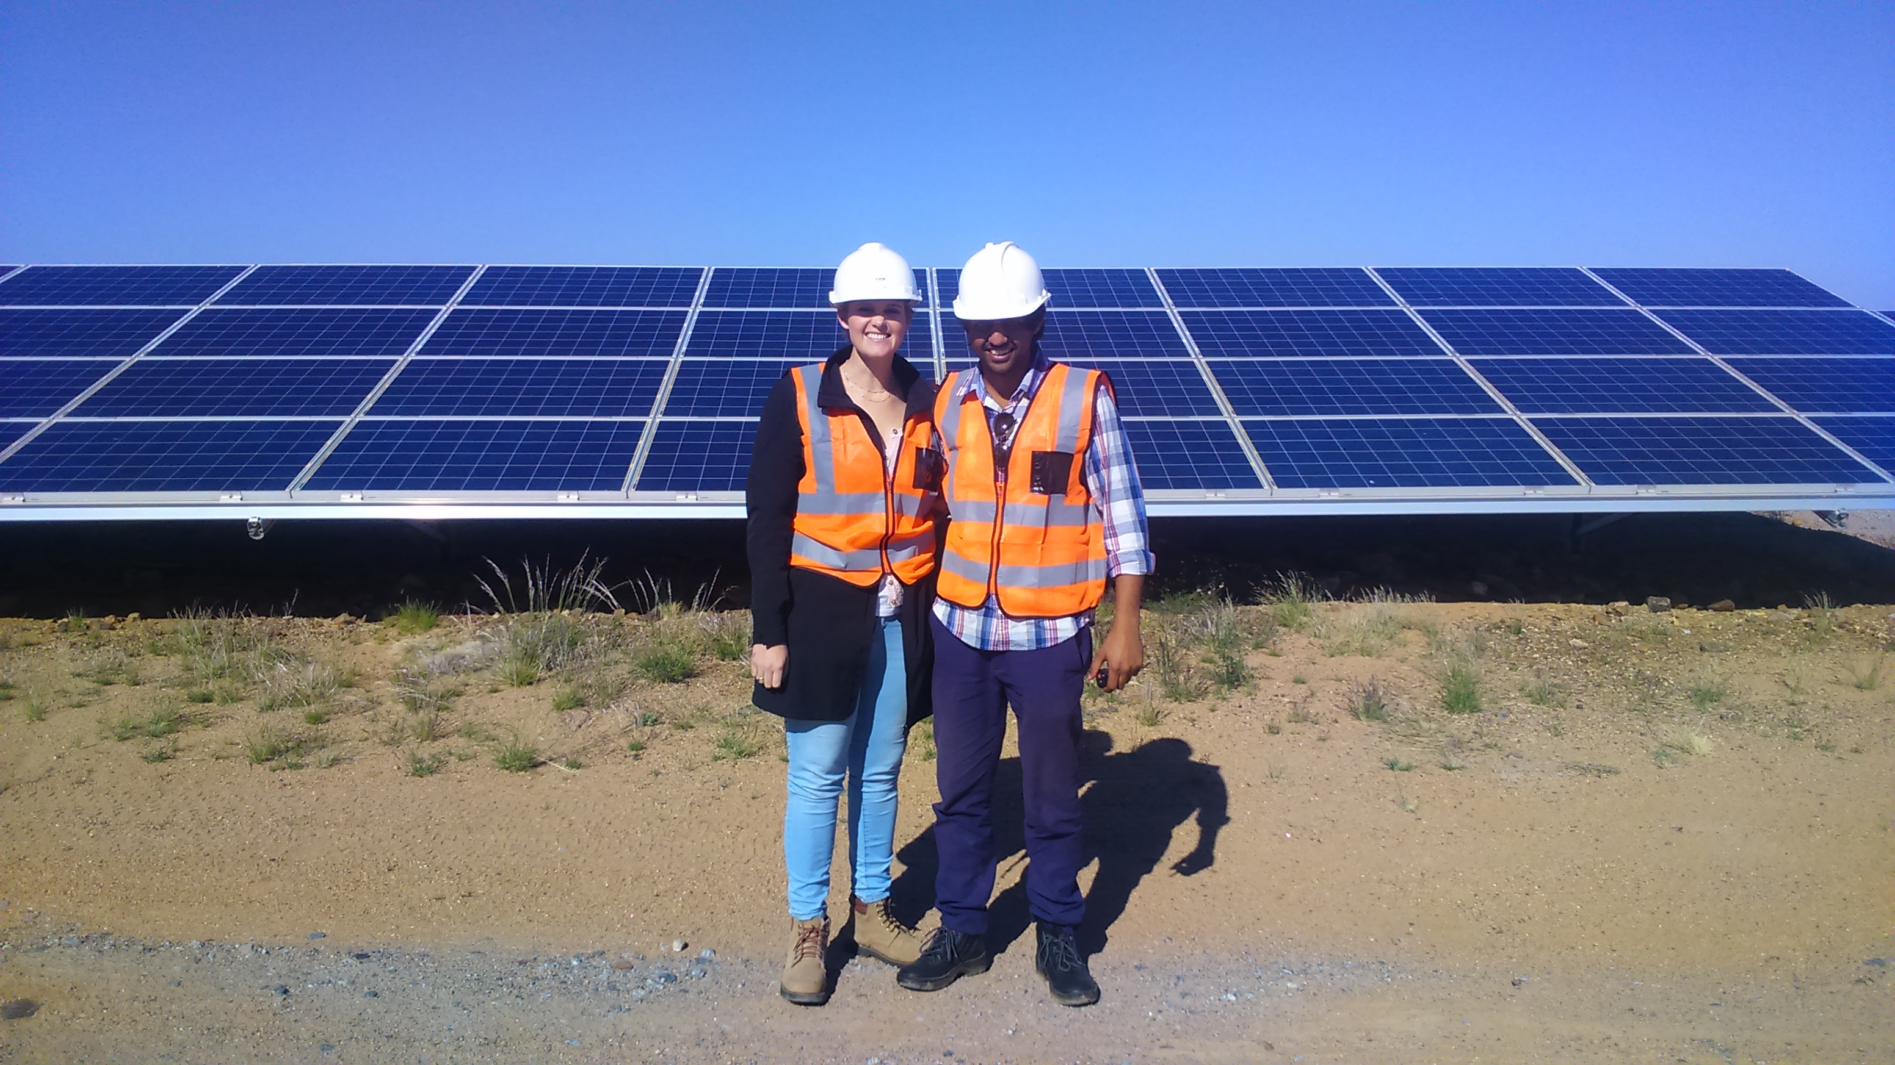
“Development in the shadow of mega-projects” – CSP, hydro, solar PV plants

Slide 15
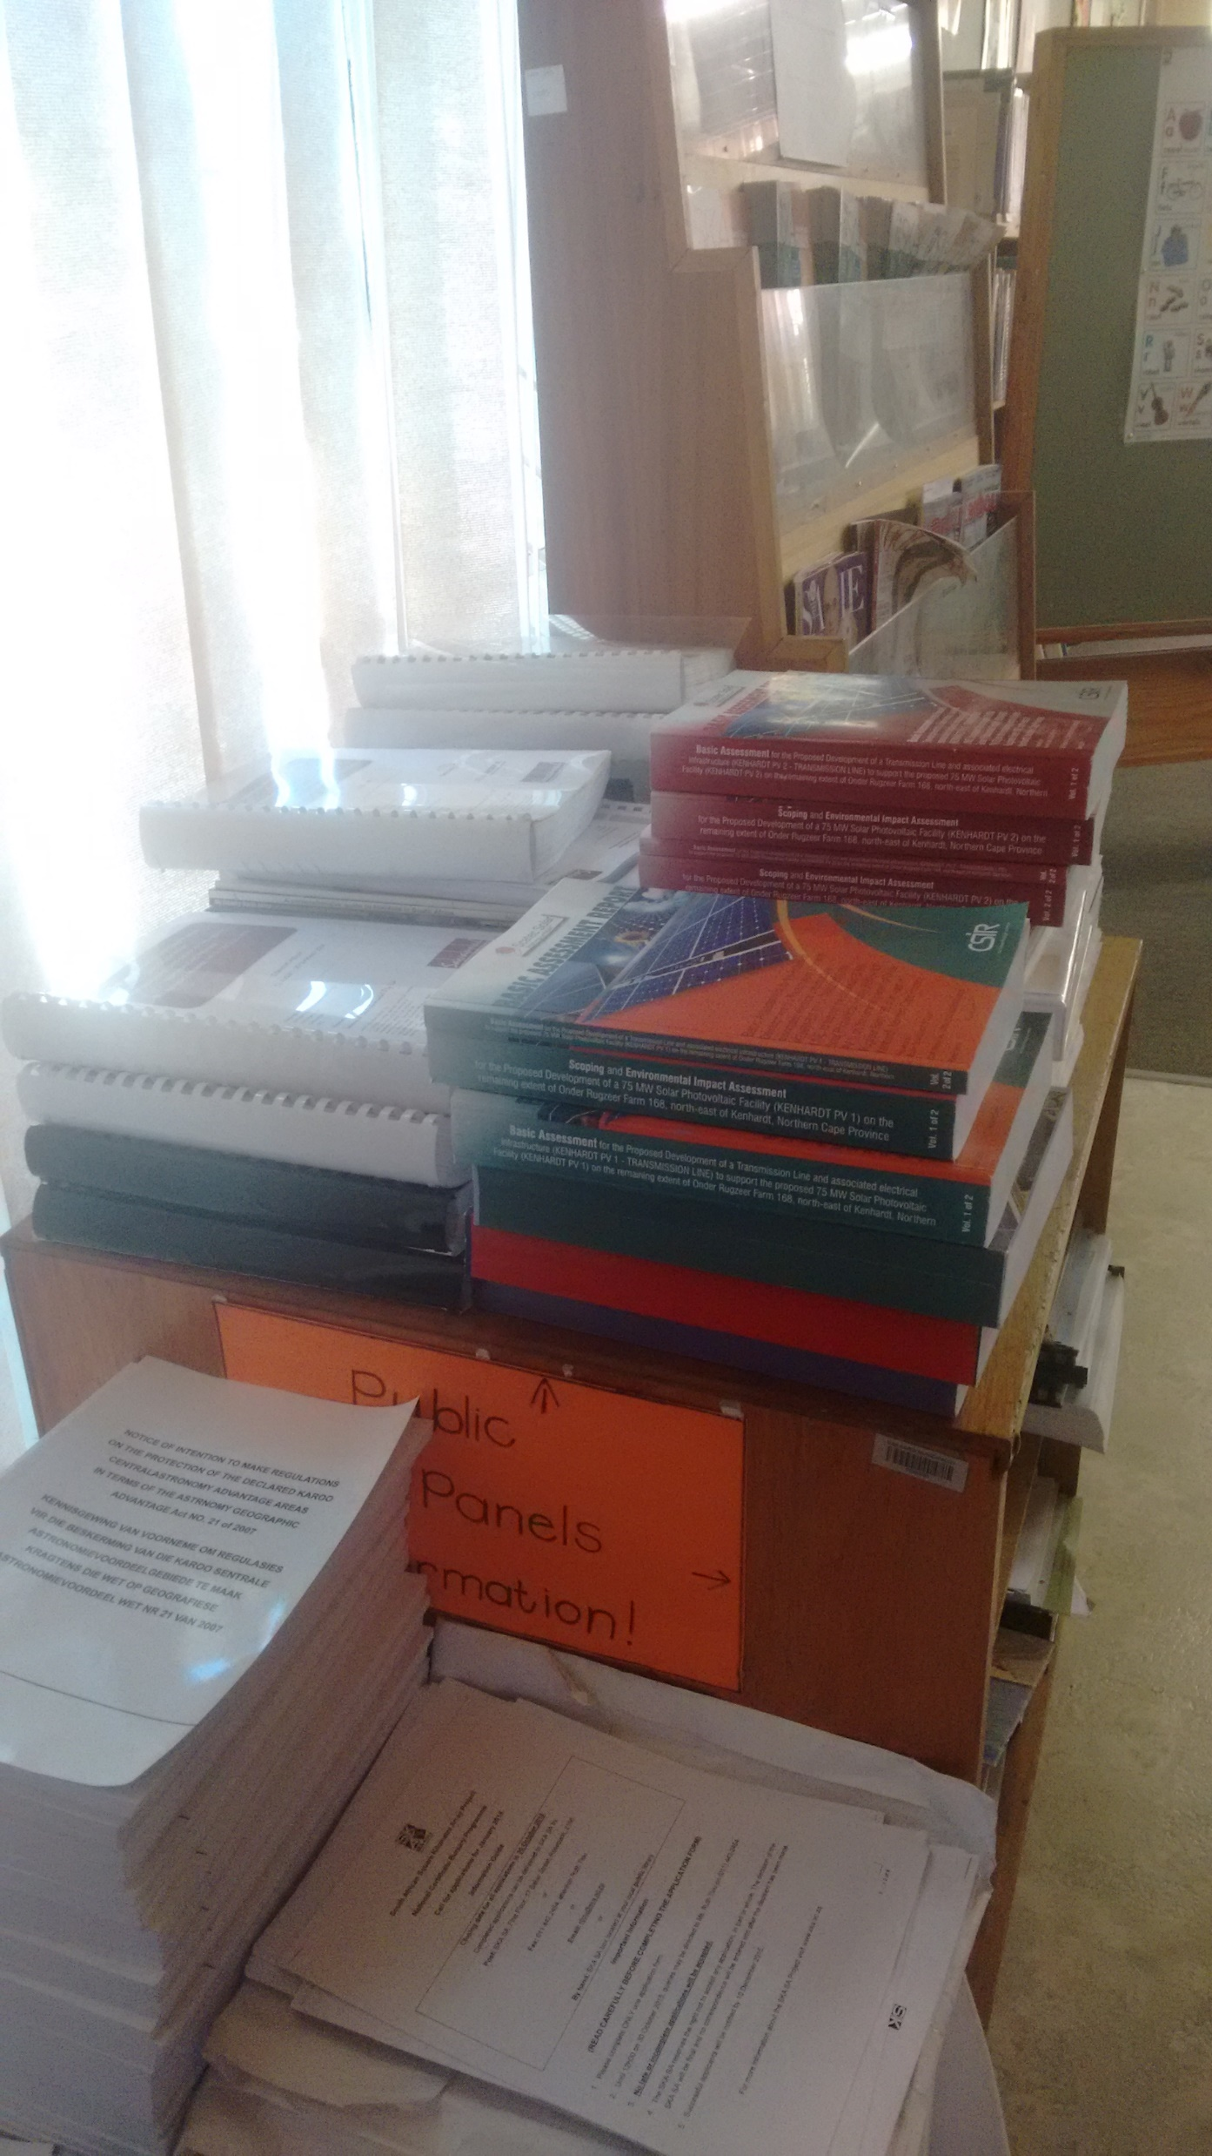
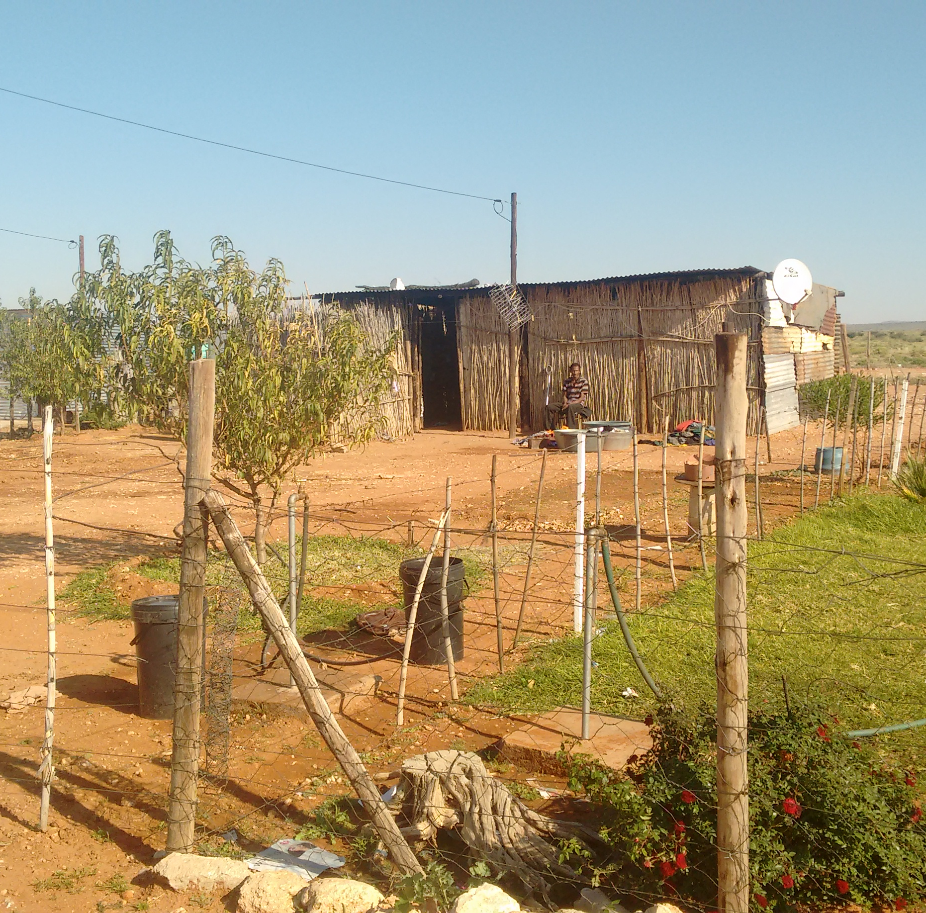
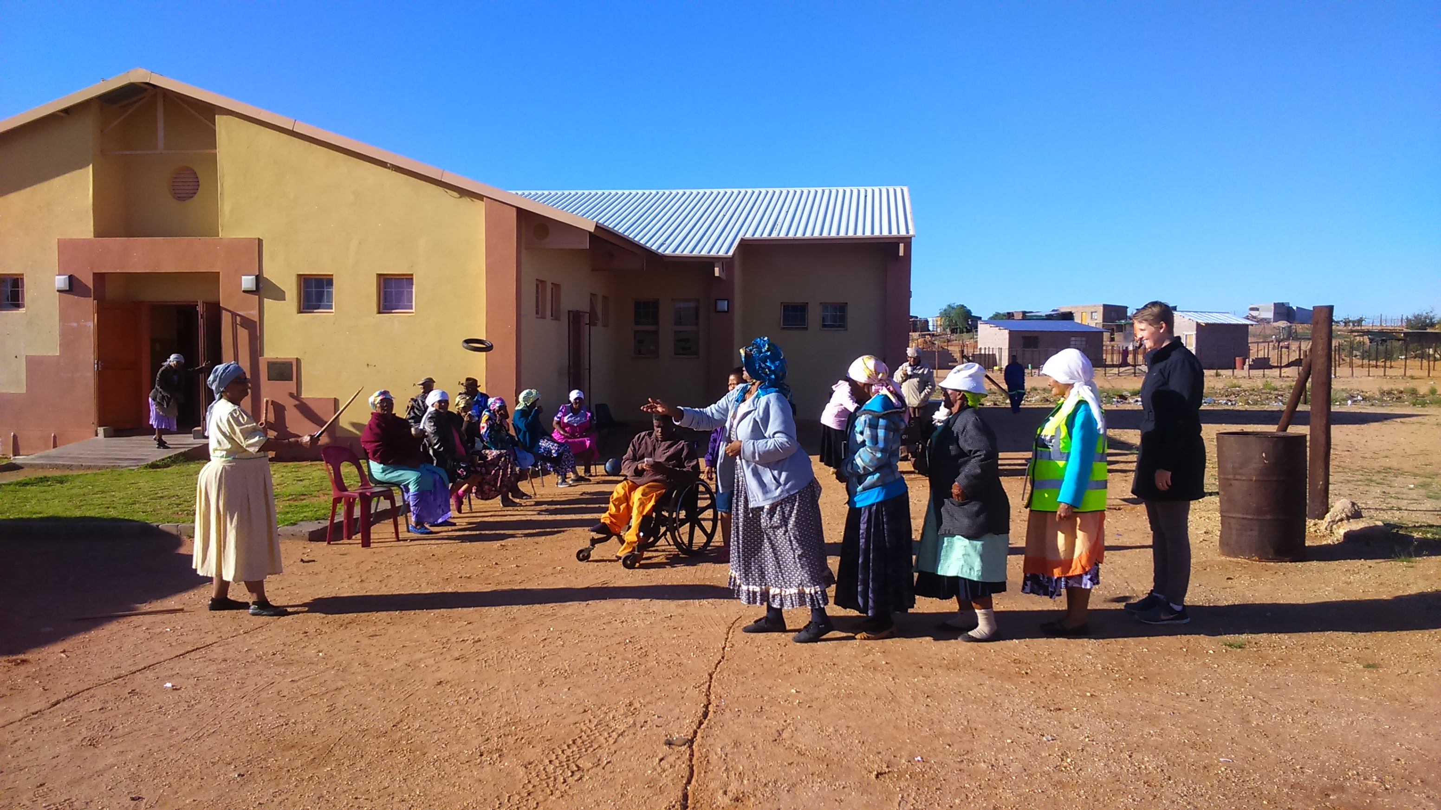
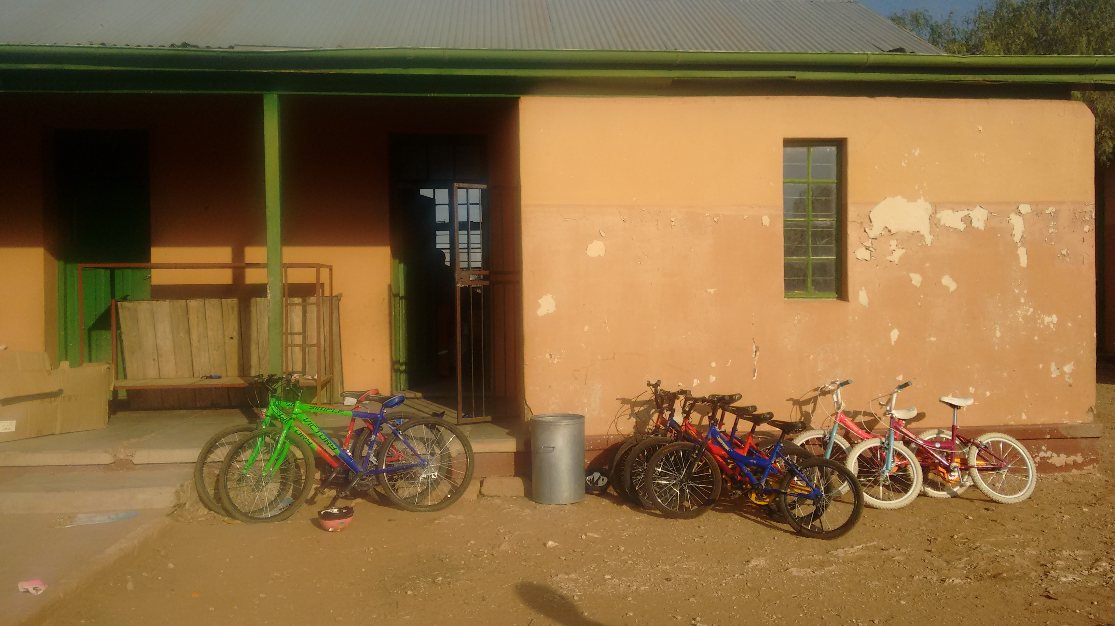
Exposure to IPP community engagement, SED and ED activities

Slide 16
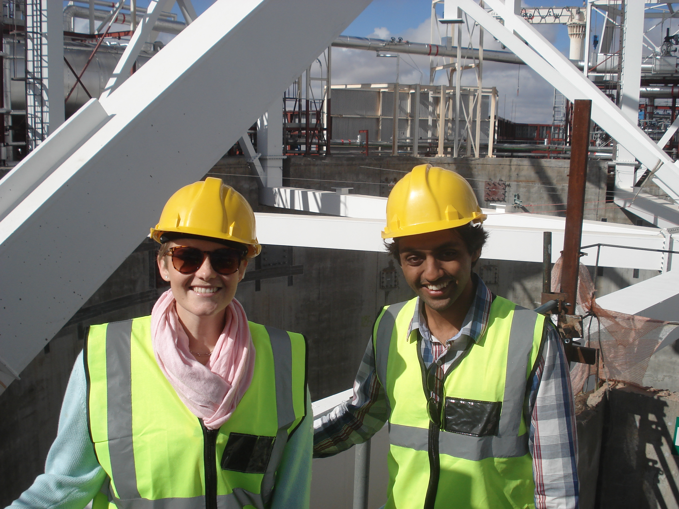
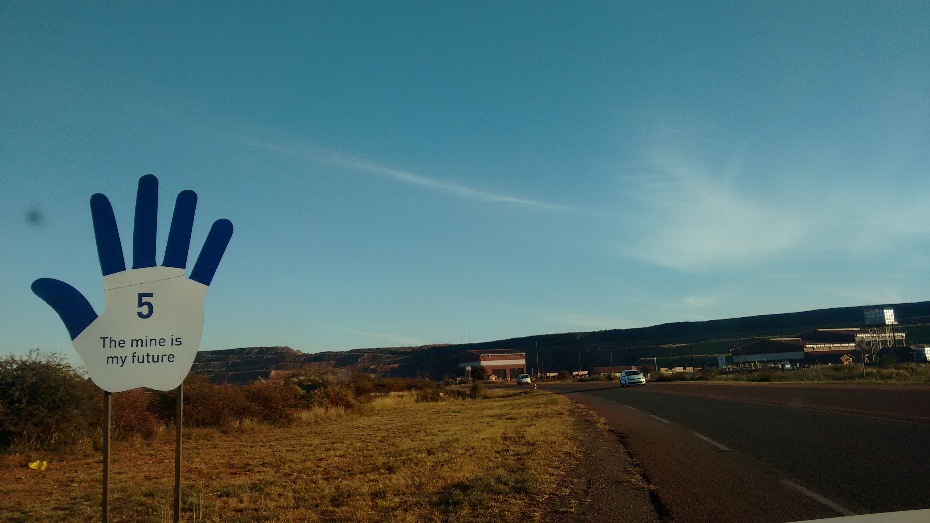
The politics of energy transitions

Slide 17
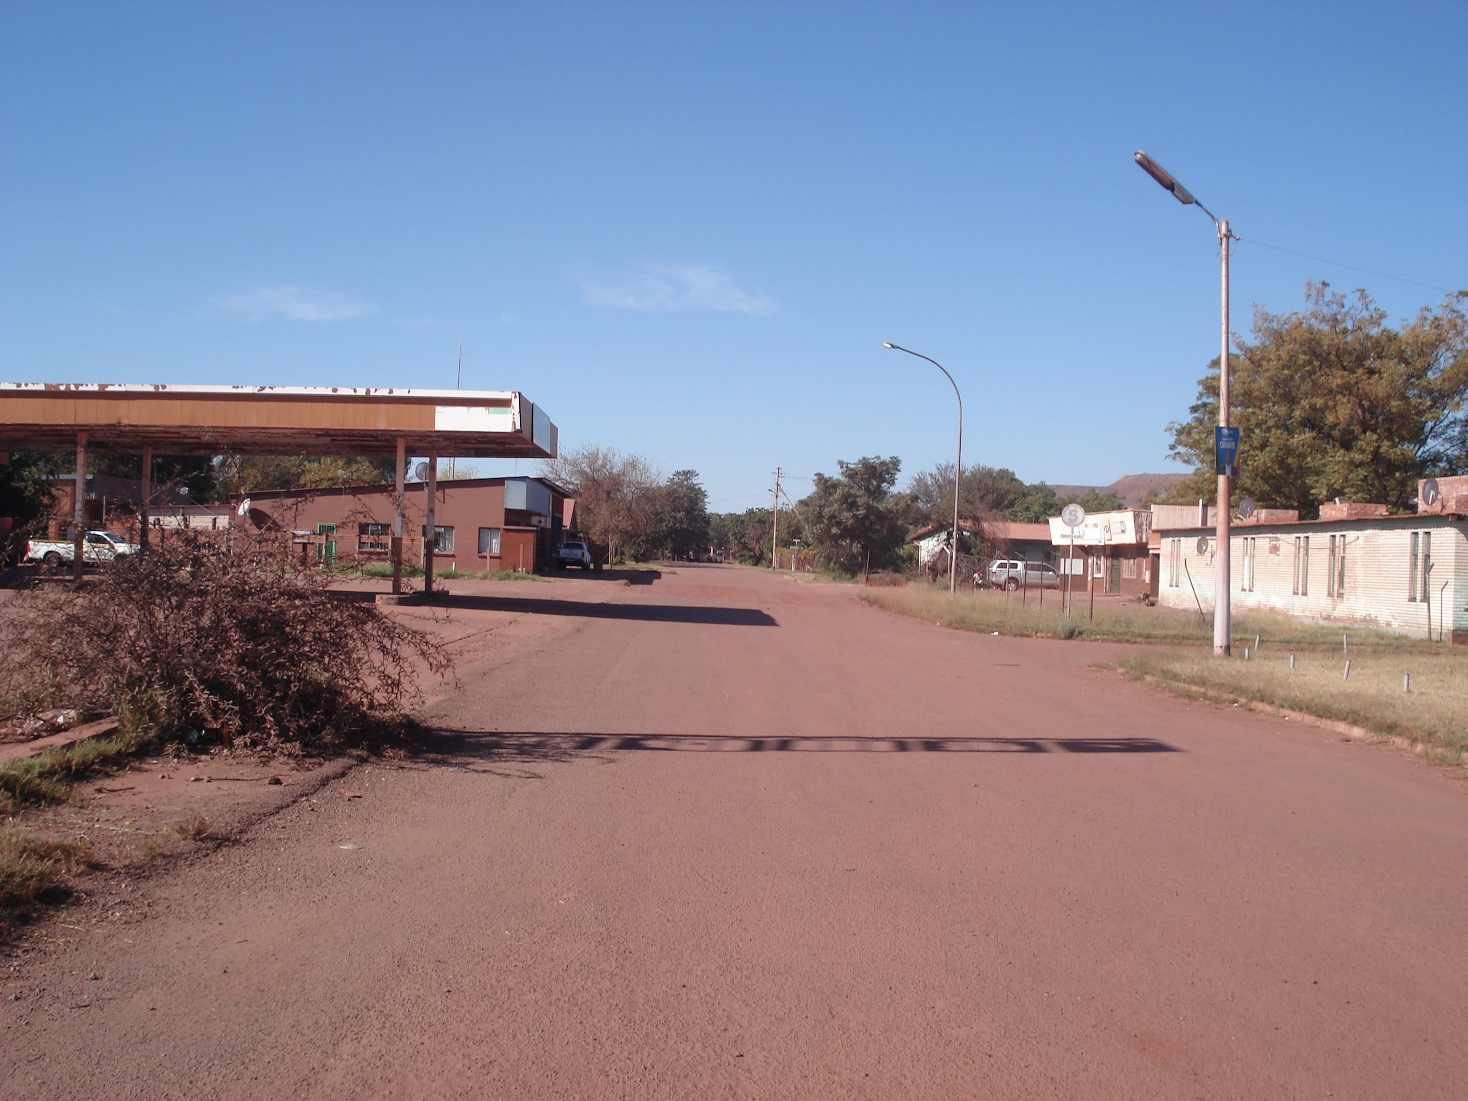
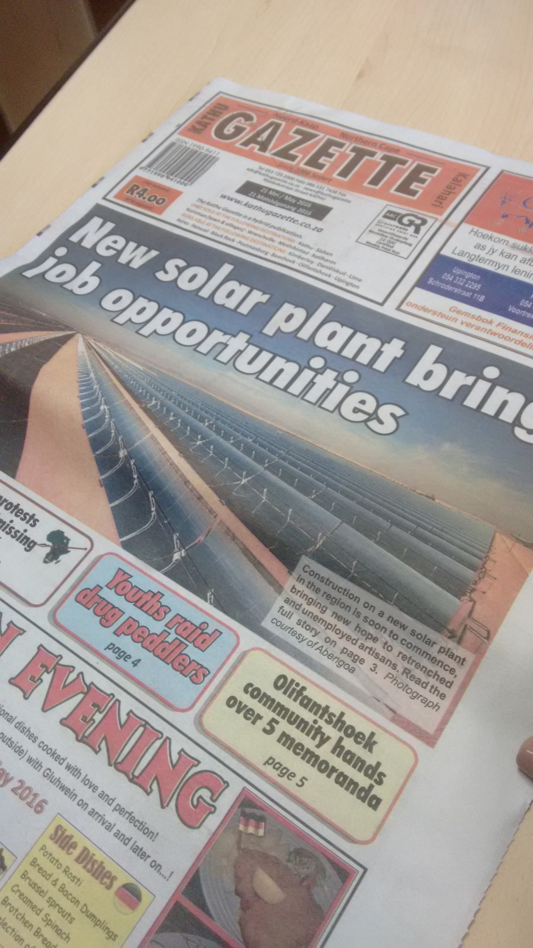
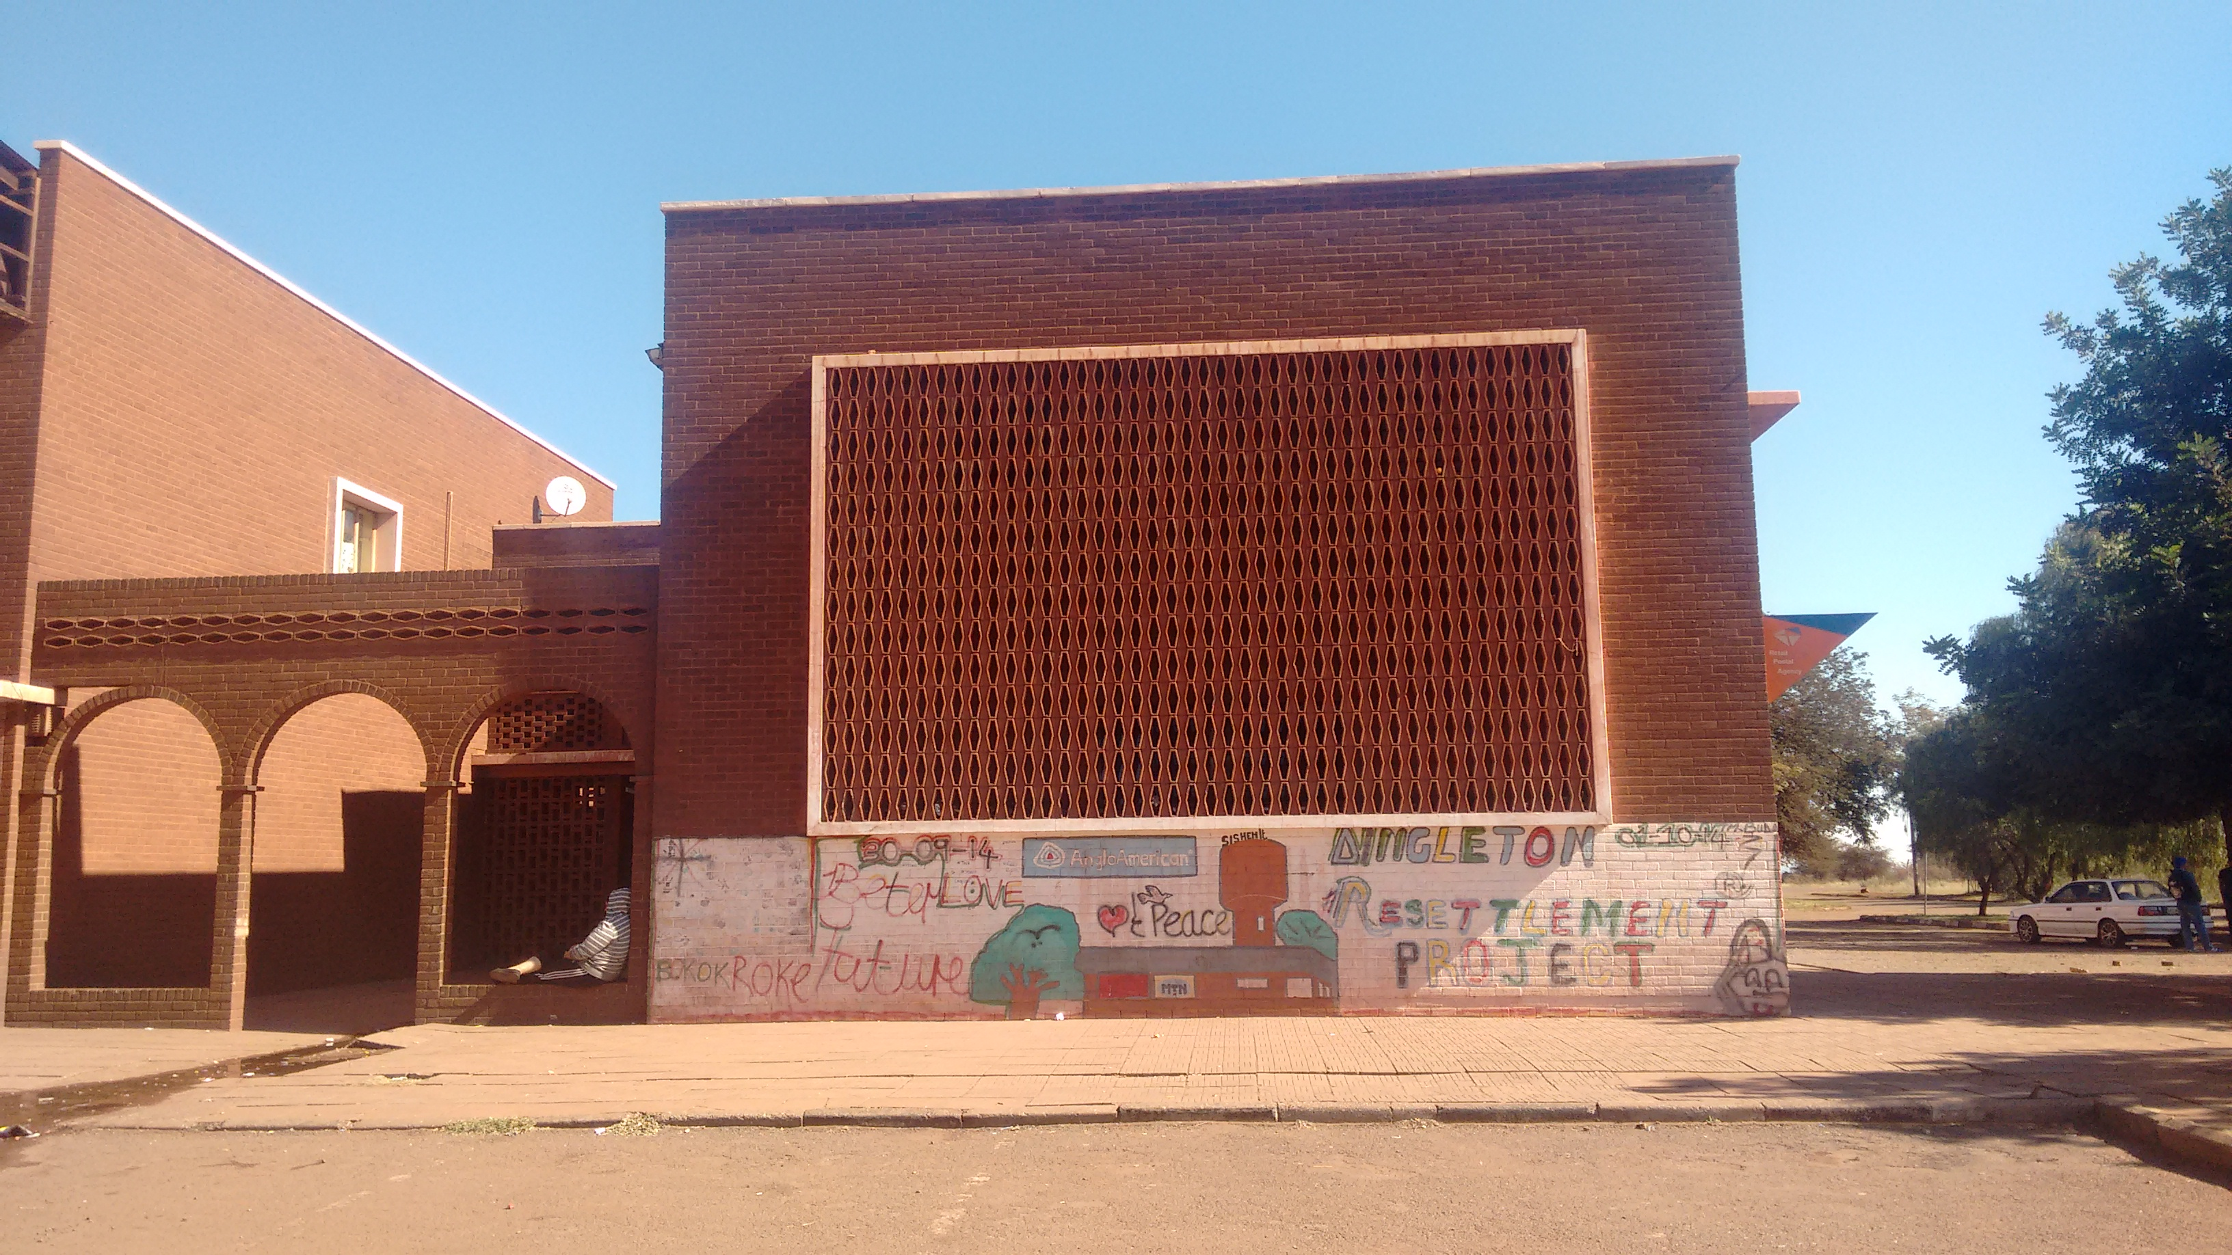
The politics of energy transitions

Slide 18
Emerging problem context
Procurement and implementation
Reporting, M&E
Governance and coordination
Notes:
50 km radius
Development is not the mandate or the job of energy companies
Multiplication of IPPs in particular areas
Late interface with the municipalities through EIA/zoning applications
‘spending drives development, not development driving spend’
Quarterly reporting
No clear focus on impact
Lack of capacity in the IPP Unit to evaluate
Industry forums – SAWEA / SAPVIA Community Working Group
Development Coordinating Forums in the Northern Cape
IPP forums in the Eastern Cape – Big Five and Coastal Six

Slide 19
Opportunities for experimental governance
Infrastructure and service delivery
Jobs and sustainability livelihoods
Needs of the municipality and demands of local residents
Necessity for socioeconomic opportunities and transformation
“Welfarist” SED / ED expenditure targets
Regulated role of private sector in development as social upliftment

Slide 20
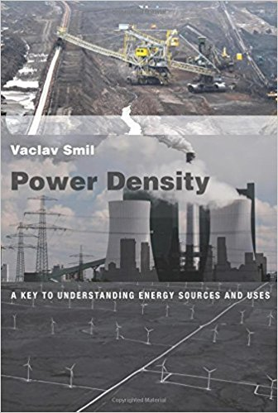

Slide 21
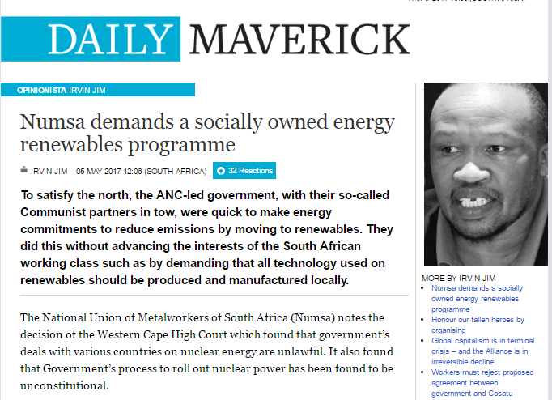

Slide 22
Reflections
Successfully created a market for renewable energy, too soon to say whether this has cultivated a renewable energy industry in South Africa – prospects for industrialisation, transformation (MJ’s reference on enabling productive outcomes)
Changing role of business / private sector in development
Further consideration of ‘evolving role finance’ (Baker 2015); reconfiguring local and regional economies (international finance, ownership, MJ)
What are the opportunities for RE infrastructure for community democracy?
Implications for RE in Southern Africa – lessons from the “lighthouse example of how RE can be deployed”
Need for ‘urban transformative capacity’ if RE prevails (vs nuclear) – strong local democratic and civil society institutions
Brenda Martin, SAWEA CEO: “The industry must act in the spirit of the constitution”

