Slide 1
“The unconventional monetary policy of the ECB: effectiveness versus exhaustion”
António Mendonça
Professor of Economics
ISEG-Lisbon School of Economics & Management
Universidade de Lisboa
CESA-Centre for African, Asian and Latin American Studies

Slide 2
In this paper, we discuss:
The issue of the effectiveness versus the exhaustion of monetary policy followed by the ECB in response to the Eurozone effects of global economic and financial crisis;
The nature and justifications for the use of unconventional policy measures in the context of the crisis developments. We concentrate on two central issues to understand the limits of monetary policy effectiveness, the so-called liquidity trap and the endogeneity versus exogeneity issue of money creation;

Slide 3
Additionally, we discuss:
The contradictions between the fiscal and monetary policies stances as a booster factor in exhausting the effect of the monetary policy;
We conclude,
By affirming the absolute need to reform the Euro system.

Slide 4
The so-called unconventional monetary policy:
four phases of development.
First phase: direct liquidity injection in the market (September 2008 - June 2014).
The ECB begins the approaching of the traditional intervention of the Central Banks, as lenders of last resort;
The Bundesbank opposes;
The main argument for this “unconventional monetary policy” is the idea that the conventional monetary policy transmission mechanism ceased to function properly, as a result of the dysfunctions produced in the financial markets
This malfunction justified the adoption of exceptional measures, designated "unconventional", creating a sort of "bypass" between monetary policy and the level of prices, avoiding the constraints of normal financing channels

Slide 5
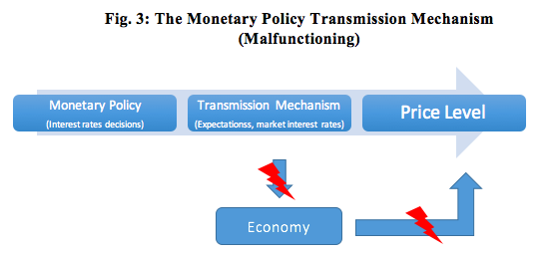
The monetary policy transmission mechanism is the process through which monetary policy decisions are transmitted to the economy and, ultimately, to the prices level, the main target of the ECB's intervention

Slide 6
A second justification for the introduction of unconventional monetary policy is the so-called "separation principle”;
Unconventional measures are complementary to the former in having clearly defined and temporally limited objectives;
Non-standard measures are distinct from the "quantitative easing" that is used by the Fed or the BoE, because they are not intended as a substitute for conventional interest rate policy in the context of "zero lower bound" ;
They work thus as a support mechanism to the conventional policy in a period of exception when disruptions in the normal financing channels of the financial system and of the economy manifest.
They should be used as long as the malfunctioning of the monetary policy transmission mechanism is evident and withdrawn as soon as this feature is recovered;

Slide 7
Seconde phase: approaching the role of “lender of last resort” (June 2014 – March 2016)
In June and September 2014 more unconventional measures were introduced, considered of a new class: two programs of assets purchased from the private sector:
an Asset Backed Securities Purchase Program (ABSPP) and a third Covered Bond Purchase Program (CBPP3), adopted in order to allow selective intervention in the markets with decisive influence on the financing of the non-financial sector;
and a new series of Targeted Long-term Refinancing Operations (TLTROs), up to 4 years, to improve bank lending to the non-financial private sector in the euro area.
The ECB clearly stated the willingness to actively expand the size of its balance sheet up to the levels needed to ease the monetary policy stance, in a situation where interest rates reached their lowest level.

Slide 8
The ECB no longer relies on the ability of the banking system to use well the liquidity facilities that are provided, by injecting itself more money into the economy through lending operations, creating direct channels of monetary transmission.
It meant, in fact, a new attitude of the ECB involving a closer approach more of a "quantitative easing" stance, followed by the Fed and other central banks, in line with the role of "lender of last resort". A formally rejected stance, or at least not assumed up to here.

Slide 9
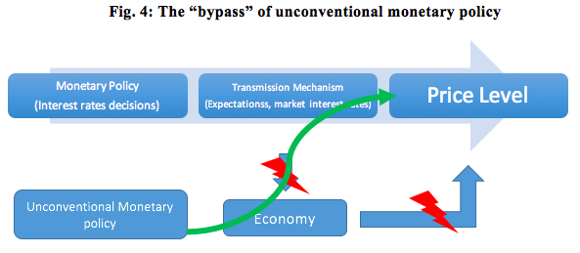

Slide 10
Third phase: the liquidity trap (March 2016 - ….).
A third phase of unconventional monetary policy was opened following the decisions of the Governing Council meeting of March 10, 2016.
The "zero lower bound" is fully reached with the setting of the interest rate on the main refinancing operations at 0%.
However, the most significant fact is the acceptance of the possibility of financing the economy at rates as low as the rate applicable to the permanent facility deposit existing at the operation start date – that is, at negative rates. (TLTRO II)

Slide 11
That is, unconventional monetary is entering a progressive exhaustion process in its ability to influence the economy in the desired direction, as a drug addict who requires increasingly stronger doses to address the symptoms of a disease, as the body will be used to the substance and the disease does not stop spreading.
This is an image that can be applied to the so-called liquidity trap, a situation where, according to many opinions, the global economy, and European economy in particular, find themselves in.

Slide 12
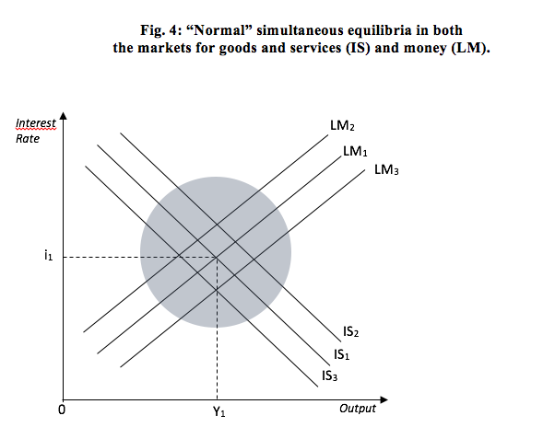

Slide 13
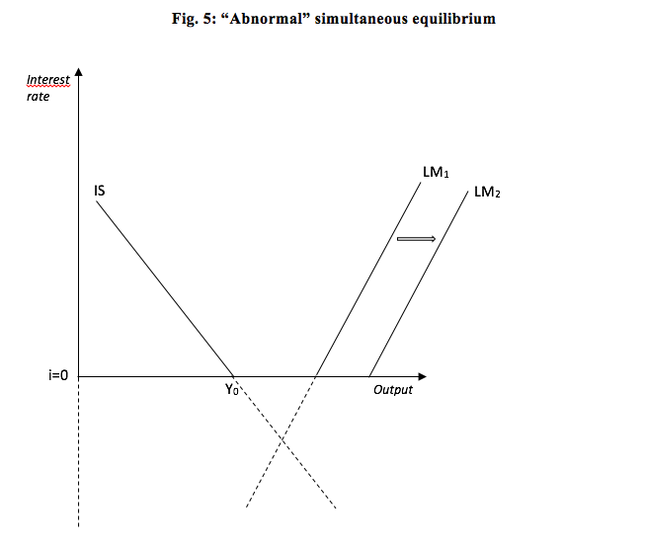
The liquidity trap
Hip: Contractionary fiscal policy
(IS curve shifts to the left)

Slide 14
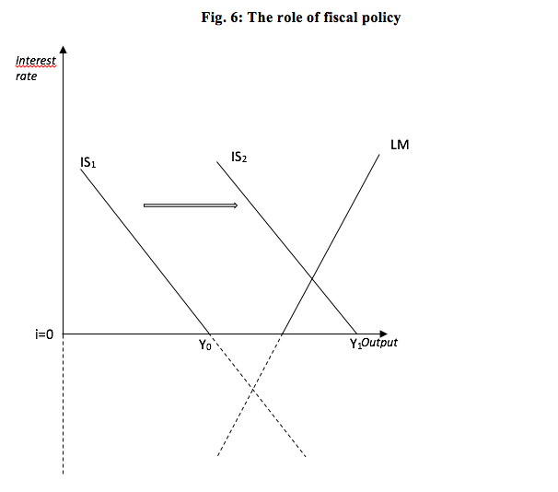

Slide 15
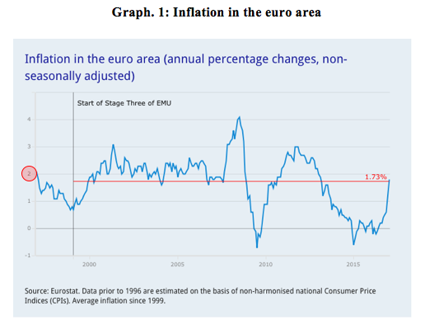

Slide 16
The endogeneity of money creation

Slide 17
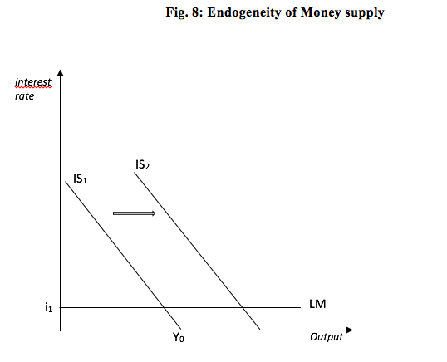

Slide 18
Final remarks:
There is little left over to use regarding the "tool box" available by the ECB;
We need a large degree of interpretation ”elasticity” to use what is left;
There is a great degree of schizophrenia regarding the use of both the monetary policy and the fiscal policy;
Notwithstanding, the ECB tries to build a theoretical and empirical justification for the need to promote public investment (See, among others, the Vice-president, Vítor Constâncio;
This need is also recognized by the IMF (Christine Lagarde, Olivier Blanchard and others);

Slide 19
The OECD seems going in a similar direction when emphasising, in its Interim Economic Outlook, of February 16, 2016, following the recognition of the weak economic growth, that “A strong collective policy response is urgent. Global macroeconomic policy, comprising monetary, fiscal and structural actions, must become more supportive of demand and resource allocation. Experience to date suggests that reliance on monetary policy alone has been insufficient to deliver satisfactory growth, so that greater use of fiscal and structural levers is required”.
what is at stake in how Europe and the Eurozone in particular have reacted to the crisis, is the euro system itself;
Within this perspective, ideas that point to a solution of a "more Europe" kind to address the problems do not seem realistic;

Slide 20
Main conclusion
“A general review of the euro system is therefore, justified in order to adjust it to the current dynamics of the different European economies and to their joint participation in the global economy. Furthermore, the immediate recovery of all rights of citizenship for fiscal policy is also justified in order to curb the monetary policy exhaustion process and enable it to bring back the economy to a sustained area reversing the stagnation tendencies that affect it.”

