Slide 1
Introduction To Conceptual Systems
Garry Jacobs
CEO, World Academy of Art & Science
Chairman of the Board & CEO, World University Consortium
Vice-President, The Mother's Service Society

Slide 2
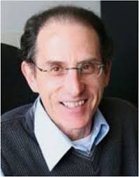
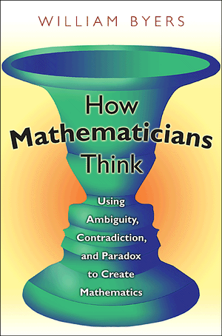
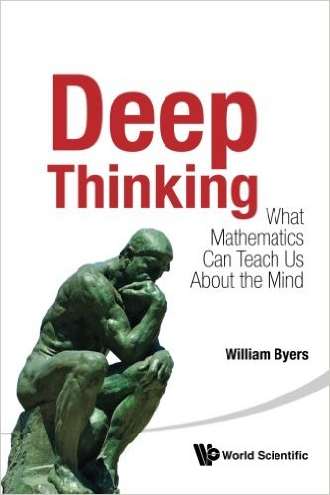
Conceptual Systems - William Byers - Deep Thinking

Slide 3
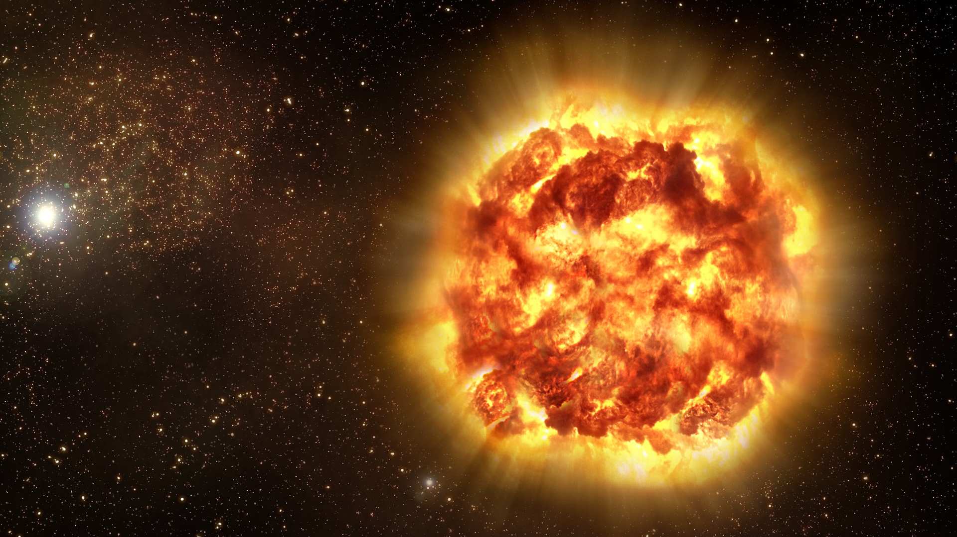
Mind creates stable CSs to represent reality
The Big Bang

Slide 4
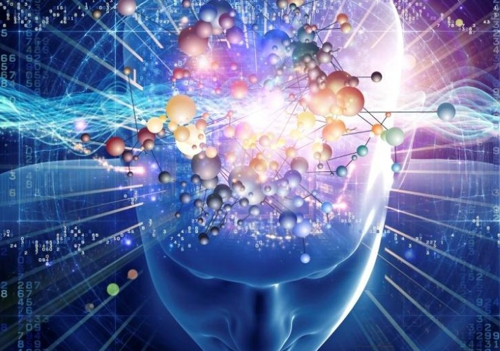
CS system is an integrated family of concepts that create a unified universe of meaning and experience

Slide 5
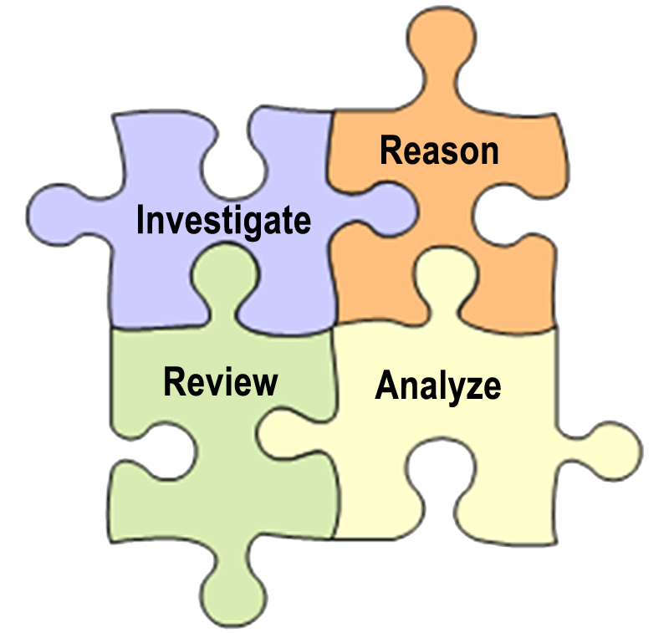
Reasoning with a CS is rule based, logical & systematic

Slide 6
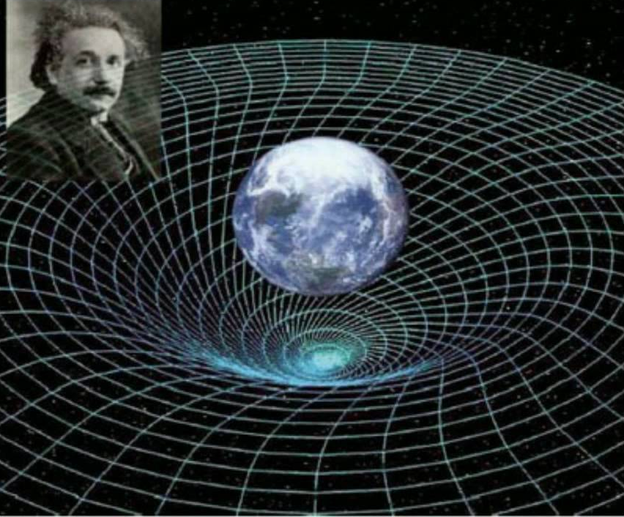
All CSs are incomplete. They contain questions they are unable to answer within the system

Slide 7
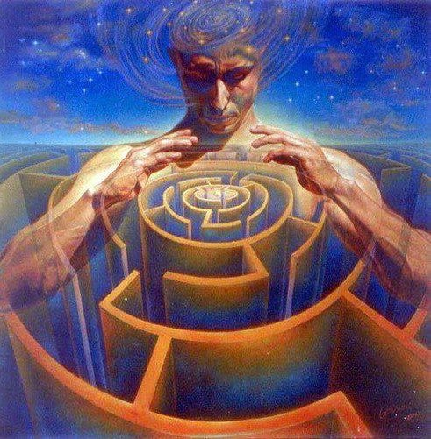
We experience it through the window of a conceptual system which defines what is real to us

Slide 8
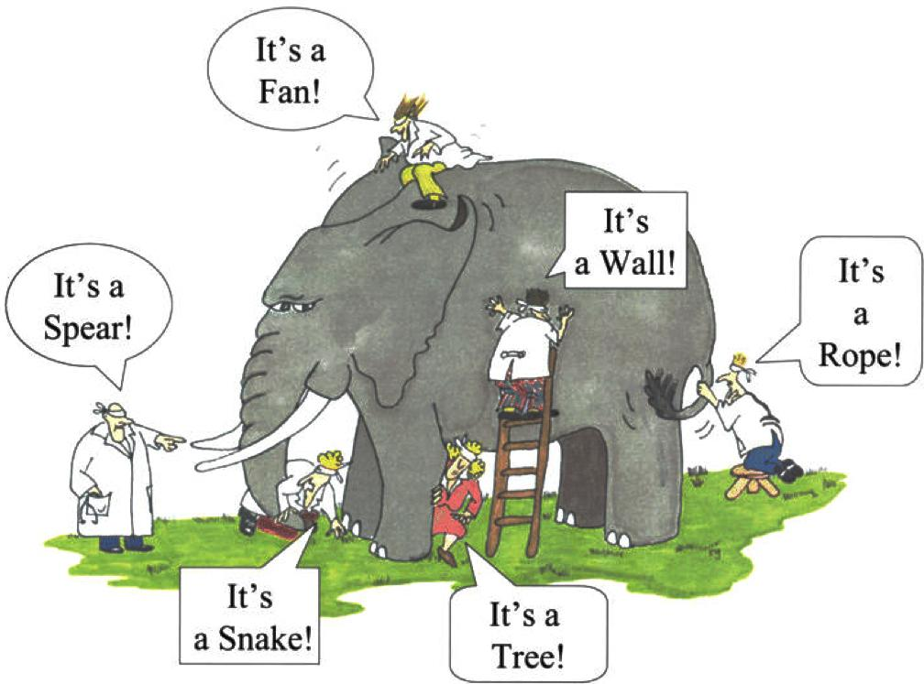
Any CS is founded on conscious and subconscious values, premises, perspectives

Slide 9
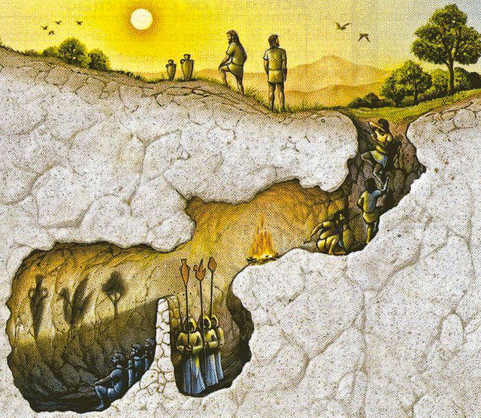
When these elements are mistaken for truth, mind mistakes the CS for reality itself
Plato’s analogy of the cave

Slide 10
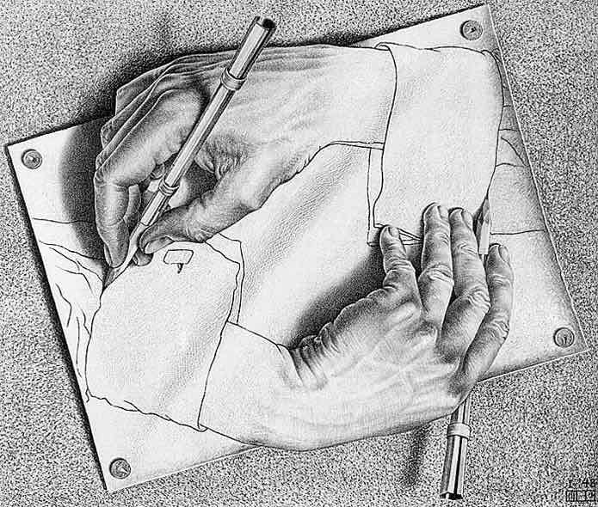
CS are self-referential

Slide 11
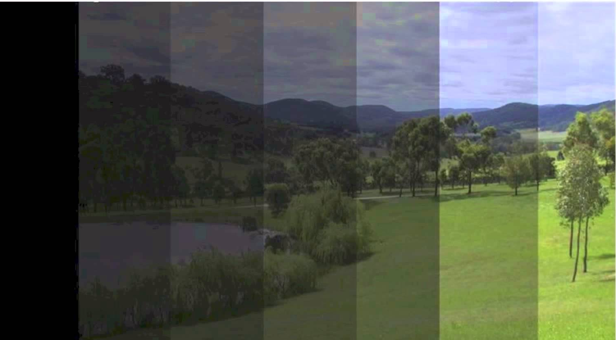
The truth or validity of any statement depends on the CS within which it is viewed

