Slide 1



School of Industrial and Information Engineering
Campus Leonardo
Department of Electronics, Information and
Bioengineering
Post-Graduate Certificate Course at Inter-University Centre, Dubrovnik, Croatia
Mind, Thinking & Creativity
April 12-15, 2016
Creativity and
Scientific Discovery
Rodolfo A. Fiorini, DEIB-Politecnico di Milano, Italy
Rodolfo A. Fiorini, http://www.linkedin.com/pub/rodolfo-a-fiorini-ph-d/45/277/498

Slide 2
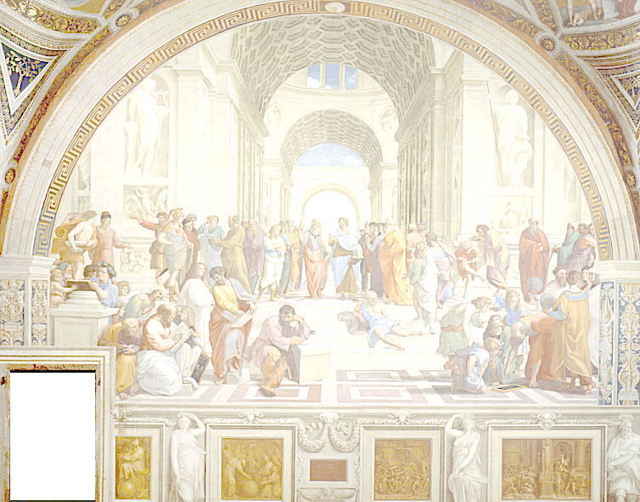
Creativity and Scientific Discovery
« Le seul véritable voyage
ce ne serait pas
d'aller vers de nouveaux paysages,
mais d'avoir d'autres yeux… »
Valentin Louis Georges Eugène Marcel Proust (1871-1922)
from La Prisonnière (1923).
Rodolfo A. Fiorini, http://www.linkedin.com/pub/rodolfo-a-fiorini-ph-d/45/277/498

Slide 3
Creativity and Scientific Discovery
« Observer
c’est pour la plus grande part, imaginer ce que l’on s’attend à voir. »
Ambroise-Paul-Toussaint-Jules Valéry (1871-1945)
from "Degas, Danse, Dessin",
in Oeuvres de Paul Valéry (Librairie Gallimard, 1960), II, p. 1169.
Rodolfo A. Fiorini, http://www.linkedin.com/pub/rodolfo-a-fiorini-ph-d/45/277/498

Slide 4

Presentation Outline
1. Introduction (15)
Scientific Method & Discovery
Paradigmatic Confusion
2. Creativity & Social Acceptance (17)
Eulogic Thought
Individual – Community Cultural Resonance
3. Guided Creativity (17)
Awareness and Creativity
EPM Educated Creativity
Rodolfo A. Fiorini, http://www.linkedin.com/pub/rodolfo-a-fiorini-ph-d/45/277/498

Slide 5
1. Introduction (00)
Paradigma Sistemico di Riferimento
1. Introduction (15)
Scientific Method & Discovery
Paradigmatic Confusion
Rodolfo A. Fiorini, http://www.linkedin.com/pub/rodolfo-a-fiorini-ph-d/45/277/498

Slide 6
1. Introduction (01)
Scientific Reference Paradigms
« Iron rusts from disuse; stagnant water loses its purity and in cold weather becomes frozen; even so does inaction sap the vigor of the mind. »
« The water you touch in a river is the last of that which has passed, and the first of that which is coming. Thus it is with time present. »
«There is no certainty in sciences where one of the mathematical sciences cannot be applied, or which are not in relation with these mathematics. »
Leonardo da Vinci (1452 – 1519)
Intellect from Emotion: "Intuitive Mind" and "Natural Inquiry Method" (to inquire Nature) are born.
Rodolfo A. Fiorini, http://www.linkedin.com/pub/rodolfo-a-fiorini-ph-d/45/277/498

Slide 7
1. Introduction (02)
Scientific Reference Paradigms
« Speak obscurely everyone knows how to do, but very few clear. »
Galileo Galilei (1564 – 1642).
« Philosophy [i.e. physics] is written in this grand book — I mean the universe — which stands continually open to our gaze, but it cannot be understood unless one first learns to comprehend the language and interpret the characters in which it is written. It is written in the language of mathematics, and its characters are triangles, circles, and other geometrical figures, without which it is humanly impossible to understand a single word of it; without these, one is wandering around in a dark labyrinth. »
Galileo Galilei (1564 – 1642), The Assayer, Cap. VI, 1623.
«And by this experience his knowledge was reduced to diffidence, so that when asked how sounds were created be used to answer tolerantly that although he knew a few ways, he was sure that many more existed which were not only unknown but unimaginable. »
Galileo Galilei (1564 – 1642), The Assayer, The Scientist and the Cicada, 1623.
Intellect without Emotion: “Rational Mind" and "Classic Scientific Method" (to inquire Immanent Reality) are born.
Rodolfo A. Fiorini, http://www.linkedin.com/pub/rodolfo-a-fiorini-ph-d/45/277/498

Slide 8
1. Introduction (03)
Scientific Reference Paradigms
Naturalistic DaVincian (1478): sxt.
Relativistic Galileinian (1632): t ≡ A; s ≡ R.
Reductionist Positivist (1687): t ≡ A; s ≡ A.
Relativistic Einsteinian (1921): sxt.
Quantum Stochastic (1924–1927): E(f(sxt)).
(The Copenhagen Interpretation: Niels Bohr, Werner Heisenberg.)
Quantum Causal (1992): sxt (Open System).
(The de Broglie–Bohm theory Interpretation: Louis de Broglie, David Bohm.)
Quantum Transactional (1986-2013): (Open Systems).
(TIQM: John G. Cramer, R. Kastner.)
Quantum Relational (1994-1997): (Open Systems).
(The RQM Interpretation: Carlo Rovelli, Basvan Fraassen and by Michel Bitbol.)
Rodolfo A. Fiorini, http://www.linkedin.com/pub/rodolfo-a-fiorini-ph-d/45/277/498

Slide 9
1. Introduction (04)
Today, we know that incredibly small groups of atoms, much too small to display exact statistical laws, do play a dominating role in the very orderly and lawful events within a living organism.
The great revelation of quantum theory (QT), discovered by Max Planck in 1900, is that features of a discreteness were discovered in the Book of Nature at system microscale (nanoscale) level ("discreteness hypothesis“, DH), in context in which anything other than continuity seemed to be absurd, according to the views held until then at macroscale level.
Furthermore, in 1924 de Broglie introduced the idea in QM of a wave description of elementary systems. Later QFT emerged from a major ontological paradigm shift with respect to Classical Physics which still provides the framework of the vision of nature of most scientists currently.
Rodolfo A. Fiorini, http://www.linkedin.com/pub/rodolfo-a-fiorini-ph-d/45/277/498

Slide 10
1. Introduction (05)
Quantum Field Theory
The traditional QFT description of a physical system is given in terms of a matter field, which is the space-time distribution of atoms/molecules, coupled to the gauge field with the possible supplement of other fields describing the nonelectromagnetic interactions, such as the chemical forces.
According to the QFT principle of complementarity, there is also another representation where the phase assumes a precise value. This representation which focuses on the wave-like features of the system cannot be assumed simultaneously with the particle representation.
The relation between these two representations is expressed by the uncertainty relation, similar to the Heisenberg relation between position and momentum:
ΔN ΔΦ ≥ 1/2
connecting the uncertainty of the number of quanta (particle structure of the system) ΔN and the uncertainty of the phase (which describes the rhythm of fluctuation of the system) ΔΦ.
Rodolfo A. Fiorini, http://www.linkedin.com/pub/rodolfo-a-fiorini-ph-d/45/277/498

Slide 11
1. Introduction (06)
Quantum Field Theory
Therefore, a complex system involves two kinds of interaction:
(A) If ΔN = 0, the number of quanta is well defined, so that we obtain an atomistic description of the system, but lose the information on its capability to fluctuate, since ΔΦ becomes infinite. An interaction similar to that considered by Classical Physics, where objects interact by exchanging energy. These exchanges are connected with the appearance of forces. Since energy cannot travel faster than light, this interaction obeys the principle of causality (Science 1.0 approach).
(B) If ΔΦ = 0, the phase is well defined, we obtain a description of the movement of the system, but lose the information on its particle-like features which become undefined since ΔN becomes infinite. An interaction where a common phase arises among different objects because of their coupling to the quantum fluctuations and hence to an e.m. potential. In this case there is no propagation of matter and/or energy taking place, and the components of the system "talk" to each other through the modulations of the phase field travelling at the phase velocity, which has no upper limit and can be larger than c, the speed of light. The system is termed "coherent" (QFT approach).
Rodolfo A. Fiorini, http://www.linkedin.com/pub/rodolfo-a-fiorini-ph-d/45/277/498

Slide 12
1. Introduction (07)
System Decoherence Modeling
Decoherence offers a way to understand system classicality as emergent from within the quantum formalism.
(W.H. Zurek, 2005)
Rodolfo A. Fiorini, http://www.linkedin.com/pub/rodolfo-a-fiorini-ph-d/45/277/498

Slide 13
1. Introduction (08)
On Paradigmatic Confusion
PARADIGMATIC CONFUSION
occurs when
incompatible epistemological assumptions
are
inadvertently mixed
in explanations and practice.
Rodolfo A. Fiorini, http://www.linkedin.com/pub/rodolfo-a-fiorini-ph-d/45/277/498

Slide 14
1. Introduction (09)
There are four keys to a science
Based on observation sharable data which are
independent of any one subject's perspective.
Based on a mathematical measuring system.
Universally applicable.
Subject to empirical testing to confirm
the observations.
As a result, the applications of science must be valid and reliable.
Rodolfo A. Fiorini, http://www.linkedin.com/pub/rodolfo-a-fiorini-ph-d/45/277/498

Slide 15
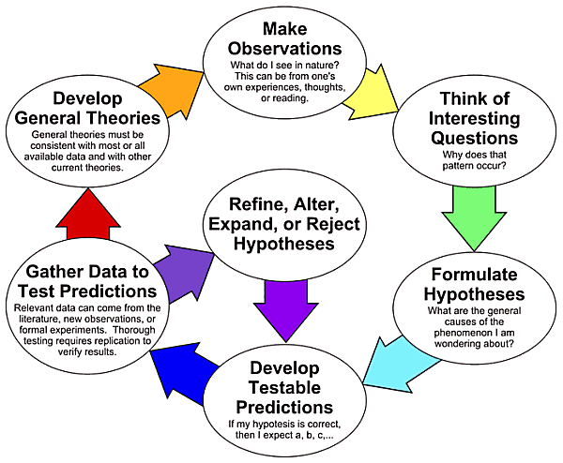
1. Introduction (10)
The Scientific Method As an Ongoing Process
Rodolfo A. Fiorini, http://www.linkedin.com/pub/rodolfo-a-fiorini-ph-d/45/277/498

Slide 16
1. Introduction (11)
Scientists as well as laymen do ignore evidence incompatible with their preconceptions.
New theories which fail to fit established views are resisted, in the hope that they will prove false or irrelevant; old ones yield to convenience rather than to evidence.
Although there are many sources of ignorance and uncertainty, they can be related to two basic areas of uncertainty that are fundamentally different from each other and recognized as traditional reference knowledge from scientific community: natural and epistemic uncertainty.
While the advantage of differentiating between natural (aleatory) and epistemic uncertainty in analysis is clear, the necessity of distinguishing between them is not, by an operative point of view. As a matter of fact, epistemic and aleatory uncertainties are fixed neither in space nor in time.
Rodolfo A. Fiorini, http://www.linkedin.com/pub/rodolfo-a-fiorini-ph-d/45/277/498

Slide 17
1. Introduction (12)
In decision theory and economics, ambiguity aversion (also known as uncertainty aversion) is a preference for known risks over unknown risks.
An ambiguity averse individual would rather choose an alternative where the probability distribution of the outcomes is known over one where the probabilities are unknown.
This behavior was first introduced through the Ellsberg paradox (people prefer to bet on the outcome of an urn with 50 red and 50 blue balls to on one with 100 total balls but for which the number of blue or red balls is unknown).
The paradox was popularized by the author Daniel Ellsberg (1931-), although a version of it was noted considerably earlier by John Maynard Keynes.
Rodolfo A. Fiorini, http://www.linkedin.com/pub/rodolfo-a-fiorini-ph-d/45/277/498

Slide 18
1. Introduction (13)
That is, given a choice of risks to take (such as bets), people "prefer the devil they know" rather than assuming a risk where odds are difficult or impossible to calculate.
Scholars have sliced and diced the terms "ambiguity," "uncertainty," and "ignorance," among others, in a variety of different ways. Oftentimes, the usefulness of these sharp lines isn’t plainly apparent.
But one dividing line between types of unknowns, i.e. the distinction between risk and ambiguity, has recently led neuroscience and neuropsychology researchers to fascinating new biological insights.
Evidence from brain science has shown that the amygdala and the orbitofrontal cortex (OFC) are more active when people face ambiguous odds rather than merely risky ones, suggesting that ambiguity is fundamentally more emotional.
Rodolfo A. Fiorini, http://www.linkedin.com/pub/rodolfo-a-fiorini-ph-d/45/277/498

Slide 19
1. Introduction (14)
A Few Scientists Ahead of Their Time
Leonardo da Vinci (b.1452-d.1519
Athanasius Kircher (b.1602-d.1680)
Giovanni Saccheri (b.1667-d.1733)
Roger Boscovich (b.1711-d.1787)
Jack Sarfatti (b.1939-)
Lee Smolin (b.1955-)
Rodolfo A. Fiorini, http://www.linkedin.com/pub/rodolfo-a-fiorini-ph-d/45/277/498

Slide 20
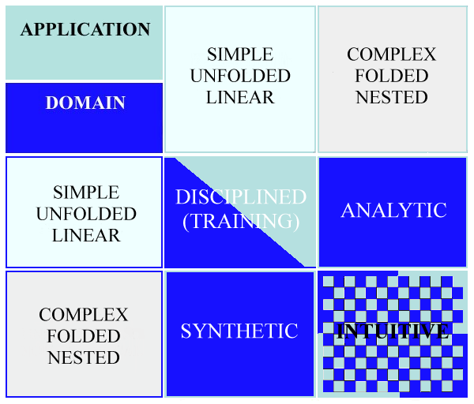
1. Introduction (15)
Structured Types of Thinking
(R.A. Fiorini, 2016)
Rodolfo A. Fiorini, http://www.linkedin.com/pub/rodolfo-a-fiorini-ph-d/45/277/498

Slide 21
2. Creativity & Social Acceptance (00)
2. Creativity & Social Acceptance (17)
Eulogic Thought
Individual – Community Cultural Resonance
Rodolfo A. Fiorini, http://www.linkedin.com/pub/rodolfo-a-fiorini-ph-d/45/277/498

Slide 22
2. Creativity & Social Acceptance (01)
Rational Human Thinking is like a solid archipelago emerging from an ocean of intuitions.
Rodolfo A. Fiorini, http://www.linkedin.com/pub/rodolfo-a-fiorini-ph-d/45/277/498

Slide 23
2. Creativity & Social Acceptance (02)
Human brain is an harmonization machine fed by unaware intuitions to produce learning and rational awareness.
Rodolfo A. Fiorini, http://www.linkedin.com/pub/rodolfo-a-fiorini-ph-d/45/277/498

Slide 24
2. Creativity & Social Acceptance (03)
Human brain as an Harmonization Machine
EULOGIC THOUGHT
PALEOLOGIC THOUGHT
Intelligent
Coupled
Relational
Teleologic
Harmonization
Surviving
Deterministic
Open Logic
Learning from Experience
Subjective
NEOLOGIC THOUGHT
Rational Thinking
Analytical
Metacognitive Abstraction
Free Will
Symbolic Reasoning
Learning To Learn
Focused Attention
Closed Logic
Body Independent
Shared (Objective)
HUMAN CREATIVITY
Rodolfo A. Fiorini, http://www.linkedin.com/pub/rodolfo-a-fiorini-ph-d/45/277/498

Slide 25
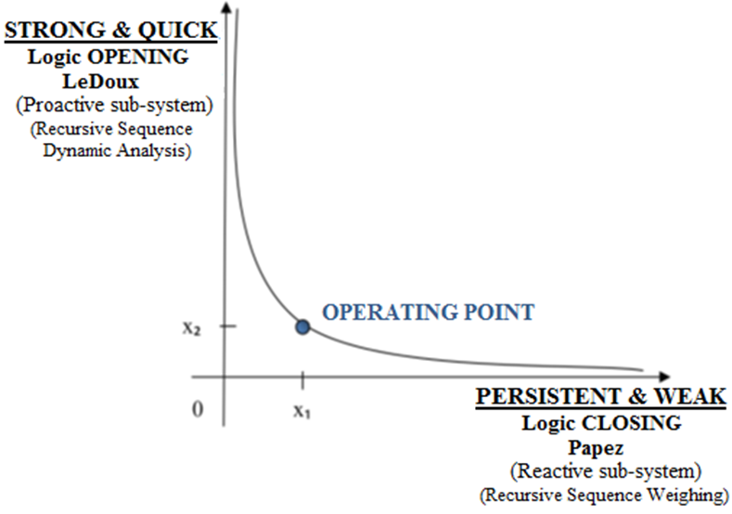
2. Creativity & Social Acceptance (04)
Emergent Transdisciplinary Reality Level
Emotional Intelligence (EI) and Emotional Creativity (EC) coexist at the same time with Rational Thinking, sharing the same input environment information.
Operating point as a trans-disciplinary reality level can emerge from two complementary irreducible, asymptotic ideal coupled concepts.
To behave realistically, system must guarantee both Logical Aperture (to get EI and EC, to survive and grow) and Logical Closure (to get Rational Thinking, to learn and prosper), both fed by environmental "noise" (better… from what human beings call "noise").
(R.A. Fiorini, 2013)
Rodolfo A. Fiorini, http://www.linkedin.com/pub/rodolfo-a-fiorini-ph-d/45/277/498

Slide 26
2. Creativity & Social Acceptance (05)
From "Five-step Graham Wallas (1926) creative process model"
(i) preparation (preparatory work on a problem that focuses the individual’s mind on the problem and explores the problem’s dimensions);
(ii) incubation (where the problem is internalized into the unconscious mind and nothing appears externally to be happening);
(iii) intimation (the creative person gets a “feeling” that a solution is on its way);
(iv) illumination or insight (where the creative idea bursts forth from its preconscious processing into conscious awareness);
(v) verification (where the idea is consciously verified, elaborated, and then applied).
Rodolfo A. Fiorini, http://www.linkedin.com/pub/rodolfo-a-fiorini-ph-d/45/277/498

Slide 27
2. Creativity & Social Acceptance (06)
Through Many Techniques & Tools…
TRIZ (theory which are derived from tools such as ARIZ or TRIZ contradiction matrix);
Creative Problem Solving Process (CPS) (complex strategy, also known as Osborn-Parnes-process);
Delphi method;
Lateral thinking process, of Edward de Bono;
Six Thinking Hats, of Edward de Bono;
Method Herrmann - right brain / left brain;
Brainstorming and Brainwriting;
Think outside the box;
Business war games, for the resolution of competitive problems;
SWOT and PEST analysis;
The method USIT of convergent creativity;
Thought experiment;
Five Ws;
Coaching;
Wideband Delphi;
Association;
Problem solving;
Decision tree;
Ideas banks;
Imagination;
Intuition;
Invention;
Metaphor
Smart mobs;
Ideation;
Improvisational theater;
The Wisdom of Crowds;
TED, a conference for "ideas worth spreading“;
and many more available at Creativity& Innovation:
http://www.mycoted.com/Category:Creativity_Techniques
…more and more…
Rodolfo A. Fiorini, http://www.linkedin.com/pub/rodolfo-a-fiorini-ph-d/45/277/498

Slide 28
2. Creativity & Social Acceptance (07)
To Creative Thinking (Parnes, 1992; Bateson, 1972; Nicolescu, 2008; Fiorini & Laguteta, 2012)
1) 1940's – a cry in the dark;
2) 1950's – the hope and hunch stage;
3) 1960's – the research, replication and report stage;
4) 1970's – the widespread application stage;
5) 1980's – the mainstream application;
6) 1990's – the trans-disciplinary reality level;
7) 2000's – the neuroscience vision;
8) 2010's – the ecology of mind;
9) 2020's – the relational network.
Rodolfo A. Fiorini, http://www.linkedin.com/pub/rodolfo-a-fiorini-ph-d/45/277/498

Slide 29
2. Creativity & Social Acceptance (08)
As a matter of fact, creativity and the creative process in an organizational context have been occupying the thoughts of Western business leaders and executives, politicians and academics since the late 19th and early 20th centuries.
The human world is moving from the Information Age to the Conceptual Age,(Pink, 2005) an age that requires both creative and logical-analytical thinking, and for much of the current theoretical work being pursued in the emerging field of neuroscience, computational neuroscience, and biomedical cybernetics.
Rodolfo A. Fiorini, http://www.linkedin.com/pub/rodolfo-a-fiorini-ph-d/45/277/498

Slide 30
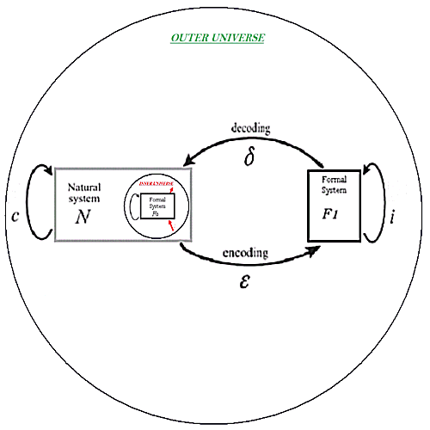
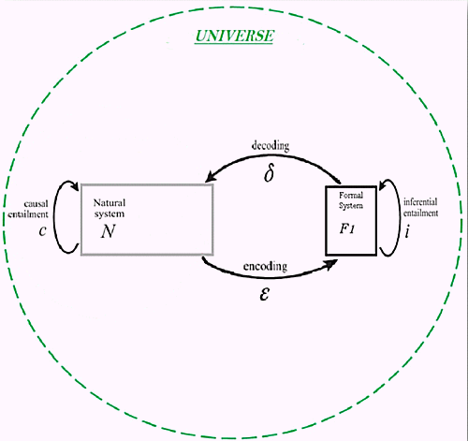


2. Creativity & Social Acceptance (09)
R. Rosen Fundamental Modeling Relation (Reflexive/Reflective)
Rodolfo A. Fiorini, http://www.linkedin.com/pub/rodolfo-a-fiorini-ph-d/45/277/498

Slide 31
2. Creativity & Social Acceptance (10)
R. Rosen Fundamental Modeling Relation (Reflexive/Reflective)
R. Rosen Fundamental Modeling Relation with explicit Reflexive and Reflective Representations.
Immediately, Reflexive and Reflective Representations create two base system scaling symmetries into ODR Model: convergent and divergent scaling symmetries.
They allow for the correspondence of a Inner Universe - SELF representation to an Outer Universe representation, both linked by the Kelvin Transform.
Convergent Scaling:
Divergent Scaling:
Rodolfo A. Fiorini, http://www.linkedin.com/pub/rodolfo-a-fiorini-ph-d/45/277/498

Slide 32
2. Creativity & Social Acceptance (11)
Kolb’s Experimental Learning Theory
Rodolfo A. Fiorini, http://www.linkedin.com/pub/rodolfo-a-fiorini-ph-d/45/277/498

Slide 33
2. Creativity & Social Acceptance (12)
Interior – Individual VS. Exterior - Collective
Rodolfo A. Fiorini, http://www.linkedin.com/pub/rodolfo-a-fiorini-ph-d/45/277/498

Slide 34
2. Creativity & Social Acceptance (13)
OBJECTIVITY NEW SOCIAL DEFINITION
OBJECTIVITY
AS A
SOCIAL CONTRACT
TO WARRANT
SUBJECTIVE INFORMATION
RELIABLE SHARING AND EXCHANGE
WITHIN COMMUNITIES
Rodolfo A. Fiorini, http://www.linkedin.com/pub/rodolfo-a-fiorini-ph-d/45/277/498

Slide 35
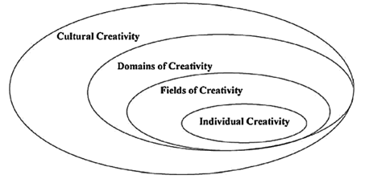
2. Creativity & Social Acceptance (14)
Creativity scheme according to Hungarian psychologist Mihaly Csikszentmihalyi (1975)
Rodolfo A. Fiorini, http://www.linkedin.com/pub/rodolfo-a-fiorini-ph-d/45/277/498

Slide 36
2. Creativity & Social Acceptance (15)
Interior – Individual VS. Exterior - Collective
Rodolfo A. Fiorini, http://www.linkedin.com/pub/rodolfo-a-fiorini-ph-d/45/277/498

Slide 37
2. Creativity & Social Acceptance (16)
Interior – Individual VS. Exterior - Collective
Rodolfo A. Fiorini, http://www.linkedin.com/pub/rodolfo-a-fiorini-ph-d/45/277/498

Slide 38
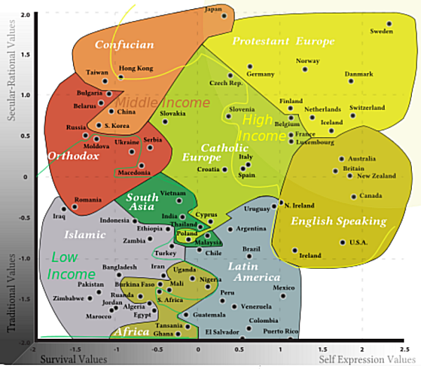
2. Creativity & Social Acceptance (17)
The Challenge of Transcultural Understanding
(Inglehart–Welzel cultural map of the world, 2010)
Rodolfo A. Fiorini, http://www.linkedin.com/pub/rodolfo-a-fiorini-ph-d/45/277/498

Slide 39
3. Guided Creativity (00)
3. Guided Creativity (17)
Awareness and Creativity
EPM Educated Creativity
Rodolfo A. Fiorini, http://www.linkedin.com/pub/rodolfo-a-fiorini-ph-d/45/277/498

Slide 40
3. Guided Creativity (01)
Awareness and Creativity (EPM)
According to Elementary Pragmatic Model (EPM), two coupled fundamental systems are at the core of human mind:
System 1 :
System 2 :
Wiring and re-wiring of a Focused
Optimal Path (FOP)
to creatively reach a planned goal.
System 1 rational assessment
and endorsement
(checking + FOP updating if needed).
(Piero De Giacomo, 1982)
Rodolfo A. Fiorini, http://www.linkedin.com/pub/rodolfo-a-fiorini-ph-d/45/277/498

Slide 41
3. Guided Creativity (02)
Awareness and Creativity (EPM)
According to Elementary Pragmatic Model (EPM), two coupled fundamental systems are at the core of human mind:
System 1 is fed by definition doubting and compromising mainly; the availability of an environmental chaotic information redundant support is required (RATL, Right Anterior Temporal Lobe):
emotion→FOP (re-)wiring→sensation→action (survival oriented).
System 2 is based on opposing, complementing and commanding; clearly defined formal rules are required to actively operate:
emotion→sensation→perception→action (learning oriented)
(i.e. solution path logical articulation→checking→difference learning).
(Piero De Giacomo, 1982)
Rodolfo A. Fiorini, http://www.linkedin.com/pub/rodolfo-a-fiorini-ph-d/45/277/498

Slide 42
3. Guided Creativity (03)
Awareness and Creativity (EPM)
Initially EPM was used as a theoretical family therapy model to classify the outcomes of dyadic interactions in psychology. It was used successfully by a group of therapists in family therapy and in clinical psychiatric training and applications (e.g. schizophrenia, nervous anorexia, etc.) Later it was applied to develop interactive psychotherapic strategies, online counseling and E-therapy.
Since the beginning of the new millennium its application area has been extended to other disciplines and even to engineering problems like user modeling, constraint requirements elicitation, software creativity and adaptive system design and development.
EPM has shown to be a high versatile tool and new application areas are envisaged continuously.
Rodolfo A. Fiorini, http://www.linkedin.com/pub/rodolfo-a-fiorini-ph-d/45/277/498

Slide 43
3. Guided Creativity (04)
Awareness and Creativity (EPM)
As a recent example, EPM contributed to find an original solution to the distressing double-bind dilemma in classic information and algorithmic theory (i.e. our computational information contemporary classic systemic tools are totally unable to capture and to tell the difference between an information-rich, optimally encoded message and a random jumble of signs that we call "noise" usually).
In turn, this new awareness has enlarged our panorama for neurocognitive system behaviour understanding, computational neuroscience, and for developing competitive information conservation and regeneration algorithms and systems.
Rodolfo A. Fiorini, http://www.linkedin.com/pub/rodolfo-a-fiorini-ph-d/45/277/498

Slide 44
3. Guided Creativity (05)
Neuro-Axiological Approach by
EPM Logically Articulated Learning Support
(Piero De Giacomo et al., 1982)
Rodolfo A. Fiorini, http://www.linkedin.com/pub/rodolfo-a-fiorini-ph-d/45/277/498

Slide 45
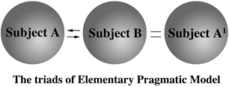
3. Guided Creativity (06)
EPM Logically Articulated Awareness Support
Level 1 - Basic Shannon’s Triad
(Piero De Giacomo et al., 1982)
Rodolfo A. Fiorini, http://www.linkedin.com/pub/rodolfo-a-fiorini-ph-d/45/277/498

Slide 46
3. Guided Creativity (07)
EPM Logically Articulated Awareness Support
Level 2 - Basic Four Interaction Co-ordinates
(Piero De Giacomo et al., 1982)
Rodolfo A. Fiorini, http://www.linkedin.com/pub/rodolfo-a-fiorini-ph-d/45/277/498

Slide 47
3. Guided Creativity (08)
EPM Logically Articulated Awareness Support
Level 3 - Sixteen Relational Style Functions
(Piero De Giacomo et al., 1982)
Rodolfo A. Fiorini, http://www.linkedin.com/pub/rodolfo-a-fiorini-ph-d/45/277/498

Slide 48
3. Guided Creativity (09)
EPM Logically Articulated Awareness Support
Level 4 - Table of Interactions
(Piero De Giacomo et al., 1982)
Rodolfo A. Fiorini, http://www.linkedin.com/pub/rodolfo-a-fiorini-ph-d/45/277/498

Slide 49
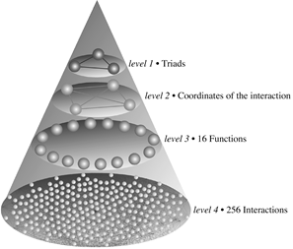
3. Guided Creativity (10)
EPM Logically Articulated Awareness Support
Total Analytical Level Overview
(Piero De Giacomo et al., 1982)
Rodolfo A. Fiorini, http://www.linkedin.com/pub/rodolfo-a-fiorini-ph-d/45/277/498

Slide 50
3. Guided Creativity (11)
EPM Logically Articulated Awareness Support
Level 5 - Final Synthesis
Three Long-Term Final Attractors
F15 (RED): Total Acceptor
F3 (GREEN): Egoview Maintainer
F0 (BLUE): Tabula Rasa
(Piero De Giacomo et al., 1982)
Rodolfo A. Fiorini, http://www.linkedin.com/pub/rodolfo-a-fiorini-ph-d/45/277/498

Slide 51
3. Guided Creativity (12)
EPM Logically Articulated Awareness Support
Subject Profiling Process
ELEMENTARY PRAGMATIC MODEL (EPM)
Table of Interactions.
Interactions are transformed into sentences by a mental process based on EPM logic and Operator’s experience and creativity.
Many sentences emerge out of this process, but those ones significant to human mind only are selected by Operator. Then they are presented to Subject under profiling.
The Subject selects those sentences that exert the strongest impact to him/her. They can represent a sort of mariner’s compass in Subject’s life (Compass-like Statement).
(Piero De Giacomo et al., 1982)
Rodolfo A. Fiorini, http://www.linkedin.com/pub/rodolfo-a-fiorini-ph-d/45/277/498

Slide 52
3. Guided Creativity (13)
EPM Logically Articulated Awareness Support
Subject Profiling Process
Rodolfo A. Fiorini, http://www.linkedin.com/pub/rodolfo-a-fiorini-ph-d/45/277/498

Slide 53
3. Guided Creativity (14)
EPM Logically Articulated Awareness Support
Subject Profiling Process
Rodolfo A. Fiorini, http://www.linkedin.com/pub/rodolfo-a-fiorini-ph-d/45/277/498

Slide 54
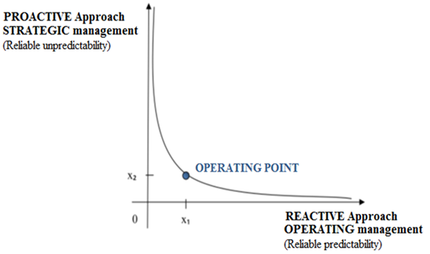
3. Guided Creativity (15)
An Ideal Asymptotic Dichotomy to Educated Creativity
Traditional EPM can be thought as a reliable starting subsystem (closed logic, OPERATING management) to initialize a process of continuous self-organizing and self-logic learning refinement (open logic, STRATEGIC management). Operating Point can emerge as a new Transdisciplinary Reality Level, based on an irreducible complementary ideal asymptotic dichotomy: Two Complementary Irreducible Coupled Information Management Subsystems.
(R.A. Fiorini, 2011)
Rodolfo A. Fiorini, http://www.linkedin.com/pub/rodolfo-a-fiorini-ph-d/45/277/498

Slide 55
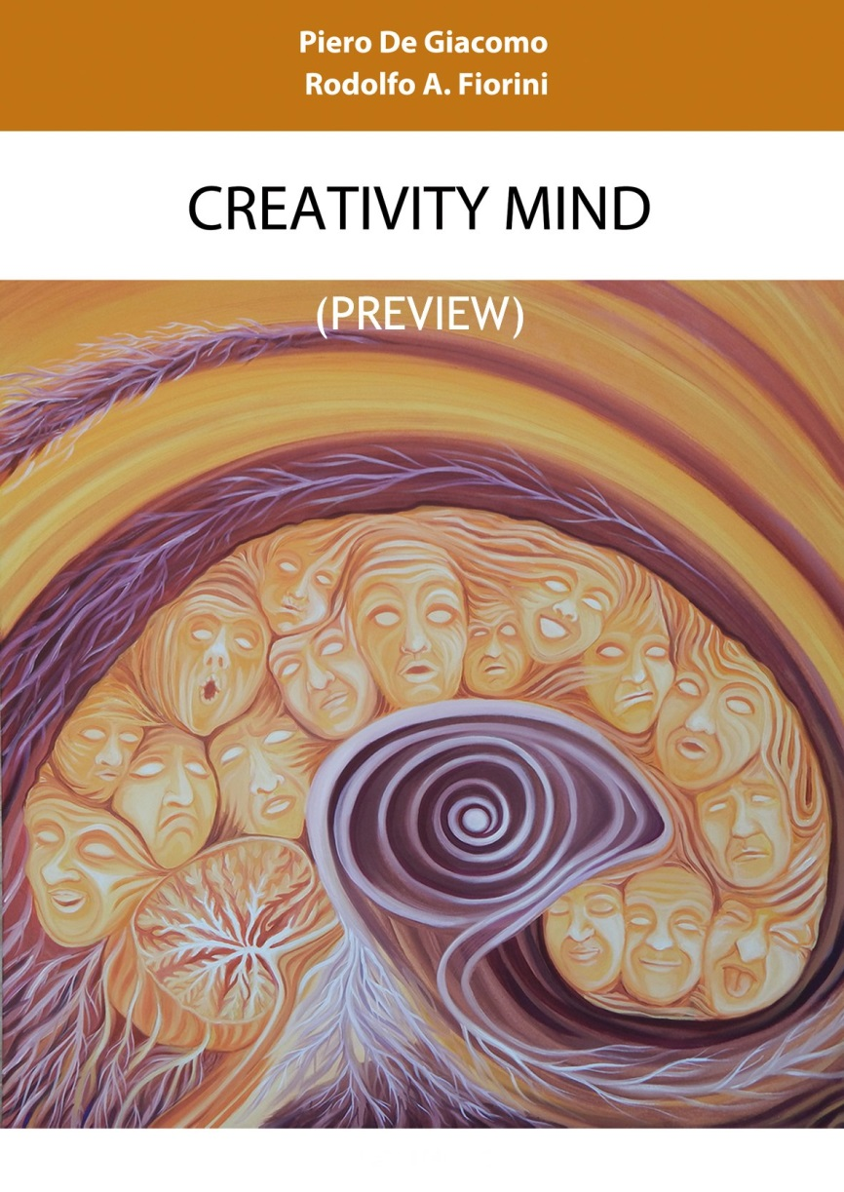
3. Guided Creativity (16)
Rodolfo A. Fiorini, http://www.linkedin.com/pub/rodolfo-a-fiorini-ph-d/45/277/498

Slide 56
3. Guided Creativity (17)
Neuralizer Work In Progress
Rodolfo A. Fiorini, http://www.linkedin.com/pub/rodolfo-a-fiorini-ph-d/45/277/498

Slide 57

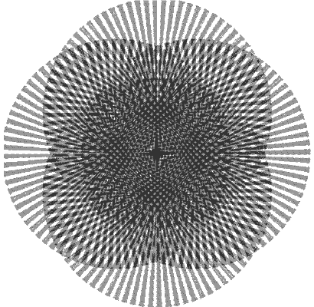
Creativity and Scientific Discovery
Thank You for
Your A t t e n t i o n
Rodolfo A. Fiorini, http://www.linkedin.com/pub/rodolfo-a-fiorini-ph-d/45/277/498

