Slide 1
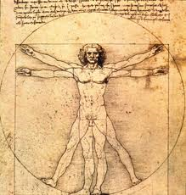
THE MIND-BODY PROBLEM
CARLOS BLANCO
DUBROVNIK, APRIL 2016

Slide 2
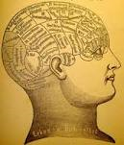
Fundamental dualities in human thought point to this unsolved problem:
Bodyu/soul, matter/spirit, causality/intentionality, facts/values, quantity/quality, exteriority/interiority, objectivity/subjectivity.

Slide 3
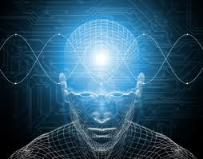
How to explain mental phenomena, in particular self-consciousness, both in terms of necessary conditions and sufficient conditions?

Slide 4
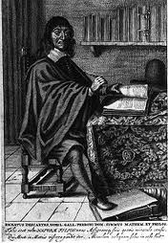
By “mental phenomenon” I understand any subjective experience of the world: thought, colour perception, will…
Consciousness (as self-consciousness) encompasses mental phenomena in the case of Homo sapiens.
Self-consciousness: to be aware of “my awareness” (meta-consciousness): I know that I know, I know that I am walking, I know that…

Slide 5
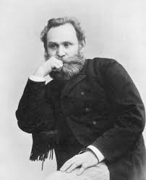
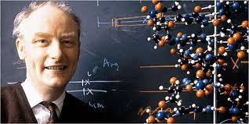
“It is necessary to admit that the progress in natural sciences, uninterrumpted and irresistible since Galileo, suffers its first halting when it faces the study of the highest parts of the brain” (Ivan Pavlov)
“Consciousness is the greatest unsolved problem in Biology” (Sir Francis Crick).

Slide 6
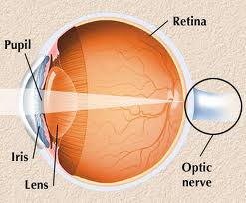
An associated problem: the binding problem (how to generate a unitary perception from heterogeneous properties in stimuli).

Slide 7
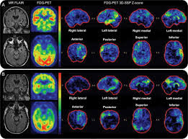
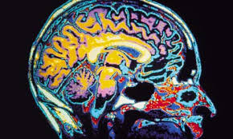
Fortunately, scientific progress in the study of consciousness has been extraordinary over the last three decades.
Neuroimaging has provided neuroscience with formidable tools of inquiry.

Slide 8
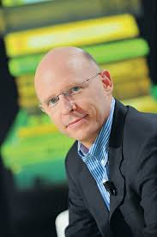
“The subjective aspects of conscious experience no longer lie beyond the realm of an objective scientific inquiry. On the contrary, a solid body of scientific evidence links consciousness to specific cognitive computations and to the physical state of networks of neurons. Advances in brain imaging now make it possible to reliably detect electrophysiological signatures of consciousness. These signatures can be used to decide, with above-chance accuracy, whether a normal person is or is not aware of a given stimulus, or whether a patient still presents a residual form of consciousness. While these advances are significant, it should be stressed that they concern primarily the simplest sense of the term “consciousness”: the ability to gain conscious access to some information. The brain mechanisms underlying the capacity for self-consciousness (knowing that we know) are only starting to be studied with similar methods” (Stanislas Dehaene)

Slide 10
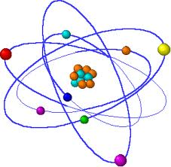
Two great philosophical solutions:
1) Psycho- physical dualism (two substances in interaction).
2) Psycho-physical monism (idealistic or materialistic)

Slide 11
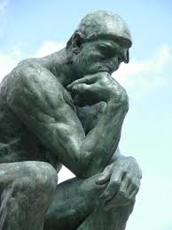
I. DUALISM
Two worlds, ruled by their own laws
Five conceptual possibilities

Slide 12
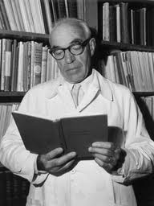
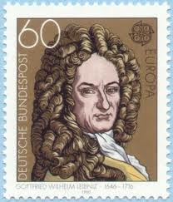
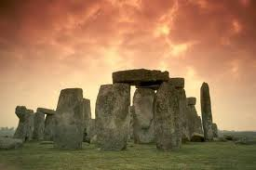
1) Radical independence of both worlds (animism).
2) Psycho-physical parallelism (preestablished harmony)
3) The physical completely determines mind
4) Mind completely determines the physical
5) Interactionism (Eccles)

Slide 13
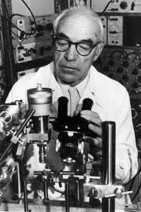
Sir John Eccles
“I maintain that the human mystery is incredibly demeaned by scientific reductionism, with its claim in promissory materialism to account eventually for all of the spiritual world in terms of patterns of neuronal activity. This belief must be classed as a superstition. . . . we have to recognize that we are spiritual beings with souls existing in a spiritual world as well as material beings with bodies and brains existing in a material world” (Evolution of the Brain, Creation of the Self, p. 241).
“Since materialist solutions fail to account for our experienced uniqueness, I am constrained to attribute the uniqueness of the Self or Soul to a supernatural spiritual creation. To give the explanation in theological terms: each Soul is a new Divine creation which is implanted into the growing foetus at some time between conception and birth.” (Evolution of the Brain, 237 ).
“We can regard the death of the body and brain as dissolution of our dualist existence. Hopefully, the liberated soul will find another future of even deeper meaning and more entrancing experiences, perhaps in some renewed embodied existence . . . in accord with traditional Christian teaching.” (Evolution of the Brain, 242).

Slide 14
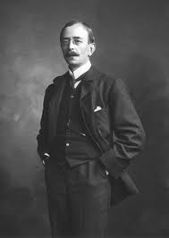
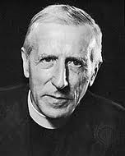
Associated idea: pampsychism
Sir Charles Sherrington: Energy and Mind exist ab initio
“Man’s mind is a recent product of our planet’s side, produced from mind already there long previously, yielding man’s mind by gradual change of previous minds” (Man on His Nature).
Question: shall it evolve towards a higher reality? How were both realities synchronized? Why at that time? Is there teleology in nature?

Slide 15
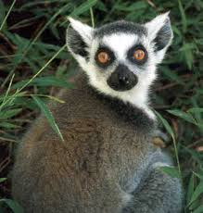
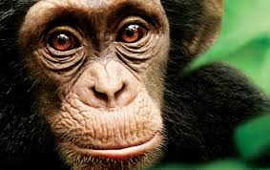
Expansion of precortal cortex in mamals:
Lemur: 8’5% of the total volume of cortex
Gibbon: 11’5%
Chimpanzee: 17%
Homo sapiens: 29%

Slide 16
In favor of dualism
1) The problem of qualia
2) Subjectivity: mind needs to conceive of a subject underlying my thoughts and decisions (Kant’s ich denke). Where is the I? In a region? In a circuit? In a single neuron?

Slide 17
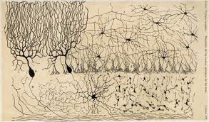
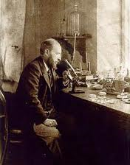
Sed contra:
1) Neuroscience is a young discipline: Ignoramus sed non ignorabimus
2) Dualism is difficult to harmonize with the theory of evolution
3) The complexity of cerebral cortex and the Central Nervous System suggests that higher psychism is the fruit of the evolution of neuronal networks.
4) Science has struggled to offer a unitary description of reality

Slide 18
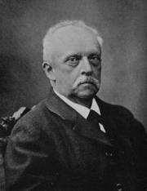
5) Science has crossed boundaries that seemed impossible to overcome (vs. Vitalism)
6) How to understand the laws of that dualistic world?
7) Dualism implies a violation of the first principle of Thermodynamics (creatio ex nihilo?)
8) What is the explanatory power of dualism?

Slide 19
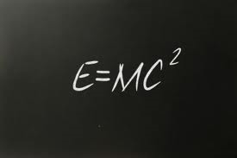
II. MONISM
1) Everything is mind (idea).
2) Everything is matter-energy.

Slide 20
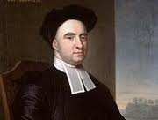
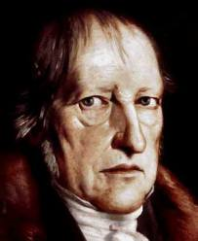
A) Idealism
1) Esse est percipi.
¿Why do I experience these affections instead of others, if matter is illusory?
2) German idealism

Slide 21
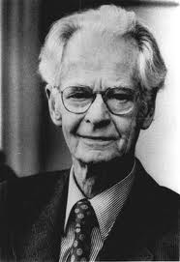
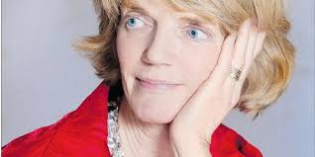
B) Materialism: matter is the only substance, in growing degrees of complexity
1) Eliminativism (behaviorism, Churchland’s criticism of “folk psychology”)
Problem: cognitive revolution, intrinsic properties of mind, mental phenomena cannot be eliminated from both discourse and concepts, internal states…

Slide 22
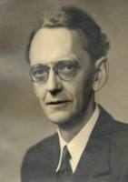
2) Reductionism: the mental can be reduced to physics.
Karl Lashley
Problem: first-person perspective, qualia.
Is Biology entirely reducible to Physics? And Psychology to Biology? And…?

Slide 23
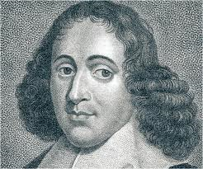
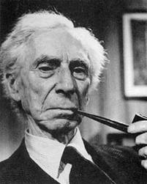
3) Neutral monism: mind and matter are two aspects of the same reality.
Spinoza: modes of the absolute substance; the spirit is the idea of the body.
Bertrand Russell, The Analysis of Mind (1921).
But who or what creates that idea?
Explanatory power?

Slide 24
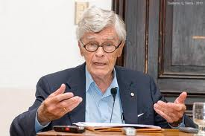
4) Emergentism: mind is a set of emerging biofunctions. Epiphenomenalism.
Complex dynamical systems: emergence of properties irreducible to the sum of the parts:
Whole > Sum of its parts
A promising theory, but:
Vagueness
Incompleteness
Why and how do these properties emerge?
How can you prove that the whole is greater than the sum of its parts?
Will new functions emerge, or evolution has stopped?
Jaegwon Kim’s criticism of emergence: $A→B$; A. Luego B. Emergence or unfolding of that which is already given in nuce.
Parts + interactions? Reorganization?

Slide 25
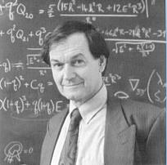
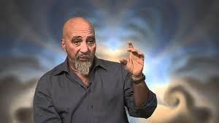
III. APROXIMACIÓN SISTEMÁTICA
Addenda
Explanations based on quantum uncertainty (Penrose-Hammeroff)
Problems:
It is conceptually interesting, but measurement problem is unsolved by Physics
Is Quantum Theory complete?
It does not propose significant neurobiological predictions and explanations
Even if something is not physically determined, it can be mentally determined: mental determinism (vs. random probabilities)
Local vs. global determinism?

Slide 26
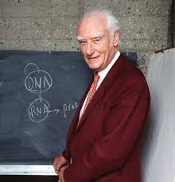
A neurobiological theory is the most promising apporach to unfolding the nature of the human mind
Neural correlates of consciousness
Correlation does not imply causation, but it makes it probable.

Slide 27
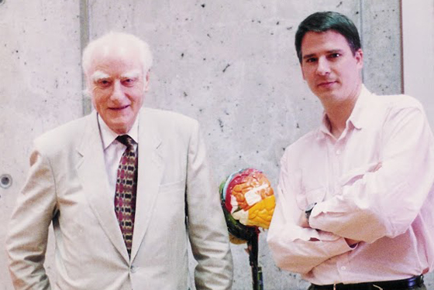
Different neurobiological models:
Synchronized discharging of cortical neurons at 40 Hz, gamma oscillations.
But this frequency has been observed in unconscious subjects.
¿Descarga sincrónica de neuronas corticales, con una frecuencia de 40 Hz, oscilación gamma? Parece ser que esta frecuencia también existe en sujetos anestesiados, “inconscientes”.

Slide 28
Karl Friston and Richard Frackowiak: relevance of prefrontal cortex and the supplementary motor area.
Prefrontal cortex: decision-making
AMS: implied in initiating an action

Slide 29
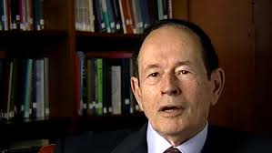
Gerald Edelman’s Neural Darwinism
Process of selection, in analogy with immunology.
Anatomic connectivity in the nervous system obeys a process of Darwinian selection, through Epigenetics.
The primary repertoire is susceptible to replication of it is useful
A second process of selection occurs through experience: more favourable synaptic connections are established. Secondary repertoire.
Re-entry systems: feedback mechanism that dilutes the Homunculus problem.
Consciousness is the result of this constant interaction with the environment.
Existence of degenerate states: different neuronal groups that could fulfil similar roles. Different possible circuits. No single area (vs. Localizationism).
The brain creates categories capable of apprehending the organization of reality. It also elaborates an internal category (perception of ourselves). Combination of images.

Slide 30
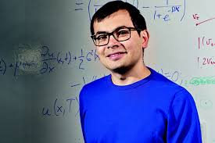
Objections
Which is the unity of replication?
Does selection imply elimination?
Which are the criteria for selection, if the brain does not know if it is going to survive?
Selection or optimal coupling?
Without a reproductive criterion, don’t we fall into a tautology?
Even if there is grouop variations, we still have clearly defined cerebral areas.
The versatility of each group is too great
Why should it be incompatible with the computational theory of mind?
Machines that learn how to learn (Demis Hassabis)
Which is the unity of evolution: the neuron, the neuronal group? It is the size of the brain what has evolved.

Slide 31
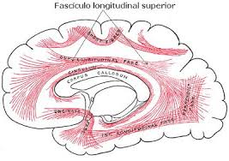
Other candidates for neural correlates:
Superior longitudinal fasciculus (bi-directional, axonic fibers connecting frontal lobe with occipital, parietal and temporal lobes in both hemispheres.
It integrates different areas; it regulates motor behavior; it controls spatial attention; it participates in the synchronization and coordination of language and in the transference of somatosensory information.

Slide 32
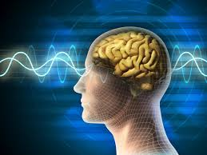
Key to mental function:
Synchronization of perception and association
Mind is time rather than space (res extensa).
Specialized areas, but consciousness is the fruit of synchronization.

Slide 33
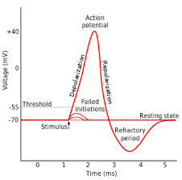
Wonder of nature: simplicity
Neural language, sensory and motor, perceptive or active, is based upon an electromagnetic signal.
Behold the universal language of the brain.
The integration of different sensory data is guaranteed by the existence of this universal language.

Slide 34
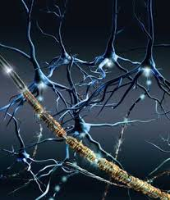
Sensory signal (e.g. in visual cortex) travels to the prefrontal cortex (it will normally pass through the limbic system)
Emotionally codified information advances and arrives in the prefrontal cortex (association cortex)
Thanks to language-processing areas, this electromagnetic signal (= perception + emotion) generates an internal representation.
Final processing in the association areas propitiates an “independent” treatment of this complex information. It also allows to reflect about the information that has been apprehended.

Slide 35
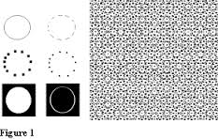
Homo sapiens: high level of perception of patterns and generalities.
These patterns can be combinated in almost infinite ways.
Association (forced or random): multiply the power of our imagination.
Humboldt: “language is the infinite use of finite means”
Parallel processing of cerebral areas: the possibility of elaborating more sophisticated rational constructions increases.

Slide 36
Knowledge: a very refined mechanism of assimilating the patterns of reality.
A certain sense gives us information about the world; knowledge allows us to unveil the structure of the universe, its general functioning.
We gain independence from the concrete stimulus (“Anima quodammodo omnia”).
Of course, it works through the superposition of images.
Superposition of superposition: metalanguages.
This is possible because there is a structural and functional difference between areas in charge of receiving perceptions and areas in charge of associating them.

Slide 37
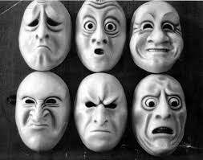
Admirable division of labour: vs. homunculus problem.
No pontifical neuron.
The I = process of perception, assimilation and decision (virtuous circle).
Posterior areas + emotional areas + anterior areas. Continuous feedback.
Fascinating tension between the object of perception, the emotion and rationality (eager to generalize).

Slide 38
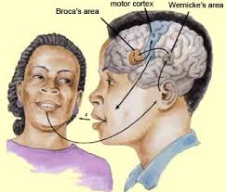
Consciousness: language that speaks to itself.
Concepts: hierarchical yuxtaposition of images.
Primacy is given to more frequent features.
La conciencia, en definitiva, es lenguaje que se habla a sí mismo.
Consciousness = semantics = syntaxis over syntaxis.
Sophisticated connection between Broca and Wernicke’s areas.
The secret of human intelligence lies in the ability to simultaneously coordinate syntantic and semantic capacities.

Slide 39
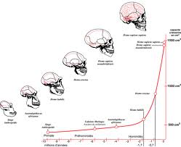
Conclusions:
1) Neuroscience is a young discipline.
The human brain: $0^{′}8×{10}^{11}$neurons, c. ${10}^{14}$ synaptic connections…
Recent developments: Brenda Milner, Eric Kandel…

Slide 40
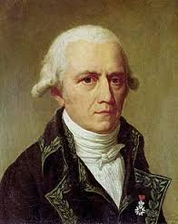
We need to analyze how information is processed by each system in order to reconstruct the dynamics of neuronal groups and the integrating action of the nervous system.
Epigenetics + possible Lamarckian mechanisms.
Development of mind: higher degrees of fine-tuning with reality.
Evolution has not stopped.

Slide 41
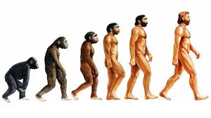
2) The theory of evolution offers an explanatory frame, but we need the specific mechanisms for the birth of higher mental functions.
The plasticity of the brain implies that an explanation in terms of its origin does not suffice to understand how it functions.

Slide 42
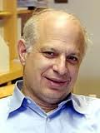
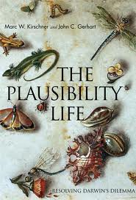
More sophisticated approaches to evolution:
Kirschner-Gerhart: “facilitated variation” (M.W. Kirschner – J.C. Gerhart, The Plausibility of Life: Resolving Darwin’s Dilemma, Yale University Press, New Haven 2005).
Role of the organism in controlling the phenotypic expression of variations.

Slide 43
3) Do we really know what matter is?
Is light a wave or a particle?
Until the 20th century, it was assumed that only two fundamental forces existed.
Future surprises…

Slide 44
Life is matter, but in astonishingly high levels of complexity.
Mind: the limit of matter (the state in which the function is emancipated from the structure: pure forms in Logic and Mathematics; a triangle as an ideal limit, asymptotic

Slide 45
Veil of Maya: evolution has led our species to the possibility of contemplating the universe of logical and mathematical forms; the world of truth.

Slide 46
There is an external norm to the human mind: the laws of nature
We do not create them; we discover and modelize them.
Not every mathematical tool is suitable for explaining the physical universe, but it is still amazing the degree of accuracy with which our mathematical models describe the world
Principle of intelligibility in nature
Evolution of mind: our mind does not exhaust “the mental”.

Slide 47
Consciousness is “wider than the sky”.
Pascal: “L’homme n’est qu’un rouseau, le plus faible de la nature; mais c’est un roseau pensant”

Slide 48
We do not understand how exactly the mind works
But we know that we this phenomenal blessing of nature can and must help us grow ethically

Slide 49
“The most beautiful thing we can experience is the mysterious. It is the source of all true art and science. To know what is impenetrable to us really exists, manifesting itself as the highest wisdom and the most radiant beauty, which our dull faculties can comprehend only in their most primitive forms—this knowledge, this feeling is at the center of true religiousness.”

Slide 50
MATERIA-ESPÍRITU

