Slide 1
Mind, Thinking & Creativity

Slide 2
Mind, Thinking & Creativity
World University Consortium
A Post-Graduate Certificate Course
Inter-University Centre, Dubrovnik, Croatia
April 11-16, 2016
Person-Centered Approach Institute
Dag Hammarskjöld University College
The Mother's Service Society

Slide 3
Illiteracy
Fundamentalism
Poverty
Are the problems confronting humanity related to the way we think and exercise the powers of mind?
Unemployment
Disarmament
Violence
Pollution
Crime
Climate
Change
Health
Refugees
Oppression
Scarcity

Slide 4
What are the different types of thinking?

Slide 5
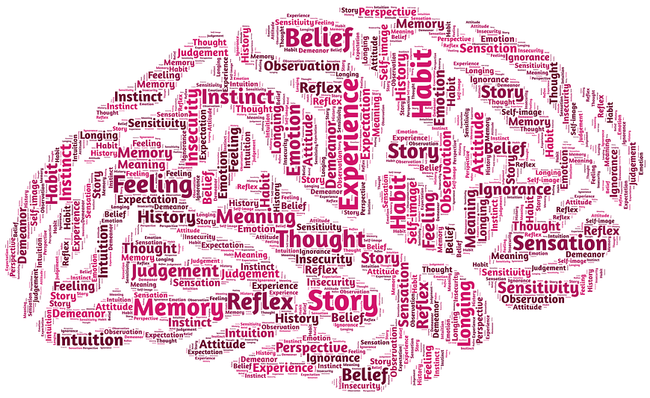
Mental Construction of Knowledge
All mental knowledge describes the world by means of social & psychological constructs.
What are the conceptual systems on which prevailing scientific knowledge is founded?

Slide 6
What is the secret of creative thinking?

Slide 7
Mind vs. AI ?
“An algorithm cannot generate creativity. In fact the reverse is true - creativity is what produces algorithms.” - William Byers, Deep Thinking

Slide 8
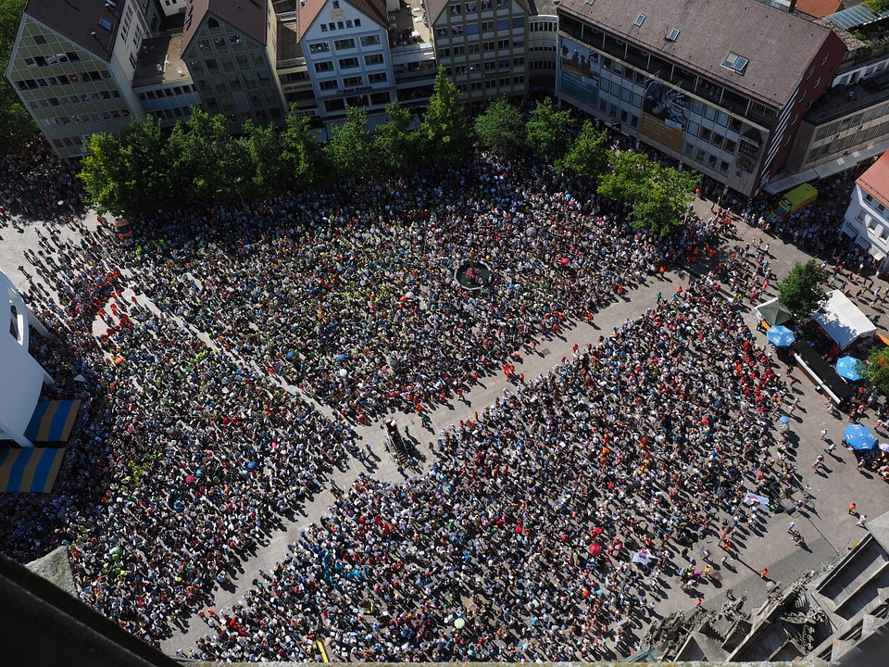
Thinking about Complexity
How can linear faculties of thinking and verbal expression capture the multi-dimensional complexity and intricate integration of living systems and conscious human communities?

Slide 9
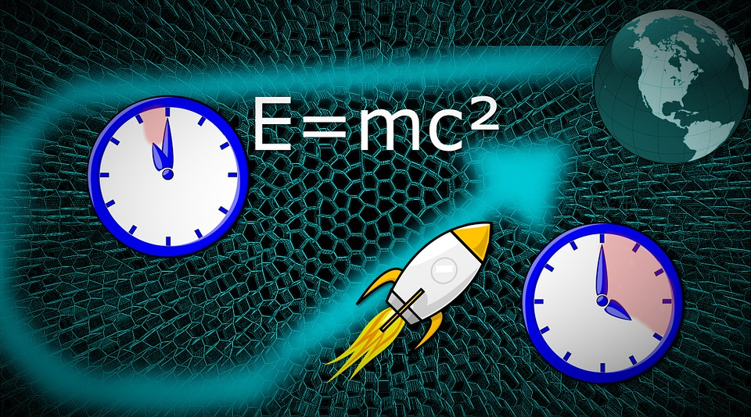
Contradictions are complements
By what faculty does mind reconcile, integrate and unify apparent contradictions?

Slide 10
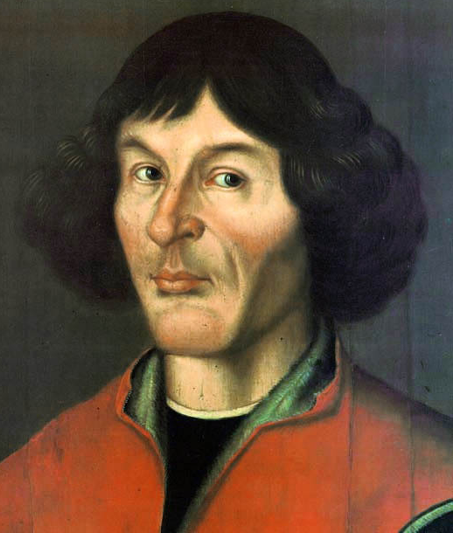
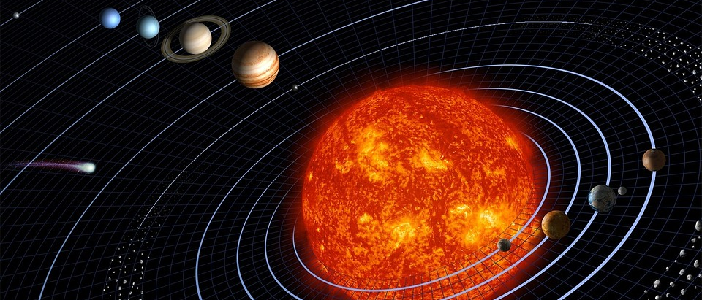
Deep Thinking
Thomas Kuhn emphasized the discontinuous nature of scientific progress—paradigm change. Ground-breaking innovation comes out of deep thinking and creating a totally new framework.
How does mind shift from one paradigm to another?

Slide 11
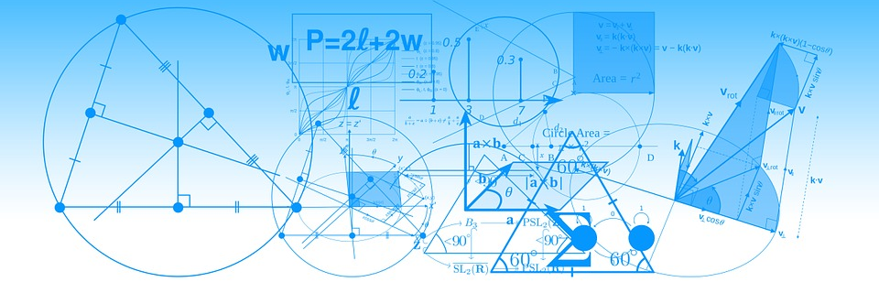
The Secret of Scientific Discovery
Testimony of great scientists confirms that the greatest discoveries of science are the result of intuitive rather than rational mental processes.
Why is science education preoccupied with teaching the scientific methodology for validating discoveries, rather than the actual process of discovery itself?

Slide 12
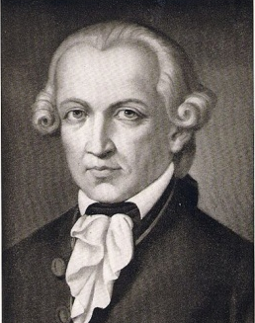
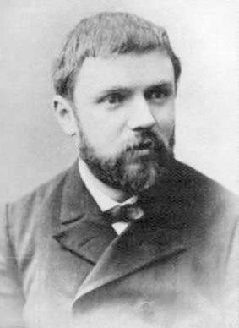
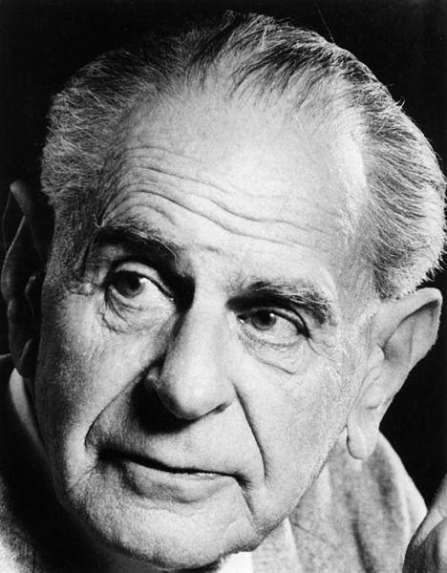
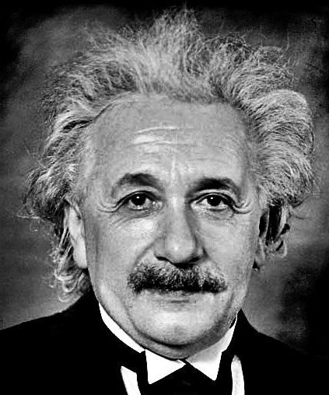
Can Intuition be learned?
The supreme task of the physicist is to arrive at those universal elementary laws from which the cosmos can be built up by pure deduction. There is no logical path to these laws; only intuition. – Albert Einstein
It is by logic that we prove, but by intuition that we discover. - Henri Poincaré
Every discovery contains an 'irrational element,' or 'a creative Intuition. - Karl Popper
All human knowledge begins with intuitions, proceeds from thence to concepts, and ends with ideas. - Immanuel Kant

Slide 13
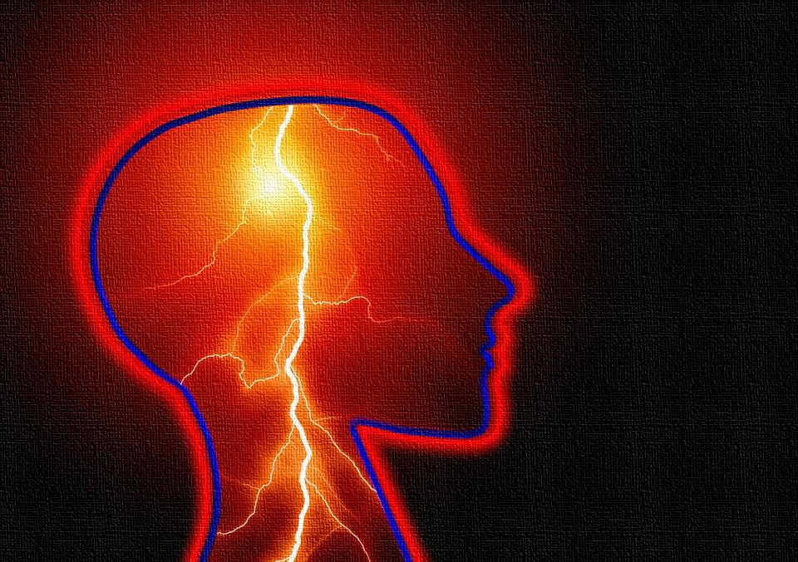
Do geniuses think differently than the rest of us?
Can genius
be taught?

Slide 14
Is reason our highest instrument of knowledge?
Are there limits to rationality?

Slide 15
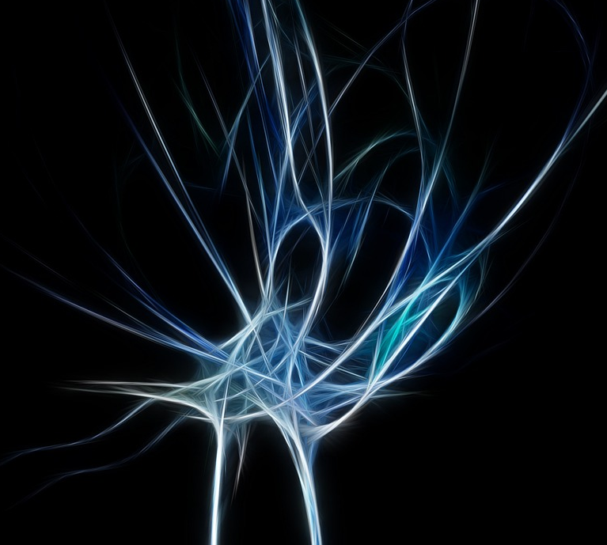
Are we capable of developing other ways of knowing?

Slide 16
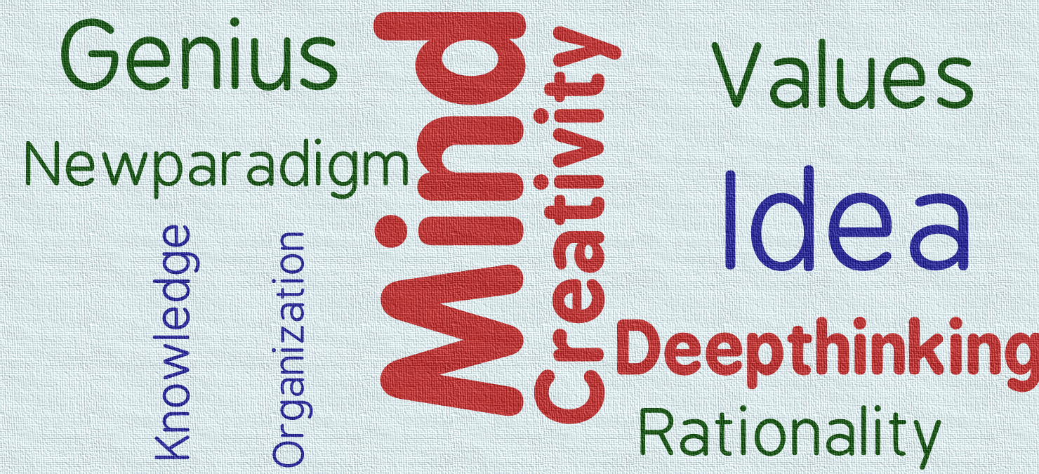
These are some of the leading edge questions that will be explored in the course
‘Mind, Thinking and Creativity’

Slide 17
Course Directors
Garry Jacobs, CEO, World Academy of Art and Science;
Alberto Zucconi, Secretary General, World University Consortium;
Winston Nagan, Professor of Law, University of Florida, USA;
Goran Bandov, Vice Dean, Dag Hammarskjöld University College, Croatia.
Faculty
This transdisciplinary course will be conducted by more than a dozen faculty of the natural and social scientists who are Fellows of the World Academy of Art & Science and partnering institutions.

Slide 18
Be One Step Ahead!
Seize the opportunity to interact and form meaningful relationships with
leading thinkers and gamechangers!

Slide 19
Partnering Institutions
World Academy of Art and Science, USA
World University Consortium, USA
Inter-University Centre, Croatia
Dag Hammarskjöld University College, Croatia
Person-Centered Approach Institute, Italy
The Mother's Service Society, India

Slide 20
Intrigued? Enroll NOW for the course on
'Mind, Thinking & Creativity’!
Students attending the course at IUC, Croatia, will be issued a Certificate of Completion by IUC. In addition, they may be eligible for a Certificate issued by Dag Hammarskjöld University College, with or without 2.5 ECTS (European Credit Transfer System) credits.
The course will be available live over the internet, and students can also attend the program online. Online participants will be eligible for a certificate of completion without ECTS credit.
A registration fee of 40 euros is payable for attendees at IUC and 60 euros for those acquiring ECTS credits. Online participation is free. However, there is a fee of 25 euros for online participants who seek completion certificates.
Click for details

