Slide 1
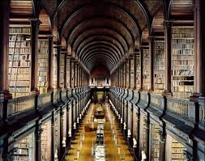
THE INTEGRATION OF KNOWLEDGE
CARLOS BLANCO
DUBROVNIK, APRIL 2016

Slide 2
I. Physics, Biology and Neuroscience
The exponential growth of knowledge demands an interdisciplinary reflection on how to integrate the different branches of the natural sciences and the humanities into a coherent picture of world, life, and mind.
Insightful intellectual tools, like evolutionary Biology and Neuroscience, can facilitate this project.

Slide 3
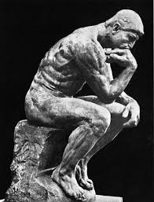
I. Physics, Biology and Neuroscience
It is the task of Philosophy to identify those fundamental concepts whose explanatory power can illuminate the thread that leads from the most elementary realities to the most complex spheres.

Slide 4
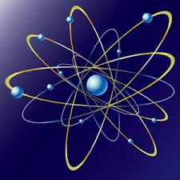
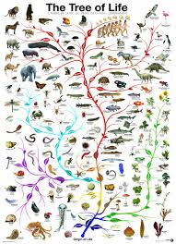
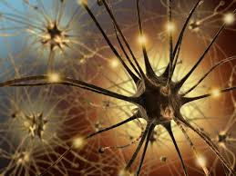
I. Physics, Biology and Neuroscience
Humanity has developed three great theoretical pillars whose immense explanatory power is destined to contribute to the unification of knowledge, a goal sought by so many visionary minds throughout the centuries: fundamental physics, evolutionary biology and neuroscience

Slide 5
I. Physics, Biology and Neuroscience
Physics has accomplished the feat of condensing the structure of the universe in a succinct elenchus of equations, such as the field equations of general relativity and the Schrödinger equation.

Slide 6
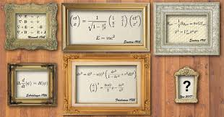
I. Physics, Biology and Neuroscience
It has not discovered the equation that rules the complete description of the universe, but it has notably approached this titanic dream; a utopia illusory for many, yet unquestionably legitimate.

Slide 7
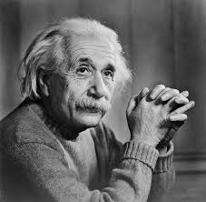
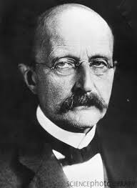
I. Physics, Biology and Neuroscience
Physics is built upon two fundamental models: general relativity and quantum mechanics. We do not know how to harmonize these two divergent pictures of reality.

Slide 8
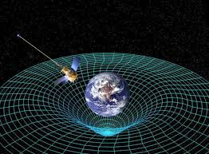
I. Physics, Biology and Neuroscience
General relativity offers a geometrical theory of gravitation, where the idea of relativity of all inertial frames of reference is generalized to cover accelerated frames of reference.
It has led to the formulation of generally covariant equations whose sophisticated mathematical expression -through the language of tensor calculus- has given us the finest, deepest, and most rigorous description of the large-scale structure of the cosmos.

Slide 9
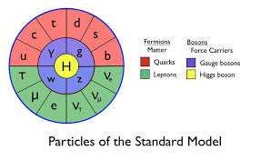
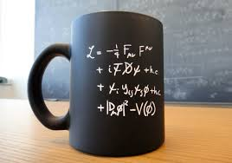
I. Physics, Biology and Neuroscience
However, for the understanding of the three remaining fundamental forces of nature, quantum mechanics has proven uniquely powerful.
Unlike general relativity and its geometrical image of force, quantum mechanics recapitulates our understanding of the physical world through a theory of fields in which the force is mediated by a set of elementary particles of bosonic nature.

Slide 10
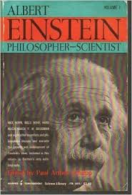
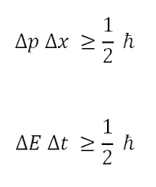
I. Physics, Biology and Neuroscience
The 20th century has therefore seen a formidable extension of the unifying power of the human mind.
Major advances in the domain of the physical sciences have stemmed from the epistemological questioning of their basic concepts.
Neither the work of Einstein nor the developments in quantum physics can be fully grasped without the examination of this profound immersion, with vivid philosophical resonances, into the fundamental categories of physics and the logical criteria required to stipulate a meaning for our notions about the objects of experience.

Slide 11
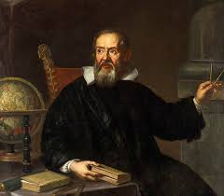
I. Physics, Biology and Neuroscience
This criticism of our intuitive notions has triggered key theoretical –and therefore also practical- advances, propitiating the fusion of pure thought and empirical knowledge.
It constitutes the most faithful reproduction of the intimate functioning of a human mind in its restless quest for unification.

Slide 12
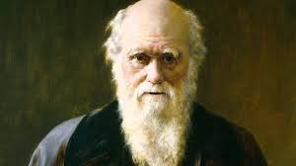
I. Physics, Biology and Neuroscience
Biology, the science that tries to understand the world of life, bestows upon us a wonderful unifying tool: the theory of evolution.
This model unifies ecological, morphological, and genetic knowledge about living beings. Through the lenses of evolution, the elucidation of the history of life allows us to delve into the structure and present functioning of biological entities.

Slide 13
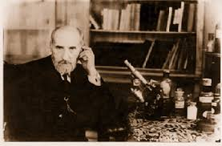
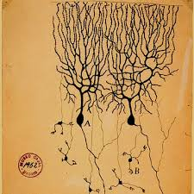
I. Physics, Biology and Neuroscience
Neuroscience is on its way to developing a unifying instrument of immense power and amplitude: the scientific understanding of mind.
From the level of the nervous cells to the sphere of the activity of the brain as a whole (the synchronization of its different regions), progress has been firm, though insufficient.

Slide 14
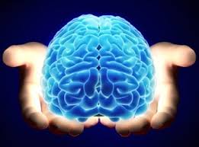
I. Physics, Biology and Neuroscience
As soon as we understand how the mind works, the origin of its abilities and the scope of its capacities, we shall be ready to unify the domain of the Humanities, a goal which until very recently seemed unattainable for science, as if it were fragmented in irreconcilable approaches and inimical cultures.
Through a neuroscientific theory of mind we will be able to examine the source of the human being’s symbolic creations. This task will contribute to building the neuroscientific foundations for the study of society, law, religion, and art.

Slide 15
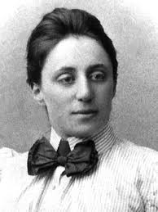
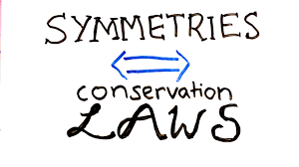
II. CONSERVATION, SELECTION, UNIFICATION
One of the neuralgic principles of reality elucidated by the physical sciences refers to the idea of conservation of certain quantities in the processes experienced by the objects of nature.
According to Noether’s theorem, we know that any differentiable symmetry is associated with a law of conservation.

Slide 16
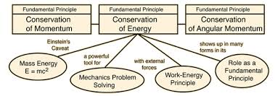
II. CONSERVATION, SELECTION, UNIFICATION
The most important concept used to express this principle of the working of nature is action, perhaps the most relevant and profound of all physical categories.
Invariance under time translation yields the principle of conservation of energy; invariance under space translation yields the principle of conservation of momentum; invariance with respect to rotation yields the principle of conservation of angular momentum.
In quantum physics, a gauge symmetry related to the conservation of charge has also been discovered.

Slide 17
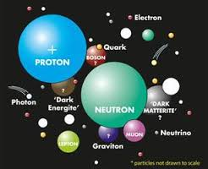
II. CONSERVATION, SELECTION, UNIFICATION
In summary, physics has unfolded principles of conservation which, from the realm of subatomic particles to the domain of thermodynamic systems, are capable of establishing laws of apparent inviolability (the status of the principle of conservation of energy in a cosmological scale is under discussion).

Slide 18
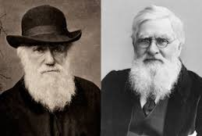
II. CONSERVATION, SELECTION, UNIFICATION
In biology, the category of selection (with its counterpart variation) is as important as the concept of conservation is in physics.
Transmitted through the power of replication that living beings possess, variability is selected by the environment in accordance with its reproductive efficiency.

Slide 19
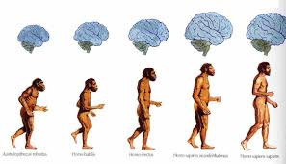
II. CONSERVATION, SELECTION, UNIFICATION
If we ascend in the scale of material complexity and we reach the universe of human consciousness, is it possible to identify a principle endowed with similar theoretical power?

Slide 20
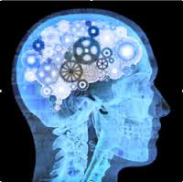
II. CONSERVATION, SELECTION, UNIFICATION
I believe that such a principle is the idea of unification.
The conscious mind unifies the perceptions which it receives. The result is the integration of data susceptible to subjective assimilation.
The human mind holds the unusual privilege of unifying the multiplicity of the world through the filter of its rationality.

Slide 21
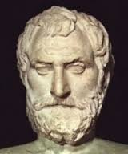
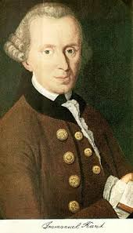
II. CONSERVATION, SELECTION, UNIFICATION
This unitary grasping of reality (Kant’s “unity of apperception” in the ich denke) means the insertion of nature into logic patterns that consciously revert to the subject.
It is one of the most remarkable progresses in the long path of evolution.
Human knowledge involves unifying, connecting, integrating that which is different on the basis of shared relations.
Behold the most genuine meaning of the Greek term logos and the philosophical scope of the verb legein since Thales and the pre-Socratics.

Slide 22
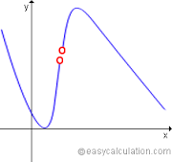
III. THE UNITY OF NATURE
These three notions (conservation, selection, and unification) are not strictly discontinuous.
Along its history, nature has been capable of rising on its own from one level onto another, and this suggests a profound ontological continuity between all realms of reality.

Slide 23
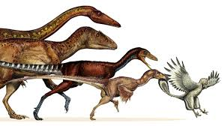
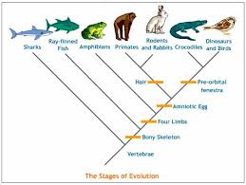
III. THE UNITY OF NATURE
It is in fact possible to draw a narrow analogy between a principle like the law of stationary action in physics (the action integral of a particle will manifest extreme values – i.e. maximal or minimal-, so that the value of action may be stationary) and the idea of natural selection, a mechanism that seeks an optimal point in the relationship between genetic variations and the surrounding environment.

Slide 24
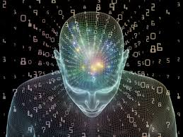
III. THE UNITY OF NATURE
Also, to unify, the act of integrating perceptions in a unitary consciousness of external and internal reality, can be contemplated as a simultaneous optimization in the value of the information coming from the world and the information elaborated by the subject, with the goal of reducing the boundless multiplicity of phenomena into the unity of the conscious being.
An entity capable of extracting, from the copious concatenation of stimuli, information of greater value, more profitable and meaningful, is certainly more conscious of the world and its own being.

Slide 25
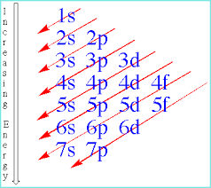
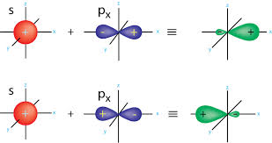
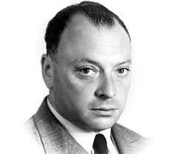
III. THE UNITY OF NATURE
The reduction of chemistry to physics has been accomplished thanks to the quantum theory of orbitals.

Slide 26
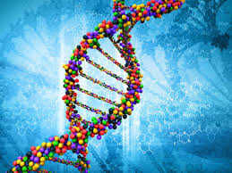
III. THE UNITY OF NATURE
Evolutionary biology covers a new semantic field of science: life.
Of course, it is based upon the fundamental laws of physics, mediated through chemistry (specifically, organic chemistry, which elucidates the structure of compounds like amino acids and nucleic acids).
However, it assumes a series of concepts which are virtually absent in the domains of physics and chemistry.

Slide 27
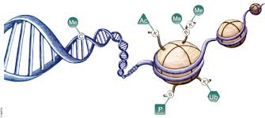
III. THE UNITY OF NATURE
We should not forget, however, that we lack a complete theory of evolution.
Research in the fields of genetics and epigenetics could actually lead to a substantial revision of some fundamental concepts of evolutionary biology.
Nevertheless, as a paradigm, the evolutionary frame has not been surpassed, and it is highly improbable that it will be substantially overcome in the future, at least in its capital aspects.
But just as classical physics was not suppressed by 20th century physics, which rather showed the limits of its approach and expanded its theoretical power, future progress in biology can actually broaden the scope of this science and enlarge its categories.

Slide 28
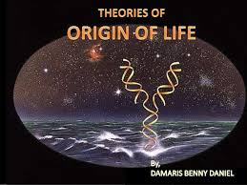
III. THE UNITY OF NATURE
The thread behind the transition from physical chemistry into biology has not been entirely elucidated, for we do not know how life flourished from inert organic matter. However, it is legitimate to hope that we shall soon solve this intricate problem.
It is reasonable to think that life on Earth appeared by virtue of a set of chemical conditions which facilitated the creation of molecules susceptible to replication, whose increasing degrees of autonomy from the environment allowed them to induce certain metabolic reactions in the interior of cells.

Slide 29
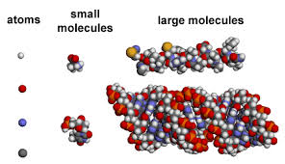
III. THE UNITY OF NATURE
The impossibility of reducing the biological level to the physical-chemical level does not stem from an intrinsic prohibition but from the overwhelming complexity of the system.
Not de iure, but de facto.

Slide 30
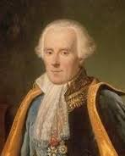
III. THE UNITY OF NATURE
Of course, the complexity of biological systems is not the sole result of their intrinsic elements but of a factor which becomes extremely relevant for biology: the effect of contingencies.
The study of life demands knowing the prolix historical itinerary through which organisms have passed. History contains necessity but above all it is permeated with contingency. Only Laplacian intelligence could have foreseen the arrival of a meteor whose devastating consequence for most of living species triggered the massive Cretaceous extinction.

Slide 31
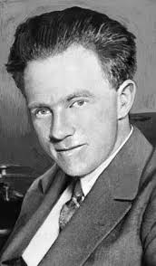
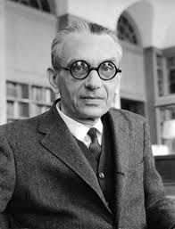
III. THE UNITY OF NATURE
Also, we know that there are unsurmountable uncertainties in the quantum scale.
Therefore, the integration of knowledge cannot seek to eradicate any trace of contingency or to reduce every explanation to a physical proposition, but rather serves to expose the inextricable imbrication that binds all domains of reality. This goal highlights the power of the human mind to perceive the fundamental principles behind the unity of such heterogeneous spheres.

Slide 32
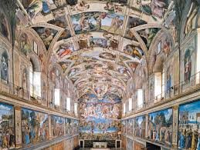
III. THE UNITY OF NATURE
In considering history, we cannot override the shadow of contingency.
However, we can understand the human constants that pervade spaces and times.
Thanks to the scientific study of mind, it is possible to understand human motivations, their logic and –why not?- the seeds of their admirable creative capacity.
This yields a fundamental framework for understanding great civilizations and the most sublime productions of the spirit.
Even without exorcizing the specter of contingency, it is still feasible to identify the fundamental axes around which human action gravitates. In our days, this knowledge comes from the neurosciences.

Slide 33
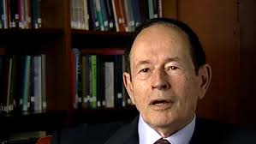
III. THE UNITY OF NATURE
It is not utopian to dream of an explanation for the neurobiological bases of consciousness.
This goal does not exhaust the understanding of every specific consciousness, because this power of Homo sapiens is nurtured by sustained interaction with both the external and the internal environments.

Slide 34
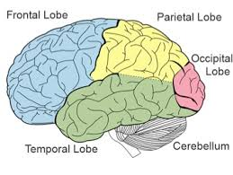
III. THE UNITY OF NATURE
It is utterly impossible to reproduce every single detail that forms the vivid experiences of conscious subjects (we would need a rigorous replication of every physical and psychological condition in which this capacity is manifested, as if we were trying to draw a 1:1 scale map).
But this deep obstacle does not prevent us from uncovering the neuroscientific foundations of consciousness, which probably lie in certain anatomical structures responsible for connecting perceptual and associative areas, like the claustrum and the superior longitudinal fasciculus.

Slide 35
IV. THE INTEGRATION
Science is in possession of the most rigorous and universal language that the human mind has developed: mathematics.
The progress of this discipline over the last few centuries, especially in the elucidation of its fundamental principles, its scopes and limits, has granted us an unsurpassed formalism for describing the structure and functioning of the universe.

Slide 36
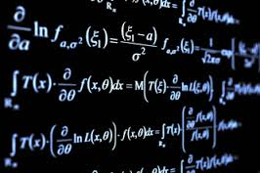
IV. THE INTEGRATION
We know, however, that this depiction of reality cannot be complete for at least two reasons: first of all, these models tend to use the language of differential equations, while our knowledge of matter has revealed the discontinuity that exists in the fundamental levels of nature, in particular at a quantum scale.

Slide 37
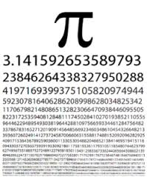
IV. THE INTEGRATION
Secondly, the use of mathematical language compels us to draw a distinction between formal and material equality.
When, in the field equations of general relativity we find number pi and in the Schrödinger equation we contemplate the imaginary number i, it is clear that the notion of equality needs to be interpreted as the equivalence of pure objects of thought (abstractions which do not necessarily enjoy ontological independence in the realm of nature).

Slide 38
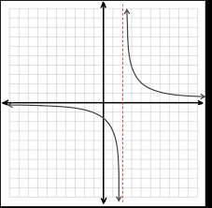
IV. THE INTEGRATION
The mathematical expression of physical categories represents the deepest and finest approach to the material universe conceived by the human mind, but only in an asymptotic limit, in whose ideality material objects fully converged with the pure objects of thought, would it be correct to say that one member of the equation is strictly equal to another.

Slide 39
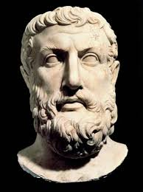
IV. THE INTEGRATION
The advantage of mathematical language resides in its versatility, for it is flexible enough to cover the practical totality of natural registers.
The invention of new mathematical tools throughout history is the best proof of this fruitful plasticity.
This is the reason why the limits of thought do not inexorably seal the frontiers of being. Against Parmenides’ thesis, the realm of mind is eminently ductile and it can adapt itself, both in its language and its categories, to the pressing challenges posed by reality.

Slide 40
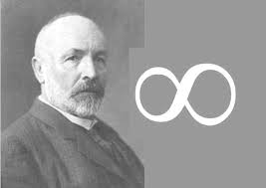
IV. THE INTEGRATION
We have even managed to expand the limits of our imagination.
Before Cantor, it was generally accepted that infinity could not be properly scrutinized by reason. After Cantor, we have learned that different types of infinity exist and that we can have infinite sets which are numerable.
The borders of thought have been wonderfully extended, helping us discover unexplored territories of both the real and the possible.

Slide 41
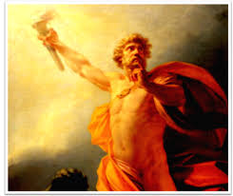
IV. THE INTEGRATION
Beyond the difficulties, it is admirable to reflect on the achievements of our Promethean longing for knowledge, in our indefatigable desire of grasping the vastness of the universe in the lightness of the concept.

Slide 42
IV. THE INTEGRATION
Every act of cognition is guided by logic, whose premises and operative rules articulate human reasoning.
However, its quantitative expression has only reached an adequate expression in sciences like physics, chemistry and –to a lesser degree- biology. Attempts at extrapolating this language onto social studies have been successful only to a limited extent.

Slide 43
IV. THE INTEGRATION
But logic is equally applied regardless of the field of knowledge.
A physicist’s mind is not governed by different logical rules than the mind of a philosopher.
Any advance towards the improvement of our logical categories and the unveiling of their possibilities, their elasticity and foundation, will provide the human intellect with new and more acute tools for apprehending realms of reality which until now have remained beyond the scope of our knowledge.

Slide 44
IV. THE INTEGRATION
Of course, the struggle to integrate knowledge by founding the most complex realities upon the simplest ones cannot be claimed to exhaust our understanding of reality.
“There are more things in heaven and earth than are dreamt of in your philosophy”

Slide 45
IV. THE INTEGRATION
The world will surely never cease to amaze us with unforeseen wonders, and blessings for our intellect.

Slide 46
IV. THE INTEGRATION
But the richness and inexhaustibility of the world does not prevent us from identifying the fundamental principles behind its vast and astonishing nature.

Slide 47
IV. THE INTEGRATION
Our mind, our logic, our intuition…, must be in a constant state of improvement through their interaction with reality, so that the deciphering of the basic axes of the universe will also unveil the true possibilities of human intelligence, of its logic and its language.

