Slide 1
WAAS Human Centred Economics Symposium, Dubrovnik 2017
Principles of Sustainable Economy:
An anthropologist’s perspective
Prof Thomas Reuter
Board, Future Earth Asia
Executive, International Social Science Council
Executive, World Anthropological Union & IUAES
Advisor, IPBES IPCC WSDR WSSR and others
Contact: treuter@unimelb.edu.au
Notes:
Bio data: Prof Thomas Reuter is a past President of the Australian Anthropological Association (2002-2005) and past Chair the World Council of Anthropological Associations (2008-2012). He is currently Senior Vice-President of the International Union of Anthropological and Ethnological Sciences, a member of the executive of the International Social Science Council, a member of the board of Future Earth (Asia) and an expert advisor to the IPBES and IPCC. Research in Indonesia and beyond has focused on indigenous people, social movements, religion, political elites, ecology, food security and globalisation. He has published 10 books and more than 100 articles.

Slide 2
Section 6: Towards a human-centered theory and practice
TOPIC
Subsection 32: Principles of Sustainable Economy
This section examines principles and practices consistent with promotion of economic welfare of all humanity in a sustainable manner that protects the ecosystem.

Slide 3
Sustainability: DEFINITIONS
What is the fundamental insight and principle of ecology?
Life forms are interdependent and evolve together, sustained in a state of dynamic mutuality as parts of a larger system.
The proximity factor: What sustains humans has a human and a whole of nature dimension
What is the fundamental principle of laissez-faire (liberal or neoliberal) economics ?
Naïve Darwinism, i.e., the idea that natural and economic interactions are based on competition between rational individuals seeking to maximise their own survival/profit
legitimising narrative for violent, unsustainable economics
In Fact: Neither nature nor society typically works like that!
Notes:
What sustains and what is being sustained? Proximity factor: those species that are directly linked through predator-prey or symbiotic relations are more intensely interdependent within subsystems; members of the same species are intensely interdependent, though to variable degrees: some species are less social than others. Humans are among the most social and most interdependent species..
In Fact: Natural selection operates on genes and associated traits, and is not premised on competition between individuals or species.

Slide 4
Sustainability: THE INTRA-HUMAN DIMENSION
Social Theory:
Norbert Elias describes the typical case of societies being sustained in mutuality
Theorem: the historical process of civilisation is characterised by ever widening webs of interdependence
Economic Theory:
Adam Smith describes the atypical case of an unsustainable society
critique of mercantilism as an uncivilised and ultimately irrational form of economic behaviour (Beggar thy neighbour)

Slide 5
Sustainability: The SOCIAL or intra-human component
Today ‘begger thy neighbour’ policies abound
Some critics of Merkel argue the huge German trade surplus, which they say is based on a policy of low domestic wages (to reduce production costs & consumer demand at home) coupled with the benefit of a low Euro exchange rate, is at the expense of other EU members.

Slide 6
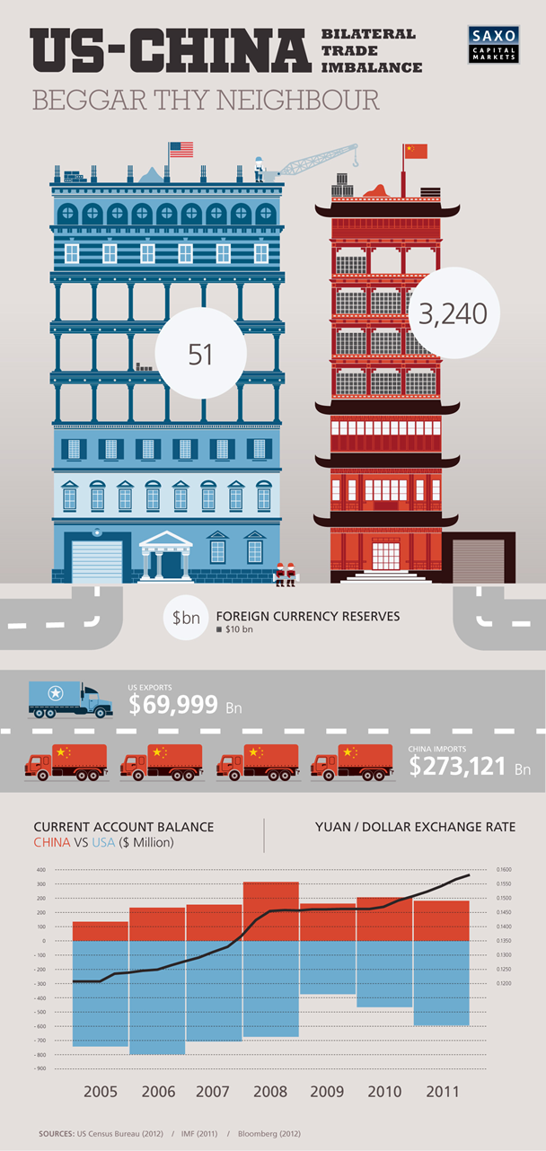
Sustainability: The SOCIAL or intra-human component
Notes:
Others attribute the US-Chinese trade surplus to currency manipulation. The Chinese would say: we have a right to catch up. In short, this is not about blaming anyone in particular, it is a widespread attitude that must be overcome.

Slide 7
Beggar thy neighbour = beggering yourself
Sustainability: The SOCIAL or intra-human component
A Race to the Bottom: Rational does not mean sane!
Notes:
Another way to begger one’s neighbour is the competitive reduction of corporate tax rates and corporate employer contributions to health and pension insurance (=wage costs) in a run away competition to attract more FDI.

Slide 8
The Case for Human Exceptionalism?
Why do humans behave in this way, if cooperation is more natural?
There is a choice between
Run away destructive competition (economic violence) and
Civilised or ‘ecological’ competition within a cooperative framework?
History: The overall success of humans as a species has been based on our unprecedented capacity for cooperation within evolving, rules-based social systems that resemble a natural ecosystem. A degree of competition and occasional systemic crises are also ‘normal’.

Slide 9
The Case for Human Exceptionalism?
Today: The global economy has not yet reached a state of ‘ecological’ competition. Moreover, the actions of rogue ‘predators’ in unregulated markets cause ripple effects down to the intra-national and intra-community and even to a family level, destroying already existing economic ecologies.
This is NOT Exceptional
Natural ecosystems also experience systemic crises!

Slide 10
The Global Economy: A SOCIAL CRISIS
POOREST 50% OF HUMANS
RICHEST 8 INDIVIDUALS
“ROGUE PREDATORS”?
Today “eight men possess the same wealth as half the world’s people…” (Oxfam 2016). Calculations based on Forbes Billionaires List and Credit Suisse Global Wealth Databook

Slide 11
The World Inequality Crisis

Slide 12
Sustainability: The Whole of NATURE Component
The "Anthropocene", following climatologist and Nobel Prize-winning chemist Paul Crutzen, is the "geological age that man created.”
Some say it began with the Neolithic Revolution ~9000 years ago in Mesopotamia that brought sedentary farming, which in turn was made possible by climatic change during the Holocene interglacial period.
Others see the beginning in the Industrial Revolution of the 18th or 19th century, or in the Post-WW2 period of global mass consumer society.
Is this a social or a natural crisis? Q.: Is there a precedent in NATURE of one antisocial species destroying all other life?
Notes:
Intro: Humans (like other species) have long relied safely on the robustness of the self-sustaining natural systems of which they are a product and an active part. But no longer:

Slide 13
Meet Cyano bacteria – Architects of Earths’ First Mass Extinction
Notes:
The so-called Global Oxidation Event or GOE was caused by cyanobacteria, which evolved into multicellular forms 2.3 billion years ago (approximately 200 million years before the GOE). They were the first microbes to produce oxygen by photosynthesis. Before the GOE, any free oxygen they produced was chemically captured by dissolved iron or organic matter. The GOE was the point in time when these oxygen sinks became saturated, at which point the oxygen was free to escape into the atmosphere. The oxygen was toxic to anaerobic life, and also caused massive global cooling, ushering in an unparalleled ice age. Cyano bacteria then entered into a symbiosis with other, aerobic bacteria that are the ancestors of all plants and animals today. The earth atmosphere then stabilised again.

Slide 14
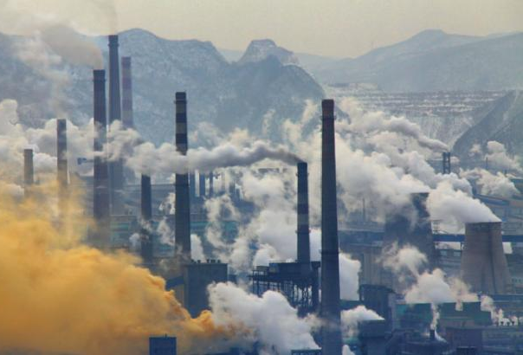
Meet Homo sapiens – Architects of the next mass extinction?
<< One Million Years ago;
progress since then. >>
Source: Mankind The Story of All of Us: Fire | History – YouTube
Right: sciencetopia.net
Notes:
It has taken humans not 200 million but just 200 years to fill all the worlds carbon dioxide sinks. Again causing climate change, as well as mass extinctions (not only due to climate change).

Slide 15
Sustainability: The whole of nature component BIODIVERSITY LOSS
Source: emaze.com
Notes:
My work with IPBES as a scoping expert, deliverable 3b, human use of wild species.
Statistics not fully up to date. From 2000 onward biodiversity is in free fall. Certainly in the last 00 years we have lost half of the population of wild species.

Slide 16
Acting with Courage – Succumbing to Fear
No species and no previous generation has ever been as informed as we are of our effect on the sustainability of the global ecosystem, and none have done as much damage.
The psychological fork in the road that lies ahead:
Mutual Efforts Toward a Transformation to Sustainability?
or
Mutual Assured Destruction?
Notes:
Mutual assured destruction is a term from the Cold War dictionary: refers to the ability of nuclear weapons to destroy everything, so that nobody wins. BUT NOTE: Many of our technologies today are of the same character as nuclear arms, i.e. they have the ability to destroy the Earth entirely. Although these other technologies (e.g. industrial agriculture) may not kill us as quickly, they still act with explosive speed measured on evolutionary time scales.

Slide 17
The Need for an Integrated Process of Transformation to Sustainability
DEMAND END OF TRANSFORMATION (WHY?)
Human Use Exceeds the Renewal Rate of Renewable Resources
Biosphere Destruction
Peaking of Non-renewable Resource Extraction (peak oil, lithium...)
Growing World Population
Growing Per Capita Consumption (Asia; but aged US, EU is peaking)
deforestation, habitat and biodiversity loss, water and food availability, and countless other, less recognized ‘ecosystem service’ crises (such as top soil loss)
global warming, ocean acidification, sea level rise (carbon) and effects of other pollution (nitrate, plastic, radioactivity, lead, Nano materials etc) or mechanical destruction (cities, roads, industrial farms)

Slide 18
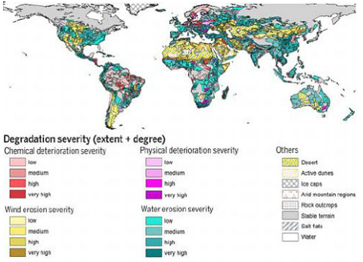
Degradation and loss of topsoil around the world
Notes:
This graph is based on conventional soil science. Cutting edge research shows that soil health is in fact already severely compromised around the world, wherever industrial farming methods are used. Soil takes millennia to grow and is an exceedingly complex ecosystem, as well as a major carbon store.

Slide 19
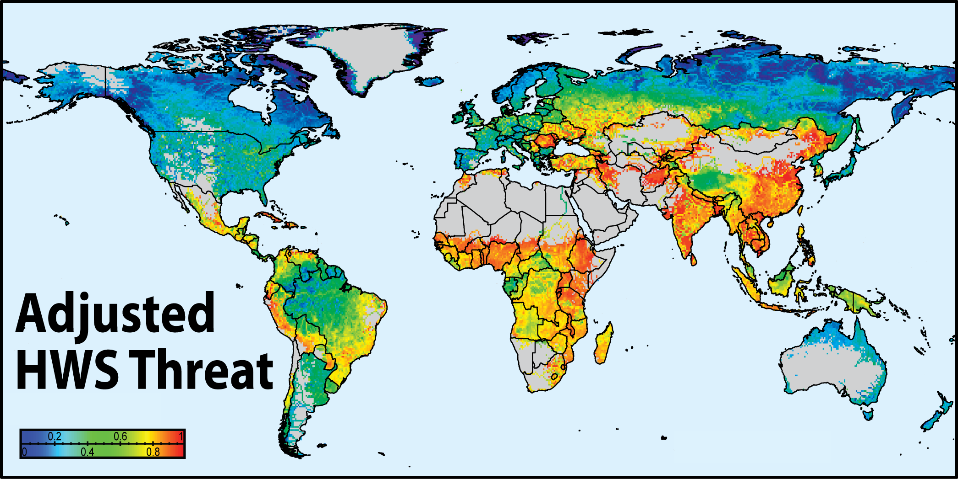
World Water Security Crisis
Notes:
Note: This is water security NOW. Likely to deteriorate rapidly in future
According to the laws of thermodynamics, a warming world will be subject to higher wind energy and greater weather extremes in general. Increased evaporation rates and declining reserves in aquifers, as well as the loss of freshwater stores in glaciers, are a major threat to our large rivers and the large irrigated agricultural production and population centres that depend on them

Slide 20
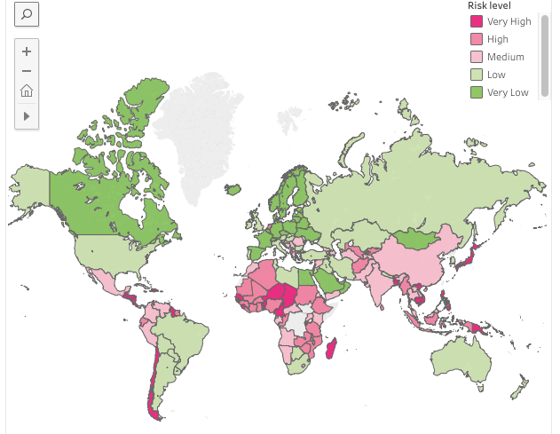
World Food Risk Levels 2015
Source: Open Page Maps, in UN-WRS 2015
Notes:
My core area of research at the moment. This chart still understates the seriousness of issue, it does not consider future trends and crises.: e/g/ UK would be in serious trouble in a world food crisis as it is highly import dependent.

Slide 21
The Need for an Integrated Process of Transformation to Sustainability
RESPONSE END OF TRANSFORMATION (HOW?)
Material Complexity
interconnected nature of the material challenges: cf. ICSU draft paper on the need to consider SDG interactions
local specificity of responses to diverse material challenges (plural ecologies)
Social Complexity
Perceptions of shared and diverging interests based on diverse identities and associated spheres of cooperation and conflict (complex social, cultural, political and historical reality)
Globalization: Links Complexity at Social and Material Levels
transnational nature of contemporary social relations (cf. N. Elias work on interdependence and the history of civilization)
transnational nature of environmental issues in the anthropocene
Building a sustainable global civilization now mandatory
Notes:
SDG example: biofuels may help meet renewable energy targets, but threaten biodiversity (palm oil from Borneo) and food security (ethanol from maize)

Slide 22
Sustainable Economics: Some Key Principles
Human Behaviour Change
Social cooperation on all scales across all sectors
Reduced material consumption – based on Increased security
Growth only possible in non-material consumption or extremely high value added products
Changes to the Mode of Production
Avoid use of non-renewable resources
Limit use of renewable resources to their renewal rate
Reuse / Repair / Upgrade – then
Recycle (closed loop of production, minimal wastage)
Superior Quality and Durability – based on warranty legislation
Short supply chains
Notes:
To point 2) Increased security is a prerequisite for reducing people’s right to consume. Excessive fear about having enough material resources often pushes people to accumulate much more than what they need, at the expense of others. This can be prevented by security guarantees that everyone is entitled to the minimum of material resources which they actually need: knowing that minimum supply to be 100% secure, there is less incentive to engage in stockpiling.

Slide 23
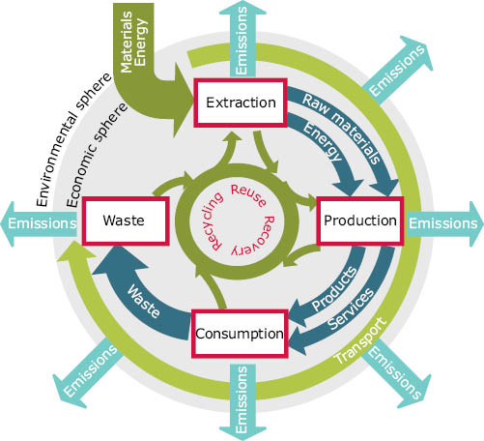
Sustainable Consumption and Production
SCP:
The Product
Lifecycle
Source: European Environment Agency
Notes:
To point 2) Increased security is a prerequisite for reducing people’s right to consume. Excessive fear about having enough material resources often pushes people to accumulate much more than they need, at the expense of others. This can be prevented by security guarantees that everyone is entitled to a minimum of material resources: knowing that minimum supply to be 100% secure there is less incentive to worry about stockpiling.

Slide 24
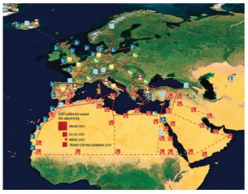
Innovation
Example: Desertec
An initiative, promoted by the Club of Rome, which demonstrates the capacity of already available solar power technology to supply all of the world’s energy in thirty years from now.
Source: Club of Rome.de
Notes:
Initiative has stalled due to the vested interests of the industry partners involved.

Slide 25
Sustainable Economics: The 6th Wave of Innovation?
Nikolai Kondratiev’s seminal ideas on economic epochs (The Major Economic Cycles, 1925) were developed and popularised by Joseph Schumpeter (Theory of Economic Development, 1970).
The 5 ‘Kondratiev waves’ are successive economic and societal revolutions triggered by major technological breakthroughs.
A restricted perspective on the broader, cyclical societal changes which historians refer to instead as episteme (M. Foucault) or paradigm shifts (T. Kuhn).

Slide 26
Sustainable Economics: The 6th Wave?
The five K-Waves of innovation and economic change
Source: moneyandmarkets.com
Notes:
Five Kondratiev waves of innovation and economic change have been proposed: the Industrial Revolution (1780-1848) to the Age of Railways & Steam Engines (1848-1873), the Age of Electrification & Heavy Engineering (1895-1940), the Age of Automobiles & Mass Production (1941-80) and The Age of Information & Communication Technology (1980-20??). The last wave, triggered by the ICT revolution, according to the authors of a recent book, reached peak in 2001 and is now in a downswing phase wherein returns on investment are dropping and demand for innovative new technologies is growing. The book is: The Sixth Wave: How to succeed in a resource-limited world, produced by James Moody (Executive Director, CSIRO) and science journalist Ms Bianca Nogrady (Sydney: Vintage Books, 2010).

Slide 27
Technological or Alternative Futures?
Technocrats hope for a great leap forward on the assumption that investors, experiencing diminishing returns at this economic fin de siècle, will be driven to innovate by sheer greed.
When it comes to sustainability, however, greed and technology in the service of greed have not been the solution but the very root of the problem. At least one visionary economist agrees with me on this: E.F. Schumacher “Small is Beautiful”, 1973.
Beware of the false promise of technological Wonderlands!
Ask first about the full socio-environmental cost (the ‘externalities’) of a new technology before you roll it out…
Notes:
I know much of the frustration of innovative science and technology experts, whose ideas are not implemented. Conversely, some of those ideas deserve scepticism (e.g. bio fuels).

Slide 28
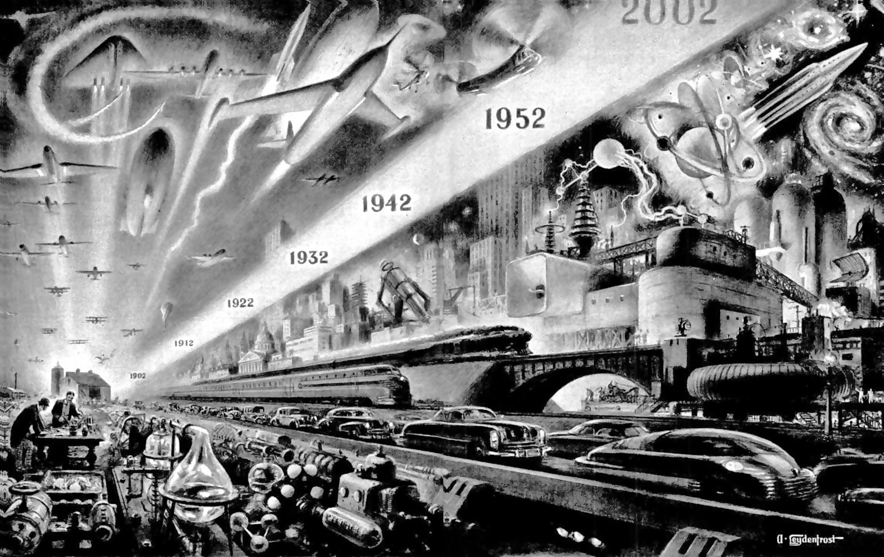
Technological Wonderlands
Source: thecharnelhouse.org
Notes:
The hubris of technological progress was at its height in the 1950s-1970s. Then a rude awakening began, that has not yet been completed to this day.

Slide 29
Technological Wonderlands or Alternative Futures?
In Schumpeter and Co.’s history of human civilisation, the ALREADY SUSTAINABLE ECONOMIES that prevailed universally and over 99% of human history are not even mentioned
The skills for sustainable living that all of humanity once already had developed are now fast disappearing.
What is left of them is found largely in pockets of “underdevelopment” threatened by technocratic interventions from the global aid and development industry.

Slide 30
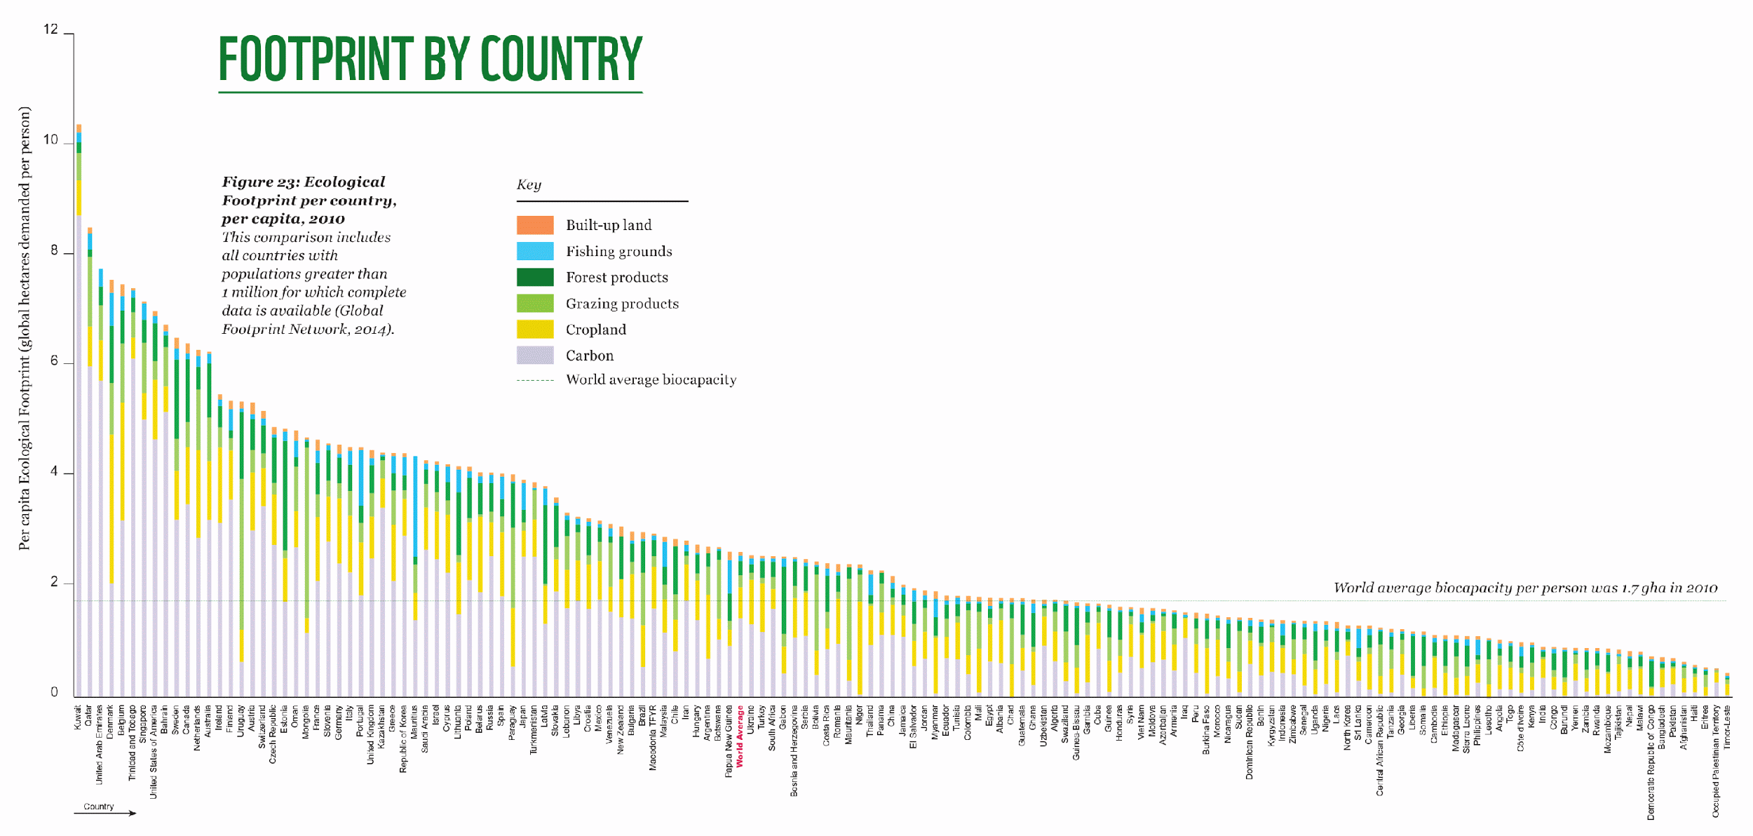
Technological Wonderlands or Alternative Futures?
Sustainability Gained or Lost? The Human Development Index
http://www.footprintnetwork.org/our-work/sustainable-development/

Slide 31
Small is Beautiful:
Fisheries
Similar pattern for
small vs. large scale farming
Source: National Geographic 2008 / UBC
Source: discover-bali-indonesia.com

Slide 32
Sustainable Economy Traditions Abound
Source: discover-bali-indonesia.com

Slide 33
Alternative Futures? Promising Fusions of the Old and the New
Source: permaground.wikispaces.com
Notes:
The Permaculture Movement is an example of a fusion of traditional wisdom and high tech. It was founded by Bill Mollison and David Holmgren, who, In the late 1960s, started developing ideas about stable agricultural systems in the Australian state of Tasmania. They saw the dire consequences of rapidly growing industrial agriculture, which is highly dependent on non-renewable resources, poisons land and water, reduces biodiversity, and removes billions of tons of topsoil from once fertile landscapes. A design approach called permaculture was their response (book Permaculture One 1978). My famous last words: DARE TO DREAM !!!

Slide 34
THANK YOU
for your attention
Contact: thor2525@gmail.com

