Slide 1
FORMS OF CAPITAL
Neantro Saavedra-Rivano
University of Tsukuba (Japan) and University of Brasilia (Brazil)
Roundtable on Human Centered Economics
WAAS-WUC
February 1-3, 2017, Inter-University Centre, Dubrovnik, Croatia

Slide 2
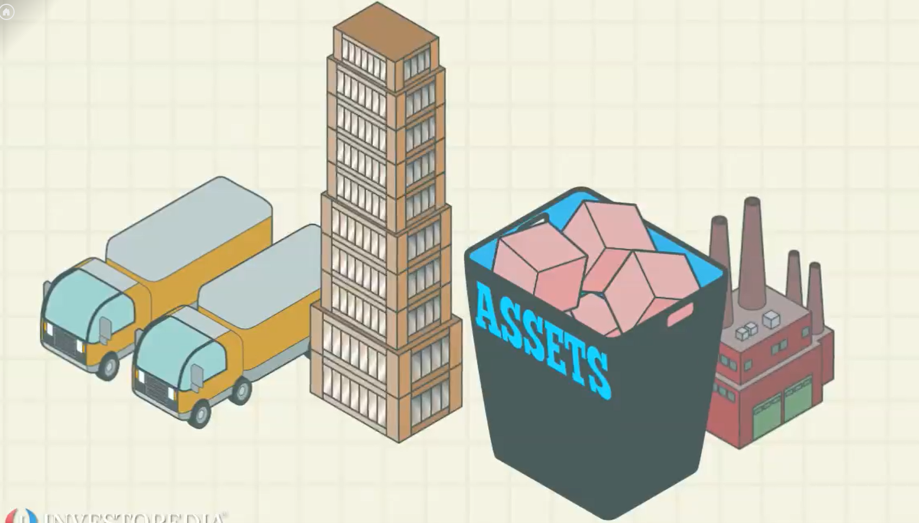
Common definition of capital
Produced durable goods used in the production of goods and services

Slide 3
Forms of capital
Natural - limited, non-renewable
Physical Infrastructure - man-made
Human - capable of unlimited development
Intellectual - knowledge, science & information
Technological - knowledge applied to facilitate physical processes
Social & Cultural - institutions, networks, systems, standards, values
Political, legal and regulatory
Financial capital

Slide 4
Proposal of a framework for a human-centered economic system
The economy as a (more or less) endogenous dynamic system
Material and intangible elements
Transients and durables
Dynamics driven by internal processes of transformation
Processes correspond to production functions (of goods and bads) and every element can be, in principle, input and output
The framework is also able to incorporate environmental elements
Capital corresponds to durables (material or intangible) entering into production processes

Slide 5
Humans and human capital
People are one of the durable elements, both input and output in transformation processes
In particular, the procreation (natural or bio-engineered) of new individuals is a central process of the system
According to the OECD, human capital is defined as “the knowledge, skills, competencies and attributes embodied in individuals that facilitate the creation of personal, social and economic wellbeing”
This means that human capital is not only an input for the production of goods but ALSO for the generation of individual and social wellbeing, a fundamental metric for the state of the system
It follows from this interpretation that investment in human capital includes the sum of all costs that allow a new being to reach economic autonomy and a full social life. Of course, it will also include additions taking place during adult life

Slide 6
Three Dimensions of Human Capital
Familial
Social
Economic

Slide 7
Who is Responsible for taking Decisions on Human Capital Formation?
Two types of decision
Bringing new beings into the world (creation)
Investment in living humans (investment decision)
There are two principal decision makers regarding investment
Families
Society (Government as the intermediary)
Other actors regarding investment decisions
Individuals themselves
Firms

Slide 8
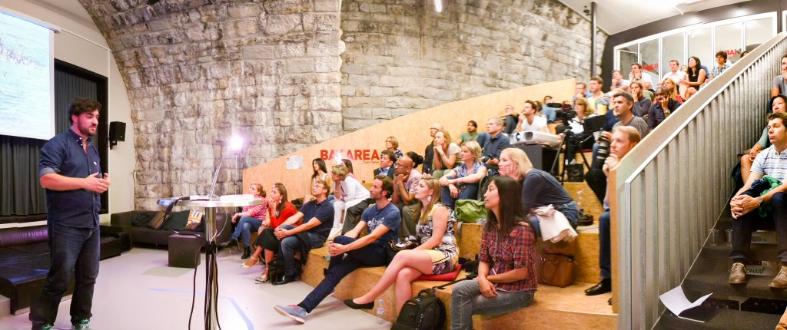
The Paradox of Human Capital
The Paradox: although most of the investment in human capital is made by families, the return on that investment is reaped by society (in addition to the individual itself)

Slide 9
From the Paradox follows a Dilemma
The paradox once again: although most of the investment in human capital is made by families, the return on that investment is reaped by society (in addition to the individual itself)
The dilemma: what to do about the lack of incentives and the inefficiencies resulting from this paradox
The rising perception on the part of families that the return on their investment is inadequate leads to undesirable demographic outcomes
Incompatibilities between family and social motivations combined with social and economic inequalities lead to serious (social) inefficiencies in investment decisions
An obvious solution
Socialization of investment in human capital
But, what about implementation?

Slide 10
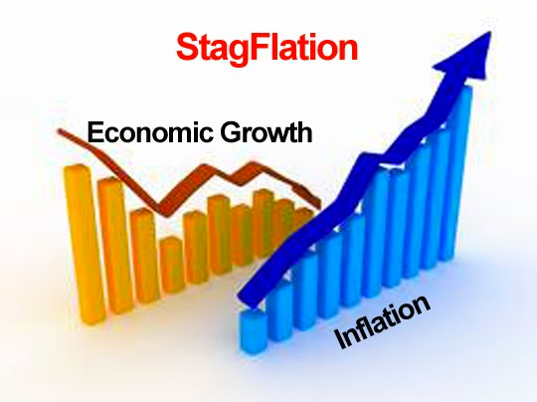
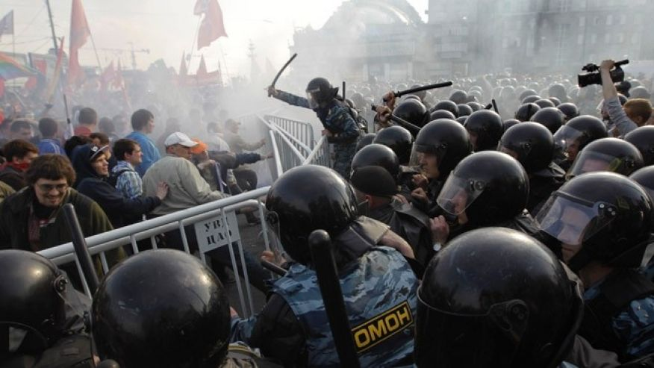
An “obvious” route: government transfers (but it does not work!)
The conventional route involves increased taxation and has, especially in the case of developing countries, insurmountable political and economic limitations

Slide 11
Another route: securitization
A market solution: securitization of human capital
Savings from the economically active population would be used to finance education and other HC expenses of the young
This promotes efficient inter-generational financial flows, thus ensuring that human capital needs to take the economy into its next cycle
Investment flows are socialized and take the form of loans rather than grants

Slide 12
Advantages of this route
Effect on economic development
It creates favorable conditions for taking full advantage of the country’s potential and stimulates economic growth, both in the short and the long run
The centrality of human capital to economic development makes it conducive to a systematic approach to developmental issues
Positive effects on economic and social disequilibria
It establishes a trend towards the equalization of opportunities, making them independent of the regional environment and of family background
It contributes to the reduction of income and wealth disparities
Other effects
A potential tool for the correction of negative demographic trends
Allows for an effective planning of development aid
An integrated approach to issues on international migration

Slide 13
Challenges of Implementation
A warning: although this route offers highly positive effects, it disrupts social, political and even family relations
Its implementation will result in important micro and macro economic adjustment
The financial system will need to adapt to the influx of these new securities, which have the potential of becoming dominant assets
Possible options for the implementation/interpretation of this scheme
“modular” implementation
gradual implementation
limited implementation (pilot programs)

