Slide 1
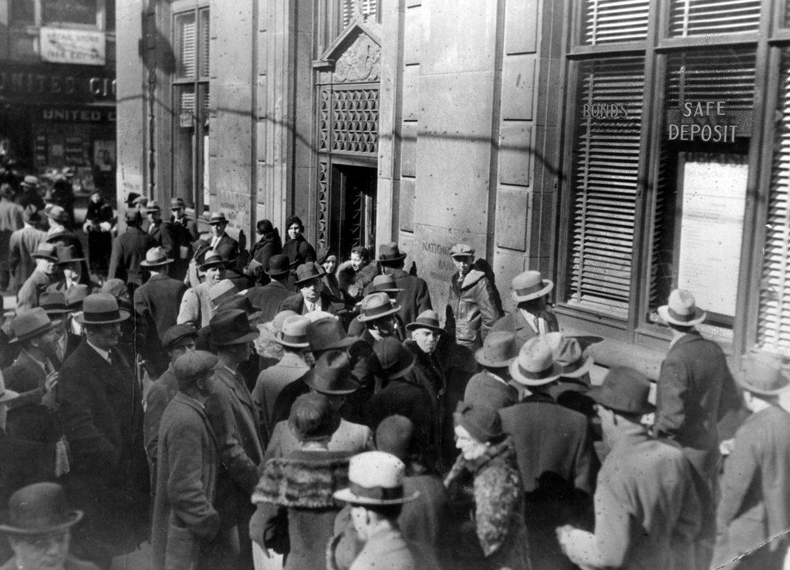
Social Theory of Money
Garry Jacobs
CEO, World Academy of Art & Science
CEO, World University Consortium
Vice President, The Mother’s Service Society (India)
Dubrovnik, February 1-3, 2017

Slide 2
Social Characteristics of Money
Money is not a thing
Money is a social organization for networking similar to language and the Internet
Money has helped liberate the individual from social & cultural constraints
Money is an instrument for social development which has become a master
Money has no inherent value outside of a social context
It is a subtle power with the capacity for multiplication and self-multiplication, the way information and knowledge can multiply
Capacity to create money can be increased by increasing the geographic area in which it is accepted, increasing velocity of money, raising trust in the institutions on which it is based, and monetarizing intangible forms of wealth
Notes:
Fdr 1933
2008

Slide 3
Money as Symbol
For products, services, technologies, physical and intellectual property companies, other forms of capital
For the economic capacities of the nation that issues it – its natural, human & technological resources, the integrity of its political institutions, capacity for self-defense, quality of educational system, aptitude for innovation, legal protection of property and human rights, cultural values related to freedom, integrity and hard work
Money is a form of social power intimately linked to other forms of power with which it is interconvertible

Slide 4
Money and Social Power
Scarcity of money reflects an unwillingness to equitably distribute social power
The power of money derives from peace, social harmony, national productivity, public confidence, trust and human values

Slide 5
Human Value of Currency
The value of money lies in its role as a catalyst to facilitate, accelerate and maximize the harnessing of all available resources for the betterment of humanity
The real value of money should reflect how effectively it serves and promotes security, welfare and well-being of people
A monetary system that benefits a few is no better or fairer than a political system that concentrates power in an authoritarian elite
Money is a symbol of the value of human life and individuality
Increasing the value of human beings increases the capacity to create money
Rationale for minimum basic income scheme is similar to universal free education
Notes:
By this standard money too fails to live up to its social mission
Inflation

Slide 6
Shift from Speculation to Investment in People
Money system can be radically altered to promote human well-being
Out of the 250 trillion in global financial assets, only 20% is used to support the real economy.
Speculative investment of the rest serves to destabilize the real economy and limit social progress
A tax on short term speculative investments is an essential measure to shift the balance from money to people

