Slide 1
Integration of Economy and Management in Theory and Practice Grażyna Leśniak-Łebkowska Warsaw School of Economics
Post Graduate Certificate Course/Roundtable
on Human Centered Economy
Dubrovnik, 1-3 February, 2017

Slide 2
Management, Organization and Strategy
Evolutionary process: from fundamentals of management to interdisciplinary approach to organized achievement of goals in changing scale and contexts with adequate corporate governance
Strategy:
Organizational self definition: who we are and whom we want to be ( H. Mintzberg)
Without a strategy the organization is like a ship without a rudder. (J. Ross, M. Kami).

Slide 3
General foundations of a strategic success
Strategy concept:
Based on values
Simple agreed objectives
Sufficient resources
Understanding environment of activity
Dynamic adjustments (flexibility and mobility)
Operational excellence
Risk management
Cooperativeness and competitiveness

Slide 4
Global environment impact on business strategy and leadership
POLITICAL
ECOLOGICAL
GLOBAL ENVIRONMENT
DYNAMICS AND
INSTITUTIONS
FUELING CHANGE
ECONOMIC
PESTE
- - - - -
TECHNOLOGICAL
SOCIAL
CHALLENGES:
OPPORTUNITIES AND THREATS
RESPONSES
ADVOCACY GROUPS DEFINING TRENDS, CREATING INITIATIVES/ PRESSURES
STRATEGIES OF ORGANIZATIONS
(STAND ALONE OR IN PARTNERSHIP)
STRATEGIC GOALS and PORTFOLIOS
MANAGEMENT TEAM AND TEAM LEADERS
BUSINESS CASE
PROJECTS PROCESSES PROGRAMS
EMPLOYEES

Slide 5
Challenges
Changing requirements and lifestyles.
Shrinking resources and growing population: growing strain on basic natural resources (water, food, energy, shelter).
Transient advantages, innovativeness, creativity, hunting for talented enablers, new generations more demanding, 60% wants to change the world for the better.
Increasing global powers and impacts (conflict management)
More regulated contexts and stringent controls to enable a just world.

Slide 6
Responses
Dramatic shifts in competitive positioning of giants and the victory of “black swans”
New business models and strategies based on temporary opportunities
Mapping and understanding demand (Big Data?)
Developing ability to deliver (Supply Chain Management).
Growth, exit and breakthrough strategies to enable fast reorientation
Agile leadership, structures, and strategic mobility as the base of resilience.
Project Management becoming the vehicle of change, capable of addressing the evolving needs and contingencies in every area.

Slide 7
Strategic mobility (resource-based view)
Ability to formulate and modify strategic intents and the ways of their implementation (visioning);
Ability to execute the strategy with respect to external change impacts (operational excellence);
Ability to build own core competences based on key resources and their unique architecture (potential);
Ability to acquire necessary resources from external partners and maintaining them so they are ready for use when needed (adaptability);
Ability to relocate strategic resources to the places of operation, adequate in terms of quantity, structure and potential use (fast reaction forces).

Slide 8
Inside organizations
LEADING
LEADING
ORGANIZING & ACQUIRING RESOURCES
PLANNING & ALLOCATING RESOURCES
Strategic intent
ORGANIZING
PLANNING
STRATEGY
Organizational system stability
INERTIA
Organizational dynamics
CHANGE
RESOURCES
OPERATIONS
CONTROLLING PERFORMANCE
CONTROLLING
IMPLEMENTING
EXECUTION OF PLANS
Outcomes & impacts
EVALUATING RESULTS

Slide 9
Three mechanisms of development of organizations
Inertia?
Imitation?
or Innovation ?

Slide 10
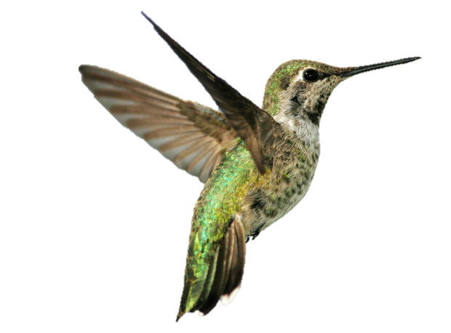
GRAŻYNA LEŚNIAK-ŁEBKOWSKA (PH.D) WARSAW SCHOOL OF ECONOMICS E-MAIL: LEBKOWSKA@SGH.WAW.PL
THANK YOU!

