Slide 1
Integration of Economy and Management in Theory and Practice: A Subjective View of an Economist
Zbigniew Bochniarz Kozminski University, Warsaw, PL & University of Washington, Seattle, US
World Academy of Art & Science
Warsaw, February 2, 2017

Slide 2
There is no commonly accepted definition of economics as one of the key social sciences. For one of the founding fathers of classical economics (what was then called “political economy”) - philosopher Adam Smith - economic science was "an inquiry into the nature and causes of the wealth of nations" (1776).
\

Slide 3
Alfred Marshall - building foundation for economics – the “hardest” and “objective – free of politics” social science, separated from political economy and based on hard sciences -- “laws” and mathematics. Economics was about human behavior in getting income and spending it, about production and exchange, less about distribution or consumption, and free of institutions and values (Principles of Economics, 1890).
\

Slide 4
I define economics as a social science searching for an optimal allocation of resources – different forms of capital – to satisfy human needs and secure human centered sustainability (HCS). It takes into account all four stages of reproduction cycle: production (extraction and manufacturing), exchange, distribution and consumption, as equally important.
\

Slide 5
There are two sides of economics – positive (what is?) and normative (what ought to be?). The first one is closely related to neoclassical economics, mainly microeconomics, why the normative is the subject of applied economics and policy design. All of them, however are dealing with a “substance” and do not describe how to reach the goal -- HCS.
\

Slide 6
This is why Economics needs Management (Mgmt) to find how to attain HCS, what process to follow. Mgmt is about the process undertaken by one or more individuals to coordinate other activities – people or organizations - to achieve results, which cannot be not achieved by acting alone (Donnelly, et al, 1995)..
\

Slide 7
The scientific management or Mgmt as a social science started appearing among practitioners – managers and engineers – who at the beginning of the XX Century began applying scientific rigors to data related to productivity.
\

Slide 8
One of the founding fathers of Mgmt science was the French manager of a large coal company Henri Fayol who formulated Principles of Management around 1929 (General and Industrial Management, 1929). The contemporary guru of management science Peter Drucker described Mgmt as making people productive, competent, integrated and performing (1980).
\

Slide 9
What Management is about? Mgmt utilizes knowledge of many disciplines, including psychology, sociology, statistics and social anthropology, as well as economics. There are many branches of management, starting with human resources management, organizational management, financial management, technology management, operational management and several others.
\

Slide 10
What is the key Mgmt branch? The key role plays the strategic management, which integrates all branches of management and makes an interface with microeconomics- the base for managerial economics.
\

Slide 11
Who controls the bulk of revenues? Due to the fact that business sector controls about 65-75% of resources (based on their revenues), it is critical for securing Human Centered Sustainability (HCS) by making business organizations sustainable (SB).
\

Slide 12
What is Microeconomics about? Microeconomics focuses on firms, households and governments, offers core knowledge as to how material wealth is created, how products or services are exchanged and revenues distributed in the first stage.
\

Slide 13
What should Economists fix first before Mgmt starts leading Business? Defining Human Centered Sustainability (HCS) or Sustainable Development
\

Slide 14
What is Sustainability?
For the global environment sustainability means that the Earth basic ecosystems are dynamically balanced and life on the planet is secure.
For human beings, sustainability means maintaining their carrying capacity in the long-term that secures their non-declining wealth and reproduction:
limitation to natural endowments (natural capital) making the foundation for carrying capacity
securing intergenerational equity (Pezzey & Toman 2002).

Slide 15
Two Basic Approaches to Sustainability and their Implications
Maximizing Material Wealth (MMW) vs. Maintaining Non-Declining Total Capital (NDTC)
Applying John HARTWICK’s rule (1977): “constant level of consumption could be maintained perpetually if all the scarcity rents were invested in capital.”(after Tietenberg 2008)
Implications of the dominant MMW approach => huge distributional gap, dominance of material private goods, discrimination of investment in non-material capital and public goods

Slide 16
Further Implications of the Dominance of the MMW Approaches
Maximizing Material Wealth led to:
Overpricing man-made and financial capital => crises
Dominance of material values over non-material values
Discrimination of investments in non-material capital
Erosion of ethical values and compassion
Greed and corruption
Uncontrolled depreciation and degradation of public goods – both natural and institutional
Local, regional and international conflicts and wars
Significant deterioration of public trust in two basic resource allocation modes: self-regulated markets and government regulations, including central planning

Slide 17
Evaluating Sustainable Development: Non-Declining Wealth vs. Non-declining Total Capital
Non-declining Wealth:
a. Non-declining income per capita (mostly GDP –PPP- per capita)
b. Non-declining genuine (adjusted net) savings (GDS or ANS)
GDS indicator (Pearce 1994):
GDS = GDP – C - Kmd D + EdI - EngD – MinD – ForD – CDD
Where:
GDS genuine domestic savings
GDP gross domestic product
C annual consumption
KmdD capital depreciation
Ed I education expenditure (investment in human capital)
EngD energy resource depletion (depreciation of natural capital)
MinD mineral resource depletion (depreciation of natural capital)
ForD forest depletion (depreciation of natural capital)
CDD damage to the environment due to carbon dioxide emission (depreciation of natural capital)

Slide 18
ANS - the Adjusted Net Savings indicator,
GNS - Gross National Savings,
Dh - depreciation of produced capital,
CSE - current non-fixed capital expenditures on education,
Rπ,i - rent from natural capital depletion,
CD - damage from carbon dioxide emissions,
GNI - Gross National Income at market prices.
Source: ANS is calculated and recommended by the WB since 1999.
Notes:
The CEE10 achieved about 10% of their net savings – similar level as the EU15.

Slide 19
Potential Implications of the Shift to the NDTC Approach to Sustainability
Maintaining Non-declining Total Capital should produce:
A right balance between material and non-material forms of capital => avoiding previous crises
Incentives to invest in human capital (HC) with its unlimited potential for creativity and innovations
Encouragement to invest in social capital (SC) forging in business and public life stronger relations based on ethical principles will produce trust, higher standards of behavior, shared norms and values, including altruism, compassion and mercy
Significant contribution to paradigm shift in economics with Human-Centered Sustainability (HCS)

Slide 20
Evaluating Sustainable Development: Non-Declining Wealth vs. Non-declining Total Capital
Non-declining Total Capital
(Bochniarz & Bolan, 2005, expanding concepts of Solow,1974; Hartwick, 1977; and Pearce, 1989)
TK = Km + Kn = constant (non-declining capital)
Where:
Km = Kph + Kf material capital (physical & financial)
Kn = Khc + Ksc non-material capital (human & social)
Kph = Kmd + Knc physical capital (man-made & natural)

Slide 21
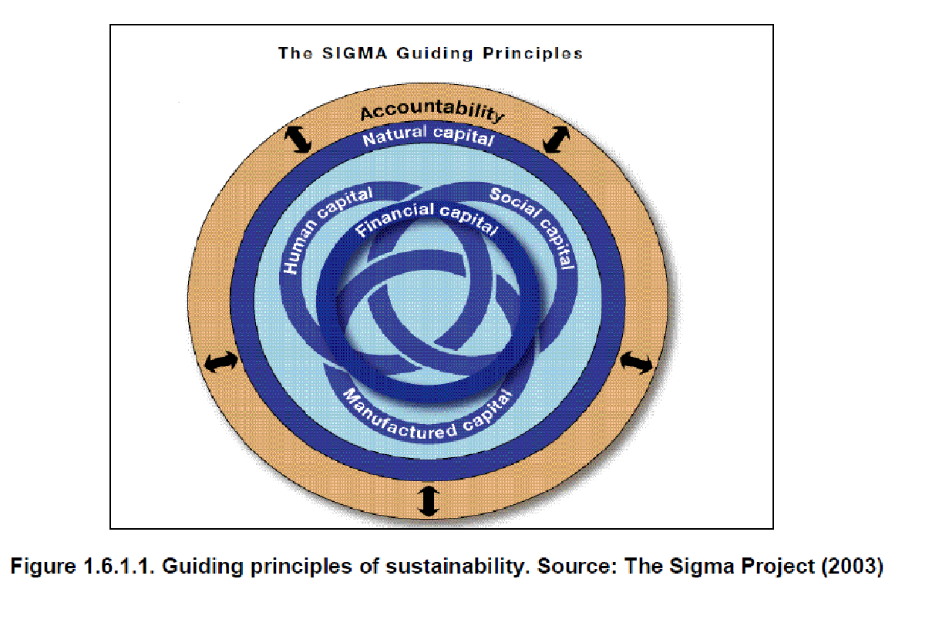
Evaluating Sustainable Development: Non-Declining Wealth vs. Non-declining Total Capital

Slide 22
Dr. rer. pol., Dipl. Biol. Joachim H. Spangenberg Sustainable Europe Research Institute SERI Germany, research coordinator Joachim.Spangenberg@seri.de, @ufz.de, @gmail.com

Slide 23
Dr. rer. pol., Dipl. Biol. Joachim H. Spangenberg Sustainable Europe Research Institute SERI Germany, research coordinator Joachim.Spangenberg@seri.de, @ufz.de, @gmail.com

Slide 24
Defining Human Capital (HC)
HC is the unique form of capital that has the ability to put other forms of capital – tools, infrastructure, land and financial assets - in motion to produce goods & services and thus to create new values.
This is the single creative form of capital.
HC = Knowledge + Skills + Attitude

Slide 25
Defining Social Capital (SC)
SC is a special type of capital resulting from investments in building relations, institutions and networks that produce collaborative attitudes, shared norms and values, mutual understanding and trust – critical factors for cooperation with other types of capital and thus contributing to sustainable development (SD).
SC – positive or negative (non-ethical)

Slide 26
Measuring SC
The economic value of SC depends on time invested in developing institutions, networks, relations, attitudes and trust within a certain group of people (from family, through firms, cluster, region, nation to global community) [Bochniarz (2008)]
Similar approach proposed by C. Roman (2009) with a set of complex indicators assessing its value mainly through surveys

Slide 27
Main Stakeholders of HCSD
Governments
Companies
NGOs
Academia
Media
Citizens
International Institutions

Slide 28
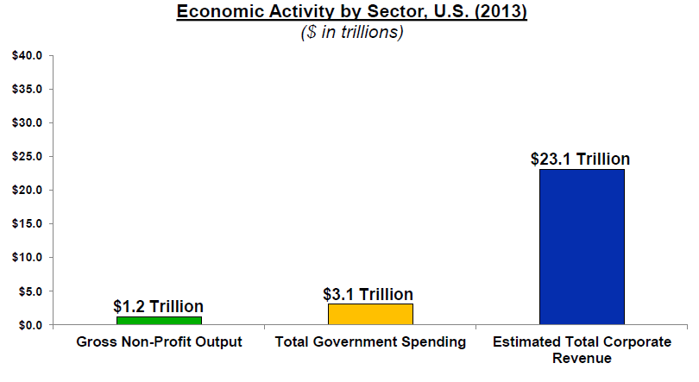
The Economic Power of Main Stakeholders in USA (Porter 2013)
Governments
Companies
NGOs
Academia
Media
Citizens
International Institutions

Slide 29
Responsibilities Call for Action!
Academia
Companies
NGOs

Slide 30
Responsibilities of Academia in paradigm shift toward HCSD (1)
In education process:
Implement student-centered approach to identify students’ unique talents => facilitate personal and professional development
Keep balance between Knowledge (K), Skills (S) and Attitudes (A) building
Help them to discover K rather then transfer
Promote not only hard but particularly the soft S = critical factor for building SC
Include ethical principles in A building by individual and team practical projects

Slide 31
Responsibilities of Academia in paradigm shift toward HCSD (2)
In research process:
Popularize best practices of government, business and NGOs leading toward HCSD
Have the courage to defend academic integrity in identifying governmental policy and market (business) failures threatening HCSD
Promote action research involving all major HCSD stakeholders and share results
Support networking as the third resource allocation mode based on ethical principles in correcting governmental and market failures and thus enriching SC and contributing to HCSD

Slide 32
Microeconomics of Competitiveness – the Global Knowledge Generation Network’s Approach to SB
From economic point of view, the SB means an enterprise that maintains its competitive advantage coming from its unique value chain (Porter 2008)
It requires strategic approach to SB including redesigning value chain, diamond of competition & shared values (Porter & Kramer 2011)

Slide 33
Two Types of Competitive Advantage (M. Porter)

Slide 34
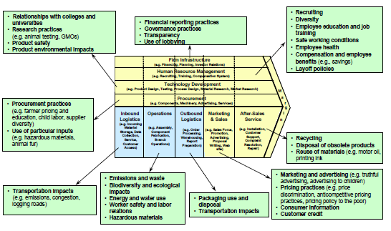
Redesigning Value Chain for HCS (Porter )

Slide 35
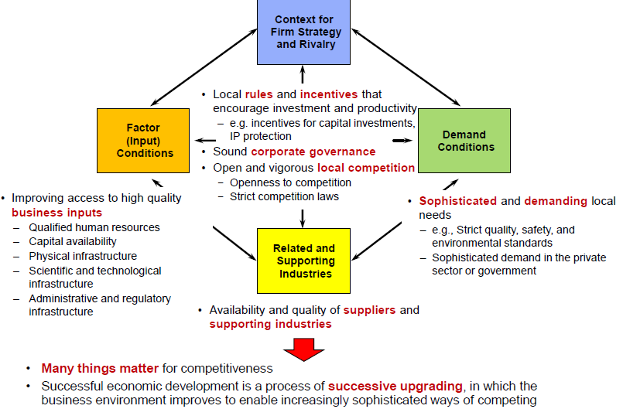
Adjusting Diamond of Competition to HCS Advantage (M. Porter)

Slide 36
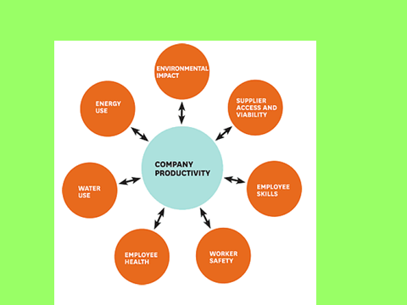
Creating Shared Value (Porter & Kramer 2011)

Slide 37
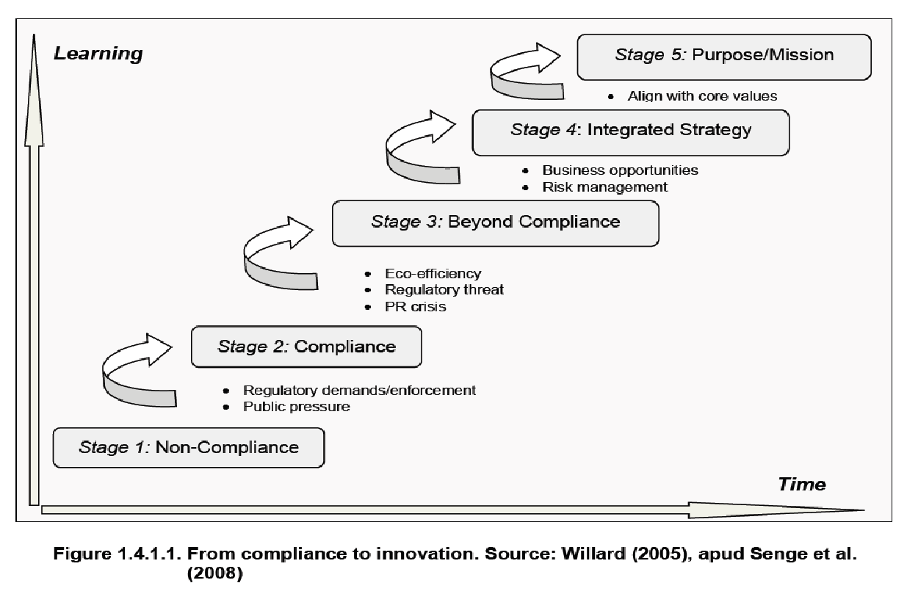
Responsibilities of Companies – Business Sector in paradigm shift toward HCSD (1)

Slide 38
Dynamics of the Global Environmental Market: 1990-2010-2030 (WB, OECD, EBI)
1990 200 billion USD
1995 500 billion USD
2000 1000 billion = 1 trillion USD
2010 1.5-1.8 trillion USD
2030 7 trillion USD
Notes:
The Climate Change market (CCM) is a significant part of the Environmental Market (EM) with a huge potential to grow in the near future while top world economies – Japan & Germany will be moving away from nuclear to energy conservation and renewable sources. There might more to follow them…This is the market of goods and services related to CC mitigation and adaptation activities.

Slide 39
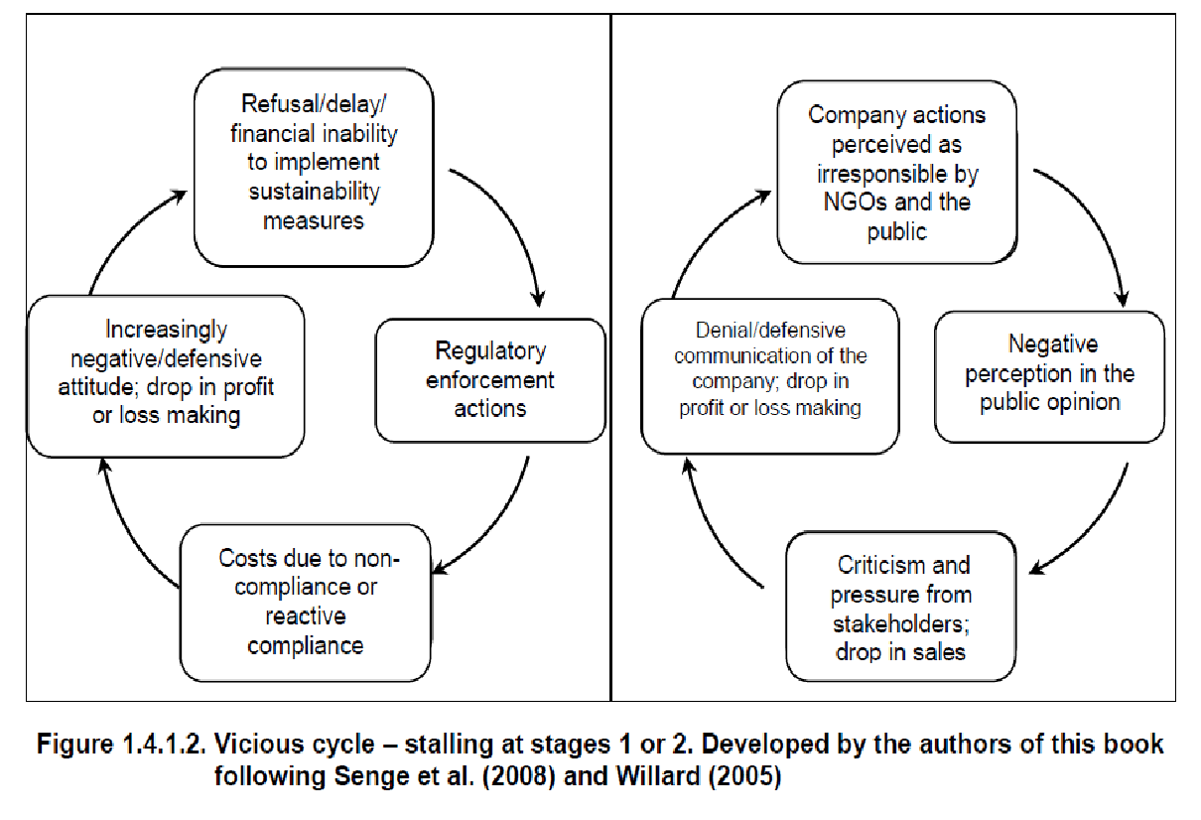
Responsibilities of Companies –Business Sector in paradigm shift toward HCSD (2)

Slide 40
Responsibilities of NGO including WAAS, WUI and others in Paradigm Shift toward HCS
???

Slide 41
Thank You!

