Slide 1
Toward a Human Centered Theory of Economy & Society
Alberto Zucconi
World Academy of Art and Science (WAAS)
World University Consortium (WUC)
Person Centered Approach Institute (IACP)
azucconi@worldacademy.org
IUC, Dubrovnick, February 1- 3, 2017

Slide 2
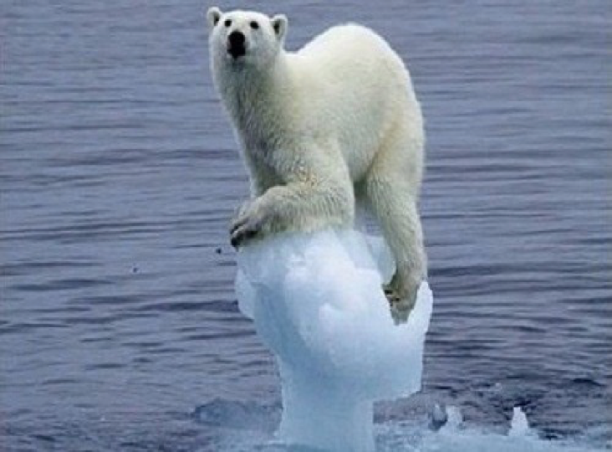

Slide 3
We live in a period of globalization and of growing complexity.
We need new and effective ways of coping to meet our present and future challenges.

Slide 4
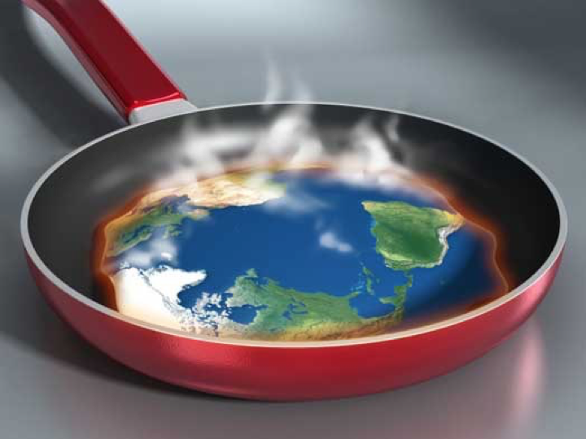

Slide 5
Paul Crutzen, Nobel Prize recipient and WAAS Fellow, reminds us that today:
“human activities are the main variable impacting on all planet’s life forms”

Slide 6
There are a mounting number of challenges to be faced.
We need to foster new and solid bases for a sustainable global society, re-examining the dynamics of global, economic, social, political and cultural constructs:
our ways of being in relationship
with ourselves, others and the world…

Slide 7
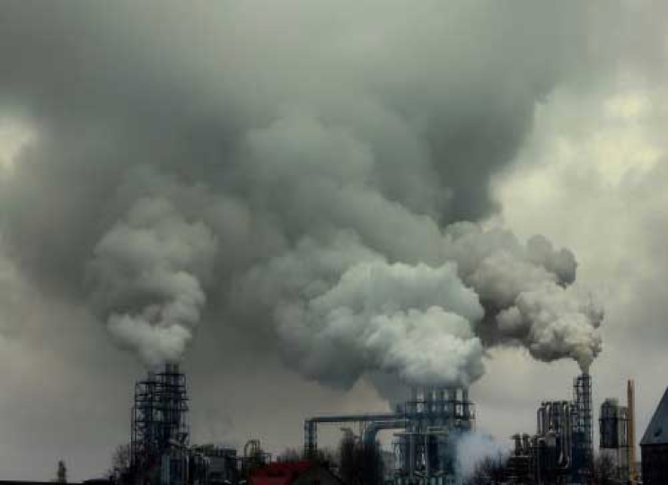

Slide 8
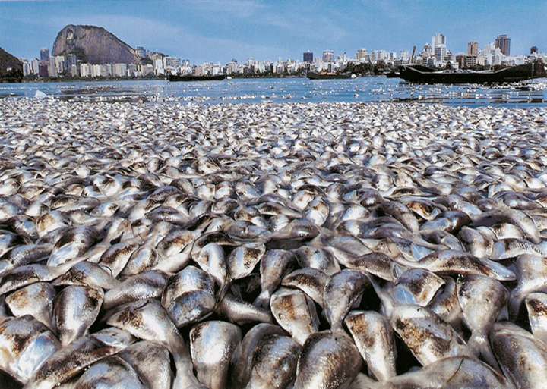

Slide 9
“We cannot solve the problems of today at the level of thinking
at which they were first created.”
Albert Einstein

Slide 10
The tools we currently use to see and solve the mounting problems are inadequate,
They are part of the problem not of the solution.
The need for a paradigm change, to enable humanity to deal effectively with the mounting challenges facing us, has become dramatically evident. & urgent

Slide 12
The present ROI shows a positive gain even when, in order to earn money, a project destroys human and natural capital.
We are still measuring the wealth of nations with the outdated GNP, failing to understand that people and the natural environment are the most valuable resources of a country and their resilience the best asset.
That we need a new paradigm in economy is evident, the traditional metrics do not measure reality!

Slide 13
Another example of blindness produced by mechanistic reductionist viewpoints and by the denial of reality is the concept of the traditional bottom line:
How much money one makes from manufacturing and selling a product
a very superficial measurement of reality, producing harm with its shortsightedness.

Slide 14
The ecology of context
New visions of economy and society should help us see and cope better. We need visions that facilitate all the stakeholders to see clearly the so called ecology of contexts.
The ecology of context is the dynamic interplay of contexts and demands that constrain and define an entity.
It is helpful for all stakeholders, offering an insight into the complexity of the responses that can result from any perturbation of the system and providing an useful epistemological device for understanding complex dynamics.

Slide 15
Ecology of context
Example:
Environmental Ecology
An agro ecosystem exists in contexts that include climate, soil, plant genetics, government policies, social and cultural constructs, the personal beliefs of the farmers and many other variables too numerous to mention.
All of these contexts are dynamic at the same time, at diverging time scales, so the ecology of contexts is a compless process of multiple dynamic relationships.

Slide 16
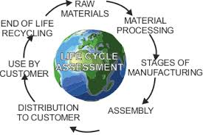
Life-cycle assessment (LCA)
also known as life-cycle analysis, Eco balance, and cradle-to-grave analysis, is a technique to assess environmental impacts associated with all the stages of a product's life from raw material extraction through materials processing, manufacture, distribution, use, repair and maintenance, and disposal or recycling.

Slide 17
Life-cycle assessment (LCA)
Designers use this process to help critique their products. LCAs can help avoid a narrow outlook on environmental concerns by:
Compiling an inventory of relevant energy and material inputs and environmental releases;
Evaluating the potential impacts associated with identified inputs and releases;
Interpreting the results to help make a more informed decision
.

Slide 18
We need to see economy with different eyes
To be able to effectively promote a change in thinking, planning and behaviors that:
See people as the most precious resource and most important form of productive capital;
Protects and promote human security, welfare and wellbeing instead of the present consumption binge and unregulated economic growth;
Protects and promotes employment opportunities and meaningful occupation for all;
Regulates, blunting the fangs of the speculation frenzy that allows for a minority of people to become very, very rich as it destroys natural, social and human capital and destabilizes entire economies and nations ;

Slide 19
A new paradigm in economy
To manage the world’s resources in a sustainable manner for both present and future generations;
To promote a more equitable distribution of income within the constraints imposed by the planet’s resources;
To shift to sustainable technology and sustainable production cycles, educating and promoting forms of sustainable production and consumption fostering maximum security, welfare, wellbeing and developmental opportunities for people.
The so called Green and Blue economies are good examples.

Slide 20
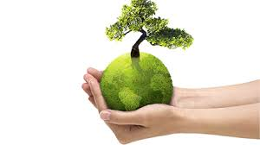
The Green economy
The Green economy is defined as the sustainability management science.
Is an economy focused at reducing environmental risks and ecological scarcities, that aims for sustainable development without degrading the environment.
It is closely related with ecological economics, but has a more politically and people centered focus.

Slide 21
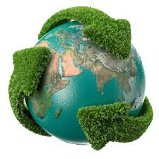
The Green economy
The 2011 UNEP Green Economy Report states:
to be green, an economy must not only be efficient, but also fair.
Fairness implies recognizing global and country level equity dimensions, assuring a just transition to an economy that is low-carbon, resource efficient, and socially inclusive.

Slide 22
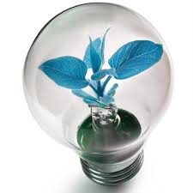
The Blue economy
The Blue Economy changes the way in which we run our industrial processes and resolve the man made environmental problems, refocusing from the use of high-energy cost resources to solutions based on simpler and cleaner technologies.

Slide 23
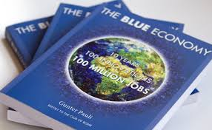
The Blue economy
Gunter Pauli, a WAAS Fellow, is the formulator of the Blue Economy, in his book Blue Economy, he illustrate hundreds of examples of good practices producing measurable benefits achieved by tackling te environmental problems with open-source scientific solutions based on physical processes common in the natural world, to create solutions that are both environmentally beneficial and produce sustainable economic and social benefits.
http://www.theblueeconomy.org/

Slide 24
A society that is effectively protecting and promoting prosperity is a society focused on effectively protecting and promoting what really makes a difference ( various forms of capital?):
Social Intelligence
Psychological resilience
Creativity
Health and wellbeing
Empatic understanding
Respect for human differences and other life forms
Effective interdisciplinary and intersectorial people centered education
Spirituality
Protection and promotion of Human rights
Equal access to sustainable opportunities
Peace
Sustainable governance
Sustainable entrepreneurship
Learning to learn
Existential grounding

Slide 25
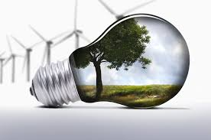
The world badly needs a coherent human-centered, ecologically sustainable theory and practice of economy that will enable us to see clearly the difference between making more money and protecting and creating sustainable prosperity.
A theory drawing on the best ideas emerging around the world as a powerful tool for educating students, informing the general public and influencing decision and policymakers, and international institutions to act to promote the security, welfare and wellbeing of all human beings and the biodiversity of the planet.

Slide 26
A New Paradigm, has to create, verify, offer & employ effective measurement tools. Some already exists:
Environmental Economic Accounting (SEEA)
Total Economic Value (TEV)
Triple Bottom Line
Quadruple Bottom Line
World Happiness Report
Human Development Index etc, etc,

Slide 27
Green accounting helps promote a sustainable future for businesses as it brings green public procurement and green research and development into the big picture.
Penalties for polluters and incentives (such as tax breaks, polluting permits, etc.) are also a crucial part of this type of accounting.

Slide 28
Green Accounting measurement tools:
System of Environmental Economic Accounting (SEEA), which focuses on the depletion of scarce natural resources and measures the costs of environmental degradation along with its prevention.
Total economic value (TEV) is a cost–benefit analysis that refers to the value derived by people from a natural resource, a man-made heritage resource or an infrastructure system, compared to not having it.

Slide 29
The Triple Bottom Line (TBL) measures Economic, Ecological and Social results, .
the Quadruple Bottom Line (QBL) that takes into account the Environmental, Social, Cultural (including governance) and Economic results.
These methods of measurement allow for a more realistic, effective and systemic assesment.

Slide 30
We need to understand the crucial role played by the ways in which we socially construed reality and in order to operate in science and conscience we need to make explicit the implicit epistemologies, hermeneutics, values,, power distribution, purposes, metrics, short, medium and long term impacts, sustainability gradients, stakeholders biases as well the kind of metrics we use to measure what we call profit, productivity and progress.

Slide 31
Once again new and effective tools for understanding and governing such epochal changes are needed as well as the facilitating of new awareness in all the stakeholders of the dangers and opportunities offered by the 4th revolution.

Slide 32
For improving effectiveness, I suggests the employment of Person-Centered Approaches (PCA), scientifically proven effective ways to create sustainable solutions on a win-win basis, promoting resilience, creativity, emphatic understanding, respect and capacity for deep contact with oneself , others and all the lifeforms.
PCA are systemic, holistic approaches that focus on capacities rather than on limitations, empower and promote wellbeing through the development of the potentialities of individuals, groups, organizations and communities.

Slide 33
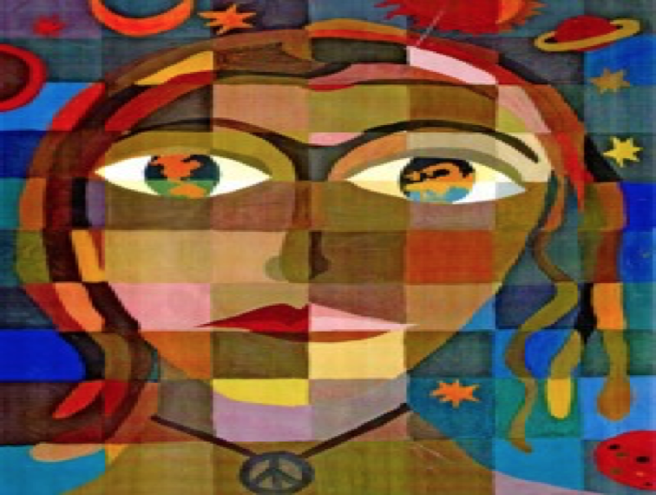
The People Centered Approach (PCA) fosters the protection and promotion of human capital and at the same time assure the maximum level of effectiveness in protecting and promoting human ecologies and natural ecosystems, while promoting sustainable change.

Slide 34
PCA is a values oriented approach based on equal rights, deep respect of all form of life, cultures and traditions. A way to become aware on how we construe our experiences of what we call reality: the relationship with ourselves, others and the world.
We need to foster at every level of society awareness of the social construction of reality, of our powers and responsibilities for the present and the future of humankind & the whole planet.

Slide 35
We need to foster a new psychological literacy and psychological resilience for billions of people, a sort of a psychological compass:
a more aware and grounded way of being with ourselves, others and the world in order to navigate in the rippling currents of change.

Slide 36
We need to effectively protect and promote human and environmental capital.
We need to think and act globally and locally in effective ways and to do so we need people to possess the knowledge, skills and competencies to operate at intersectorial and interdisciplinary levels:
Socio cultural
Environmental
Economic
Psychological
Spiritual
How can professionals contribute to this?........

Slide 37
Our social construction of professional competence is largely obsolete since various professions are still construed by using the outmoded mechanistic reductionist divisions of the traditional fields of expertise.
This situation reflects the limited knowledge of the world we had when the modern professional and scientific disciplines first emerged and continue to be stifled by the lines of jurisdiction in these traditional divisions of expert labor.
This has little to do with offering the best services to society and much to do with the power struggles among the competing professional corporations or guilds.
Andrew Abbott, 1988

Slide 38
Education is the most effective means that society possesses for confronting the challenges of the future.
Education shapes the world of tomorrow but will the outcomes be positive or negative?

Slide 39
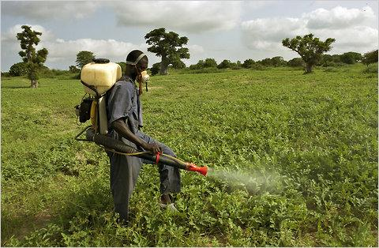
We still graduate agronomists that know very well how to increase the yields for each acre of land with artificial fertilizers and pests killers, but are blind to the fact that in so doing they are poisoning the waterways and ignoring the obvious - since everything is interconnected - the chemicals flow down the rivers, acidify the seas, transforming teeming marine ecologies into deserts.

Slide 40
Education to become more effective needs to shift:
from subject centered to human-centered learning
from passive to active learning
from memorization or understanding to original thinking
from information or mental understanding to development of the whole person
from academic theoretical to life-centered knowledge
from fragmented knowledge to integrated knowledge
shift from creating standardized products to fostering the development of resilience, individuality and creativity

Slide 41
We need to develop a new paradigm in education.
With the awareness that the process is going to be as important as the product: We need to bring together not only the universities, but all the stakeholders for the creation of a process that will generate effective understanding and effective tools for sustainable governance.

Slide 42
A research of the University of Michigan shows a significant drop of empathy in U.S. college students.
Empathy was linked with agreeableness, conscientiousness, self-esteem, subjective well-being, and prosocial behaviors.
Today - 40% of empathy as compared in the 80’s and 90’s
Today + Narcissim - the Narcissism Epidemic covers a broad range of cultural symptoms, including increases in materialism, entitlement, public violence and aggression, self-promotion and the desire for uniqueness.

Slide 43
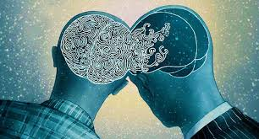
The characteristic that distinguishes non-narcissists from narcissists is empathy.
Empathy is the capacity and tendency to experience life not just from one’s own point of view but also from that of others, to feel others’ joy and sorrow, and to care about others’ wellbeing.
Specialists in moral development consider empathy to be the foundation for human compassion and morality.

Slide 44
Empathy
Those who score high in narcissism overrate their own abilities, lash out angrily in response to criticism, and commit white-collar crimes at higher rates than the general population. Those who score low in empathy are more likely than the average person to engage in bullying and less likely to volunteer to help people in need.
For over three decades, researchers have been assessing both narcissism and empathy using questionnaires developed in the late 1970s

Slide 45
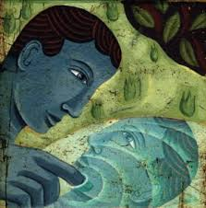
Over the years, the data reveal that the average narcissism score has been steadily increasing statistically:
70 percent of students today score higher on narcissism and lower on empathy than did the average student thirty years ago.

Slide 46
What can we do about the epidemic of narcissism?
Social: Teaching empathy and social skills in schools instead of self-focus;
Personal: parenting differently, practicing gratitude, caring for others, and self-compassion.
Action at both levels is necessary to effectively curtail the epidemic of narcissism .

Slide 47
In the present Era promoting processes that protect and foster the development of fully functioning persons, families, groups, organizations and communities is not only of vital importance for human survival and welfare but also for the welfare of the entire planet.

Slide 48
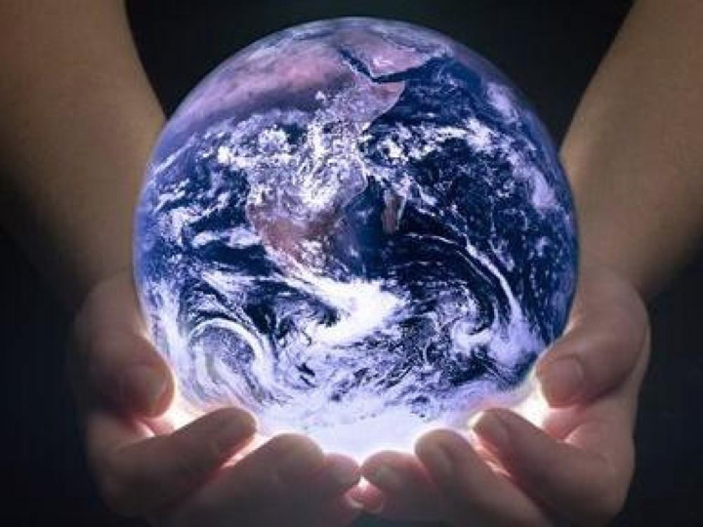
Grazie!
Thankyou!

Slide 49
Alberto Zucconi
alberto.zucconi@iacpedu.org
Istituto dell’Approccio Centrato sulla Persona
Person Centered Approach Institute (IACP)
www.iacp.it
World Academy of Art and Science (WAAS)
www.worldacademy.org
World University Consortium (WUC)
www.wunicon.org

