Slide 1



HUMAN CENTERED ECONOMICS
Feb 1-3 2017
Inter University Centre
Dubrovnik, Croatia
Joe St Clair
Managing Director
Laszlo Institute of New Paradigm Research (L-INPR)
Global President
Eternea
Consultant
The Club of Budapest

Slide 2

“What do you think the Grown-Ups should do to make the world a better place?”

Slide 3
“Stop killing Animals”
“Help the Poor People”
“Look after the trees and the water”
“Be kind to each other”

Slide 4
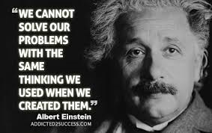

Slide 5
SCIENTIFIC AMERICAN MAGAZINE
SLICK SOLUTION: HOW MICROBES WILL CLEAN UP THE DEEPWATER HORIZON OIL SPILL
The last (and only) defense against the ongoing Deepwater Horizon oil spill in the Gulf of Mexico is tiny—billions of hydrocarbon-chewing microbes, such as Alcanivorax borkumensis. In fact, the primary motive for using the more than 830,000 gallons of chemical dispersants on the oil slick both above and below the surface of the sea is to break the oil into smaller droplets that bacteria can more easily consume.

Slide 6
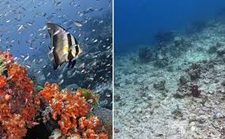
BEFORE AFTER

Slide 7
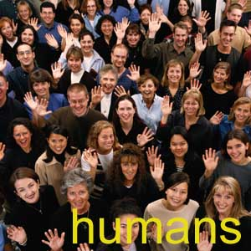
WHAT DOES ‘HUMAN CENTERED’ REALLY MEAN ???

Slide 8

Introducing Mr & Mrs ‘Homo Economicus’

Slide 9
Mr & Mrs ‘Homo Economicus’
We are Consumers and we live in a very competitive Consumer Society
We pay our taxes and we pay into a pension
We are both employed
We spend our income on Goods and Services
We make ‘rational choices’
We are law abiding citizens and we trust our Government
We have 2.4 children
We have two cars
We go on holiday once or twice a year
We will probably die when we are about 80

Slide 10
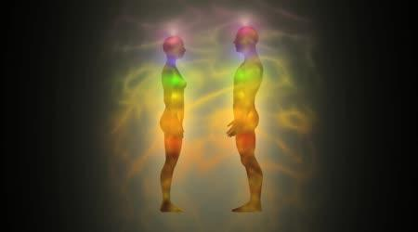
Mr and Mrs ‘Homo Spiritus’
We are spiritual beings temporarily borrowing a human body
We make our own choices about how to live
We have values like Compassion, Empathy, Forgiveness, Gratitude and Love
We make decisions based on our values and beliefs
We believe in Equality, Altruism, Co-operation and Respect for others
We support sustainability and caring for the natural environment and all other species sharing our planet

Slide 11
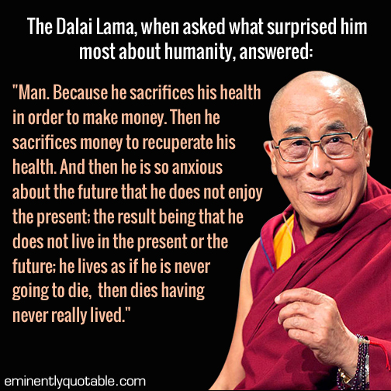

Slide 12
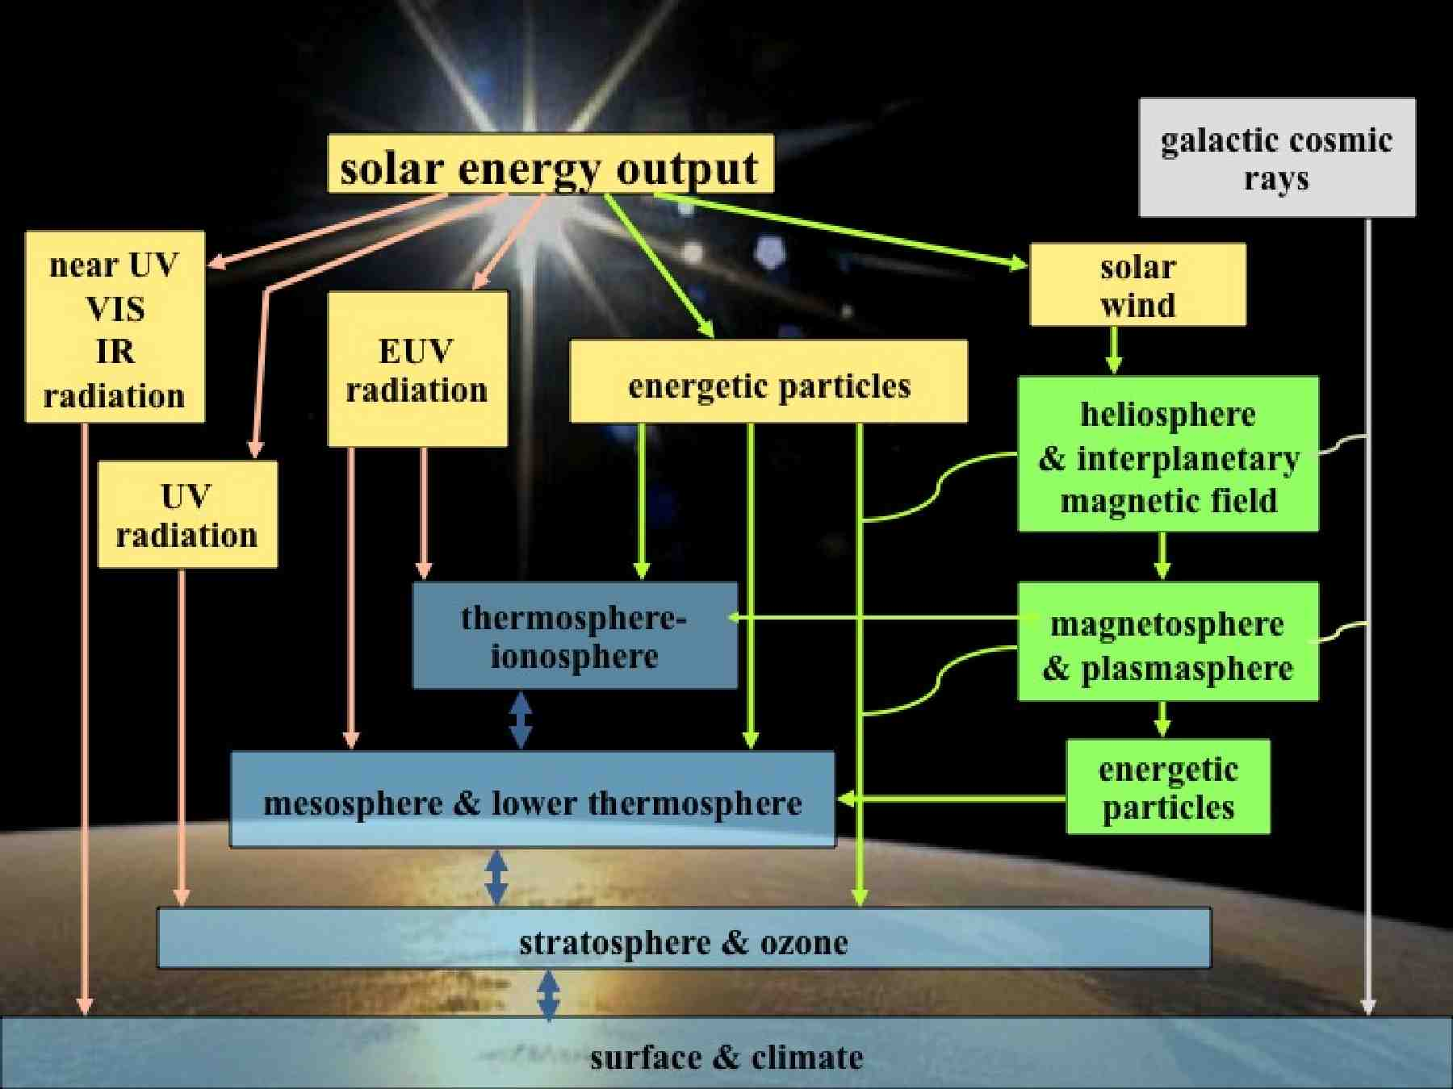
Science has proven that our entire ‘planetary-level ecosystem’ is intimately connected. ‘Economic Resources’ are not isolated ‘exploitables’ but are part of a connected ‘whole’

Slide 13
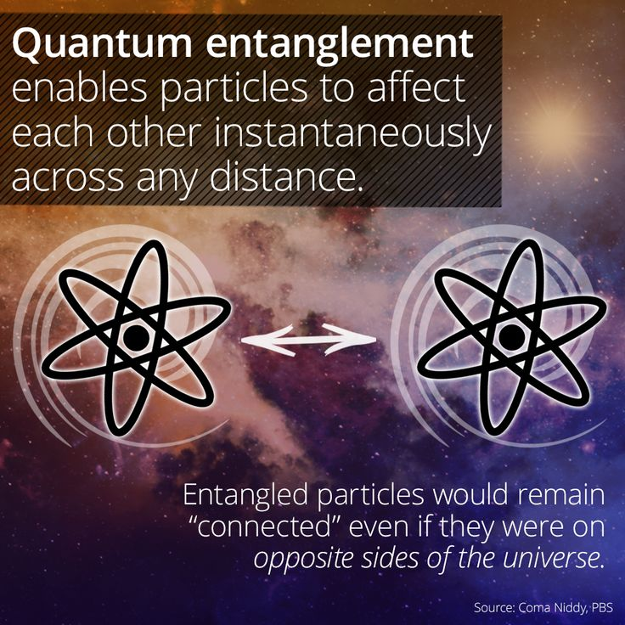
The latest research in Quantum Physics is changing the way we understand how particles communicate across space and time

Slide 14
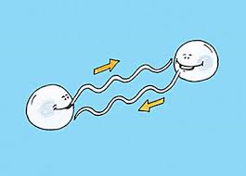
The average Human body has approximately 38 trillion cells all of which are in constant communication
Latest research has found that our cells also communicate with those around us i.e. The cells of other human beings

Slide 15
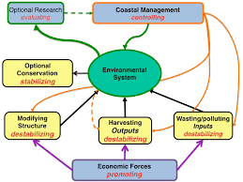
The Environmental System is a ‘holistic’, living, breathing interconnected entity. It is not composed of isolated components that we like to call ‘economic resources’.

Slide 16

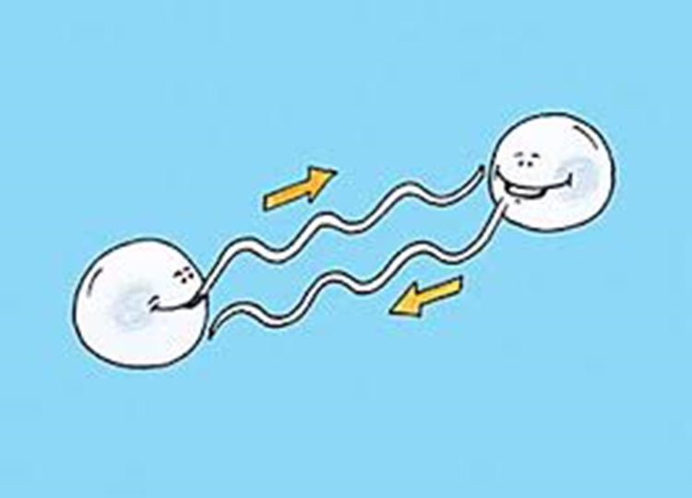


The Scientific proof of the convergence of Quantum Physics, Bio-cellular communication research, Natural Ecosystems interactions and Planetary Energy systems and flows…
Confirm that man is not a separate entity from the whole but an intrinsic and connected part of the whole complex system

Slide 17
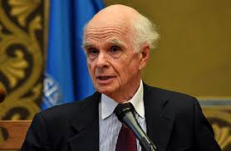
“We have not just divorced ourselves from nature but we have also divorced ourselves from our inherent spirituality”
Ervin Laszlo
llll

Slide 18
- ONLY TOTALLY INTEGRATED AND HOLISTIC SOLUTIONS WILL SOLVE THE WORLD’S PROBLEMS
- WE NEED TO FIND ‘A NEW WAY OF THINKING’
- WE NEED TO ADOPT A NEW FORM OF CONSCIOUSNESS AND AWARENESS OF WHO WE REALLY ARE AS A ‘CONNECTED’ SPECIES
- WE REALLY ARE ‘ONE’ – AND ‘ONE WITH THE UNIVERSE’
THE BOTTOM LINE

Slide 19
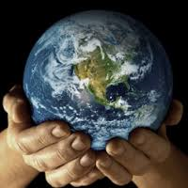
ONE FRAGILE PLANET AT TIPPING POINT…
ONE HUGE RESPONSIBILITY…

