Slide 1
Tibor Toth

Slide 2
    Global
    Youth Unemployment
73 million unemployed
169 million employed youth were living on less than US$2 per day
286 million lived on less than US$4 per day

Slide 3
SOS
World
73 million young unemployed
40 million new entrants each year
0.5 million while we talk in Dubrovnik

Slide 4
S O S

Slide 5
Next generation:
14 - 40

Slide 6
Empower massively
  employ
  enroll
  train
  educate
  replicable good practices of
    mass employment
    mass empowerment
  at community and cross-boundary level

Slide 7
Entrepreneurs
young entrepreneurs
small-scale
sustainability/new economy
enterprising-friendly legal, tax, business environment for youth empowerment
education & vocational training supporting entrepreneurs

Slide 8
Impact
Empower 20.000 / year young unemployed (with secondary and tertiary education)
Empower 100.000 / decade young unemployed (allotment of 5000 EUR/year/person for 2 years)
Incubators at 5.000 entities in any year and at any moment (4 persons / incubator on average)
25.000 incubators / decade involved (two years average run-time)
250 successful spin-off incubators (1 % success rate) involved in novel technologies
Successful spin-off creators (1% success rate) 1.000 in a decade
An SOS Movement of 100.000 Next Generation, New Economy Entrepreneurs
New Economy ‘Silicon Valley’

Slide 9
  Externalities
  &
  Spin-offs

Slide 10
Sustainability
(as defined, but not exclusively, by the thematic scope of the following arrangements and concepts)
  2030 Sustainable Development Goals
  Paris Agreement (under UNFCCC) on climate change
  Sendai Framework for Disaster Risk Reduction 2015-2030
  Circular Economy
  Blue Economy

Slide 11
‘New economy’
  Sustainability (see definition in previous slide) packages as products
  market-based or embedded in the economy
  mitigating the consequences
    existing massive youth unemployment
    further deterioration of the job market (AI and robotics)
  boost the economy as an alternative to Qualitative Easing
  alternative to Guaranteed Minimum Income as a pro-active tool
  create New Economy ‘Silicon Valley’

Slide 12
Novel S&T applications/solutions
novelty stemming from
New, emerging or reemerging science/technology
new combination of existing sciences/technologies
new application of existing science/technology

Slide 13
  Science and technology
    Applied science and technology
    System integration
      ‘hardware’ (equipment)
      ‘software’ (application)
      enablers (legal, tax, enterprising, etc.)
      education and training

Slide 14
Incubators
  Cradle of novel spin-off products and start-up enterprises
  Small, creative groups collocated at participating entities
    Volunteering individuals with experimental mindset
    Merging volunteer staff of participating entities with outside young volunteers
    Using existing infrastructure & capacities
  Reaching out to existing incubators or so-called ‘policy labs’ at
    Universities and research centers
    Piggy-bag with recent initiative of EU Joint Research Center to create an EU-wide network of policy labs (incubators)
  Initiating new (interdepartmental) incubators at participating entities

Slide 15
Consortium (partnership of)
  Scientific and research institutions
  Organizations
  Academies of science and art
  Universities
  Businesses
  Communities

Slide 16
Global science and technology organizations
  e.g. CERN, IPCC,WMO, ITU, ISO, CTBTO, IAEA, NGOs (selected)
  Science and technology-based organizations/arrangements supported by
  hundreds/thousands of scientists collaborating on
  multi-disciplinary projects
  relying on large modeling/monitoring platforms/networks

Slide 17
Prototype
  A prototype testing region
    sustainable technologies ‘industrialization’ of the region
  incubators at institutes, organizations, academies, universities, communities
  Later replicate the model globally

Slide 18
Mode of operation
Empowerment of next generation
  empowering unemployed from tertiary and secondary educational system
  employing them at partnering incubators and centers of excellence
  facilitating empowerment opportunities at community level
  crowd-sourcing

Slide 19
Mode of operation
‘Do Tank’
  Applied research, development and system integration tuned to ‘package’ delivery
  Rely on local/regional role models
    ‘Champions of S&T’
    ‘Movers & Shakers’

Slide 20
Mode of operation
‘Amazon of Sustainability S&T Solutions’
  ‘Match making’ electronic platforms
  to bring together demand and supply side
  electronic one-stop shopping
    Sustainability S&T entrepreneurship platform
    Education platform

Slide 21
Mode of operation
Supply side
  Driven by proposals from the
    incubators,
    centers of excellence,
    IGOs,
    academies
    universities,
    business

Slide 22
Mode of operation
Demand side
  Community level (local) identification of needs and requirements
  through EU Local Action Groups
  competitiveness to support inventors and communities
  virtual coordinating organization for strategic impact
  Consider EU regional development and reconciliation support
    In existing priority areas
      Renewable energy and energy connectivity
      Transportation connectivity
      Youth employment and empowerment
      Reconciliation and the regional cooperation between young people
      Regional mobility
      Citizen participation
    In new areas initiated jointly with partners
        EU institutions
          Joint Research Center
          European Investment Fund
          European Investment Bank
        Consortium partners

Slide 23
Mode of operation
  Local strategic plans and prioritization
  S&T applications packaged in accordance with community level requirements
  Package integrates in a system solution ‘hardware’ and ‘software’ components as well as legal, tax, enterprise, competitiveness and other enablers

Slide 24
Mode of operation
Integrating different aspects
  economic
  cultural
  social

Slide 25
South-East Europe (flexible definition)
  Western Balkans countries (as per EU Western Balkans / Berlin Process initiative): Albania, Bosnia and Herzegovina, Kosovo, Macedonia, Montenegro, Serbia,
  EU members from neighborhood: Austria, Bulgaria, Croatia, Greece, Hungary, Italy, Romania, Slovakia, Slovenia
  A prototype New Economy ‘Silicon Valley’

Slide 26
Possible early pilot projects
Model incubator: Prototype scoping of modalities in SEE partnership entities
Model community (‘Youth for Sustainability Community’): Prototype scoping & prioritization in SEE
Youth-driven Technology Foresight on Renewable Energy for SEE
Youth-driven Technology Foresight on S&T for Sustainability in SEE

Slide 27
Mission statement
Empower massively the next generation of ‘new economy’ entrepreneurs in novel S&T applications
for sustainability through a prototype consortium of spin-off incubators in South-East Europe that
replicates global S&T organizations’ know-how in trans-boundary mass collaboration (CERN model)

Slide 28
Youth-driven
Spin-off Incubators for Sustainability
(SOS)

Slide 29
Financing
Project-based (with overhead)
EU Horizon 2020
  Emphasis on the third pillar’s (’Societal Challenges’) 7 sub-programmes and 2 themes
EU ‘Communities of Innovation’ support
EU resources (project-based): ESFRI, Western Balkans Process;
Support from International Financial Institutions in the Western Balkans Process framework
Tax and other benefits provided to individuals and entities
In-kind contributions by partners
Donations by contributors
Crowd funding
Prize funding

Slide 30
SOS
World
73 million young unemployed
40 million new entrants each year
0,5 million while we talk in Dubrovnik

Slide 31
SOS
Europe
      In some OECD countries young unemployment above 50%
      Economic loss in Europe 150 billion EUR / year
      1,2 % of GDP in Europe
      1,5 trillion since 2007

Slide 32
Financing
Dedicated investment funds
  10-20 funds
  50-100 million EUR each
  States shepherding creation of funds in cluster(s) they lead
  European Investment Fund and European Investment Bank participating
  Investment Funds by clusters (17 SDG goals, Circular Economy, Blue Economy, Renewable Energy, etc.)
  1 billion EUR in 10 years

Slide 33
  Financing
  1 billion EUR / 10 years investment
  Versus 1,5 trillion EUR / 10 y loss

Slide 34
SOS
600 million jobs to be created over the next decade

Slide 35
S O S

Slide 36
Impact
Empower 20.000 / year young unemployed (with secondary and tertiary education)
Empower 100.000 / decade young unemployed (allotment of 5000 EUR/year/person for 2 years)
Incubators at 5.000 entities in any year and at any moment (4 persons / incubator on average)
25.000 incubators / decade involved (two years average run-time)
250 successful spin-off incubators (1 % success rate)
Successful spin-off creators (1 % success rate) 1.000 in a decade
A Movement of 100.000 Next Generation, New Economy Entrepreneurs

Slide 37
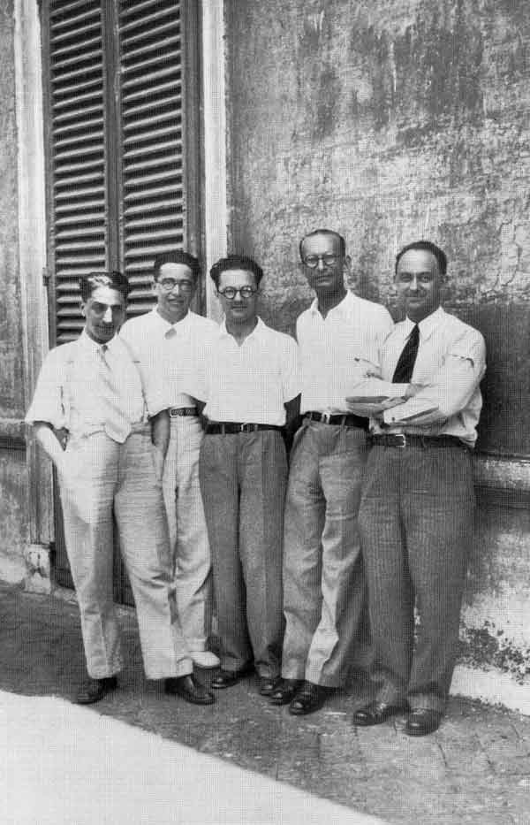
1934
The Via Panisperna boys in the courtyard of Rome University's Physics Institute in Via Panisperna:
Oscar D’Agostino, Emilio Segrè, Edoardo Amaldi, Franco Rasetti and Enrico Fermi (Ettore Majorana not on the photo)
Wikipedia

Slide 38
Youth-driven
Spin-off Incubators for Sustainability
(SOS)

