Slide 1
Transition to a new paradigm in economy: the need for management and perspective integration
Grażyna Leśniak-Łebkowska
lebkowska@sgh.waw.pl
Warsaw School of Economics
Dubrovnik 2017

Slide 2
Methodological approaches to science:
Euclides-Cartesian tradition: from axiom through deduction to theory describing reality. Also includes reduction type of reasoning (dividing the object into smaller parts).
Babylonian (III. C.BC, stoic Philosophers and so called Babylon Talmud, VI c). Explains the world in harmony with nature and mind, role of ethical values. Holistic approach is mainly based on empirical methods with induction based on experience. Logical rules are applied only to subsystems.
Both traditions present in ancient Greece and Rome. In Middle Ages more popular than the second one, while from Enlightenment (XVIIc) through next 3 centuries shift to the domination of the first one. From the middle of XX c. holistic approach in research regains attention with the stress on ethical issues and social justice, as well as social teachings of Church.
At present both approaches are present and have their promoters.

Slide 3
Management sciences
are predominantly empirical based on analysis leading to understanding phenomena, problems, processes and cause-effect relationships.
Analysis as a starting point for any action with measurement and description. When investigating outcomes and impacts we discover the causes.
Analysis is a method of knowing the whole through its division into parts and focusing on their nature and on the interdependencies among them.
The next step is synthesis as a result of generalization based on research components. The explaining value of such theory can only be tested through the deduction approach: conclusions from theory should bring positive results. If not, the theory is not sufficient to explain reality.
In empirical sciences experiments and observations allow for formulation and verification of hypotheses.

Slide 4
Transient nature of management theories
Any scientific theory is a complete description of reality, so it will be replaced by a new one closer to changing reality.
In solving complex problems existing theories encounter new types of affecting factors. Idealization is inevitable (only a limited number of factors and interdependencies explain the investigated phenomena).
At the era of breakthrough changes the rational approach is holistic, interdisciplinary, dynamic.
As the organizations change the management also has to change.

Slide 5
Premises for change of contemporary economy and management theories
Demographic and social structure change
Rapid urbanization
Growing aspirations and expectations of society; Reducing poverty
Concentration of property and wealth, exclusive growth
vs BoP market
Globalization of economy and growing competition on international scale
Increase in propensity to cooperate
ICT revolutionary change, Big Data
Technological changes’ impact on industries
Pressures on environmental care, climate change, nonrenewable resource base
Political shifts in global power, wars and alliances
Institutional development and advocacy

Slide 6
Between economy of shortage and economy of surplus (J. Kornai, 1980)
Two types of logic and two types of economic and social crises start from political order: global power game between communist type of centralized governance (leading to economy of shortage) and democratic liberal (leading to economy of surplus). Different winners and losers.
At present the megatrends interfere creating unexpected outcomes and erratic solutions both from the economy’s perspective and management sciences.
Political responses are polarized on extremes.

Slide 7
Challenges vs Management Sciences Approach
Regardless of global efforts to create the best conditions for human and social development the population will never (fortunately) be homogenous nor happy.
Human and social factors in management are not treated as homogenous entities due to different human features (knowledge, behavior, emotions, ability to contribute, structure of needs and expectations, talent, skills) and social features (propensity to socialize, cooperate, undertake risk, take responsibility, lead and care for others…). Statistical normal distribution rules.
The stakeholder approach and differentiation of roles in society and economy.

Slide 8
Management solutions
Reality: Rational and emotional reactions to uncertainty, ambiguity and complexity stemming from pace of change(wicked problems).
Multi-option approach (more emotions, communication, cooperation and work, - shortening time of relevance).
Changed models of management processes incorporating action-learning (e.g. strategy process, decision-making, change management, CRM/ CEM).

Slide 9
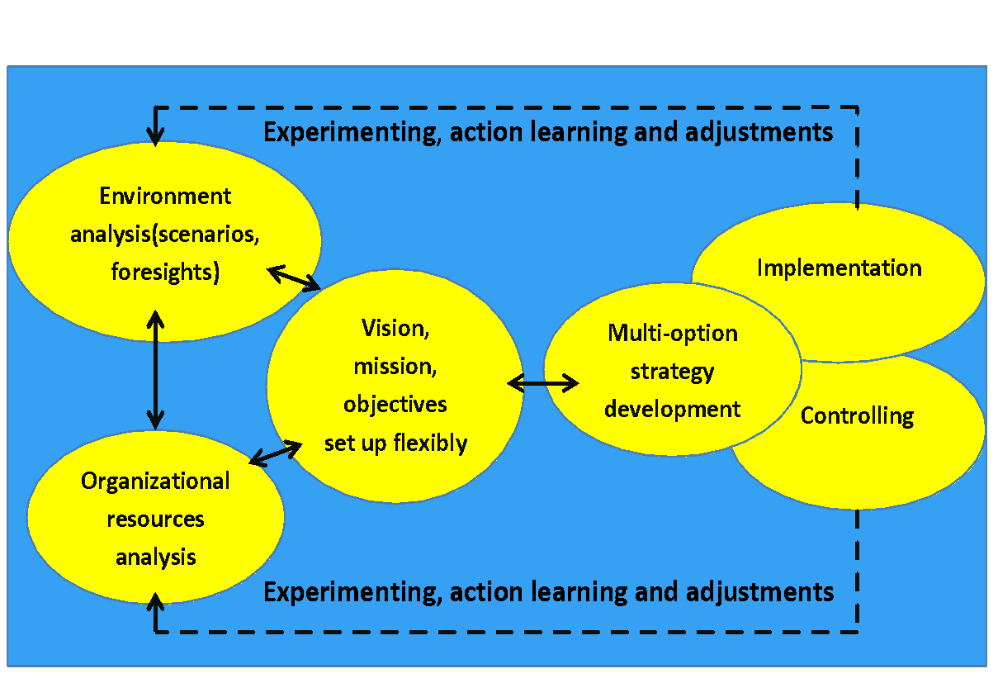
Strategy as a dynamic process

Slide 10
Conclusion
We need to cope with the pace and scope of change in a more comprehensive and controllable way:
the economy with its elegant scientific models should become more contingent incorporating new challenges, verifying the concept of limits to grow, helping decision-makers at all levels of governance.
Collaborating towards multidisciplinary holistic view of the world.
Management sciences and economy interface is strategy and the use of resources. Enterprises are responsible for strategy and operations aimed at execution of strategies in the most effective and efficient way to deliver value to stakeholders.
Human resources as multiform capital to be discovered and use more widely.
Environment is the only livable space for humans.
Knowledge based integrated solutions are at demand.

