Slide 1
Chance and Causality
Janani Ramanathan
Research Associate, The Mother’s Service Society
Associate Fellow, World Academy of Art and Science

Slide 2
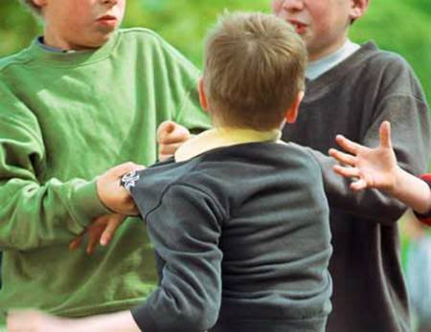
We come across many real life incidents that we call chance, coincidence, luck...
Mind, Thinking & Creativity
Chance and Causality
What have we explained by the term ‘chance’?

Slide 3
Is is possible that we have discovered all that there is? Are there deeper, more subtle levels of causality that are yet to be learnt?
Mind, Thinking & Creativity
Chance and Causality
The unrealized is not necessarily unrealizable

