Slide 1
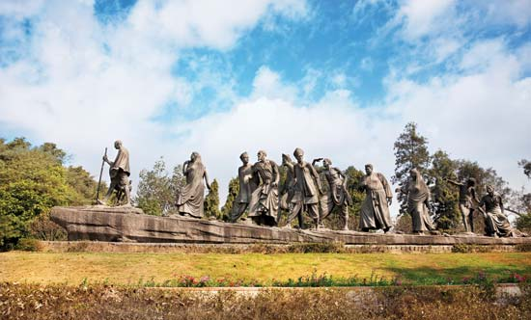
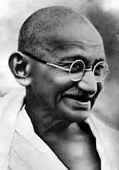
WAAS Meditation on Peace Dubrovnik 2017
Eladio Valencia
November 2017

Slide 2
Agenda
The 1930 Salt March
“The Disruptive Experience”

Slide 3
The 1930 Salt March
India was never a unified nation in the past. At the time it attained independence in 1947, it still included 500 princely states under Britian with a shared culture and diverse ethnic, religious and linguistic traditions.

Slide 4
The 1930 Salt March
Gandhi’s goal was to gain freedom for India without violence. He understood that unification of a country is not just by wining a war, it requires forging a common sense of identity and emotional solidarity between its diverse people

Slide 5
The 1930 Salt March
Gandhi came up with a creative initiative to create common identity and unite India. He did it using the symbol of salt to challenge the authority of the British. The British had imposed heavy tax on salt, a staple food. Gandhi called on the Indian people to make salt in violation of tax law.

Slide 6
The 1930 Salt March
It was a brilliant original strategy with no apparent strategic value. The British understood that defiance of British authority by millions of Indians would be a powerful demonstration of the helplessness of foreigners to subdue and control an unwilling population.

Slide 7
The 1930 Salt March
When Gandhi announced his plan to start making salt with just 80 of his followers, even his lieutenants like Nehru and Patel never believed that it would be of any significance. However, millions of people marched to the country’s 4,000 mile coastline to make their own salt.

Slide 8
The 1930 Salt March
This launched the massive act of symbolic civil disobedience that led to the overturning of the colonial government. It not only demonstrated their power, but also created a sense of identity among Indians.
The non-violent defeat of colonialism in India led within a few years to the collapse of colonial empires all over the world.
A creative symbolic act of emotional solidarity defeated colonialism

Slide 9
The Distuptive Experience

