Slide 1
Mind, Thinking and Creativity Mental and machine intelligence
Notes:
The limitations I am going to talk about are of the same nature of those that we are addressing in this course, but at a lower level of complexity
I will I will be using examples that relate to the public at large in order to illustrate some fundamental limitations in the way we understand and utilize the human mind and the mental processes on which knowledge is based.

Slide 2
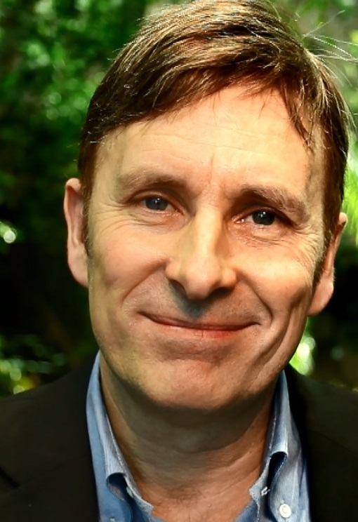
MARIO HYTTEN
Swedish
CEO, Planetaire AB, Sweden
35 years of communication through sports
Author of INSTINCTIVELY SUSTAINABLE

Slide 3
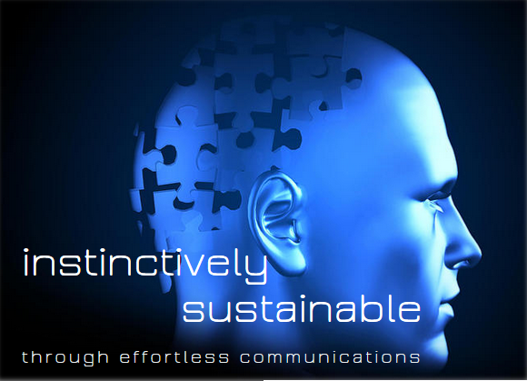
www.mariohytten.com
Notes:
I am covering these subjects in more detail in my white book, published on the internet
Today I will summarise them BUT NOT EXPLAIN THEM IN DETAIL

Slide 4
Purpose of thIS session
ways to enhance human creativity, primarily original thinking and mental creativity
what is unique about human intelligence and what we can do to fully develop it rather than focusing on aspects in which machines excel

Slide 5
Mental intelligence:
“software operating in wetware”
Machine intelligence:
“software operating in hardware”

Slide 6
HOw DID HUMANS BECOME THE DOMINANT SPECIES?

Slide 7
WHAT ARE THE SIMILARITIES AND DIFFERENCES BETWEEN HUMAN AND MACHINE INTELLIGENCE?

Slide 8
WHAT ARE THE UNIQUE CHARACTERISTICS OF HUMANS?

Slide 9
How can machine intelligence be harnessed most effectively to enhance the creativity of human intelligence? (rather than to merely replace it)

Slide 10
discussion

