Slide 1
Technological Innovation, Commercial Creativity & Social Change
Mind, Thinking & Creativity
Vani Senthil
Research Analyst, The Mother’s Service Society, India

Slide 2
Future of the Railways
“Rail travel at high speed is not possible because passengers, unable to breathe, would die of asphyxia.”
- Dr. Dionysus Lardner (1793-1859), Professor of Natural Philosophy and Astronomy at University College, London

Slide 3
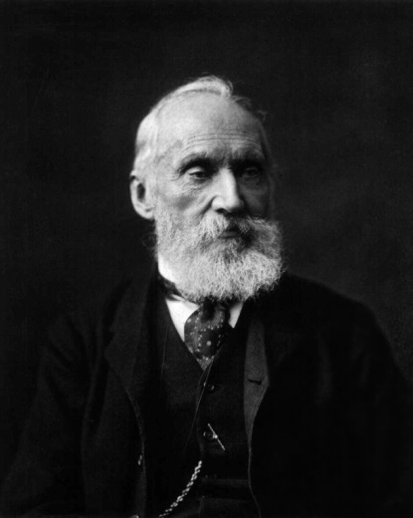
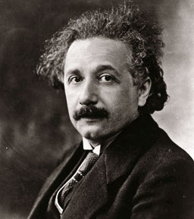
“Heavier-than-air flying machines are impossible” - Lord Kelvin, mathematician and physicist, President of the British Royal Society
“There is not the slightest indication that nuclear energy will ever be obtainable. It would mean that the atom would have to be shattered at will.” - Albert Einstein

Slide 4
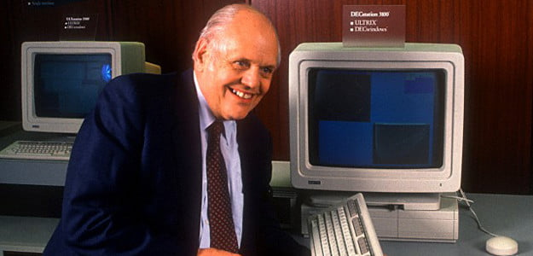
Future of Computer
“I think there is a world market for maybe five computers.” - Thomas Watson, President of IBM
“There is no reason anyone would want a computer in their home.” - Ken Olsen, founder of Digital Equipment Corporation (DEC), 1977

Slide 5
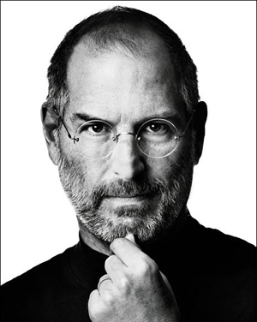
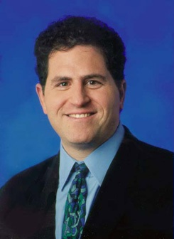
Steve Jobs returned to Apple in 1997
“I'd shut it down and give the money back to the shareholders.”
- Michael Dell

Slide 6
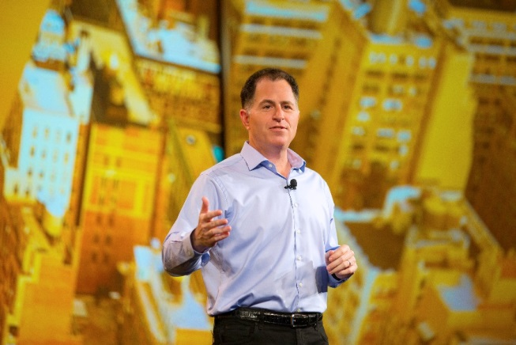
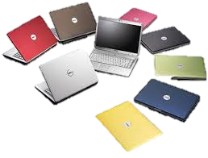
Achievements of Michael Dell
Dell made his first million by age 19.
In 1996, Dell earned $1 million per day
In 1997, Dell earned $3 million per day.
Youngest CEO ever to earn a ranking in Fortune 500
Largest PC manufacturer.

Slide 8
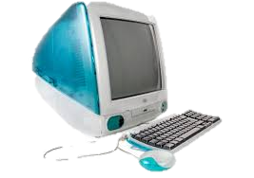
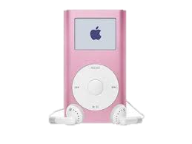
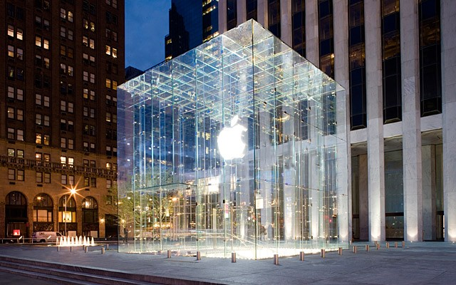
1998 : Sold 800,000 iMac in five months for $1 billion
2001: Launched iPod
2005: Sales 20 million, 45% of revenue
2001: Launched APPLE STORES
2011: 326 stores, total sales $10 billion

Slide 9
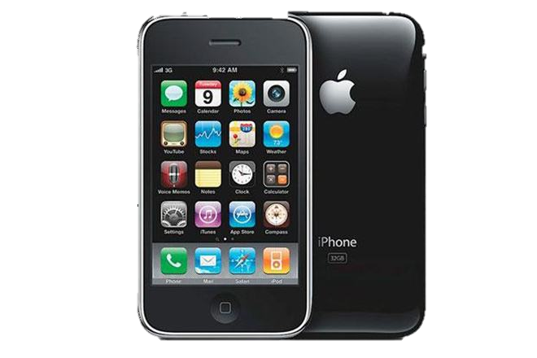
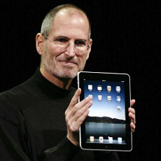
2007: Launched iPhone
2012 : Annual sales 37 million, 73% of total global profit from cell phone sales
2010 : Launched iPad
2012 : sales 57 million
World’s most valuable company with market cap of $800 billion

Slide 10
Integration and Unification of knowledge are acts of Creativity
“There is a fundamental error in separating the parts from the whole, the mistake of atomizing what should not be atomized. Unity and complementarity constitute reality.”
- Werner Heisenberg

