Slide 1
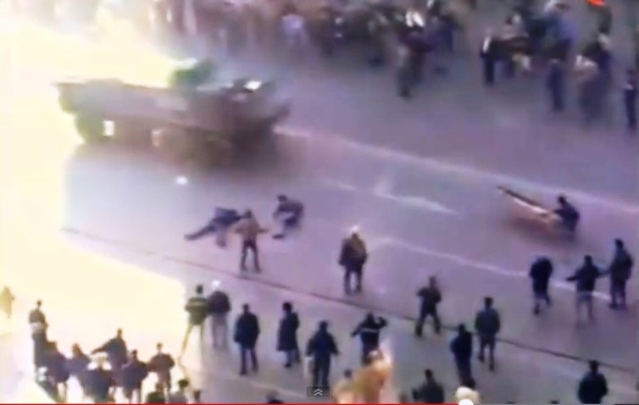
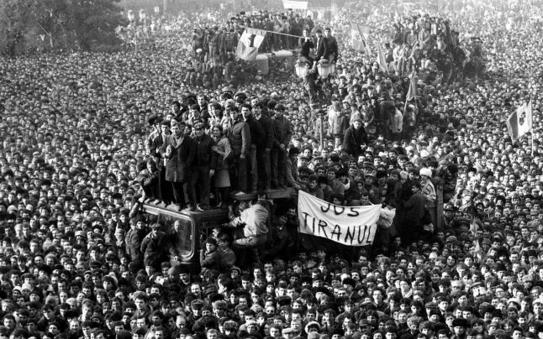
THE MEMORY OF SUFFERING AND THE PEDAGOGY OF FREEDOM
Emil Constantinescu
Former President of University of Bucharest,
Former President of Romania
Postgraduate Certificate Course in Social Power
Dubrovnik, November 1st, 2016

Slide 2
THE MEMORY OF SUFFERING AND THE PEDAGOGY OF FREEDOM
Memories of a life under tyranny
Peace without freedom
Freedom, a fundamental human right
Culture of freedom defeats dictatorship tanks
Crossing the post-totalitarian desert
Democracy as power sharing tool
“Free world”: peace through democracy
Freedom and bread
Freedom and democracy
The decay of Western civilization and the vulnerability of democracy
Freedom to choose

