Slide 1
Informal Sources of Social Power Inter-University Centre, Dubrovnik, Croatia 31st Oct – 2nd Nov, 2016
Janani Ramanathan
Associate Fellow, World Academy of Art and Science
Research Associate, Mother’s Service Society

Slide 2
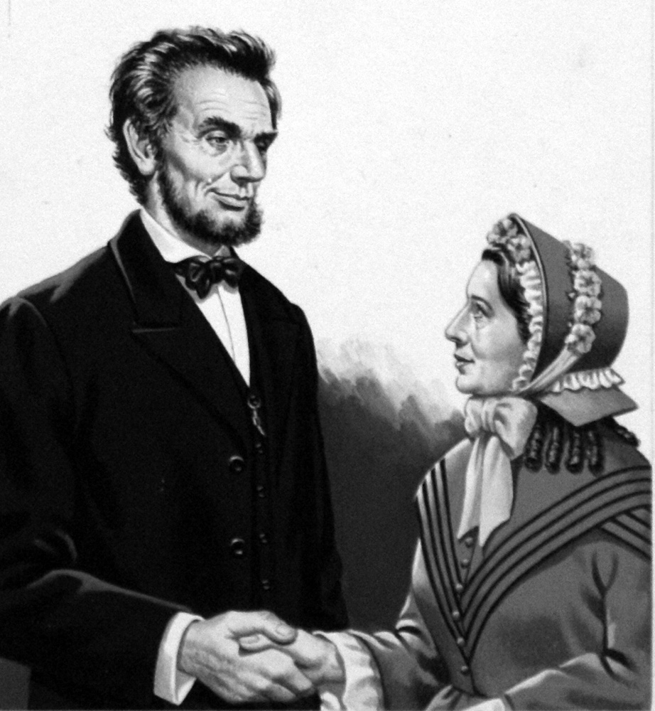
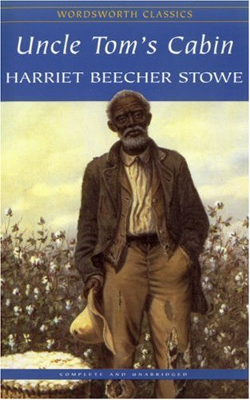
Informal Sources of Social Power
Abraham Lincoln and Harriet Stowe

Slide 3
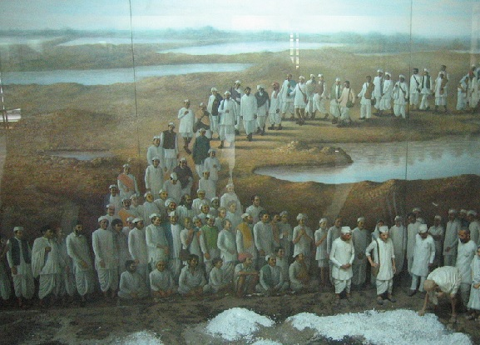
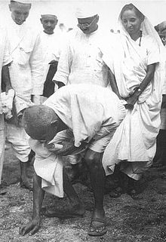
Informal Sources of Social Power
Salt March and the Indian Freedom Movement

Slide 4
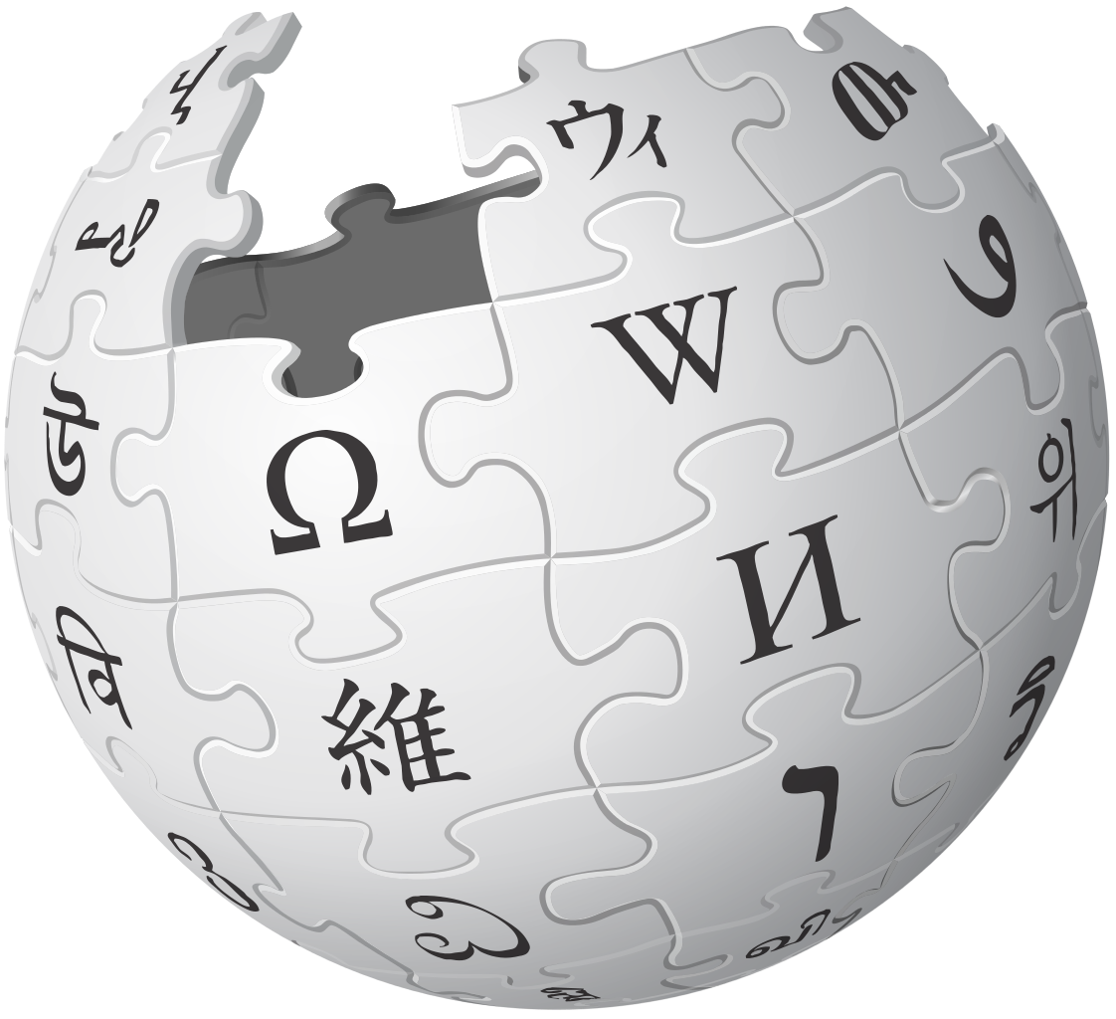
Informal Sources of Social Power
Formal Informal
United Nations Humanity
Military Patriotism
Company Brand value
Law Public opinion
Government Nationality
University City
Family Relationships

