Slide 1


Individuality & Social Power
Alberto Zucconi
World Academy of Art and Science (WAAS)
World University Consortium (WUC)
Person Centered Approach Institute (IACP)
azucconi@worldacademy.org
IUC, Dubrovnick, October 30-November 3, 2016
World Academy of Art and Science
World University Consortium

Slide 2
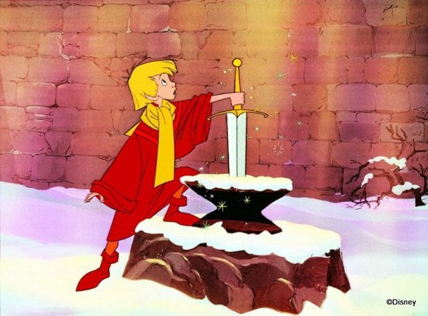
World Academy of Art and Science
World University Consortium

Slide 3
Power is energy, is the capacity to act and impact:.
Power is not positive or negative, the use of power produces positive or negative results.
Power is structurally part of any relationship, PERSONAL and SOCIAL POWER ARE NOT TWO SEPARATE ENTITIES,
They are interwined:
The environment, society and culture impact individuals and vice versa.
World Academy of Art and Science
World University Consortium
Notes:
3

Slide 4
Personal Power has many facets
more facets= more power
Intelligence
intuition
Knowledge
Skills
Will power
Charisma
Leadership
Physical strength
Beauty
Sex appeal
Power of ideas and ideals (Martin Luther King I have a Dream….)
World Academy of Art and Science
World University Consortium
Notes:
4

Slide 5
Education plays a crucial role in the social construction of reality, together with child rearing and interpersonal relationships is one of the main variables in promoting individual and social power or when is obsolete and ineffective, education is stunting individual and social power is becoming iatrogenic for the individual and for society.
Fragmented education is a form of disempowerment
It is more and more evident that we need a paradigm change in education in order to enable people to deal effectively with the mounting challenges facing humanity.
This retooling needs to start with our frames of reference.
We need to create a new paradigm of education i to enable education to serve people’s needs
and to have relevance in public service, social responsibility and sustainable governance and development.
World Academy of Art and Science
World University Consortium
Notes:
5

Slide 6
    Our social construction of professional competence is largely obsolete since various professions are still construed by using the outmoded mechanistic reductionist divisions of the traditional fields of expertise.
    This situation reflects the limited knowledge we had when the modern professional and scientific disciplines first emerged and continue to be stifled by the lines of jurisdiction in these traditional divisions of expert labor.
    This has little to do with offering the best services to society and much to do with the power struggles among the competing professional corporations or guilds
    (Andrew Abbott, 1988)
World Academy of Art and Science
World University Consortium
Notes:
6

Slide 7
Person/Student Centered Education
There is a large body of evidence with research assessing the results of more than 13 millions of students from several countries that follow Person/student centered approaches courses (Zucconi 2016).
enhance academic achievement
promote the development of important learning skills,
critical thinking,
problem solving,
work cooperatively with others
World Academy of Art and Science
World University Consortium
Notes:
7

Slide 8
Benefits of the student-centered approach:
Every learner benefits from effective instruction, no matter how diverse their learning needs (Stuart, 1997).
Learner motivation and actual learning increase when learners have a stake in their own learning and are treated as co-creators in the learning process (McCombs & Whistler, 1997).
Learners that experience success in taking new re-sponsibilities gain self-confidence and self-esteem (Aaronsohn, 1996). National Research Council, & Committee on Learning Research and Educational Practice. (2000). How People Learn: Brain, mind, experience, and school
Learners have higher achievement when they succeed thanks to their own abilities and efforts. North Central Regional Laboratory, 2000).
For further research and information on Person Centered Education:
Zucconi,A. (2016). The need for Person Centered Education. Cadmus, Volume 3, No.1, October 2016, 1-26.
World Academy of Art and Science
World University Consortium
Notes:
8

Slide 9
“I never teach my students; I only attempt to provide the conditions in which they can learn.” Albert Einstein
Power redistribution
Even if the research show clearly the effectiveness of person-student centered education at every level and grade, there are some barriers that have slowed the applications of this approach; the major obstacles are the so called power issues:
Student centered learning is a process that requires power sharing and responsibilities sharing at the policy level, administrative level, curriculum development level, assessment and evaluation level, classroom management and relational level. The teachers have to become facilitators of learning and trained to be able to do so. The principal, teachers and amministrative personnel shold be respected and related as persons as well non only the students.
World Academy of Art and Science
World University Consortium
Notes:
9

Slide 10
Personal power expands and varies with the changing of society:
If in the past enormous power was gained by a successful and resourceful generals that thanks to his military successes could become one of the emperors of Rome or create an empire like Alexander the Great or Genghis Khan. The technological revolutions have been offering new opportunities.
Think of the impact of movies, television, record industry etc. Thanks to technology not only new economic fortunes have been created, but new role models have emerged.
The Beatles with their wonderful music would not have any planetary impact without the production and distribution capacity of the record industry, radio and television networks.
In the electronic age computers and internet have created a new breed:
The very powerful & super rich Techno Gurus:
Steven Jobs, Mark Zuckenberg, Jeff Bezos, Larry Ellisosn (Oracle), Larry Page & Sergey Brin (Google), Steve Ballmer (Microsoft); Michael Dell, Paul Allen, etc.
World Academy of Art and Science
World University Consortium
Notes:
10

Slide 11
That in turn have offered to billions of people new forms of personal powers since personal power for individuals expands and varies with the changing of society just think of a democracy versus a theocratic state or a free market versus a caste ordered society.
The new personal power people can empower themselves are:
Digital literacy
E-learning
E-Commerce
E-Work
E-networking
Blogging
Just by free phone calls and conferences provided by Skipe, Viber or Whats App and similar connective free devices, people can create friendships, partnerships and multiply their opportunities by using their networking power a relevant aspect of personal and social power scenarios that presumably will continue to grow and impact our lives even more in the future.
World Academy of Art and Science
World University Consortium
Notes:
11

Slide 12
Researchers investigate the various forms of
Individual or personal power:
Agency
Resilience
Hardiness
Self esteem
Empathy
Genuineness
Love
Caring
Passion
Intelligence
Intuition
World Academy of Art and Science
World University Consortium
Notes:
12

Slide 13
Capacity of effective communication
Speech
Poetry
Literature
Visual Arts
Teaching
Entrepreneurship
Professional experience
Charisma
Courage
Leadership
Genius
Spiritual Leadership
Wisdom
World Academy of Art and Science
World University Consortium
Notes:
13

Slide 14
Researchers in the field of health and well being study other variables or forms of personal power:
Good genetic pool
Good immune system
Mental health
Optimism
Self efficacy
Resilience
Capacity to be in touch with emotions
Capacity to express them
Capacity to ask for help
Capacity to relate effectively with others
Emotional and social intelligence
Existential depth
World Academy of Art and Science
World University Consortium
Notes:
14

Slide 15
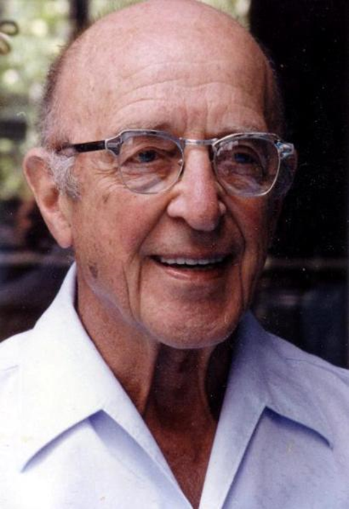
Carl Rogers summed it up on his book On personal power :
The power to know
The power to do
The power to be
World Academy of Art and Science
World University Consortium
Notes:
15

Slide 16
From infancy to old age human beings strive to actualize their highest potentials, establish and maintain close mutual connections with others.
People, possess enormous inner resources for self-regulation and self-healing which can be accessed in the service of recovery and growth.
Healing and self-actualization is facilitated by having relationships rich in key interpersonal conditions:
mutual respect, warmth, acceptance, empathy and genuineness.
World Academy of Art and Science
World University Consortium
Notes:
16

Slide 17
If these disconnections or violations occur early in life, or persist over long periods, people develop defensive psychological coping mechanisms which further
cuts them off from being in contact with the deeper organismic flow of life and from other human beings.
Self-awareness becomes interrupted and authentic interactions with others become impossible.
When this happens fundamental needs satisfactions and existential depth is impaired, causing further distress and alienation which may spiral into deeper difficulties.
World Academy of Art and Science
World University Consortium
Notes:
17

Slide 18
Abraham Maslow studied historical figures as examples of self-actualized individuals: Albert Einstein, Ruth Benedict, Frederick Douglass, Jane Addams Eleanor Roosevelt, Max Wertheimer, Henry David Thoreau….
and he found that they were, accepting of themselves and of their life circumstances; very creative; focused on finding solutions to cultural problems rather than just to concentrate on personal problems; open to others' opinions and ideas; had a strong sense of privacy, autonomy, human values and appreciation of life, few intimate friendships rather than many superficial ones.
They also all reported the frequent occurrence of peak experiences . These occasions were marked by feelings of harmony and deep meaning: feeling at one with the universe.
World Academy of Art and Science
World University Consortium
Notes:
18

Slide 19
Carl Rogers found in his research that fully functioning persons where:
Self aware, integrated, in touch, deep, authentic, trusting, creative, good capacity for affiliation and communication, balanced and realistic.
Psychological health, maturity, existential depth, effective self- regulation, respect for themselves and others
Openness to experience (instead of the rigid defense stance of the person feeling under threat)
Personality: mature, fluid, absence of rigidity and fundamentalism
Maximum of adaptability and resilience, trust in themselves, their organism, their intuition, their feelings and their values
Sense of direction, purpose, leadership qualities
World Academy of Art and Science
World University Consortium
Notes:
19

Slide 20
Carl Rogers’ research over the last 70 years has identified specific qualities in relationships which promote the development of fully functioning people as well as the healing of partially functioning people:
Respect
Empathic understanding
Authenticity/congruence ( capacity of deep contact)
World Academy of Art and Science
World University Consortium
Notes:
20

Slide 21
All paradigms are based on a vision of reality, of human nature, from which descend their pedagogic theories, theories of health and illness and the process of how problems or pathologies are generated and what promotes the desired solutions, healing, health and well-being.
The humanistic person centered view is that people experience pain when spontaneous movement towards self- actualization and successful connections with significant others becomes cut off, blocked, violated or exploited.
World Academy of Art and Science
World University Consortium
Notes:
21

Slide 22
We need to be aware on how we construe our experiences of what we call reality:
The relationship with ourselves, the others and the world.
World Academy of Art and Science
World University Consortium
Notes:
22

Slide 23
We need more fully functioning people that relate to themselves, to others and to the planet with more
Respect
Empathy
Authenticity (capacity of deep contact)
World Academy of Art and Science
World University Consortium
Notes:
23

Slide 24
Each of us is part of the daily social construction of reality.
Are we part of the solution
or
are we part of the problem?
World Academy of Art and Science
World University Consortium
Notes:
24

Slide 25
We need to foster at every level of society awareness of the social construction of reality, of our powers and responsibilities for the present and the future of humankind and the whole planet.
World Academy of Art and Science
World University Consortium
Notes:
25

Slide 26

We need more people that relate to themselves, to others and to the planet with more
Respect
Empathy
Authenticity/congruence (deep contact)

Slide 27
To promote change and be capable of Effective Empowering requires:
Cognitive competence (to know)
Skills (to do)
Attitudes (to be)
In order to be:
        Person centred
        People centred
        Community centred
        Organization centred
        Culture centred
World Academy of Art and Science
World University Consortium
Notes:
27

Slide 28
By fostering the conditions that protect and promote individuality and empowerment in all the processes of the construction of reality, identity, social roles and behaviors.
By relating to others in respectful, emphatic, genuine and congruent ways and applying them as the relational foundations in:
                Parenting
                Schooling
                Workplaces
                Community
                Society
                Culture

Slide 29
Lets empower ourselves and our fellows human beings to
co-construe
People-Centered
&
Person- Centered
sustainable narratives!!
World Academy of Art and Science
World University Consortium

Slide 30
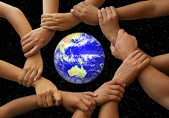
World Academy of Art and Science
World University Consortium

Slide 31
Alberto Zucconi
azucconi@worldacademy.org
World University Consortium (WUC)
www.wunicon.org
World Academy of Art and Science (WAAS)
www.worldacademy.org
Person Centered Approach Institute (IACP)
www.iacp.it
World Academy of Art and Science
World University Consortium

