Slide 1
Individuality and Social Power Inter-University Centre, Dubrovnik, Croatia 31st Oct – 2nd Nov, 2016
Janani Ramanathan
Associate Fellow, World Academy of Art and Science
Research Associate, The Mother’s Service Society

Slide 2
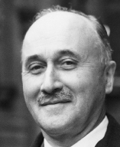
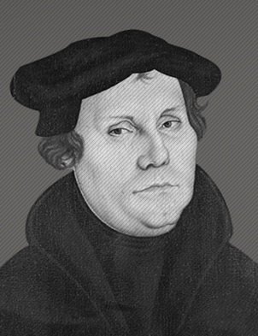
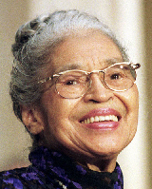
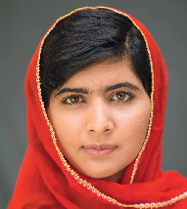
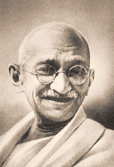
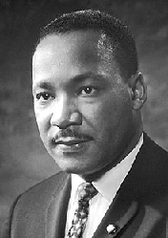
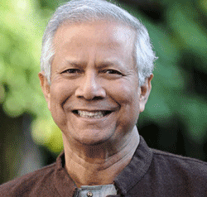
Individuality and Social Power
Mikhail Gorbachev
Jean Monnet
Martin Luther
Rosa Parks
Malala Yousafzai
Mahatma Gandhi
Muhammad Yunus
Martin Luther King Jr.

Slide 3
Individuality and Social Power
All well-developed individuals –
Belong to society, and relate to it on equal terms
Identify with the aspirations of all
Look beyond their own self-interest
Have a strategy
Take an organized effort

