Slide 1


Human Relationships & Social Power
Alberto Zucconi
World Academy of Art and Science (WAAS)
World University Consortium (WUC)
Person Centered Approach Institute (IACP)
azucconi@worldacademy.org
IUC, Dubrovnick, October 30-November 3, 2016
World Academy of Art and Science
World University Consortium

Slide 2
As promoters of change, no matter if we are scientists, health practitioners, opinion makers, politicians, educators or committed citizens we need to be aware of:
How our social and personal selves are socially construed?
Are the present narratives effective for promoting the sustainable development of the human potentialities of all the people or not?
World Academy of Art and Science
World University Consortium

Slide 3
Socio-cultural and personal constructs
    The ways communities and individual construe their experiences at the emotional and cognitive level- are interacting and influencing all the time with the social and individual dimensions.
World Academy of Art and Science
World University Consortium

Slide 4
Individual Factors:
Biological factors — including genetic predispositions, age-related processes
Lifestyle factors —including nutrition, smoking, alcohol consumption, substance abuse, exercise patterns, sexual practices, stress, sleep habits, leisure activities, and marital status
Psychological factors —including coping abilities, self-efficacy, hardiness, self-esteem, communication skills, problem-solving skills , existential depth, meaningful life
Family Factors ;
Including strength of family structure, amount of emotional support
Socio-Economic Factors:
Including socio-economic status, education, access to services , working conditions, adequacy of housing, nutrition, exercise, availability of jobs, quality of social relationships and social support
Cultural Factors:
Including beliefs, practices, customs, social activities, sexual practices, gender and role expectations
Consumer Practices:
Including advertising, pricing, availability of goods and services
Environmental Factors:
Including climate change, atmospheric pollutants, noise pollution, quality of water, chemical and nuclear waste, deforestation, industrial procedures
Structure of Society:
Including laws, regulations, taxation, public health structure, school systems, industrial production, rule of government (whether democracy or not), availability of jobs, social equality, access to information
World Academy of Art and Science
World University Consortium

Slide 5
Reality is “socially construed”
What is perceived as real varies from society to society and is produced, transmitted and conserved through social processes.
Our perception of reality is largely modeled from beliefs and assumptions that are typical of the society and culture in which we belong.
What we know, what we consider true and right, the behaviors we adopt, all are influenced by the social/cultural environment in which we live.
This process happens through the internalization of a “reality” that occurs during the socialization process.
Berger e Luckmann(1968).
World Academy of Art and Science
World University Consortium

Slide 6
This occurs largely without an awareness that “The world of everyday life is not only taken for granted as reality by ordinary members of society in the subjectively meaningful conduct of their lives. It is a world originated in their thought and actions, and is maintained as real by these.” (Berger & Luckmann, 1966, page 19).
Our reality is largely determined by the roles that are played by the people who interact with us, by the roles that they give us and from the ways in which we relate with ourselves, others and society at large.
World Academy of Art and Science
World University Consortium

Slide 7
Power is energy, is the capacity to act and impact: power is not positive or negative, the use of power produces positive or negative results.
Power is structurally part of any relationship, PERSONAL and SOCIAL POWER ARE NOT TWO SEPARATE ENTITIES, but we may choose to study power from the individual or social angle.
Social power variables with positive & sustainable results include:
Person-People centered narratives
Capacity to communicate effectively
Capacity to learn from experience
Capacity to live in peace with neighbors
Capacity to prosper in sustainable ways
Capacity of inclusion all the stakeholders
Agreement (introjections) on sustainable common ground and rules
World Academy of Art and Science
World University Consortium
Notes:
7

Slide 8
Power is energy, is the capacity to act and impact: power is not positive or negative, the use of power produces positive or negative results.
Lets not forget the many negative examples …
World Academy of Art and Science
World University Consortium
Notes:
8

Slide 9
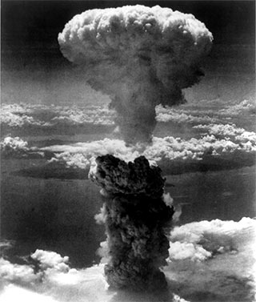

Slide 10
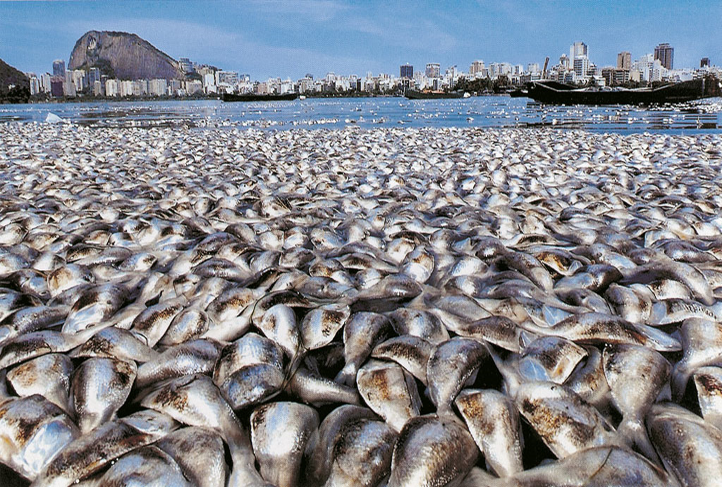

Slide 11

World Academy of Art and Science
World University Consortium

Slide 12
Power is attibuted, and at the same time the powerful actively and often brutally acquire and extend their power by propaganda that generate identification and intojection.
Critical thinking was banned even punished with death
In the past power was embedded with religious institutions
The sorce of power deriving by the ultimate power source: God in monotheist religion, the gods in politheist religions .
The cast of higth priests was recognized to have enourmous power as an intermediary between Gog and the people’s needs.
Rulers in many nations and cultures where god on earth, it was so for the Parahon Egypt, the Cesare in the Roman empire.
Also in modern times we have similar examples:, Lenin, Stalin, Mussolini, Hitler, Mao, Kim il Sung etc.
World Academy of Art and Science
World University Consortium

Slide 13

How we construe our experience?
What kind of narratives we create?
What kind of consequences we bring upon ourselves and the planet?
How we use our power?

Slide 14
How society has organized education and graduated experts, leaders, decision makers that cannot see clearly how we created the problems
Then we socially construe ourselves
as impotent
lacking the effective ways to manage the problems we created for ignorance, greed and alienated short-sighted ways of being in relation with ourselves others and the world….
World Academy of Art and Science
World University Consortium

Slide 15
Power is attibuted, and at the same time the powerful actively and often brutally acquire and extend their power by propaganda that generate identification and intojection.
Critical thinking was banned even punished with death
In the past power was embedded with religious institutions
The sorce of power deriving by the ultimate power source: God in monotheist religion, the gods in politheist religions .
The cast of higth priests was recognized to have enourmous power as an intermediary between Gog and the people’s needs.
Rulers in many nations and cultures where god on earth, it was so for the Parahon Egypt, the Cesare in the Roman empire.
Also in modern times we have similar examples:, Lenin, Stalin, Mussolini, Hitler, Mao, Kim il Sung etc.
World Academy of Art and Science
World University Consortium

Slide 16
The social environment influences individual behavior through the imposition or communication of societal norms and through individual adherence to and respect for the social model of control.
This process occurs in every community since every community is an epistemic community that in order to survive and possibly to prosper needs to effective communication and social organization provided by having and sharing a consensus reality
World Academy of Art and Science
World University Consortium

Slide 17
The term “consensus reality" here is referred to any generally accepted set of beliefs or assumptions or the meaning of some experience.
The consensus reality migth be functional or disfunctional for a community and its individual members.
Is functional if permits non distorted contact with external reality and in doing so has adaptive values (survival and prosperity) when disfunctional it imperil the survival of the community and of its members
Examples: Peublo Indians self destruction and Antropocene Era self imposed destruction
World Academy of Art and Science
World University Consortium

Slide 18
Every approach to religion, philosophy, political system, organizational stucture or human science, like medicine, psychology, sociology, psychiatry is based on a view of human nature, which in turn is based on values. Those values determine the politics of the approach and
influence outcomes.
Example: To be trained generally in the traditional educational model, centerd on the teacher or to be trained as a facilitator of learning in a person centered and student centered model is to enter into and belong to a construed world of values, to take on different roles, and to create educational settings that actively promote different narratives. The definitions of human nature, learning processes, pedagogies, learning objectives, the roles of teachers and students or learners are all influenced by differences of the educational approach (Zucconi, 2001, 2003, 2013, 2016).
World Academy of Art and Science
World University Consortium

Slide 19
Rogers found in his research that fully functioning people where:
Self aware, integrated, in touch, deep, authentic, trusting, creative, good capacity for affiliation and communication, balanced and realistic.
Psychological health, maturity, existential depth, effective self- regulation, respect for themselves and others
Openness to experience (instead of the rigid defense stance of the person feeling under threat)
Personality: mature, fluid, absence of rigidity and fundamentalism
Maximum of adaptability and resilience
Trust in themselves, their organism, their intuition, feelings and their values
Sense of direction, purpose, leadership qualities
World Academy of Art and Science
World University Consortium
Notes:
19

Slide 20
Carl Rogers’ research over the last 70 years has identified specific qualities in relationships which empower people to develop their potentialities:
The relationships that foster personal growth are:
Respect
Empathic understanding
Authenticity/congruence ( capacity of deep contact)
World Academy of Art and Science
World University Consortium
Notes:
20

Slide 21
People that are related to in this nourishing way tend to reproduce these qualities in their relationships.
Unfortunately, this also tends to hold true in the opposite case:
when people are related to in unhealthy, dysfunctional, demeaning, disrespectful and violent ways they tend to suffer from such mistreatment and tend to reproduce the same relational patterns with others;
their capacity of contact with their inner core is lost, self-regulation becomes impaired and as a result they become rigid and defended and risk fragmentation, a quite dramatic form of disempowerment.
World Academy of Art and Science
World University Consortium
Notes:
21

Slide 22
We need to be aware on how we construe our experiences of what we call reality: the relationship with ourselves, the others, the world.
World Academy of Art and Science
World University Consortium
Notes:
22

Slide 23

We need to foster the conditions to have more self actualized people that relate to themselves, to others and to the planet with more
Respect
Empathy
Authenticity (capacity of deep contact)
World Academy of Art and Science
World University Consortium
Notes:
23

Slide 24
By fostering the conditions that protect and promote individuality and empowerment in all the processes of the construction of reality, identity, social roles and behaviors.
By relating to others in respectful, emphatic, genuine and congruent ways and applying them as the relational foundations in:
                Parenting
                Schooling
                Workplaces
                Community
                Society
                Culture

Slide 25
Each of us is part of the daily social construction of reality.
Are we part of the solution
or
are we part of the problem?
World Academy of Art and Science
World University Consortium
Notes:
25

Slide 26
Lets empower ourselves to co-construe
People-Centered &
Person- Centered
sustainable narratives!!
World Academy of Art and Science
World University Consortium

Slide 27
At the social level you have mithologies and narratives that can be functional or difunctional, exactly as in individuals the way they construe the experience of thwenmselves, others and the words can be funtional or disfunctional.
World Academy of Art and Science
World University Consortium

Slide 28

World Academy of Art and Science
World University Consortium

Slide 29

World Academy of Art and Science
World University Consortium

Slide 30
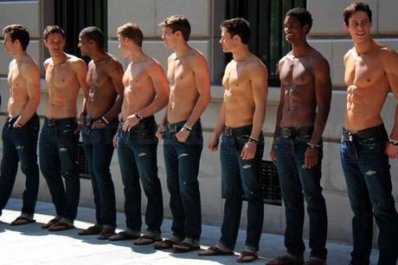
World Academy of Art and Science
World University Consortium

Slide 31
The Ideal body type portrayed in advertising is possessed by only 5% of American females.
47% of girls in 5th-12th grade reported wanting to lose weight because of magazine pictures.
69% of girls in 5th-12th grade reported that magazine pictures influenced their idea of a perfect body shape.
42% of 1st-3rd grade girls want to be thinner (Collins, M.E. (1991). Body figure perceptions and preferences among pre-adolescent children. International Journal of Eating Disorders, 199-208.
81% of 10 year olds are afraid of being fat (Mellin et al., 1991). Mellin, L., McNutt, S., Hu, Y., Schreiber, G.B., Crawford, P., & Obarzanek, E. (1991). A longitudinal study of the dietary practices of black and white girls 9 and 10 years old at enrollment: The NHLBI growth and health study. Journal of Adolescent Health, 23-37.
World Academy of Art and Science
World University Consortium

Slide 32
Almost 50% of people with eating disorders meet the criteria for depression.
Only 1 in 10 men and women with eating disorders receive treatment.
Only 35% of people that receive treatment for eating disorders get treatment at a specialized facility.
•
World Academy of Art and Science
World University Consortium

Slide 33
Up to 30 million people in the U.S. of all ages and genders suffer from an eating disorder.
Eating disorders have the highest mortality rate of any mental illness.
91% of women surveyed on a college campus had attempted to control their weight through dieting. 22% dieted “often” or “always.”
World Academy of Art and Science
World University Consortium

Slide 34
Anorexia is the third most common chronic illness among adolescents.
The mortality rate associated with anorexia nervosa is 12 times higher than the death rate associated with all causes of death for females 15-24 years old.
World Academy of Art and Science
World University Consortium

Slide 35
WHO’ action plan 2013-2020
Proposed actions for international and national partners:
Engage all stakeholders in advocacy
to raise awareness of the magnitude of burden of disease associated with mental disorders and the availability of effective intervention strategies for the promotion of mental health, prevention of mental disorders and treatment, care and recovery of persons with mental disorders.
World Academy of Art and Science
World University Consortium

Slide 36
WHO’ action plan 2013-2020 is based on cross-cutting principles and approaches:
1. Universal health coverage
2. Human rights
3. Evidence-based practice
4. Life course approach
5. Multisectoral approach: A comprehensive and coordinated response requires partnership with all the public sectors: health, education, employment, judicial, housing, social and the private sector, the media, the opinion makers etc.
6. Empowerment: Persons with mental disorders and psychosocial disabilities should be empowered and involved in mental health advocacy, policy, planning, legislation, service provision, monitoring, research and evaluation.
World Academy of Art and Science
World University Consortium

Slide 37
.
Advocacy
All the stakeholders need to address social, cultural, organizational, economic and political factors influencing health narratives and to advocate for appropriate health policies and decision-making procedures that are consistent with current knowledge and practice, for fairness and inclusiveness in health resource allocation, including policies and programs addressing all the determinants of health
World Academy of Art and Science
World University Consortium

Slide 38
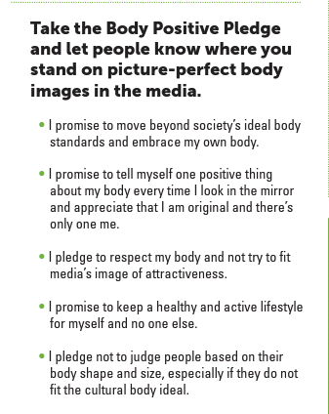
World Academy of Art and Science
World University Consortium

Slide 39
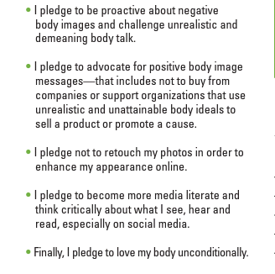
.
World Academy of Art and Science
World University Consortium

Slide 40

World Academy of Art and Science
World University Consortium

Slide 41
Lets empower ourselves to co-construe
People-Centered &
Person- Centered
sustainable narratives!!
World Academy of Art and Science
World University Consortium

Slide 42
Alberto Zucconi
azucconi@worldacademy.org
World University Consortium (WUC)
www.wunicon.org
World Academy of Art and Science (WAAS)
www.worldacademy.org
Person Centered Approach Institute (IACP)
www.iacp.it
World Academy of Art and Science
World University Consortium

