Slide 1
Introduction to the Course on Social Power
Garry Jacobs, Chief Executive Officer
World Academy of Art & Science
World University Consortium

Slide 2
Multi-dimensional Global Challenges
Peace & Security
Law & Governance
Economy & Employment
Education & Healthcare
Energy & Ecology

Slide 3
Effective solutions require changes at the level of
Public policies and responsible private initiative
Institutions for global and national governance
Educational content and pedagogy
Theoretical understanding of society and its processes
Development of mind, thinking, creativity, values and individuality

Slide 4
WAAS-WUC Transdisciplinary Courses
Individuality and Accomplishment – August 2014
Toward a Transdisciplinary Science of Society – September 2014
Transformational Leadership – March 2015
Education for the 21st Century – September 2015
Mind, Thinking and Creativity – April 2016
Social Power – October 31 to Nov 2, 2016
New Economic Theory – February 2017
Creativity and Individuality – November 2017

Slide 5
Where can humanity find the power to address these challenges effectively?

Slide 6
Schedule of Lectures
Oct 31 | Nov 1 | Nov 2
Introduction | Knowledge as Power | Money, Power & Values
Nature and Types of Social Power | Informal Sources of Social Power | Legitimacy and Legality
Human Relationships & Social Power | Freedom, Democracy, Political Representation & Distribution of Power | Strategies for Equitable Distribution of Social Power
Global Social Power | Music and Politics | Individuality & Social Power
Formal Centers of Social Power | Open Discussion & Q&A with online participants | Concluding Session

Slide 7
Course Links
Course website
http://www.worldacademy.org/courses/iuc-oct-2016/social-power
On-line forum
https://wuc-courses.appspot.com/social_power/forum

Slide 8
The Nature and Varieties of Social Power

Slide 9
Accomplishment and Power
Human beings undertake purposeful activity for accomplishment
Accomplishment includes meeting material needs, fulfilling social aspirations, satisfying intellectual curiosity, enjoying life, growing personally, developing civilization and culture, and evolving as a species.
All these forms of accomplishment require power – power of movement, change, growth, development and evolution.

Slide 10
Extraordinary Powers of Accomplishments
Modernization during the 19th and 20th century
Green Revolution in the 1960s & 70s
Internet & Worldwide Web since 1995

Slide 11
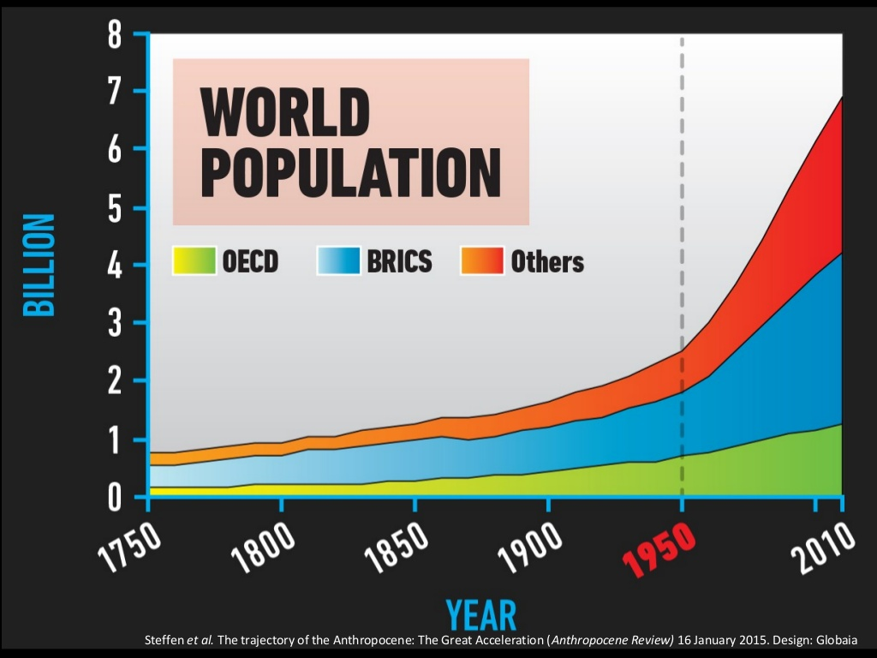

Slide 12
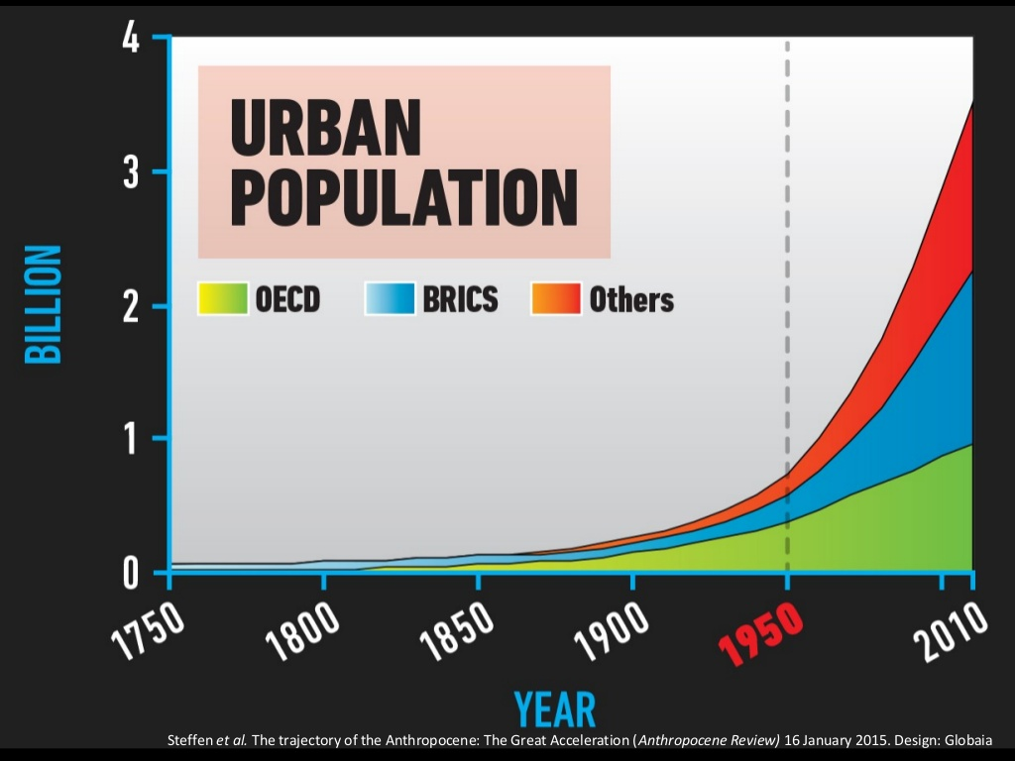

Slide 13
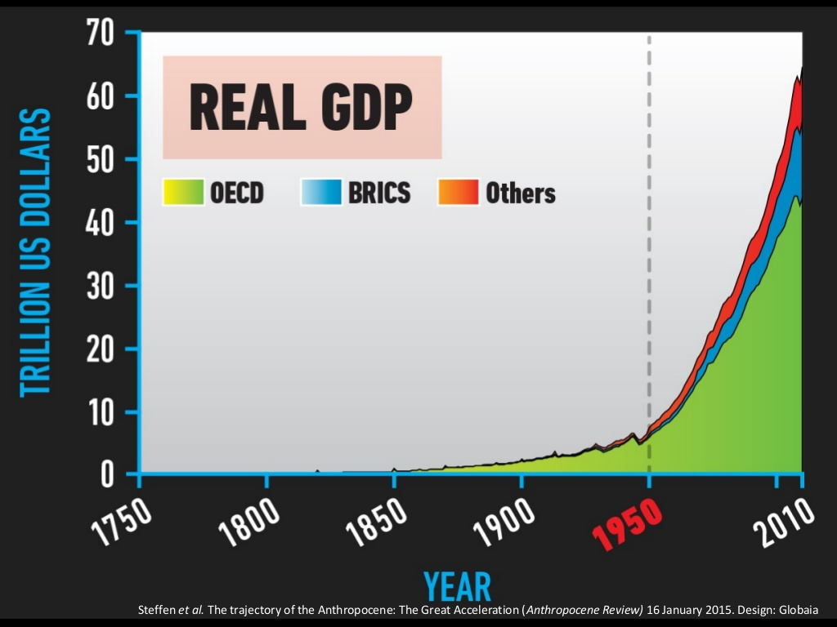

Slide 15
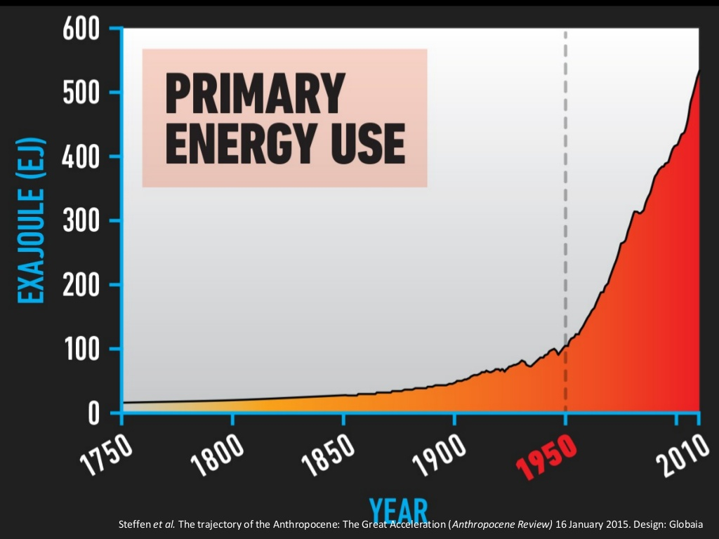

Slide 20
Human beings utilize myriad forms of Power
Language & Numbers
Organization of activities & groups
Self-defense & Conquest
Invention of tools
Production
Specialization
Exchange, Trade, Commerce
Communication
Transportation
Money
Credit, Banking, Finance
Law, Governance, Taxation
Urbanization
Diplomacy
Morality, Religion & Ethics
Organization of Facts, Knowledge, History
Education
Public Opinion & Media
Patriotism, Nationalism
Ideas, Idealism & Philosophy
Scientific Research & Tech Innovation
Literature & Artistic Creativity
Civil Society, Networks & Integration
Culture
Individuality
Spiritual values & experience

Slide 21
All these are forms of Social Power
They all arise from interaction, cooperation, coordination and organization between human beings.
Language
Markets & Money
Internet
They are all expressions of the capacity of the society to express human energies to achieve the goals and aspirations of the social collective.
These energies are physical, social, emotional, mental and spiritual

Slide 22
After Tamerlane: Rise & Fall of Global Empires 1400-2000 by John Darwin
Capacity to defend borders and administer larger areas
Consolidation of small political units into larger units
Effective tax revenue systems to support defense, administration, industry
Opening of inter-continental sea transportation
Opening up of vast new regions in the Americas, Central Asia, Siberia, Australia-NZ, Africa
Expansion and modernization of agriculture to support diversification
Specialization of production based on competitive advantage
Spread of industrial production
Development of domestic and international commercial marketing networks
Adoption of new technologies in industry, transport, communications– steam, rail, telegraph, petroleum
Creation of a legal framework and public policies to promote investment, commerce and trade
Support of strong naval security
Development of international banking
Development of port cities and megacities on trade routes
Rise of international capital markets for overseas investment
Conducive cultural values, intellectual rationale, and social aspirations

Slide 23
Process governing expression of social energies
Stages of the process
Awareness of opportunities & challenges generates Energy
Aspiration for accomplishment converts the energy into Force
Organization of the directed energy transforms it into Social Power
Expression of the power generates accomplishment
This process applies to all forms of social energy & all fields of expression

Slide 24
The source of these energies is what we call Society
Society is the sum total of human individuals living and acting in families, groups, communities, national and international organizations.
Society includes the structures, systems, activities, values, customs, beliefs, knowledge, skills, laws and institutions that define the complex nexus of relationships between these individuals and groups.
Society is a living organism that is greater than the sum of its parts – rather than a mechanical assemblage of parts, linkages, interactions and interrelationships.
Society grows, develops and evolves by increasing levels of awareness, organization and integration between its geographic units, social groups, institutions, activities, sectors and levels.

Slide 25
Social Power is organized at multiple levels
Formal organized structures – military, government, law
Partially organized activities – political, economic, transport, communication, media, education, healthcare, entertainment, etc.
Informal institutions – values, beliefs, culture, custom and ways of life.
Social potential – the unlimited reservoir of unorganized aspirations, energies, knowledge, skills, capacities and activities that are available to organize and draw upon by individuals and the collective.
Society – encompasses all these levels and dimensions

Slide 26
Distribution of Social Power
The distribution and utilization of social power for individual and collective benefit is determined by both formal and informal institutions, legal and extra-legal factors, national values and culture.
Divisions between social classes and castes
Concentration & distribution of political power
Concentration & distribution of wealth and economic power
Access to information, knowledge, technology & education
Freedom of worship & authority of religious bodies
Social conformity & freedom of individual thought and self-expression

Slide 27
Questions for Exploration and Discussion
What is the social potential that is the source of all the achievements humanity has drawn up for its advancement over thousands of years?
What are the determinants and limits to that social potential?
Why do societies differ widely in their capacity to draw upon and organize this social potential both spatially and temporally?
What is the impact of the distribution of social power – both legally and illegally –on the overall power of society and its capacity for accomplishment?
How can societies today increase their capacity to generate, release, direct and organize social potential for higher levels of accomplishment?
What is the role of the individual is the generation and utilization of social power?
How do societies empower their members to access and utilize the available social power for individual and collective benefit?

Slide 28
Objectives of this course
To become conscious of the enormous underutilized social potential available to modern society to address challenges & tap opportunities
To identify ways to enhance the generation, direction, organization and expression of social power to promote human welfare & well-being
To evolve practical strategies for mobilizing greater social power individually and collectively
To evolve a transdisciplinary conception of human accomplishment applicable to all fields

