Slide 1
Contextual Education
Future Education
Inter-University Center, Dubrovnik
September 21-23, 2015
Janani H Ramanathan
Research Associate, The Mother’s Service Society
Associate Fellow, World Academy of Art and Science

Slide 2
What is Contextual Education?
A method of teaching and learning where knowledge is presented to students in such a way that they are able to relate to it and construct meaning based on their own knowledge and experience.
There is a constant emphasis on establishing relationships.

Slide 3
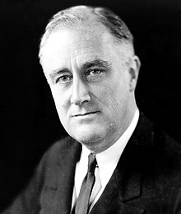
Solving a Crisis
Franklin Roosevelt solved the US Banking Crisis of 1933 because he saw the problem in its context, not in isolation.

Slide 4
Evolution of Education
Education takes the knowledge of centuries, organizes it within a comprehensive framework and multi-layered structure, and encapsulates it into a 15-20 year study.

Slide 5
Abstraction and Organization of Knowledge
When all the knowledge of humanity has to be encapsulated in a 15-20 year study, it has to be condensed into abstract principles and partitioned into different disciplines.
Marilyn Ferguson, American author and speaker says our educational institutions "break knowledge and experience into subjects, relentlessly turning wholes into parts, flowers into petals, history into events.”

Slide 6
Abstraction and Organization of Knowledge
Fragmenting knowledge and partitioning it into smaller and smaller portions creates a horizontal divorce.

Slide 7
Abstraction and Organization of Knowledge
Condensing knowledge of life experience into generalized abstract principles leads to a vertical divorce of mind from life.

Slide 8
Contextualizing Education
Isolation is a theoretical impossibility in the universe. Individuals are the content, our relationships are the context. It is the context that gives meaning to individual existence. Similarly in education, no subject or topic can provide meaningful knowledge when taken in isolation.

Slide 9
Teaching a discipline contextually, with reference to other disciplines
Every discipline, subject or topic can be taught with reference to all other disciplines.

Slide 10
Teaching everything contextually, with one subject
Every discipline, subject or topic can be complemented with any one discipline.

Slide 11
Educating the person, not the subject
Education needs to be person-centered, not discipline or course centered.
Grades matter for the first two years of one’s career.
Beyond that, it is upto one’s personality.

Slide 12
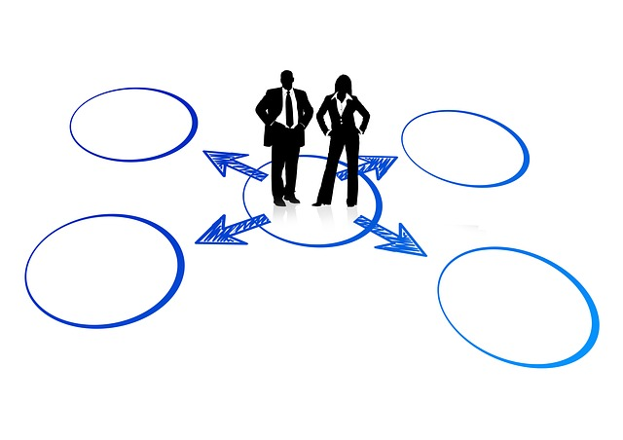
Educating the part in the context of the whole
Anything is effectively handled when it is seen in the context of the whole. No problem can be solved or opportunity created when an issue is seen in isolation.
Future education must see the part in the context of the whole.

Slide 13
Conclusion
Contextual education exists, but is not systematized.
Not all disciplines lend themselves to be contextualized. Specialization cannot coexist with contetualization. These are questions that need to be answered.
Contextualizing it transforms a two dimensional image into a three dimensional holograph.

