Slide 1


Person-Centered Learning
Alberto Zucconi
World Academy of Art and Science (WAAS)
World University Consortium (WUC)
Person Centered Approach Institute (IACP)
azucconi@iacp.it
Inter University Center (IUC)
September 21-24, 2015, Dubrovnick
World Academy of Art and Science
World University Consortium

Slide 2
The Person Centered Approach (PCA)
Has been formulated by the late Dr. Carl Rogers.
PCA is a scientifically validated systemic, holistic approach with
applications in all the helping professions:
Psychology, Education, Medicine, Social Work,
Management, Intercultural communication, conflict prevention
and resolution, etc.
PCA focuses on health not illness, on solutions not on problems, PCA empowers rather than cures, promotes the development of potentialities of individuals, groups and organizations through the process of making people responsible for what they do rather than encouraging dependency .
World Academy of Art and Science
World University Consortium

Slide 3
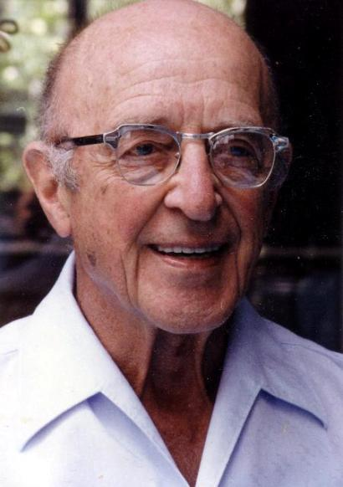
For Carl Rogers human nature has a fundamental tendency, the actualizing tendency, where self-awareness generates self-regulation.

Slide 4
The actualizing tendency aims to develop all capacities in ways that maintain or enhance the organism and move it toward autonomy.
This tendency is directional, constructive and present in all living things.
Every person has innate potentialities to become a fully functioning person.
World Academy of Art and Science
World University Consortium

Slide 5
The research of Carl Rogers and his group on fully functioning persons found the following common denominators:
Self aware, integrated, in touch, deep, authentic, trusting, creative, good capacity for affiliation and communication, balanced and realistic
Psychological health, maturity, existential depth, effective self- regulation, respect for themselves and others
Openness to experience (instead of the rigid defense stance of the person feeling under threat) able to learn from experience
Personality: mature, fluid, absence of rigidity/ fundamentalism
Maximum of adaptability, resilience
Trust in themselves, their organism, their intuition, feelings and their values
Sense of direction, purpose, leadership qualities
World Academy of Art and Science
World University Consortium

Slide 6
PCA recognizes people as being in charge of their own life and problems, the ones with the most data about their personal situation.
The role of the Person Centered helping professional is that of a facilitator,
Providing a relational climate which fosters growth and empowerment, enabling the client to explore and find solutions to their problems and ways reach their goals .
World Academy of Art and Science
World University Consortium

Slide 7
Carl Rogers’ research over the last 70 years has identified specific qualities in relationships which promote the development of fully functioning persons as well as the healing of partially functioning people.
These relational qualities are also present in effective facilitators of learning and are:
Respect
Empathic understanding
Authenticity/congruence (deep contact)
World Academy of Art and Science
World University Consortium

Slide 8
Carl Rogers on education
“The educational system is probably the most influential of all institutions-outranking the family, the church, the police, and the government-in shaping the interpersonal politics of the growing person.”
(Carl Rogers 1977- Carl Rogers on Personal Power, p. 69)
World Academy of Art and Science
World University Consortium

Slide 9
Student-Centered Learning is a personally significant kind of learning
that integrates new elements, knowledge, or insights to the current repertoire of the learner’s own resources such that he /she moves to a new constellation of meaning and resourcefulness (Barrett-Lennard, 1998).
Student-Centered Learning goals:
• a participatory mode in all aspects of learning promoting self responsibility;
• a climate of trust in which curiosity and the natural desire to learn can be nourished and enhanced;
• helping students to achieve results they appreciate and consider worthwhile and meaningful;
• uncovering the excitement in self-initiated discovery, which leads students to become life-long learners, fosters originality and creativity;
• helping teachers to grow as persons finding rich satisfaction in their interactions with learners and thus increase their personal resourcefulness;
• Increasing a person’s capabilities to experience and explore his or her own processes, raising the awareness of meaningful ways of inquiry, learning how to learn, promoting successful problem solving in new situations.
World Academy of Art and Science
World University Consortium

Slide 10
Carl Rogers on the interpersonal relationship in the facilitation of learning
the basic hypothesis underlying Person-Centered Teaching/Learning can be stated as follows: Human beings are constructive in nature and strive to actualize and expand their experiencing organism to fulfill their potential in full. According to Rogers the actualizing tendency can unfold itself best in a climate that is characterized by three attitudinal conditions: Congruence, also called realness, genuineness, transparency, authenticity, openness; acceptance, also called respect, unconditional positive regard; and empathic understanding, a deep understanding for the feelings and meanings of the other. These must be held and lived by facilitators and communicated to the students such that they actually can perceive them and experience them as part of the teaching and learning relationship.
World Academy of Art and Science
World University Consortium

Slide 11
This can hardly be achieved if an instructor looks down on his students and is primarily occupied with lecturing.
Topics can be elaborated in small groups, problems of common interest can be turned to cooperatively, students can give feedback to presenters of material, etc.
However, our empirical studies show that this kind of education is superior only, if instructors are perceived by students as real, respectful and understanding (MotschnigPitrik and Mallich, 2004).
World Academy of Art and Science
World University Consortium

Slide 12
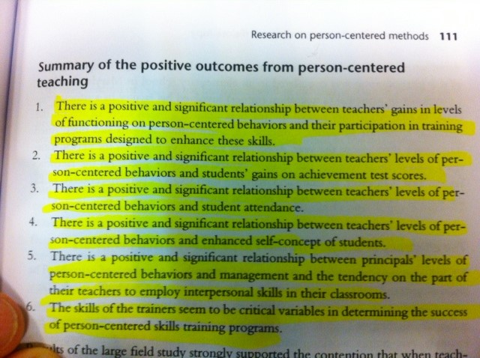
“
World Academy of Art and Science
World University Consortium

Slide 13
Carl Rogers on the interpersonal relationship in the facilitation of learning
Creativity – it follows that they will feel more free to be creative. They will also be more creative in the way they adapt to their own circumstances without feeling a need to conform.
Reliability and constructiveness – they can be trusted to act constructively. An individual who is open to all their needs will be able to maintain a balance between them. Even aggressive needs will be matched and balanced by intrinsic goodness in congruent individuals.
A rich and full life – Rogers describes the life of the fully functioning individual as rich, full and exciting and suggests that they experience joy and pain, love and heartbreak, fear and courage more intensely.
World Academy of Art and Science
World University Consortium

Slide 14
Person Centered Education Purpose
To protect and promote the person innate creative capacities of learning from their experiences
To promote wholeness and integration in the individual
by focusing on the student’s personal growth and development
To promote the development of creative and competent members of society , able to contribute effectively to the life of their community
World Academy of Art and Science
World University Consortium

Slide 15
The role of the student centered Teacher
A professional commitment to learning and to effective, democratic and value based education
Able to share her/his passion about learning
Able to relate to the students with respect, empathy and congruence
Capable to be in touch with herself, her students, the members of her community, the world
Wanting and having the needed skills and attitudes to be a facilitator of learning
An effective mentor promoting student creativity & autonomy
Capable to help students develop their personal and social skills
World Academy of Art and Science
World University Consortium

Slide 16
The role of the student in Person Centered Education
Learning to take responsibility for one’s own personal development
Interested in the development of social, personal and problem-solving skills
Learning to learn
Learning from mistakes
Willing to contribute to a cooperative and tolerant school ethos
Able to learn how to relate to herself and others with respect, empathy and congruence
World Academy of Art and Science
World University Consortium

Slide 17
Person-Centered Practices
Person-Centered Practices include both person-centered thinking and person-centered planning.
To be person-centered means treating individuals with dignity and respect; facilitating the development of their strengths and talents; helping people connect to their community and develop relationships; listening and understanding; taking time to know and understand individuals and the things that make them unique. Person-centered thinking involves a deep respect for individuals and their equality.
Person-centered planning involves a process and an approach for determining, planning for & with the people: working for empowering individuals to fulfill their needs and potentials involving all the stakeholders in the process.
World Academy of Art and Science
World University Consortium

Slide 18
Education, together with family and culture is one of the fundamental building blocks of the social construction of reality.
Education is one of the main narratives to prepare new generations to be an active & constructive part of society
Education is one of the main carriers of values
Values can be implicit or explicit
In Person Centered Education values are made Explicit to facilitate students to have a critical and proactive role, an effective training to became fully functioning members of the POLIS
World Academy of Art and Science
World University Consortium

Slide 19
The World Academy of Art and Science (WAAS)
The World University Consortium (WUC)
The Person Centered Approach Institute (IACP)
Are endorsing and actively promoting the Poznan Declaration
a call to all higher education institutions to include the teaching of ethics in their curriculum
World Academy of Art and Science
World University Consortium

Slide 20
Advantages of Student-centered teaching over Professor-centered teaching
With student-centered education schools, colleges and universities attain higher rates of student retention and have better prepared graduates than those students who are traditionally trained
(Matlin, 2002; Sternberg & Grigorenko, 2002).
World Academy of Art and Science
World University Consortium

Slide 21
Some schools are effectively using student-centered
learning
“We believe that students learn by doing, and they are the most engaged when they are doing…. The goal here is for students to have the ability to think critically, and communicate clearly, with an advanced level of preparedness for the academic and career paths that await them beyond these walls.”
Jesse Bean, Former Principal, Impact Academy of Arts and Technology
World Academy of Art and Science
World University Consortium

Slide 22
Examples of student-centered practices
At the Person Centered Approach Institute (IACP) with branches in Italy, France, Switzerland and Malta
The post graduate courses are organized as a learning community where professors and students intentionally create a facilitative climate of learning and collaboratively strive to achieve the common goals.
Exams are far from traditional exams: the students share their self evaluation with their group and receive their peers’ and the professors’ feedback. In addition each professor and tutor receive feedback from the students . The secretaries and the facilities are also evaluated by the students. Suggestions for improvement are given to each professor , tutor and secretary as well as for each facility. The feedback of the students is discussed in a staff meeting after which the course director and the local IACP branch director communicate to the students the changes and improvements that they are willing and able to implement with their help .
Students can request a learning community meeting where problems are addressed and resolved.
World Academy of Art and Science
World University Consortium

Slide 23
Examples of student-centered practices
City Arts and Technology High School of San Francisco:
The curriculum includes a strong focus on social justice and identity. Social justice themes are used as a strategy to empower youth and encourage them to think critically. Often there is an interdisciplinary dimension to the integration of social justice issues, particularly between social studies, English, and art. For instance, upper division history students prepared educational fliers on a criminal justice topic of their choosing — racial profiling, death penalty and people of color, pregnant women in jail, immigration and detention, etc. Their next steps were to create a video and outreach campaign on their topic, read and analyze published writing on their topic, and create related campaign materials such as t-shirts, buttons, and posters.
World Academy of Art and Science
World University Consortium

Slide 24
Dozier-Libbey Medical High School in Antioch
12th-grade students examined medical ethics, across academic disciplines. They began by reading The Immortal Life of Henrietta Lacks, a nonfiction book about an African American woman whose body was used to harvest stem cells without her family’s consent. Meanwhile, in Medical Ethics, students learn about the eugenics movement and medical experimentation. In physics they are developing, designing, and building a device to address a disability. As a culminating project, the students deeply investigate the meaning of disability and the biases in the notions of “fixing” a disability. Students write a paper on who benefits, who is harmed, and the cost of making their medical device.
World Academy of Art and Science
World University Consortium

Slide 25
Life Academy of Health and Bioscience in Oakland
the culminating and most rigorous work for students is the senior research paper, a yearlong and multistage assignment that many graduates describe as one of the academic experiences that was most helpful for the first year of college. For the senior paper, each student researches a question that emerges out of her internship experiences and about which the student is authentically curious. For example, one student whose internship involved working with young children was interested in becoming a child psychologist and loved literature. That student chose to explore the question: “To what extent could literature help children cope with psychological problems?” To answer the student-selected question, each student conducts a scaled-down literature review, interviews an expert, writes a paper, and presents and defends findings to a panel that includes the advisor, students, and family or community members.
World Academy of Art and Science
World University Consortium

Slide 26
Impact Academy of Arts and Technology in Hayward
Teachers emphasize that there are multiple perspectives to any issue. A history teacher describes a unit on Reconstruction: "We looked at different historical interpretations…. from the 1870s and from the 1920s and from the 1960s and they had to pick a claim that a historian made about Reconstruction. They had to do research to either prove the claim true or debunk it and compile the primary source research and analyze the documents." History was taught as an occurrence requiring interrogation and interpretation, not passive acceptance. Welcoming students into this process of critical thinking and analysis seems universal at Impact Academy—across the board, teachers prompt students to interact with texts so that they work in collaboration to make their own meaning of the world around them.
World Academy of Art and Science
World University Consortium

Slide 27
Education plays a crucial role in the social construction of reality and it is more and more evident that we need a paradigm change in education in order to enable people to deal effectively
with the mounting challenges facing humanity.
World Academy of Art and Science
World University Consortium

Slide 28
This retooling needs to start with our frames of reference.
We need to create a new paradigm of education in order to enable education to serve people’s needs
and to have relevance in public service, social responsibility and sustainable governance and development.
World Academy of Art and Science
World University Consortium

Slide 29

World University Consortium
World Academy of Art and Science

Slide 30
    We need to effectively protect and promote
    human & environmental capital
    We need to think globally and act locally in effective ways and to
    do so we need to offer people the knowledge, skills and
    competencies to operate at intersectorial and interdisciplinary levels
    Socio cultural
    Environmental
    Economic
    Psychological
    Spiritual
World Academy of Art and Science
World University Consortium

Slide 31

In the Anthropocene Era
promoting processes that facilitate the creation of new paradigm, effective forms of education, to protect and foster the development of fully functioning persons, families, groups, organizations and communities is not only
of vital importance for human survival and welfare but also for
the welfare of the entire planet.
World Academy of Art and Science
World University Consortium
Notes:
At the end of the line “welfare of the entire planet” add instead the following:
For the ecological and human integrity of the entire planetary community.

Slide 32

Grazie!
Thank you!
World Academy of Art and Science
World University Consortium

Slide 33
Alberto Zucconi
azucconi@worldacademy.org
World University Consortium (WUC)
www.wunicon.org
World Academy of Art and Science (WAAS)
www.worldacademy.org
Person Centered Approach Institute (IACP)
www.iacp.it
World Academy of Art and Science
World University Consortium

