Slide 1
FUTURE EDUCATION
WAAS
Dubrovnik

Slide 2
FUTURE OF EDUCATION

Slide 3
EDUCATION OF FUTURE

Slide 4
WHY ?
Season denial
Winter?
Emperor(s) ill-prepared?

Slide 5
EDUCATION OF FUTURE
Three Bubbles & Leadership?

Slide 6
EDUCATION OF FUTURE
Security Bubble?

Slide 7
SECURITY BUBBLES | Challenge | Outcome/Risk | Managed
1900-45 (WW I&II) | Geopolitical & Arms Race | WWI 30 million dead WWII 60 million dead | Mismanaged & Extremism
1950-63 (62 Crisis) | Geopolitical & Arms Race | Potentially Hundreds of million | Leadership & Luck
1975-85 (83 Panic) | Geopolitical & Arms Race | Potentially Hundreds of million | Luck & Leadership
2000-25 (….Crisis) | Geopolitical & Arms Race | Potentially Hundreds of million | Mismanaged? Extremism? Luck ? Leadership?
 | Challeng | Outcome | Opportunity
WW I&II | Geopolitical & Arms Race | WWI 30 million dead WWII 60 million dead | Missed
1950-63 (Cuban Crisis) | Geopolitical & Arms Race | Potentially Hundreds of million | Luck & Leadership
1975-85 (1983 Panic) | Geopolitical & Arms Race | Potentially Hundreds of million | Luck

Slide 8
 | Challeng | Outcome | Opportunity
WW I&II | Geopolitical & Arms Race | WWI 30 million dead WWII 60 million dead | Missed
1950-63 (Cuban Crisis) | Geopolitical & Arms Race | Potentially Hundreds of million | Luck & Leadership
1975-85 (1983 Panic) | Geopolitical & Arms Race | Potentially Hundreds of million | Luck
SECURITY BUBBLES | Challenge | Outcome / Risk | Managed
1900-45 (WW I&II) | Geopolitical & Arms Race | WWI 30 million dead WWII 60 million dead | Mismanaged & Extremism
1950-63 (62 Crisis) | Geopolitical & Arms Race | Potentially Hundreds of million | Luck & Leadership
1975-85 (83 Panic) | Geopolitical & Arms Race | Potentially Hundreds of million | Luck & Leadership
2000-25 (.. Crisis) | Geopolitical & Arms Race | Potentially Hundreds of million | Mismanaged? Extremism? Luck ? Leadership?

Slide 9
 | Challeng | Outcome | Opportunity
WW I&II | Geopolitical & Arms Race | WWI 30 million dead WWII 60 million dead | Missed
1950-63 (Cuban Crisis) | Geopolitical & Arms Race | Potentially Hundreds of million | Luck & Leadership
1975-85 (1983 Panic) | Geopolitical & Arms Race | Potentially Hundreds of million | Luck
SECURITY BUBBLES | Challenge | Outcome / Risk | Managed
1900-45 (WW I&II) | Geopolitical & Arms Race | WWI 30 million dead WWII 60 million dead | Mismanaged & Extremism
1950-63 (62 Crisis) | Geopolitical & Arms Race | Potentially Hundreds of million | Luck & Leadership
1975-85 (83 Panic) | Geopolitical & Arms Race | Potentially Hundreds of million | Luck & Leadership
2000-25 (.. Crisis) | Geopolitical & Arms Race | Potentially Hundreds of million | Mismanaged? Extremism? Luck ? Leadership?

Slide 10
EDUCATION OF FUTURE
Growth Bubble?

Slide 11
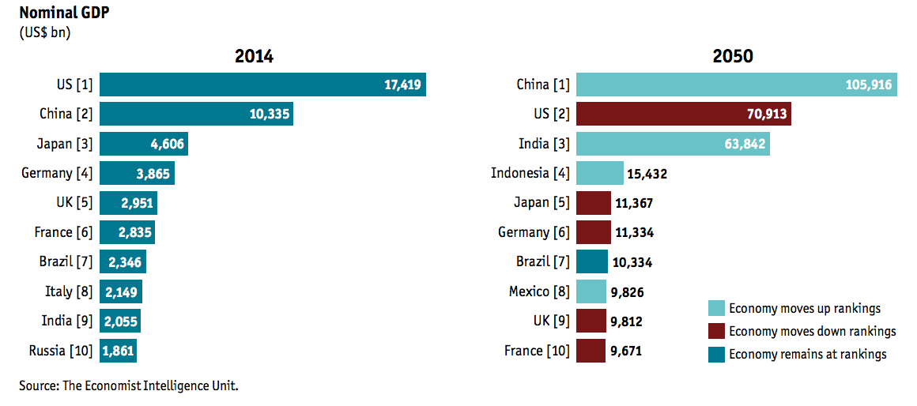

Slide 12
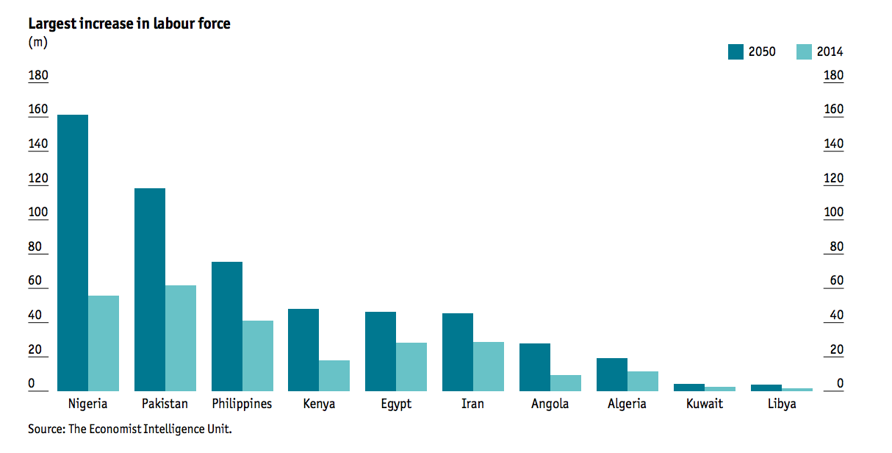
FUTURE OF EDUCATION

Slide 13
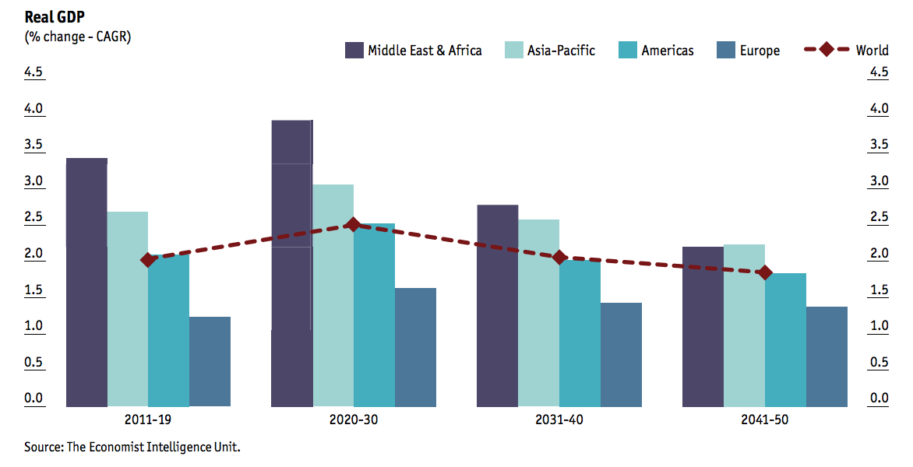
FUTURE OF EDUCATION

Slide 14
EDUCATION OF FUTURE
Sustainability Bubble?

Slide 15
 | WHY? | WHAT? | HOW?
PEOPLE | Distribution dis-functionality Lost Generation: 20-50% population Ticking bomb
ECONOMY | Crisis ➔ Crises Distribution dis-functionality ➔ Socio-economic crash? Loose - Loose Resource deficit Negative externalities Regulation fatigue Globalization vs. Closing Down
IGOs | Unfit for crash prevention Triple fatigue Regulation fatigue IGO fatigue Cooperation fatigue

Slide 16
 | WHY? | WHAT? | HOW?
PEOPLE | Distribution dis-functionality Lost Generation: 20-50% population Ticking bomb | Empower through work for the Commons | Massive knowledge sharing Wikinomy of Commons
ECONOMY | Crisis ➔ Crises Distribution dis-functionality ➔ Socio-economic crash? Loose - Loose Resource deficit Negative externalities Regulation fatigue Globalization vs. Closing Down | Internalize Negative Externalities Multiply Positive Externalities Beyond Externalities Areas: Real economy Sustainable development Environment Dangerous technologies | Market-based 3M Footprint: Model Measure Mitigate Priorities Best return mitigation
IGOs | Unfit for crash prevention Triple fatigue Regulation fatigue IGO fatigue Cooperation fatigue | IGO 3.0 | Top down Bottom up From inside From outside

Slide 17
Global & Local Incubators

Slide 18
 | WHY? | WHAT? | HOW?
PEOPLE | Distribution dis-functionality Lost Generation: 20-50% population Ticking bomb | Empower through work for the Commons | Massive knowledge sharing Wikinomy of Commons Massive Leadership
ECONOMY
IGOs

Slide 19
Global & Local Incubators Learning Leaders

Slide 20
 | WHY? | WHAT? | HOW?
PEOPLE
ECONOMY | Crisis ➔ Crises Distribution dis-functionality ➔ Socio-economic crash? Loose - Loose Resource deficit Negative externalities Regulation fatigue Globalization vs. Closing Down | Internalize Negative Externalities Multiply Positive Externalities Beyond Externalities Areas: Real economy Sustainable development Environment Dangerous technologies | Market-based 3M Footprint: Model Measure Mitigate Priorities & Best return Executive Leadership
IGOs

Slide 21
Global & Local Incubators Learning Leaders Learning Organizations (3.0)

Slide 22
 | WHY? | WHAT? | HOW?
PEOPLE | Distribution dis-functionality Lost Generation: 20-50% population Ticking bomb | Empower through work for the Commons | Massive knowledge sharing Wikinomy of Commons Massive Leadership
ECONOMY | Crisis ➔ Crises Distribution dis-functionality ➔ Socio-economic crash? Loose - Loose Resource deficit Negative externalities Regulation fatigue Globalization vs. Closing Down | Internalize Negative Externalities Multiply Positive Externalities Beyond Externalities Areas: Real economy Sustainable development Environment Dangerous technologies | Market-based 3M Footprint: Model Measure Mitigate Priorities Best return mitigation Leadership
IGOs | Unfit for crash prevention Triple fatigue Regulation fatigue IGO fatigue Cooperation fatigue | Learning IGO 3.0 | Bottom up From inside: Incubators From outside: Competition Sustainable Reporting IGO Leadership

Slide 23
 | WHY? | WHAT? | HOW?
PEOPLE | Distribution dis-functionality Lost Generation: 20-50% population Ticking bomb | Empower through work for the Commons | Massive knowledge sharing Wikinomy of Commons Commons Sans Frontiers Leadership
ECONOMY | Crisis ➔ Crises Distribution dis-functionality ➔ Socio-economic crash? Loose - Loose Resource deficit Negative externalities Regulation fatigue Globalization vs. Closing Down | Internalize Negative Externalities Multiply Positive Externalities Beyond Externalities Areas: Real economy Sustainable development Environment Dangerous technologies | Market-based 3M Footprint: Model Measure Mitigate Priorities & Best return Sustainable Reporting Executive Leadership
IGOs | Unfit for crash prevention Triple fatigue Regulation fatigue IGO fatigue Cooperation fatigue | Learning IGO 3.0 | Top down Bottom up From inside From outside Sustainable Reporting IGO Leadership

