Slide 1
The Purpose of Education
Sesh Velamoor

Slide 2
The Purpose of Education should be to generate a Planetary Human Identity & Ethically Evolve as Planetary Citizens
Introduction
What Education?
Education Past and Present
New/Old Comprehensions
Organizing Principles
Purpose of Education re-stated
Proposed Curriculum Additions
Concluding Thoughts

Slide 3
What Education? Consilience
In education the search for consilience is the way to renewing the crumbling structure of liberal arts. During the past thirty years the ideal of the unity of learning, which the Renaissance and Enlightenment bequeathed us has been largely abandoned.
- Ed Wilson
People have the idea that from childhood, young people have to placed into a framework where they are going to follow orders. This is often quite explicit.
- Noam Chomsky

Slide 4
Education past and present The closing of the mind
To the central question of how to sort true beliefs from the lunatic here are five answers, five decision making principles- not the only principles by any means, but the most important contenders right now:
The fundamental principle: Those who know the truth should decide who is right.
The simple egalitarian principle: All sincere persons beliefs have equal claims to respect.
The radical egalitarian principle: Like the simple egalitarian principle, but the beliefs of persons in historically oppressed classes or groups get special consideration.
The Humanitarian Principle: Any of the above but with the condition that the first priority is to cause no hurt.
The Liberal Principle: Checking of each by each through public criticism is the only legitimate way to decide who is right.. Impelled by the notions that science is oppression and criticism is violence, the central regulation of debate and inquiry is returning to respectability.
- Johnathan Rauch

Slide 5
New Comprehensions Return to the old!
As it relates to the nature of systems. The new systems biology shows that fluctuations are crucial in the dynamics of self organization, they are the basis of order in the living world. Ordered structures arise from rhythmic patterns. The idea of fluctuations as the basis of order is one of the major themes in all Taoist texts. The mutual interdependence of all aspects of reality and the non linear structure of its interconnections are emphasized throughout eastern mysticism.
- Henry Morris

Slide 6
New Comprehensions Return to the old!
If it turns out that Gaia theory provides a fair description of the Earth’s operating system, then most assuredly we have been visiting the wrong specialists for the diagnosis and cure of our global ills.
- James Lovelock

Slide 7
New Comprehensions Return to the old!
As it relates to human agency a view of human freedom requires a view of what used to be called “mans place in Nature”. In order to assess what autonomy or self determinatism, if any, nature allows to individuals.
- John Walkins

Slide 8
New Comprehensions Return to the old!
As it relates to the polarities we observe on the surface, Alan Watts remarked that by and large, western culture is a celebration of the illusion that good may exist without evil, light without darkness, pleasure without pain.
- Alan Watts

Slide 9
New Comprehensions Return to the old!
In modern terms, the western perspective has regarded nature as a linear phenomenon in which what happens at a given place and time is determined exclusively by what has occurred in nearby places, immediately before hand. The holistic view assumes nature to be intrinsically non linear so that non local influences predominate and interact with one another to form a complicated whole. It is not that the eastern approach was misguided. It was simply premature.
- John Barrow

Slide 10
Consilience
Environmental
Ethics
Environmental
Ethics
Social Science
Biology
Social Science
Biology

Slide 11
The New Context Earth as System
Geosphere
Natural Evolution
Biosphere
Individual
Zoosphere
Planetary Identity
EDUCATION
Ethical Evolution
Noosphere
Collective
Cultural Evolution
Atmosphere

Slide 12
Purpose of education restated
E+ducere

Slide 13
Purpose of education restated
Education should prepare young people for life, work and citizenship. You can’t have one without the others.
- Arthur H. Camins

Slide 14
Proposed curriculum additions
CRITICAL THINKING
PRIMER ON BIOLOGICAL AND CULTURAL EVOLUTION
GAIA – THE PLANET AS SYSTEM
SELF ORGANIZATION AND TIPPING POINTS
GLOBALIZATION AND EMERGING TRANSITIONS
PROGRESS RE-DEFINED
HUMAN IDENITITY

Slide 15
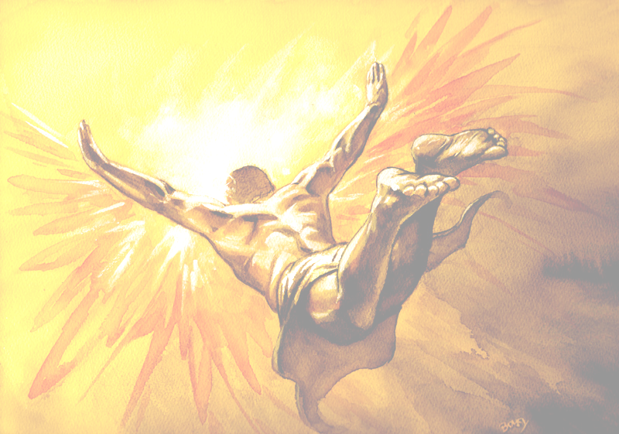
Conclusion
It is a wonderful feeling to recognize the unity of a complex of phenomena that to direct observation appear to be quite separate things
- Einstein to Marcel Grossaman
We are obliged by the deepest drives of the human spirit to make ourselves more than animated dust, and we must have a story to tell about where we came from, and why we are here
- Ed Wilson
Let us see how high we can fly before the sun melts the wax in our wings.
- Subrahmanyan Chandrashekhar

