Slide 1
‘The Future of Education'
'The Creativity Response':
What Neurobiology and Clinical Psychology can tell us about
Learning, Creativity, Performance and Problem-solving
Dubrovnik
World Academy of Art and Science
World University Consortium
September-2015
Stefan Brunnhuber MD PhD
www.stefan-brunnhuber.de
Fellow WAAS

Slide 2
Purpose of Education
Primary Education: enables graduates to function in society
by promoting basic knowledge such as literacy, mathematics and science.
Higher Education: prepares the next generation to solve the
complex problems facing modern society, assuming societal leadership and
responsibility in various fields, striving for the Truth
and/ or self-development/self-knowledge.
Roy Y. Chan, Gavin T. L. Brown, and Larry H. Ludlow, 2015

Slide 3
Current Discussion On Global Education
IT and Big Data
Public versus private Financing
Relevance of translational - interdisciplinary programs
Gender and Ethnical Aspects
Focusing on demands of the economy versus ‚general education‘
Access to Primary and Higher Education
Reconcile Teaching & Research; Excellence & Equity
OECD 2012, 2015, Tertiaer Higher Education

Slide 4
Creativity:
Creativity is about something new, happening in each of us.
Creativity is about integrating opposites in each of us.
There are several components necessary to unleash creativity.

Slide 5
Thesis
Most educational programs in place do not tap into the full creative potential
of our mind and of our brain and often lead to suboptimal outcome.
Findings in Clinical Psychology, Neurobiology and Social
Psychology (life science) are not sufficiently considered
in setting up programs.
Cognitive Neuroscience, the Biology of the Mind
Gazzaniga, 4th edition, 2013
Brain & Behavior: An Introduction to Biological Psychology
Garrett, 3rd edition, 2010
Principles of Neural Science
Kandel, 5th edition, 2012

Slide 6
What makes a difference: A first Look
The Hattie-Study: (800 Meta-analysis)
What does not work, is neutral or of little help (examples):
Retention
TV
Mobility
long summer vacation
age bridging classes
state welfare support
Technology based learning at home
Preschool classes
seize of classes
web-based programs
homework
gender-aspects
What makes a different (examples): ES>0,4
Peer tutoring
Feedback and mistakes
Meta-cognitive Training
Teacher Training
Cyclical repeating and drill with pauses
relation between teacher and student
cooperative peer learning
Acceleration
J. Hattie 2009, 2012ff

Slide 7
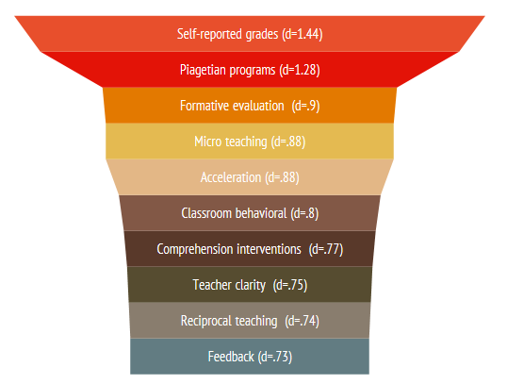
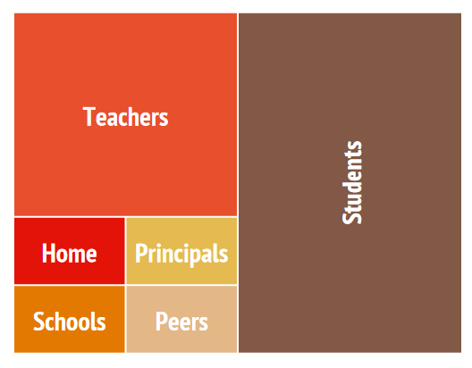
Inter-personal variables oversteer institutional variables by factor 2
Hattie 2009, 2012

Slide 8
About Learning-Performance: The Creativity Response
Exercise and Cognition
Mindfulness versus BIG DATA
Rest and Sleep versus 7/24
Multi-sensory learning versus digital learning
Social Competence versus Competitiveness
Nutrition and Supplements versus Neuro-enhancement
Mihaly Csikszentmihalyi 2012
Carl Gustav Jung 1958 ff
Gazzangia 2013
Garrett, 2010

Slide 9
The Creativity Response: Exercise and Cognition
A walk in the park
Link between Exercise - Executive Functions - Memory - Mood - Cognitive Enhancement
Neurobiology: Prefrontal Cortex - Hippocampal Neurogenesis - pro/ anti-inflammatory States
Healthy Subjects & Student benefit from intensive exercise intervals: Attention-span -
Mathematics - All-Performance
Mixed results in clinical population: Preventive against aging, dementia & depression -
alleviates positive and negative symptoms in schizophrenia, anxiolytic in phobia and Trauma
Cognitive Reserve
Zschucke E, Renneberg B, Dimeo F, Wüstenberg T, Ströhle A Psychoneuroendocrinology. 2015 Jan;
51:414-25. doi: 10.1016/j.psyneuen.2014.10.019. Epub 2014 Oct 25.
The stress-buffering effect of acute exercise: Evidence for HPA axis negative feedback.
Diamond A Ann Sports Med Res. 2015 Jan 19;2(1):1011.
Effects of Physical Exercise on Executive Functions: Going beyond Simply Moving to Moving with Thought.
Ballesteros S, Kraft E, Santana S, Tziraki C4 Neurosci Biobehav Rev. 2015 Jun 5. pii: S0149-7634(15)00162-1. doi:
10.1016/j.neubiorev.2015.06.008. Maintaining Older Brain Functionality: A Targeted Review.
Gregory N. Bratman, J. Paul Hamilton, Kevin S. Hahn, Gretchen C. Daily, and James J. Gross
PNAS 2015 112 (28) 8567-8572; published ahead of print June 29, 2015:

Slide 10
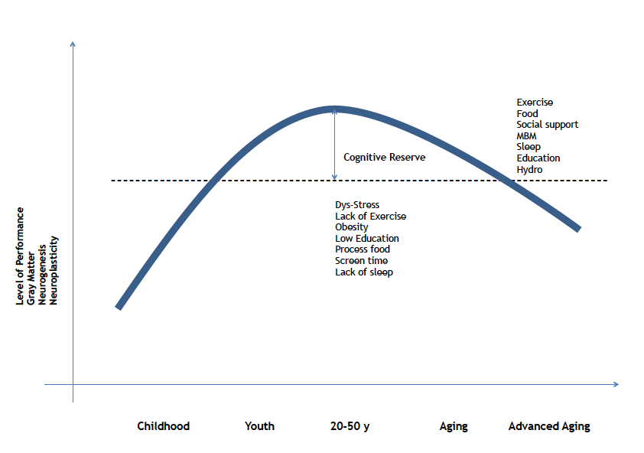
The Creativity Response: Exercise and Cognitive Reserve
Erickson, K. et al 2009: Aerobic fitness is associated with hippocampal volume in elderly humans, Hippocampus V. 19,2009 1030-1039
Dik M., et al. 2003 Early life physical activity and cognition at old age; J. Clinc Exp. Neuropsychol V. 25, 2003, 643-653
Rovio S. et al. Leisure -time physical activity at midlife and the risk of dementia and Alzheimer Disease, Lancet Neol V. 4. 2005, 705-711
Diniz BS et al, 2013 Br J Psy. 202-329-335, Late life depression and risk of vascular dementia and Alzheimer disease: systematic review and metaanalysis of
community based cohort studies.
Ströhle A, et al 2007, Physical Activity and prevalence and incidence of mental disorders in adolescents and young adults. Psychol. Med. 37:1657-1666
Pajonk FG et al, 2010 Arc Gen Psych; Hippocampal plasticity in response to exercise in schizophrenia, 67:133-143

Slide 11
The Creativity Response: Exercise and Cognition
A walk in the park
Link between Exercise - Executive Functions - Memory - Mood - Cognitive Enhancement
Neurobiology: Prefrontal Cortex - Hippocampal Neurogenesis - pro/ anti-inflammatory States
Healthy Subjects & Student benefit from intensive exercise intervals: Attention-span -
Mathematics - All-Performance
Mixed results in clinical population: Preventive against aging, dementia & depression -
alleviates positive and negative symptoms in schizophrenia, anxiolytic in phobia and Trauma
What works best ? aerobic - resistant - coordinative- cognitive-based exercise
Zschucke E, Renneberg B, Dimeo F, Wüstenberg T, Ströhle A Psychoneuroendocrinology. 2015 Jan;
51:414-25. doi: 10.1016/j.psyneuen.2014.10.019. Epub 2014 Oct 25.
The stress-buffering effect of acute exercise: Evidence for HPA axis negative feedback.
Diamond A Ann Sports Med Res. 2015 Jan 19;2(1):1011.
Effects of Physical Exercise on Executive Functions: Going beyond Simply Moving to Moving with Thought.
Ballesteros S, Kraft E, Santana S, Tziraki C4 Neurosci Biobehav Rev. 2015 Jun 5. pii: S0149-7634(15)00162-1. doi:
10.1016/j.neubiorev.2015.06.008. Maintaining Older Brain Functionality: A Targeted Review.
Gregory N. Bratman, J. Paul Hamilton, Kevin S. Hahn, Gretchen C. Daily, and James J. Gross
PNAS 2015 112 (28) 8567-8572; published ahead of print June 29, 2015:

Slide 12
The Creativity Response: Mindfulness versus BIG DATA
Sensory overload - information overload - filter failure
Mind-Body- Medicine- Different to Psychotherapy - Different to ‚closing your eyes‘
Increases Creativity and performance through Des-identification
Meditation is not simply relaxation
Executive Function - memory consolidation - Grey matter changes after 5 weeks
Darya L. Zabelina, Daniel O’Leary, Narun Pornpattananangkul, Robin Nusslock, Mark Beeman. Creativity and sensory gating indexed by the P50:
Selective versus leaky sensory gating in divergent thinkers and creative achievers. Neuropsychologia, 2015; 69: 77 DOI: 10.1016/j.neuropsychologia.2015.01.034
Front Psychol. 2013 Jul 9;4:398. doi: 10.3389/fpsyg.2013.00398. eCollection 2013.
Brain Gray Matter Changes Associated with Mindfulness Meditation in Older Adults: An Exploratory Pilot Study using Voxel-based Morphometry.
Kurth F, Luders E, Wu B, Black DS.
Neurosci Biobehav Rev. 2014 Jun;43:48-73. doi: 10.1016/j.neubiorev.2014.03.016. Epub 2014 Apr 3.Is meditation associated with altered brain structure?
A systematic review and meta-analysis of morphometric neuroimaging in meditation practitioners.Fox KC1, Nijeboer S2, Dixon ML,
Floman JL, Ellamil M, Rumak SP, Sedlmeier P, Christoff K.
Front Hum Neurosci. 2015 May 12;9:281. doi: 10.3389/fnhum.2015.00281. eCollection 2015.
Neuroprotective effects of yoga practice: age-, experience-, and frequency-dependent plasticity.
Villemure C, Čeko M, Cotton VA, Bushnell MC
Lorenza S. Colzato, Ayca Ozturk, Bernhard Hommel. Meditate to Create: The Impact of Focused-Attention and Open-Monitoring
Training on Convergent and Divergent Thinking. Frontiers in Psychology, 2012; 3 DOI: 10.3389/fpsyg.2012.00116
Effect of meditation on cognitive functions in context of aging and neurodegenerative diseases.
Fox KC, Nijeboer S, Dixon ML, Floman JL, Ellamil M, Rumak SP, Sedlmeier P, Christoff K Neurosci Biobehav Rev. 2014 Jun;43:48-73.
doi: 10.1016/j.neubiorev.2014.03.016.,Is meditation associated with altered brain structure? A systematic review and
meta-analysis of morphometric neuroimaging in meditation practitioners.
Paulson S, Davidson R, Jha A, Kabat-Zinn J. Becoming conscious: the science of mindfulness.Ann N Y Acad Sci. 2013 Nov;1303:87-104.

Slide 13
The Creativity Response:
Mindfulness, the common denominator
Non-reactivity to internal stimuli
Observational to emotional, physiological and cognitive process
Enlarged Consciousness
Verbalization of experiences
Non-Judgemental
Des-identification
Repetitive Practice

Slide 14
The Creativity Response: Rest and Sleep versus 7/24
Sleep is an active state and vital need. 7-9 hours a sleep is natural
20% less than 100 years ago
Americans would be happier, healthier and safer if they slept 60-90 minutes more a night
>80 Million People affected by insomnia globally
>78% perceive higher stress-levels with poor sleep
Obesity, Cardiovascular, Altered Pain Perception
Insomnia: Strongest Predictor for a mental disorder
24 hour sleep deprivation is equivalent to 0,8 promil of alcohol
Hippocampal neurogenesis
American Psychological Association. (2004, May). More sleep would make most Americans happier, healthier and safer. Retrieved from http://www.apa.org/research/action/sleep-deprivation.aspx
F. Sofi, F. Cesari, A. Casini, et al. Insomnia and risk of cardiovascular disease: a meta-analysis Eur J Prev Cardiol, 21 (2014), pp. 57–64
Bastien CH, Vallières A, Morin CM. Precipitating factors of insomnia. Behav Sleep Med. 2004;2:50–62.
Pressman MR. Definition and consequences of sleep deprivation. UpToDate®; 2013. Im Internet: http://www.uptodate.com/contents/definition-and-consequences-of-sleep-deprivation.
J Altern Complement Med. 2015 Mar;21(3):175-9. doi: 10.1089/acm.2013.0450. Epub 2015 Feb 11.
Monitoring the neural activity of the state of mental silence while practicing Sahaja yoga meditation.
Hernández SE1, Suero J, Rubia K, González-Mora JL.

Slide 15
The Creativity Response: Rest - Stress - Performance
Sleep is not a luxury but a necessity.
Memory Consolidation - Encoding New Information after Sleep - Performance - Executive Function
Risk factor and Causal link to a variety of physical condition
Children /student: Performance require naps and quality of sleep
Neurogenesis - Pro-inflammatory states - Cortisol
5 ways to manage poor sleep:
Life style (sports-nutrition)
Sleep Hygiene (dark, cool, quiet room)
Hydro: ‚Vasodilation predicts falling asleep…’
MBM: Breathing technics, Yoga, Zen
Supplements: Melatonin, Tryptophan, Cashew nuts, Lavender, Passionfruit, St. John Worth
.
Feld GB, Diekelmann S. Front Psychol. 2015 May 12;6:622. doi: 10.3389/fpsyg.2015.00622. eCollection 2015.
Sleep smart-optimizing sleep for declarative learning and memory.
Sara Studte, Emma Bridger, Axel Mecklinger. Nap sleep preserves associative but not item memory performance. Neurobiology of Learning and Memory, 2015; 120: 84 DOI: 10.1016/j.nlm.2015.02.012
Irwin MR. Annu Rev Psychol. 2015 Jan 3;66:143-72. doi: 10.1146/annurev-psych-010213-115205. Epub 2014 Jul 21.
Why sleep is important for health: a psychoneuroimmunology perspective.
Tempesta D, De Gennaro L, Natale V, Ferrara M Sleep Med. 2015 Jul;16(7):862-70. doi: 10.1016/j.sleep.2015.01.024. Epub 2015 Apr 14.
Emotional memory processing is influenced by sleep quality.
Cho HJ, Seeman TE, Kiefe CI, Lauderdale DS, Irwin MR Brain Behav Immun. 2015 May;46:319-26. doi: 10.1016/j.bbi.2015.02.023. Epub 2015 Feb 28. Sleep disturbance and longitudinal risk of inflammation: Moderating influences of social integration and social isolation in the Coronary Artery Risk Development in Young Adults (CARDIA) study.

Slide 16
The Creativity Response:
Multi-sensory versus digital learning
Prefrontal Cortex - Hippocampus
Attention-span - memory consolidation
Performance - Distraction
Mental and physical condition
FOMO
Gregory N. Bratman, J. Paul Hamilton, Kevin S. Hahn, Gretchen C. Daily, and James J. Gross Nature experience reduces rumination and subgenual prefrontal
cortex activation, PNAS 2015 112 (28) 8567-8572; published ahead of print June 29, 2015
Hutton JS, Horowitz-Kraus T, Mendelsohn AL DeWitt T, Holland SK Pediatrics. 2015 Aug 10. pii: peds.2015-0359. [Epub ahead of print] Home Reading
Environment and Brain Activation in Preschool Children Listening to Stories.
Cai L, Zhu X, Yi J, Bai M, Wang M, Wang Y, Hu M, Yao S. J Dev Behav Pediatr. 2013 Apr;34(3):197-203. doi: 10.1097/DBP.0b013e3182825c41.
Neurological soft signs and their relationship with measures of executive function in Chinese adolescents; Goldstein Sam, Jack A. Naglier,
A. Jack, 2014 Handbook of Executive Functioning, Springer New York
Roberts JA., Pirog SF. 2013, A prelimenary investigation of materialism and impulsiveness as predictors of technological addictions among young adults,
J.of Behavioral Addictions 2:56-62
Lepp A, Barkley JE, Karpinski AC. 2014, The relationship between cell phone use, academic performance, anxiety and satisfaction
with life in college students. Computers in Human Behavior 3: 343-350
Katja M. Mayer, Izzet B. Yildiz, Manuela Macedonia, Katharina von Kriegstein. Visual and motor cortices differentially support the
translation of foreign language words. Current Biology, 5 February 2015

Slide 17
The Creativity Response:
Social Competence versus Competitiveness
‚One friend within a mile’ and general well being
Living in an adversive neighborhood (crime, noise, vandalism) leads to faster aging(10y) and lower performance
psychological adjustment in clinical condition (HIV, CHD, Depression, Anxiety, PTSD, Eating disorders, Schizophrenia)
Quality of social support: Social media/ Screen time correlates with life satisfaction, performance,
perceived stress, addiction, eating habits, sleep, depression - negatively
Social competence is one of the best predictor for future success
The Role of Social Support in Reducing Psychological Distress, March 2012, CIHI
Mijung Park, Josine E. Verhoeven, Pim Cuijpers, Charles F. Reynolds III, Brenda W. J. H. Penninx. Where You Live May Make You Old: The Association between Perceived Poor Neighborhood Quality and Leukocyte Telomere Length. PLOS ONE, 2015; 10 (6): e0128460 DOI:
Sherman SM, Cheng YP, Fingerman KL, Schnyer DM. Soc Cogn Affect Neurosci. 2015 Jun 8. pii: nsv071. Social Support, Stress, and the Aging Brain.
Thomee, S. Härenstam A. Hagbergb M. Mobile phone use and stress, sleep disturbances, and sympoms of depression among young adults, a prospective cohort study, BMC Public Health 2011, 11:6
Fowler JH, Christakis NA. Dynamic spread of happiness in a large social network: longitudinal analysis over 20 years in the Framingham Heart Study. BMJ 2008;337:
Lahdenperä,M. et al, 2004 Fitness benefits of prolonged post-reproductive lifespan in women, Nature V, 428pp:178-181
Lepp A., Barkley JE, Karpinski AC. 2014 Therelationship between cellphone use, academic performance, anxiety, and satisfaction with life in college students, 2014, Computer in Human behaviors 31:343-350

Slide 18
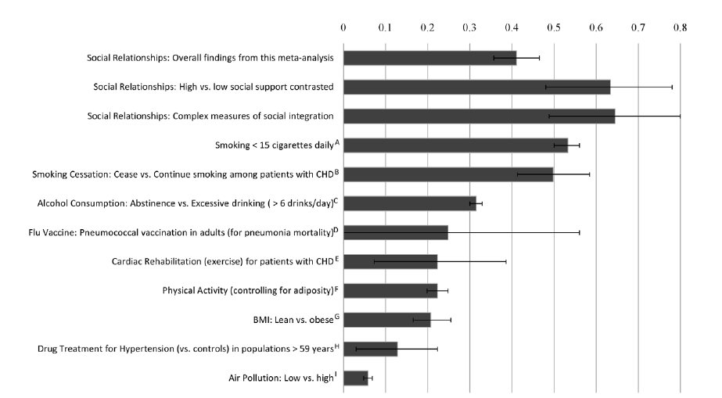
The Creativity Response: Quality of Social Support
J. Holt-Lunstad, T.B. Smith, J.B. Layton
Social relationships and mortality risk: a meta-analytic review
PLoS Med, 7 (2010), p. e1000316

Slide 19
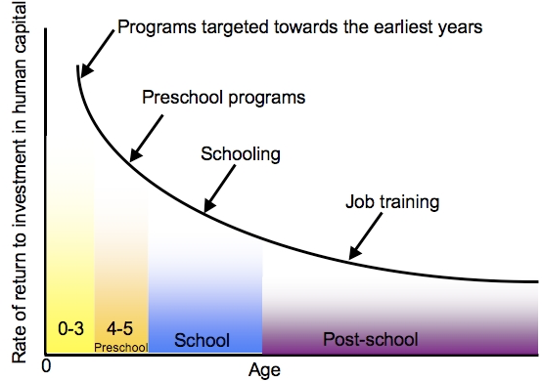
The Creativity Response:
Early Intervention makes the Difference
The Heckman curve: heckmanequation.org

Slide 20
The Creativity Response: Nutrition versus Neuro-enhancement
Population-level: low meat-Mediterranean diet associated with lower risk of CVD, DM, Cognitive Impairment and Depression
Fasting: Weight loss, insulin sensitivity, reduce blood pressure, anti-inflammatory, limits lipid levels, longevity
Mental Health: Memory consolidation, sleep, mood disorders, anxiety, bipolar, stress-axis
Supplements are anti-inflammatory, antioxidative: Omega-3, Vit.D3, Zinc, Vit B-Complex.
Neuro-enhancement: negative impact on memory, mood, executive function, expensive
Singh I, Filipe AM, Bard I, Bergey M, & Baker L (2013) Globalization and Cognitive Enhancement: Emerging Social and Ethical Challenges for ADHD Clinicians.
Current Psychiatry Reports, 15(385). doi: 10.1007/s11920-013-0385-0 Fond G, Macgregor A, Leboyer M, Michalsen A. Psychiatry Res. 2013 Oct 30;209(3):253-8.
Longo VD, Mattson MP. Fasting: molecular mechanisms and clinical applications. Cell Metab. 2014 Feb 4;19(2):181-92.
Jerome Sarris, Alan C Logan, Tasnime N Akbaraly, G Paul Amminger, Vicent Balanzá-Martínez, Marlene P Freeman, Joseph Hibbeln, Yutaka Matsuoka,
David Mischoulon, Tetsuya Mizoue, Akiko Nanri, Daisuke Nishi, Drew Ramsey, Julia J Rucklidge, Almudena Sanchez-Villegas, Andrew Scholey, Kuan-Pin Su,
Felice N Jacka. Nutritional medicine as mainstream in psychiatry. The Lancet Psychiatry, 2015; 2 (3): 271
Nagel SK (2010) Ethics and the Neurosciences. Ethical and social consequences of neuroscientific progress. Paderborn: mentis
Sahakian B, Morein-Zamir S (2007) Professor’s little helper. Nature 450: 1157–1159.
R.M. Battleday, A-K. Brem Modafinil for cognitive neuroenhancement in healthy non-sleep-deprived subjects: a systematic review, S0924-977X(15)00249-7, European Neuropsychopharamcology
.

Slide 21
Creativity Response: Conclusion
Creativity is about something new, happening in each of us.
Regardless to the field of study and the program installed,
findings in life science could make a difference.
There are at least 6 components necessary to unleash creativity
promoting higher performance, leadership, self-esteem
motivational aspects and content.

Slide 22
The Creativity Response: Performance and Level of Arousal
.
Yerkes RM, Dodson JD (1908). "The relation of strength of stimulus to rapidity of habit-formation". Journal of Comparative Neurology and Psychology 18: 459–482.

Slide 23
Fact Sheet: History and Present
OECD Spending
1,6% of GDP on education
Spending on HE exceed GDP
ROI differs by level and region and subject:
Subsahara: PE 1:25 HE 1:10
OECD: PE 1:12 HE 1: 8
Global: PE 1:18 HE 1:10
Humanity 20y
MIST 12y
Correlation between Education and Growth
100 PISA Point 1,2%
Finance
EU: 70% of R&D is state funded
Degree
50% of university teachers BA, globally
China: 9% PhD India 35% PhD
International Mobility
2010: 2,5 Mill 2020 7 Mill

