Slide 1
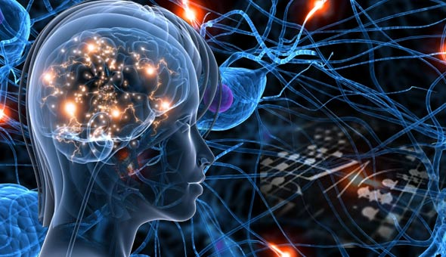
Education of the Mind
& Its Faculties
THINKING
15

Slide 2
Scientific Discovery
What do we know about the phenomenon of genius?
According to Popper and the testimony of many great scientific discoverers, the process of formulating new hypotheses is intuitive rather than logical. The process of logical analysis, testing and validation comes only afterwards.
Why is it then that almost all science education focuses on the process of validation rather than on the process of discovery itself?
What do we know about the process of discovery that can be taught?
18

Slide 3
Bias for Physicality
What is reality?
  Material?
  Emotional?
  Conceptional?
  Consciousness?
Dependence on the senses has created an implicit bias for the objective material dimensions of reality
  Correlation does not prove causality – psychotropic drugs
  Downgrading the subjective dimension of reality
The unrealized is not the unrealizable
  Dominance of the past and present over the future
  Determinative power of anticipation and aspiration
18

Slide 4
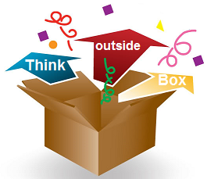
Unification in Science
Great scientific discoveries unify apparently disparate or independent phenomena
  Newton – motion & inertia
  Maxwell – magnetism & electricity
  Einstein – matter & energy, gravity & acceleration, space & time
The capacity to conceive of apparent contradictions as complementary dimensions of a wider reality is a characteristic of genius
Can it be taught?
18

Slide 5
Types of Thinking
Analytic | Reductionism | Uniqueness
Synthetic | Systemic | Commonalty
Integrative | Unifying | Essentiality
16
Notes:
e.g. Character– Culture – Human Nature

Slide 6
Dualistic, Synthetic &
Integrative Thinking
Dualistic – views reality in terms of contradictions or mutual exclusive opposites – truth vs. truth -- categorization
  Neoliberalism vs Keynesianism
  Individualism vs. Collectivism
Holistic – views reality comprehensively and inclusively
  No freedom without responsibility
  No free markets without regulation
Integrative – reconciles apparent contradictions as complementary poles of a wider reality – truths completing truths – reveals the underlying transdisciplinary principles
  Individual and Society are complementary dimensions
  Process of human accomplishment – energy, organization, aspiration, awareness, values
6
Notes:
“Not setting truth against truth to see which will stand and survive, but completing truth by truth in the light of the one Truth of which all are the aspects.” LD 983
Genius
Deep thinking – William Byers – paradigm change – change in conceptual framework

Slide 7
Deep Thinking
All knowledge is based on a conceptual framework
Since the framework is implicit, subconscious, taken for granted, it is extremely difficult to comprehend perspectives or solutions that lie outside it
Problems generated by the implicit premises of a conceptual framework persist until a new framework emerges – a new, more inclusive paradigm
Education is build on progressive layers of paradigms
We learn to embrace multiple paradigms once they are established
What we rarely learn is how to consciously identify the limiting premises of prevailing paradigms and consciously love to transcend them
The capacity to become conscious of conceptual limitations and overcome them is the essence of creative thinking
William Byers, Deep Thinking
18

