Slide 1
Contextual Education
Janani Ramanathan

Slide 2
The System of Education
Education abridges the knowledge of millennia into a 15-20 year study
This is done by abridging and organizing the knowledge into generalized abstract mental principles

Slide 3
Gap between Theory and Life
In the process of teaching the abstractions divorced from context, much precious knowledge is lost and relevance to the real world becomes obscure

Slide 4
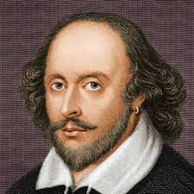
Literature
All great literature depicts and reflects realities of human character, society, values and aspirations

Slide 5
Contextualized Education
Education becomes contextualized when studied within the physical, social and cultural circumstances characterizing real life situations, the subjective mental and emotional processes that prompt human action, and the creative role of individuals in the collective social process
Creating the relevant context, education come to life

Slide 6

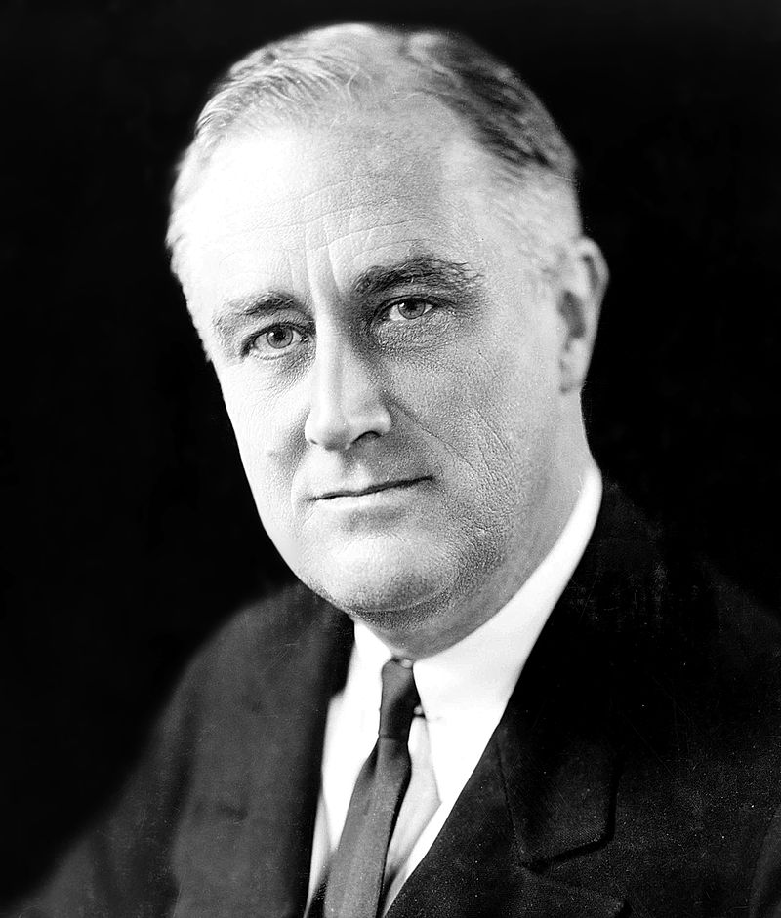
Value of Values
The value of values has been recognized as an essential driver of business excellence

Slide 7
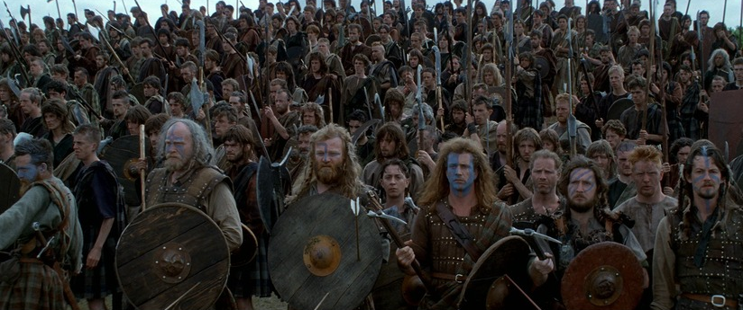
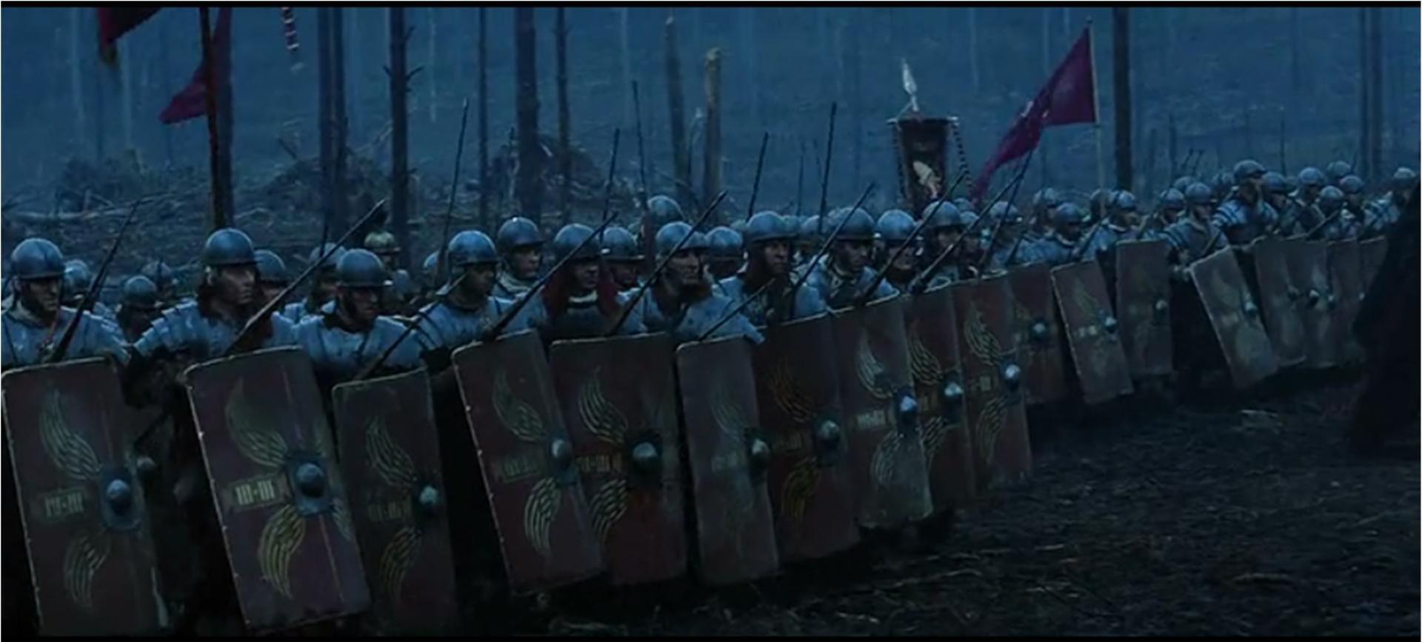
History, Biography, Art
Organization is a fundamental principle behind social evolution in every field of life – commercial, economic, social, political, religious, educational, scientific... but the true power of organization is rarely brought forth with sufficient clarity and emphasis

Slide 8
Contextualizing Education
- Bridging the gap between abstract concept and social relevance -

