Slide 1
June 26, 2015
Webinar on the Future of Education
Education for Planetary Citizenship
HAZEL HENDERSON
D.Sc.Hon., FRSA
President, Ethical Markets Media (USA &Brazil)
EthicalMarkets.com
MercadoEtico.com.br
EthicalBiomimicryFinance.com

Slide 2
www.ethicalmarkets.com www.ethicalmarkets.tv
Universal access to education
Priority for public investment
Free to all learners everywhere
Now possible!
(MOOCs)
© 2015 Hazel Henderson

Slide 3
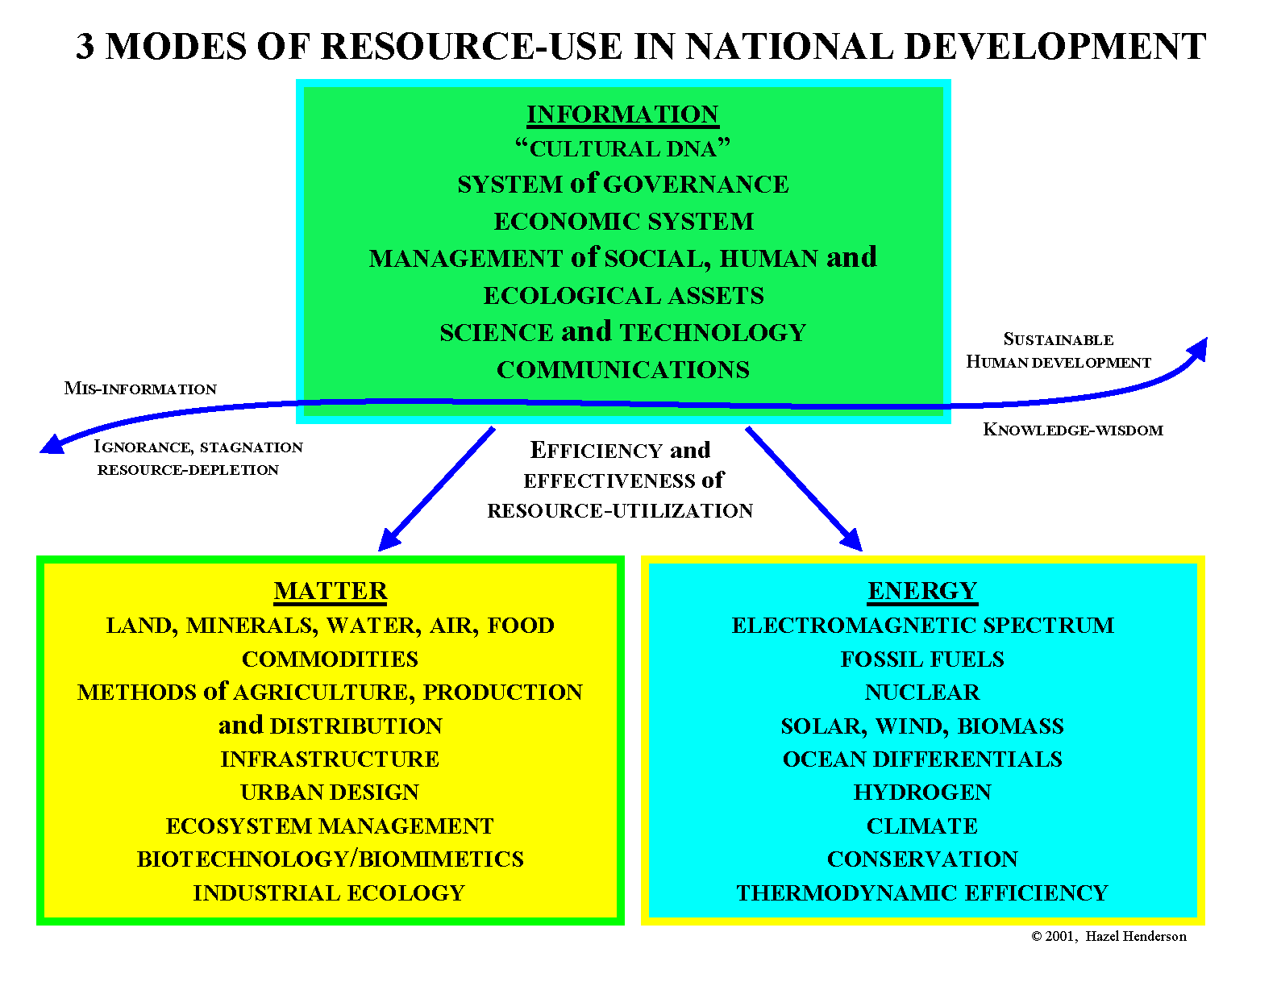
www.ethicalmarkets.com www.ethicalmarkets.tv

Slide 4
www.ethicalmarkets.com www.ethicalmarkets.tv
Curriculum: Earth System Science
Earth-observing satellites
Mapping the global transition from mining the Earth to harvesting Sun’s free photons
Biomimicry
© 2015 Hazel Henderson

Slide 5
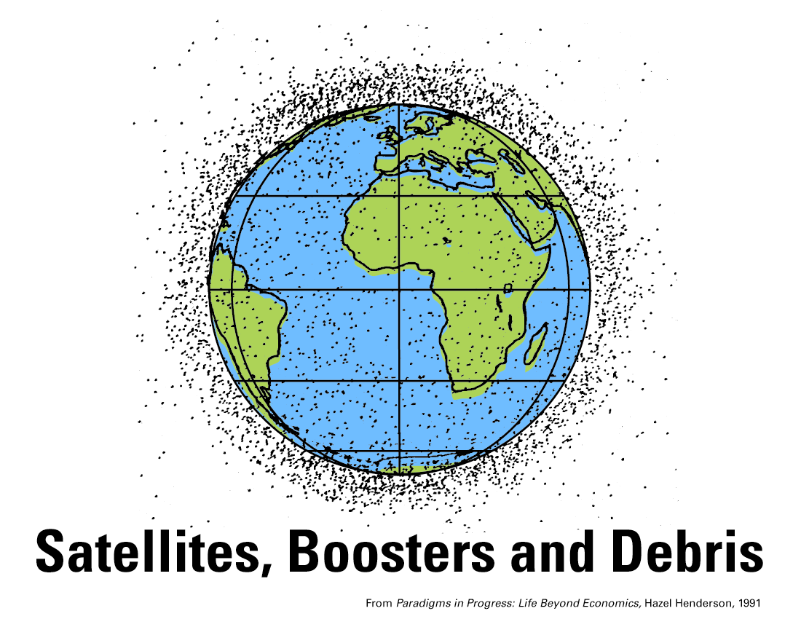
www.ethicalmarkets.com www.ethicalmarkets.tv
Earth Ethics in the Anthropocene Age

Slide 6
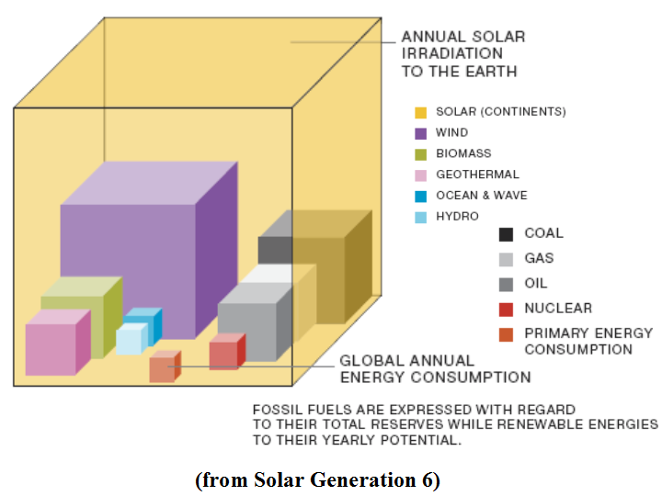
www.ethicalmarkets.com www.ethicalmarkets.tv
Solar irradiation versus established global energy resources
"Solar Generation 6," EPIA 2011

Slide 7
www.ethicalmarkets.com www.ethicalmarkets.tv
Re-integrating Human Knowledge
From disciplines to systems, synthesis
Extend time and space horizons
Engage learners’ interests, curiosity, purpose and passion
Cultivate
self-knowledge,
reflection,
empathy and
ethical concern
© 2015 Hazel Henderson

Slide 8
www.ethicalmarkets.com www.ethicalmarkets.tv
Shifting Public Budgets, GDP Account
Toward Education
Change GDP classifications of “education” from Consumption to Investment
Create Asset Accounts in GDP for all public investments in
Infrastructure (schools, public transport, health, buildings)
Infostructure (education, access to internet, broadband research, public media, MOOCs)
Add People as Assets!
© 2015 Hazel Henderson

Slide 9
www.ethicalmarkets.com www.ethicalmarkets.tv
A systems approach to understanding
green business,
environment,
economies,
energy,
science,
innovation,
technology
and the role of money as applied to
climate change,
community development,
finance and the many ways we sustainably interact with each other
EthicalMarketsExploratorium.com
© 2015 Hazel Henderson

