Slide 1
FUTURE OF EDUCATION

Slide 2
EDUCATION OF FUTURE

Slide 3
EDUCATION OF FUTURE
Three Bubbles & Leadership?

Slide 4
EDUCATION OF FUTURE
Security Bubble?

Slide 5
SECURITY BUBBLES | Challenge | Outcome/Risk | Managed
1900-45 (WW I&II) | Geopolitical & Arms Race | WWI 30 million dead WWII 60 million dead | Mismanaged & Extremism
1950-63 (62 Crisis) | Geopolitical & Arms Race | Potentially Hundreds of million | Leadership & Luck
1975-85 (83 Panic) | Geopolitical & Arms Race | Potentially Hundreds of million | Luck & Leadership
2000-25 (….Crisis) | Geopolitical & Arms Race | Potentially Hundreds of million | Mismanaged? Extremism? Luck ? Leadership?
 | Challeng | Outcome | Opportunity
WW I&II | Geopolitical & Arms Race | WWI 30 million dead WWII 60 million dead | Missed
1950-63 (Cuban Crisis) | Geopolitical & Arms Race | Potentially Hundreds of million | Luck & Leadership
1975-85 (1983 Panic) | Geopolitical & Arms Race | Potentially Hundreds of million | Luck

Slide 6
 | Challeng | Outcome | Opportunity
WW I&II | Geopolitical & Arms Race | WWI 30 million dead WWII 60 million dead | Missed
1950-63 (Cuban Crisis) | Geopolitical & Arms Race | Potentially Hundreds of million | Luck & Leadership
1975-85 (1983 Panic) | Geopolitical & Arms Race | Potentially Hundreds of million | Luck
SECURITY BUBBLES | Challenge | Outcome / Risk | Managed
1900-45 (WW I&II) | Geopolitical & Arms Race | WWI 30 million dead WWII 60 million dead | Mismanaged & Extremism
1950-63 (62 Crisis) | Geopolitical & Arms Race | Potentially Hundreds of million | Luck & Leadership
1975-85 (83 Panic) | Geopolitical & Arms Race | Potentially Hundreds of million | Luck & Leadership
2000-25 (.. Crisis) | Geopolitical & Arms Race | Potentially Hundreds of million | Mismanaged? Extremism? Luck ? Leadership?

Slide 7
 | Challeng | Outcome | Opportunity
WW I&II | Geopolitical & Arms Race | WWI 30 million dead WWII 60 million dead | Missed
1950-63 (Cuban Crisis) | Geopolitical & Arms Race | Potentially Hundreds of million | Luck & Leadership
1975-85 (1983 Panic) | Geopolitical & Arms Race | Potentially Hundreds of million | Luck
SECURITY BUBBLES | Challenge | Outcome / Risk | Managed
1900-45 (WW I&II) | Geopolitical & Arms Race | WWI 30 million dead WWII 60 million dead | Mismanaged & Extremism
1950-63 (62 Crisis) | Geopolitical & Arms Race | Potentially Hundreds of million | Luck & Leadership
1975-85 (83 Panic) | Geopolitical & Arms Race | Potentially Hundreds of million | Luck & Leadership
2000-25 (.. Crisis) | Geopolitical & Arms Race | Potentially Hundreds of million | Mismanaged? Extremism? Luck ? Leadership?

Slide 8
EDUCATION OF FUTURE
Sustainability Bubble?

Slide 9
 | WHY? | WHAT? | HOW?
ECONOMY | Crisis ➔ Crises ➔ Socio-economic crash? Loose - Loose Resource deficit Negative externalities Supra-national Regulation fatigue | Internalize Negative Externalities Multiply Positive Externalities Beyond Externalities Areas: Real economy Sustainable development Environment Dangerous technologies | Market-based 3M Footprint: Model Measure Mitigate Priorities Best return mitigation Leadership
IGOs | Unfit for crash prevention Triple fatigue Regulation fatigue IGO fatigue Cooperation fatigue | IGO 3.0 | Top down Bottom up From inside From outside Leadership
PEOPLE | Distribution dis-functionality Lost Generation: 20-50% population Ticking bomb | Empower through work for the Commons | Massive knowledge sharing Wikinomy of Commons Leadership

Slide 10
 | WHY? | WHAT? | HOW?
ECONOMY | Crisis ➔ Crises ➔ Socio-economic crash? Loose - Loose Resource deficit Negative externalities Supra-national Regulation fatigue | Internalize Negative Externalities Multiply Positive Externalities Beyond Externalities Areas: Real economy Sustainable development Environment Dangerous technologies | Market-based 3M Footprint: Model Measure Mitigate Priorities Best return mitigation Leadership
IGOs | Unfit for crash prevention Triple fatigue Regulation fatigue IGO fatigue Cooperation fatigue | IGO 3.0 | Top down Bottom up From inside From outside Leadership
PEOPLE | Distribution dis-functionality Lost Generation: 20-50% population Ticking bomb | Empower through work for the Commons | Massive knowledge sharing Wikinomy of Commons Total leadership

Slide 11
 | WHY? | WHAT? | HOW?
PEOPLE | Distribution dis-functionality Lost Generation: 20-50% population Ticking bomb | Empower through work for the Commons | Massive knowledge sharing Wikinomy of Commons Leadership
ECONOMY | Crisis ➔ Crises ➔ Socio-economic crash? Loose - Loose Resource deficit Negative externalities Supra-national Regulation fatigue | Internalize Negative Externalities Multiply Positive Externalities Beyond Externalities Areas: Real economy Sustainable development Environment Dangerous technologies | Market-based 3M Footprint: Model Measure Mitigate Priorities Best return mitigation Leadership
IGOs | Unfit for crash prevention Triple fatigue Regulation fatigue IGO fatigue Cooperation fatigue | IGO 3.0 | Top down Bottom up From inside From outside Leadership

Slide 12
 | WHY? | WHAT? | HOW?
PEOPLE | Distribution dis-functionality Lost Generation: 20-50% population Ticking bomb | Empower through work for the Commons | Massive knowledge sharing Wikinomy of Commons Leadership
ECONOMY | Crisis ➔ Crises ➔ Socio-economic crash? Loose - Loose Resource deficit Negative externalities Supra-national Regulation fatigue | Internalize Negative Externalities Multiply Positive Externalities Beyond Externalities Areas: Real economy Sustainable development Environment Dangerous technologies | Market-based 3M Footprint: Model Measure Mitigate Priorities Best return mitigation Leadership
IGOs | Unfit for crash prevention Triple fatigue Regulation fatigue IGO fatigue Cooperation fatigue | IGO 3.0 | Top down Bottom up From inside From outside Leadership

Slide 13
EDUCATION OF FUTURE
Growth Bubble?

Slide 14
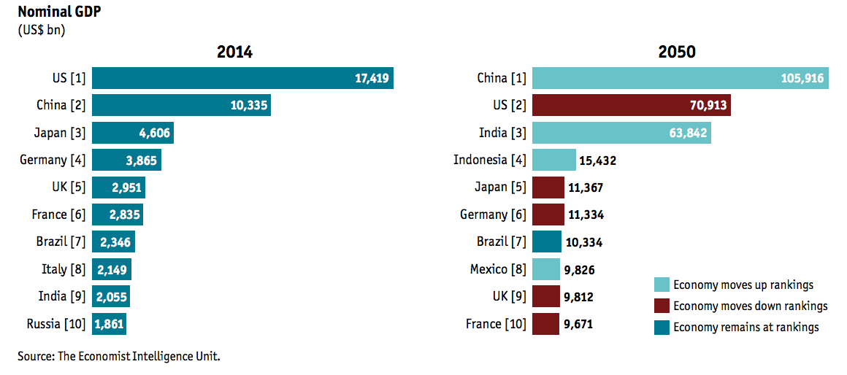

Slide 15
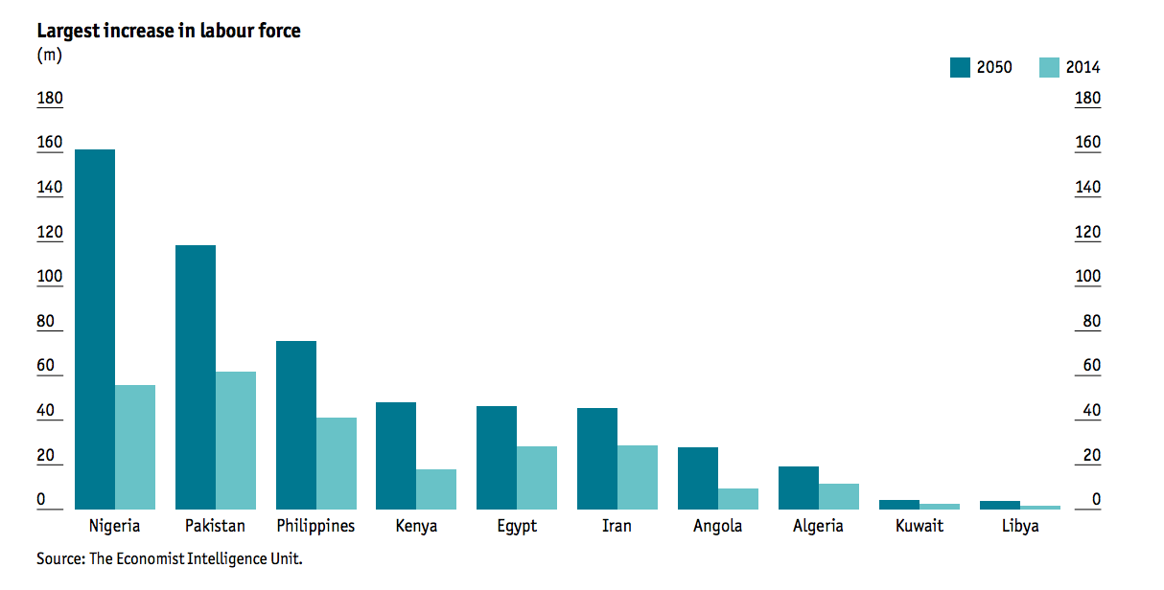
FUTURE OF EDUCATION

Slide 16
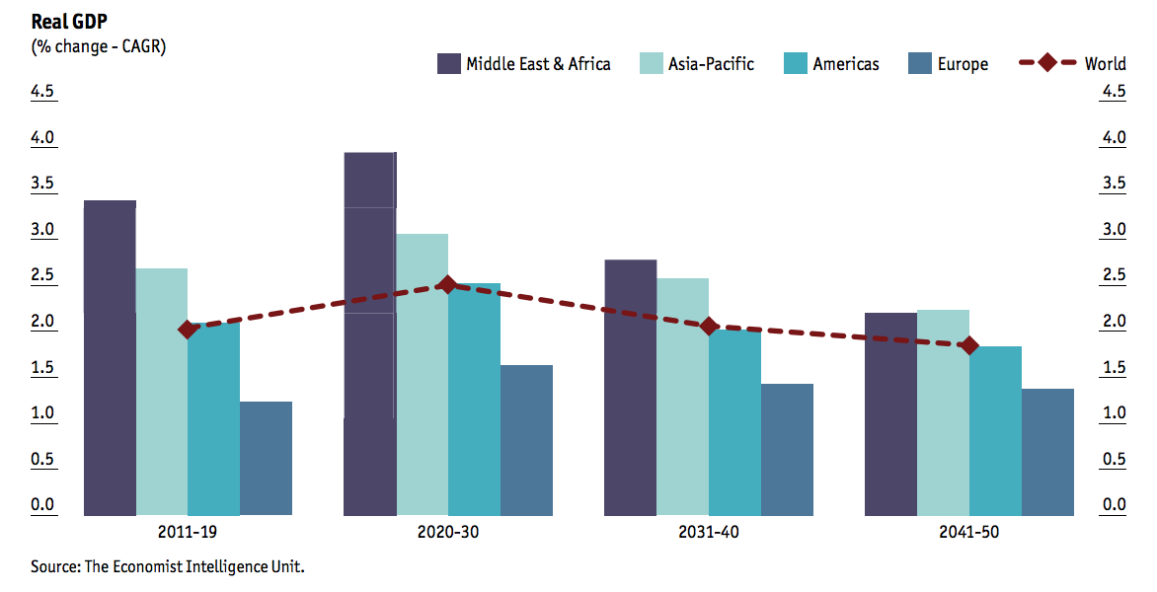
FUTURE OF EDUCATION

Slide 17
 | WHY? | WHAT? | HOW?
PEOPLE | Distribution dis-functionality Lost Generation: 20-50% population Ticking bomb | Empower through work for the Commons | Massive knowledge sharing Wikinomy of Commons Leadership
ECONOMY | Crisis ➔ Crises ➔ Socio-economic crash? Loose - Loose Resource deficit Negative externalities Supra-national Regulation fatigue | Internalize Negative Externalities Multiply Positive Externalities Beyond Externalities Areas: Real economy Sustainable development Environment Dangerous technologies | Market-based 3M Footprint: Model Measure Mitigate Priorities Best return mitigation Leadership
IGOs | Unfit for crash prevention Triple fatigue Regulation fatigue IGO fatigue Cooperation fatigue | IGO 3.0 | Top down Bottom up From inside From outside Leadership

Slide 18
EDUCATION OF FUTURE
GLOCAL
E-CUBATOR

