Slide 1
Scott Williams Conference on Science, Technology, Innovation & Social Responsibility CERN, 11 November 2015 @scott42195
Align. Connect. Unlock.
Scaling up to meet demand in a world of non-linear systemic disruption

Slide 2
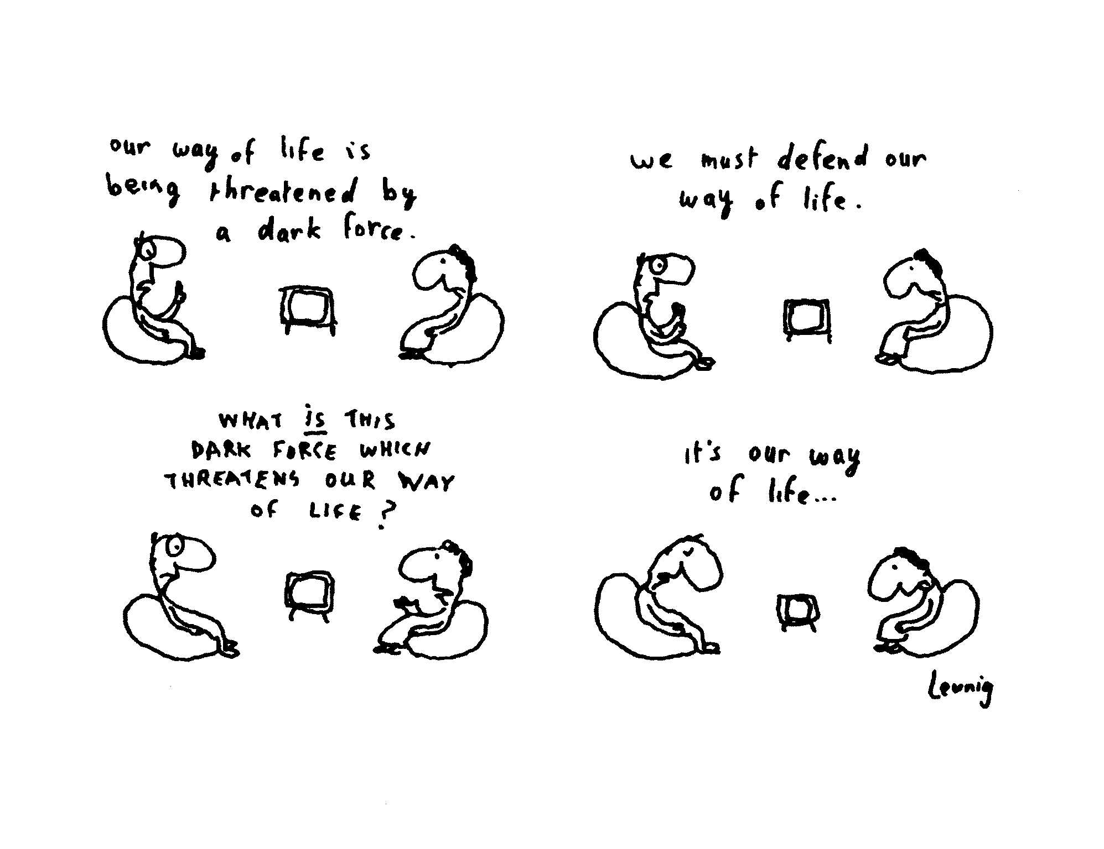

Slide 3
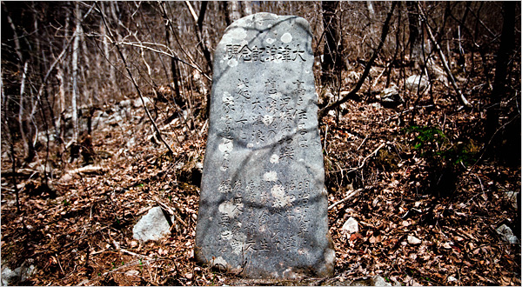
Source: Nytimes.com

Slide 4
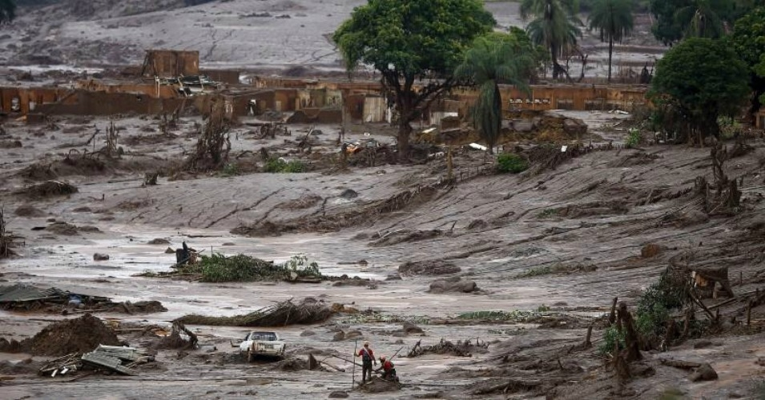
Source: Reuters

Slide 5
400ppm

Slide 6
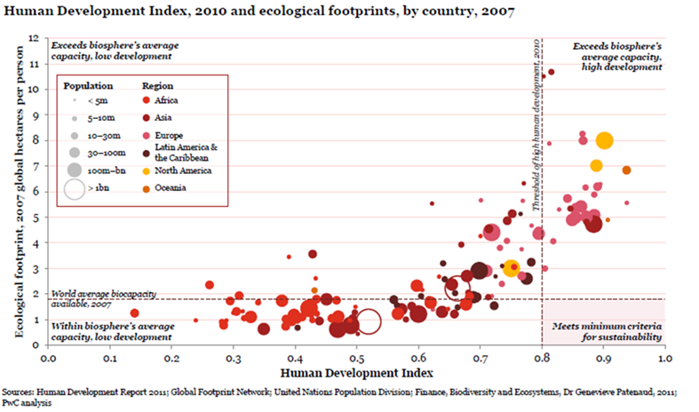
The big picture….externalities still the rule
Ecological debt
Human potential debt
SDG 2030

Slide 9
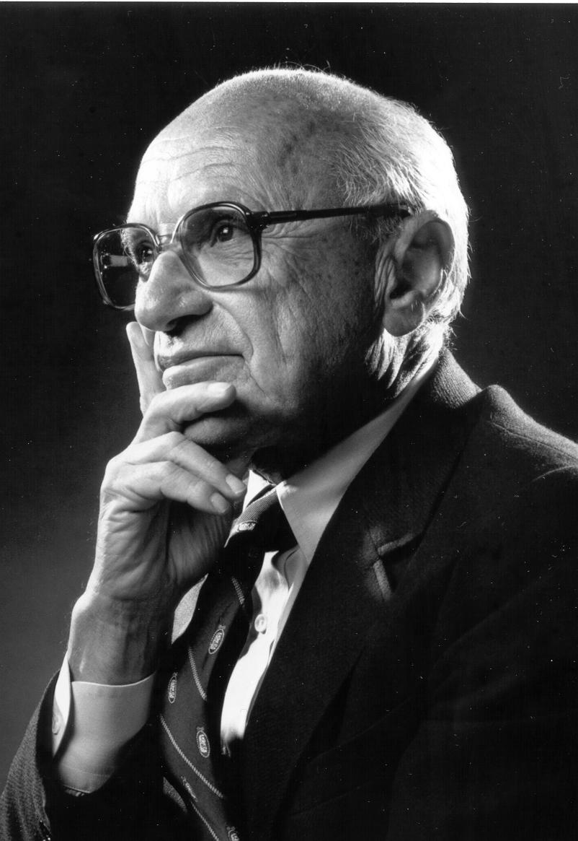
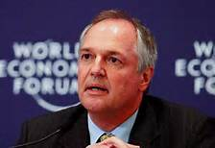
“If you don’t buy into this, then I respect you as a human being, but don’t put your money in our company.”
"What we can bring to the table is a credible price tag for the decisions that are taken or not taken, making sure everybody understands that in the short term you may not take a decision but you will definitely pay a price in the long term”
Michel Lies, CEO SwissRe, Sep 2015
“Social responsibility… is a fundamentally subversive doctrine”
“…if allowed a single wish in the coming 50 years, it would be a global ‘zero carbon’ culture..”
“If you want me to do things only for ROI reasons, you should get out of this stock”

Slide 10
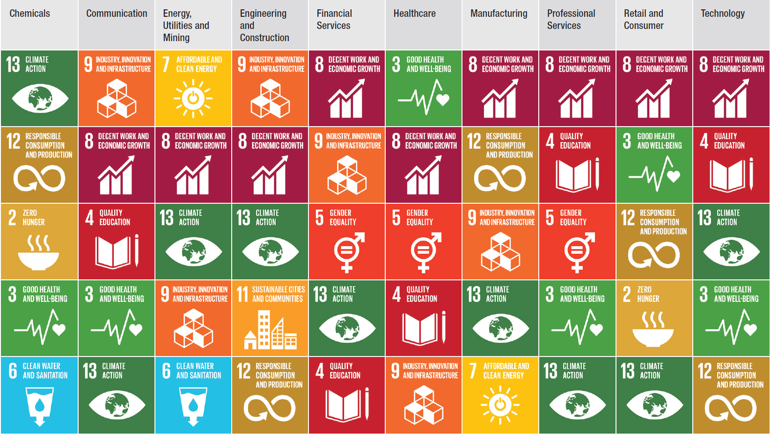

Slide 12
1 Incorporate information
2 Redefine success
3 Move from control to harmony

Slide 13
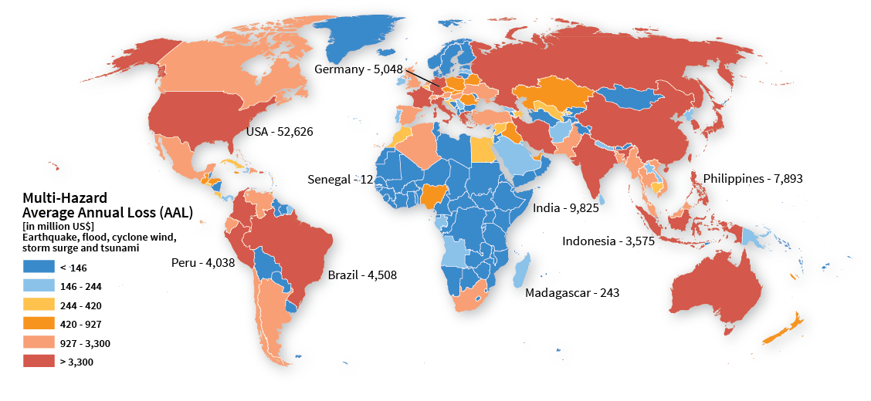
A risky world made a little more visible…
Expected future disaster losses annualized over the long term

Slide 14
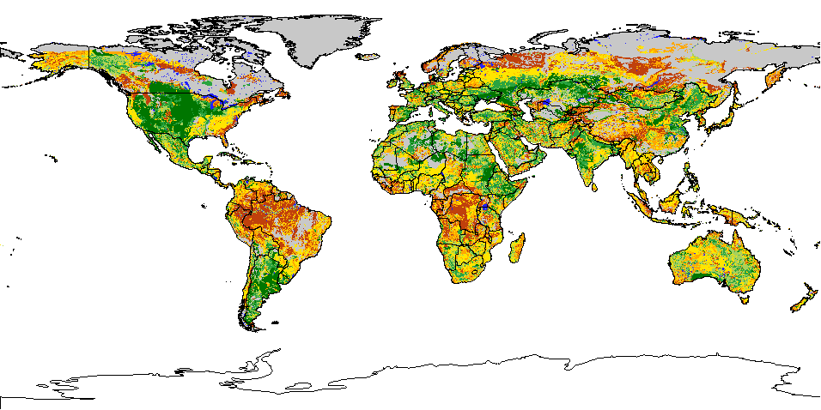
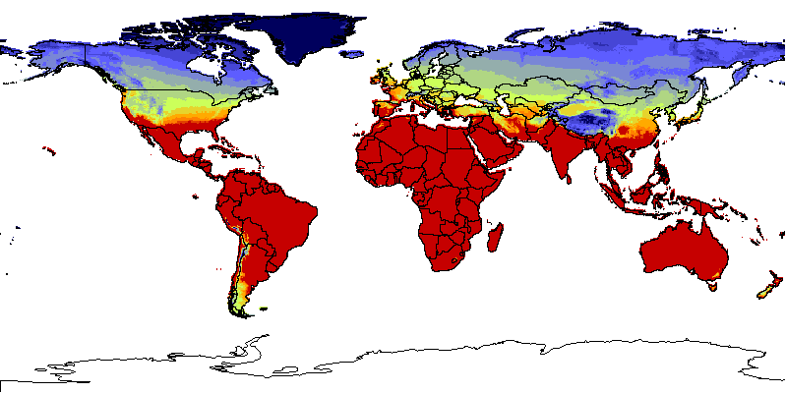
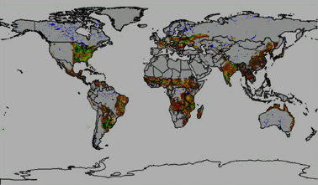
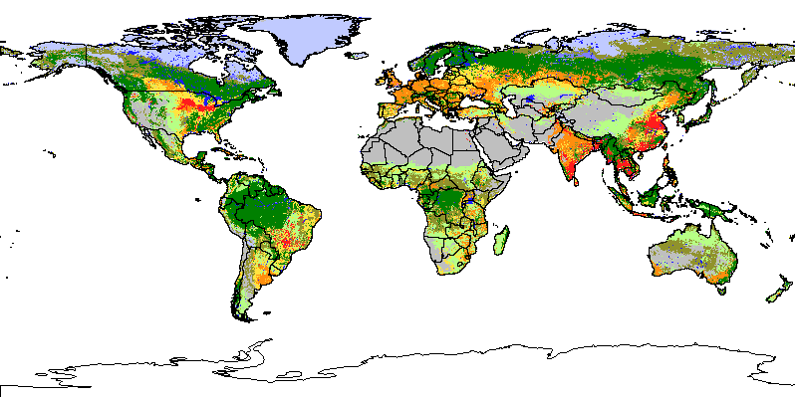
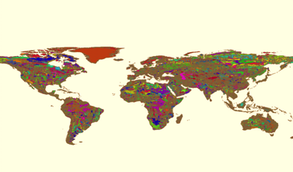
…but so much more is needed Improved knowledge systems can scan for patterns, zero in on places, learn from actions at scale & catalyze data-driven development, the Knowledge Systems for Sustainability Collaborative is one example ready to deliver
Identify, leverage and integrate:
Computational
Modeling
Informatics
Visualization
Analytics resources
Climate, energy, economic, and environmental research results and data
Human-dimensions and decision-process research results and information
Food, production, consumption
Natural resources
Demographics
Weather and Climate
Infrastructure, logistics
Nutritional security
Governance, Land Use
Integrated NRT feeds
Data, information, and knowledge assets
Modeling of complex systems
High-quality information exchange that supports decisions about management that advance the “circle of securities”
Learning systems
Waste
Soil
NRT: Near real-time

Slide 15
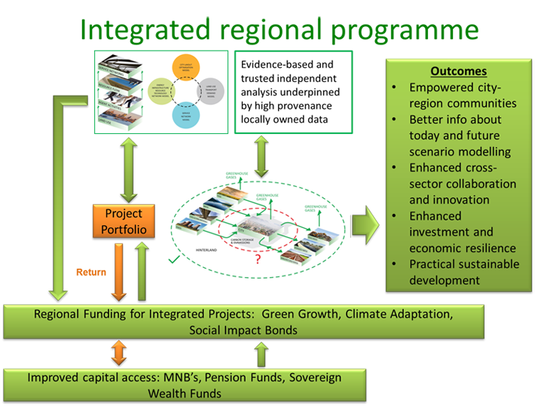
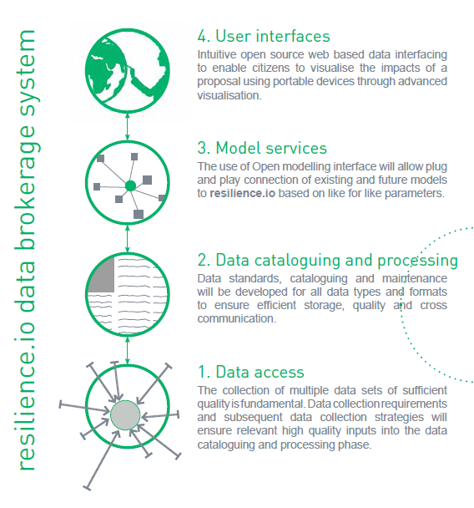
Ultimately the transition to manage the non-linear state shifts requires an open-systems view, like the resilience.io systems model

Slide 16
High stakes challenges and opportunities to be addressed now… to enable a safe(r), transitional pathway from systemic sociopathic arbitrage to optimised, economically sustainable human development and ecological stewardship
A
Quantitative revolution is happening
Quantification and granularity of data cannot be ignored, moving towards multi-dimensional data and open source science, old ways of understanding changing rapidly, silos breaking down, uncertainty of broader data sets being established
B
Political
(and business) landscape is rapidly changing
Globally governments accept and have endorsed appropriate frameworks for action and explicitly recognize the necessity for private sector involvement in creating risk-resilient societies
C
Investment
(and insurance) rationale is changing
Institutional investors and insurers, as well as regulators, rapidly coming on board to shift from “risk-blind” to “risk-informed” investment, trillions on the move

Slide 17
