Slide 1
Tomas Björkman
Borned 1958 in Sweden
Studied Mathematics and Physics at Uppsla and University of Sussex
Serial entrepreneur: IT, Real Estate and Banking
Chairman of EFG Investment Bank (Sthlm, Oslo, Helsingki) 2000-2006
Main residence: Geneva 1994-2006, London 2006-
Ekskäret (The Oak Island) Foundation 2008, Stockholm

Slide 2
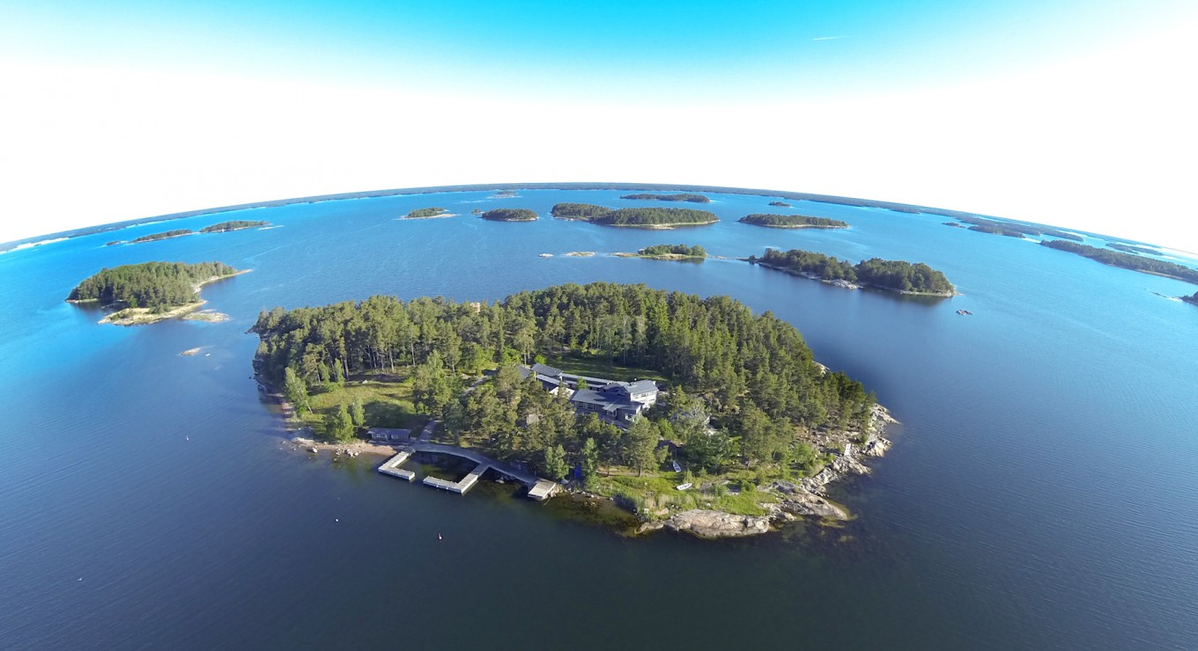

Slide 3
Ekskäret Foundation
Founded in 2008 for the purpose of promoting growth of human consciousness.
We are specially interested in the co-evolution of personal development and societal development and our individual and our collective ability to handle complexity.
Notes:
Vi har kört fast!
Naturen
Global warming
Samhället
USA 300 - 2300
14 år
SD, Skolan, Tiggare
Individen
Vi mår sämre, 6h

Slide 4
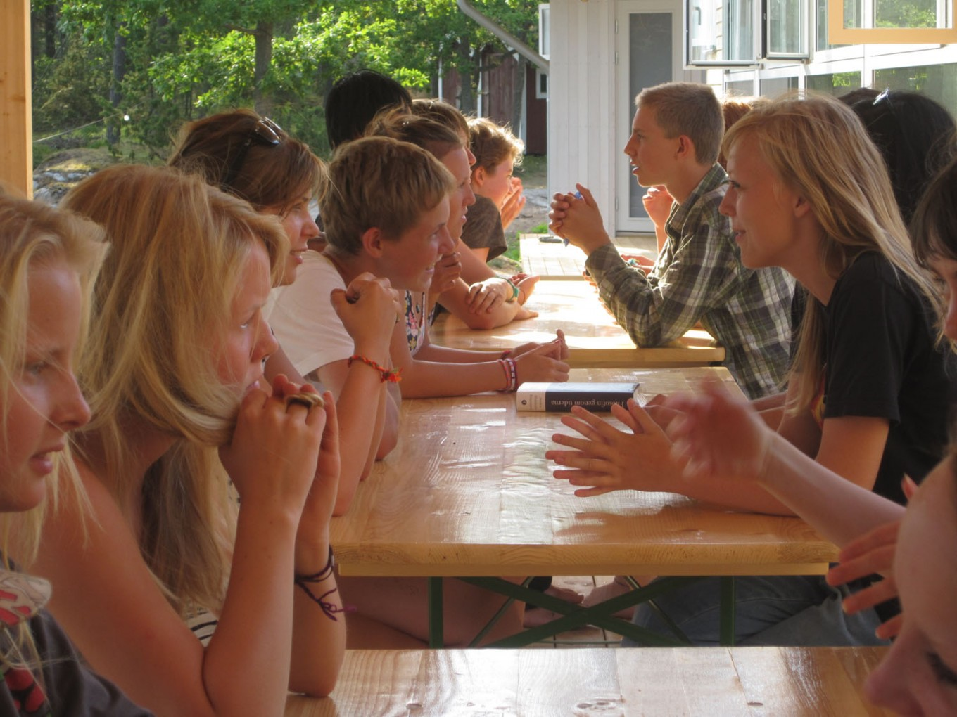

Slide 5


Slide 6
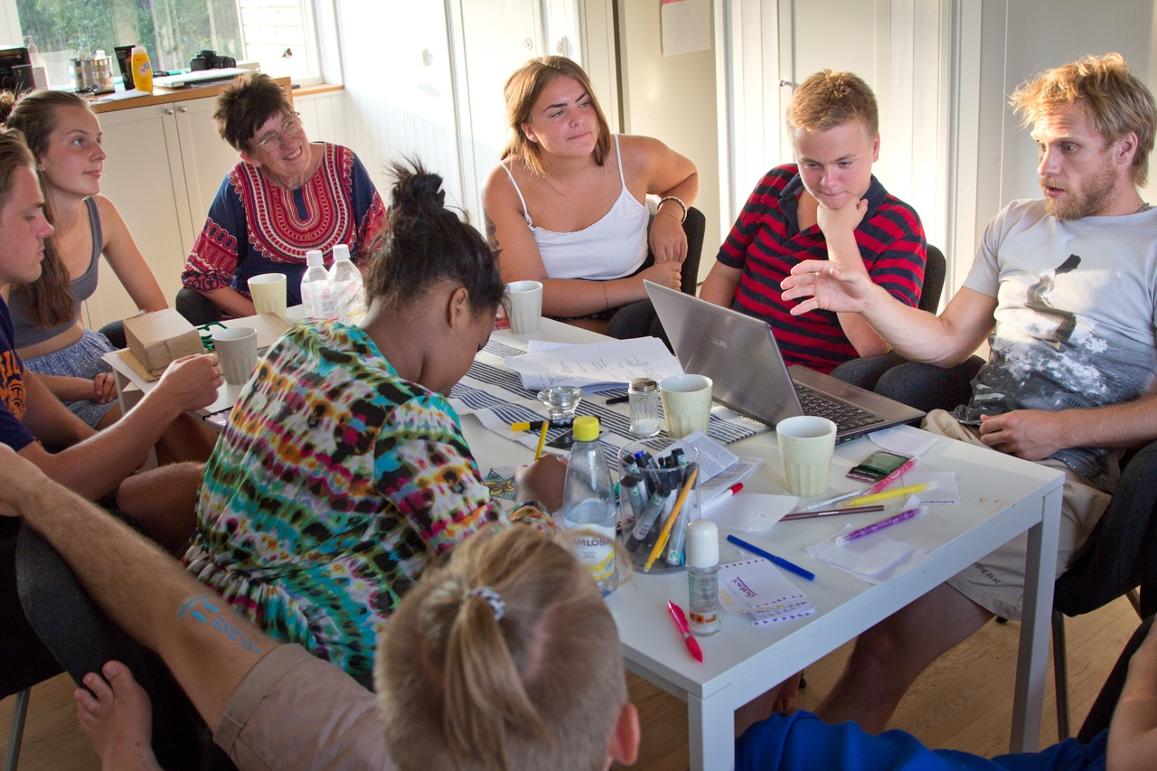

Slide 7
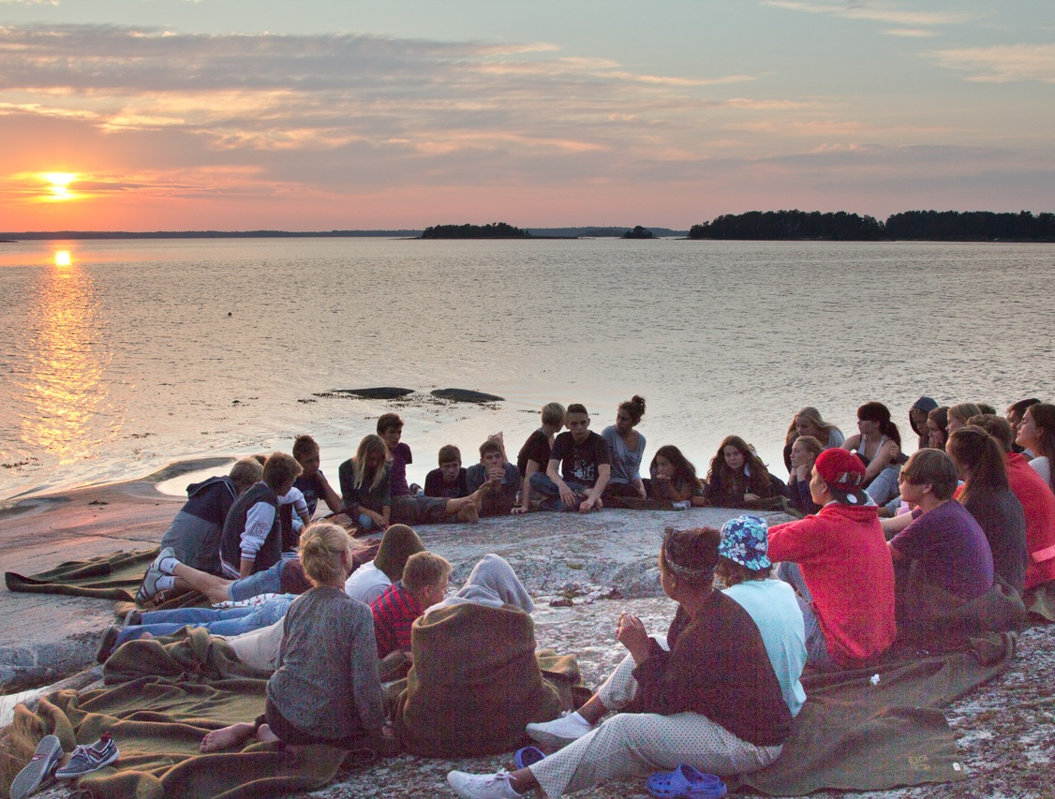

Slide 8
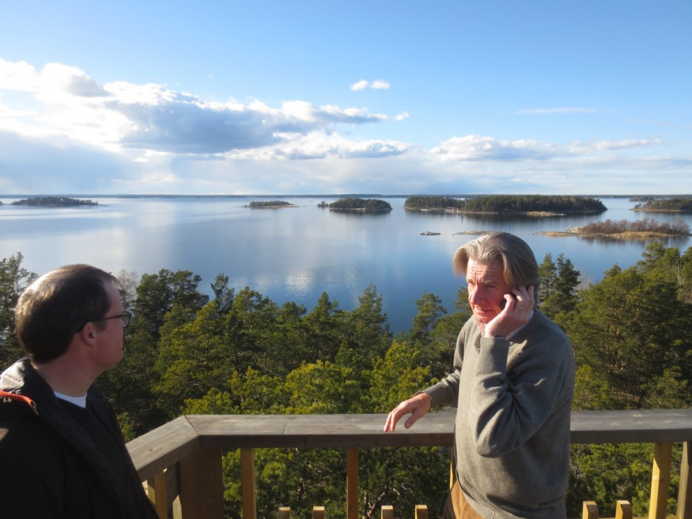

Slide 9


Slide 10
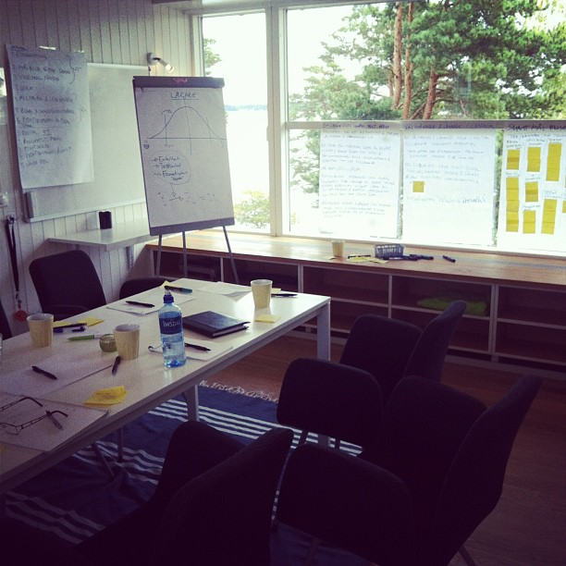

Slide 11
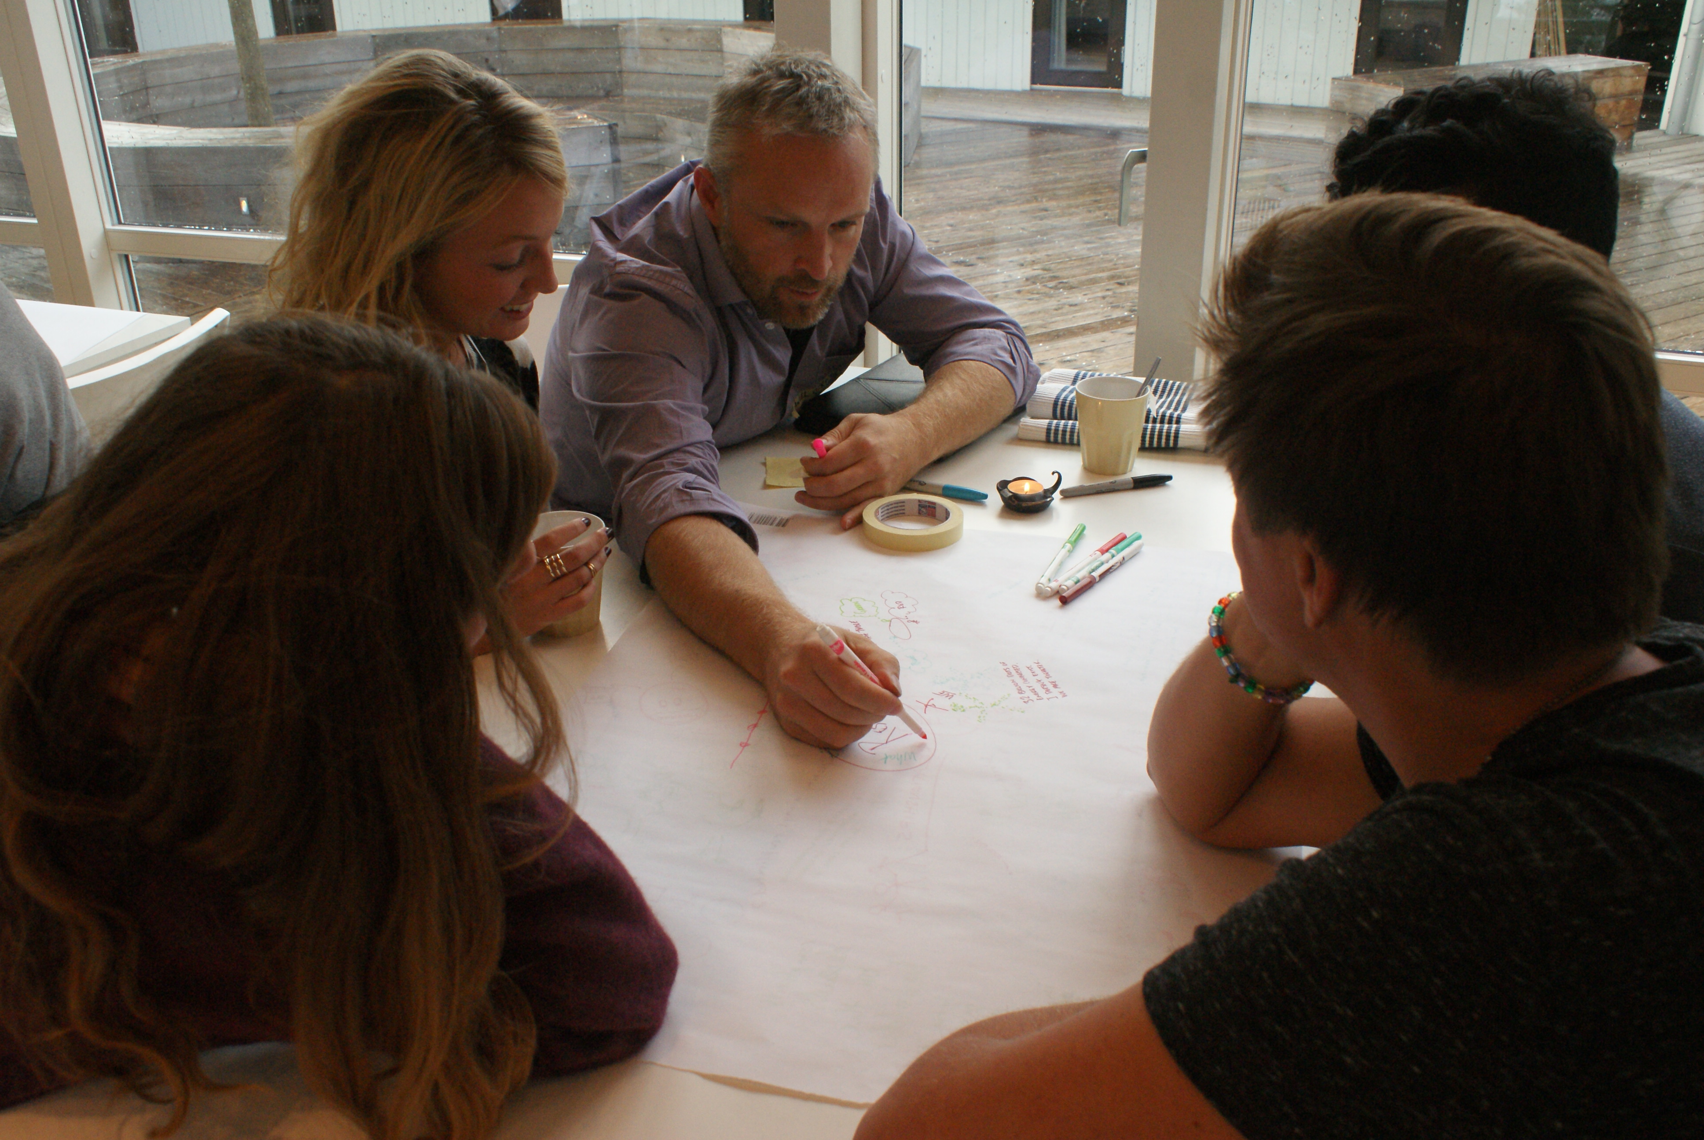

Slide 12


Slide 13
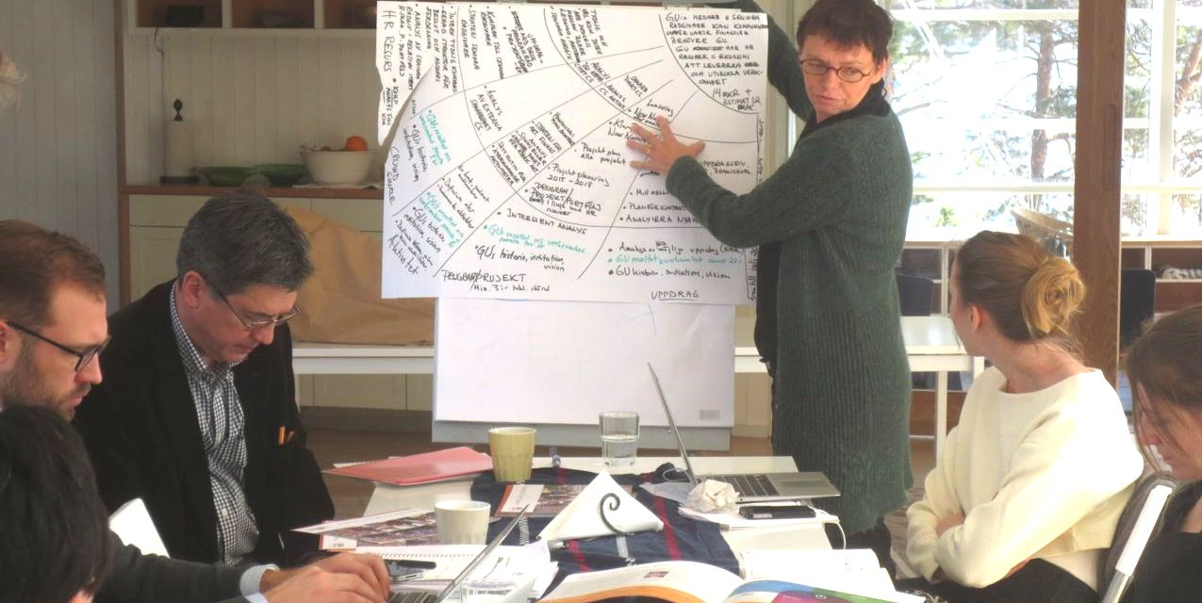

Slide 14
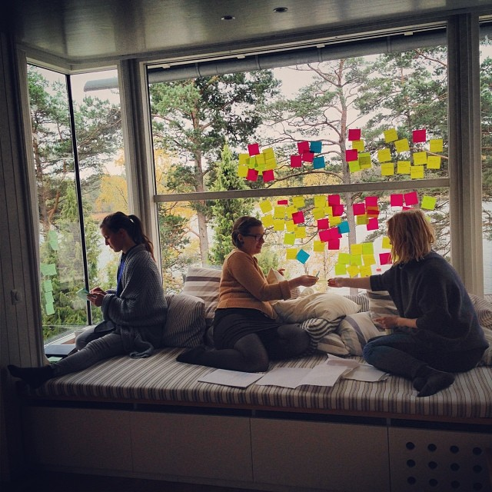

Slide 15
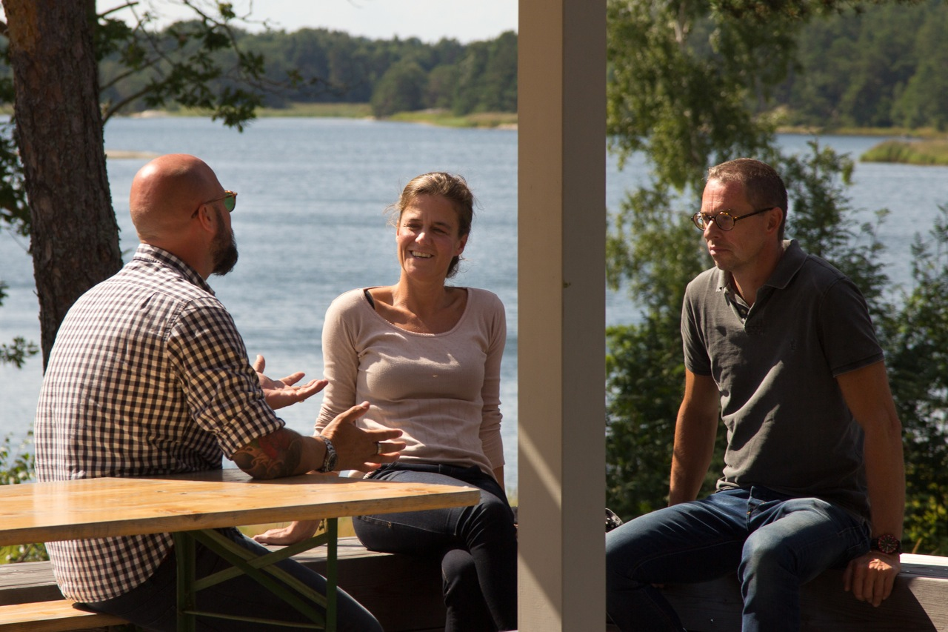

Slide 16
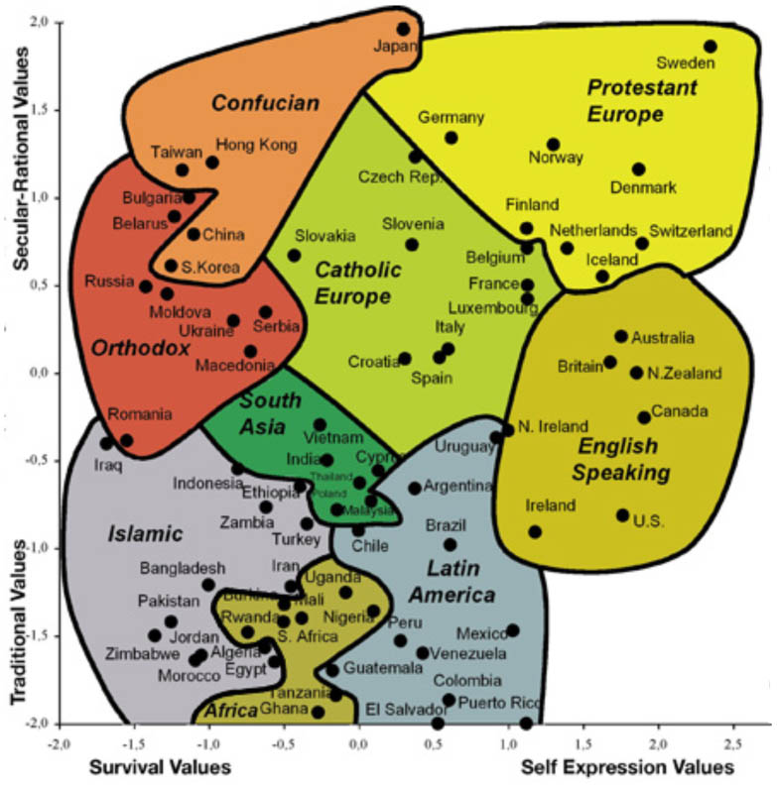

Slide 17
Break the Box
Holistic Values
Our Challange!
Again!
Self Transcendence Values

Slide 18
Other projects
Club of Rome
  “Mind and Society Institute”, London (Co-founder with Jonathan Rowson, RSA, London)
  “Foundation for Reinventing Learning” (with Karolinska Institute, Stockholm)
Book: The Market Myth (1Q 2016)

Slide 19
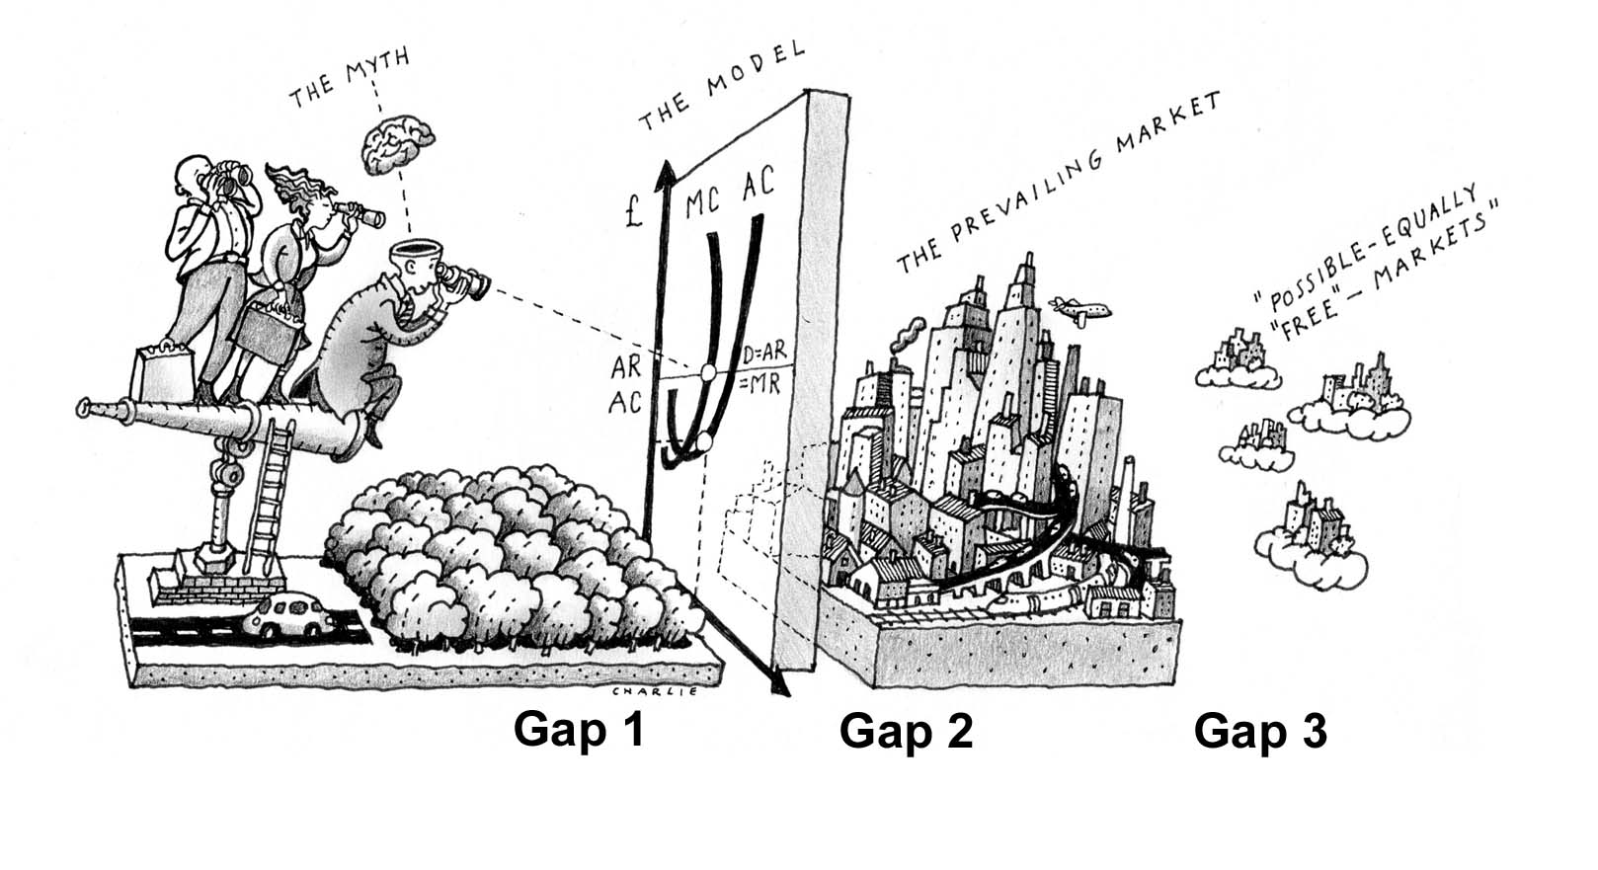
The Market Myth

Slide 20
The Market
The market is an open complex adaptive system
  Already Adam Smith understood this
During the 1900s we tried to model this complex system using Newtonian mathematics
  We started to believe in the crude assumptions made to get the mathematics to work at all
In contrast to many of the open complex adaptive system we find in nature, the market has got socially constructed feedback mechanisms and internal rules
  Few today understand the importance of this and the possibility this creates for us to choose what sort of “free market” we want to have. This potential for collective freedom is largely untapped.

Slide 21
The Complex Market
“our collective ability to handle complexity”
We need to understand the market on an adequate level of complexity recognizing both:
  technical complexity: The Market is a complex system that can not be modeled by equilibrium mathematics
  and social complexity: The Market is a socially constructed complex system and we need to distinguish between regulative rules that regulate a pre-existing activity, an activity whose existence is logically independent of the rules and constitutive rules that constitute (and also regulate) an activity the existence of which is logically dependent on the rules.

Slide 22
Example copyright
Social good
Private Profits
0
25
50
75
100 år

Slide 23
Construction of the
“free market”
  We should carefully choose the internal, constitutive rules of the market so that the market “pre-distribution” as far as possible aligns with the common good of society and not with some special interests groups that has historically most often been the case.
  Once we through the constitutive rules have created an efficient “free market” that self-organizes in a way that as far as possible aligns with the common good, then we might still need some regulating rules and re-distribution to fine tune.

