Slide 1
On Common Future Education
J. Hattie and Beyond
The Creativity Response (CR)
Tertiary Education (TE)
The impact of a dual vocational training (VT)

Slide 2
What makes a difference: J. Hattie and Beyond
The Hattie-Study: (800 Meta-analysis)
What does not work, is neutral or of little help (examples):
Retention
TV
Mobility
long summer vacation
age bridging classes
state welfare support
Technology based learning at home
Preschool classes
seize of classes
web-based programs
homework
gender-aspects
What makes a different (examples): ES>0,4
Peer tutoring
Feedback and mistakes
Meta-cognitive Training
Teacher Training
Cyclical repeating and drill with pauses
relation between teacher and student
cooperative peer learning
Acceleration
J. Hattie 2009, 2012ff

Slide 3
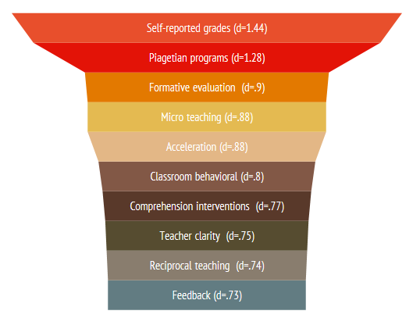
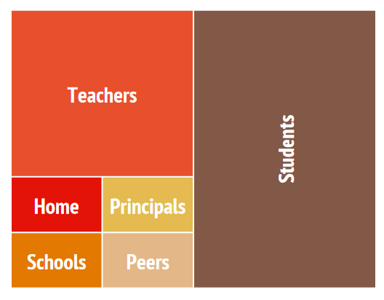
Inter-personal variables oversteer institutional variables by factor 2
Hattie 2009, 2012

Slide 4
About Active Learning: The Creativity Response (CR)
Exercise and Cognition
Mindfulness versus BIG DATA
Rest and Sleep versus 7/24
Multi-sensory learning versus digital learning
Social Competence versus Competitiveness
Nutrition and Supplements versus Neuro-enhancement
Mihaly Csikszentmihalyi 2012
Carl Gustav Jung 1958 ff
Gazzangia 2013
Garrett, 2010

Slide 5
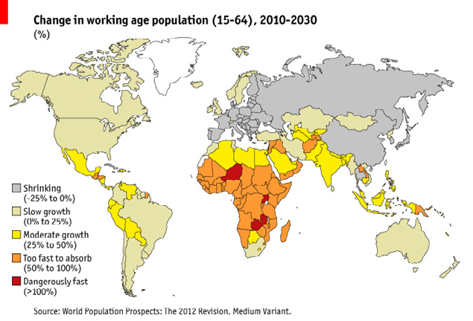
The impact of a dual vocational training (VT)
50y to change an educational system
10y to implement und 40y labor replacement
HE: Demand of 100 Mill
Entering Labor Force: 100 Mill (-2025)
Higher Education is not Vocational Training
VT: 500y experiences dual system

Slide 6
On Future Education: Conclusion
(Inter-) personell factors > institutional factors
Life Science demonstrates the importance of a Creativity Response
Vocational Training > Traditional Higher Education

