Slide 1
“International Conference on Nuclear Threats and Security” in Dubrovnik/HRV, 14 - 17 September 2012
Inter/Intra State Conflicts and WMD
– The Role of NATO –
LtCol (DEU-AR) Bernd Allert
NATO HQ – IS/ESC(WMD Non-Proliferation Centre)

Slide 2
OUTLINE
Lisbon Tasking how NATO can Better Counter the Proliferation of WMD
Strategic Concept for the Defence and Security of The Members of the NATO
NATO’s Comprehensive, Strategic-Level WMD/CBRN Defence Policy
Conclusion
Defence and Deterrence Posture Review

Slide 3
OUTLINE
Lisbon Tasking how NATO can Better Counter the Proliferation of WMD
Strategic Concept for the Defence and Security of The Members of the NATO
NATO’s Comprehensive, Strategic-Level WMD/CBRN Defence Policy
Conclusion
Defence and Deterrence Posture Review

Slide 4
New Security Environment
Range of complex challenges and threats.
Both State and non-State actor threats.
The spread of WMD and the possibility that terrorists will acquire them.
Non-adherence to international arms control, disarmament and non-proliferation commitments.
Programmes to develop WMD and their means of delivery.
Nuclear weapons and CBRN materials vulnerable to exploitation.
Increase of bio-terrorism threat.

Slide 5

NATO’s Core Tasks
Strategic Concept for the Defence and Security of The Members of the North Atlantic Treaty Organisation adopted by Heads of State and Government in Lisbon
Collective Defence. NATO members will always assist each other against attack, in accordance with Article 5 of the Washington Treaty.
Crisis Management. NATO has a unique and robust set of political and military capabilities to address the full spectrum of crises – before, during and after conflicts.
Cooperative Security. The Alliance will engage actively to enhance international security, through partnership with relevant countries and other international organisations.
http://www.nato.int/cps/en/natolive/official_texts_68580.htm
Notes:
Deterrence and collective defence
NATO has significant maritime capabilities and inherently flexible maritime forces, which are key to deterring aggression. As such, maritime activities contribute to nuclear deterrence as well as to deterrence from conventional attacks. NATO will ensure it has the capabilities to deploy its maritime forces rapidly, to control sea lines of communication, to preserve the freedom of navigation and to conduct effective mine counter-measure activities.
Crisis management
NATO maritime forces can also play an important role in crisis management. These responsibilities can range from enforcing an arms embargo, to conducting maritime interdiction operations, to contributing to the Alliance’s counter-terrorism efforts, and to providing immediate humanitarian assistance in the aftermath of a natural disaster.
Cooperative security
The activities of NATO’s maritime forces not only contribute to ensuring Alliance security. The engagement with partners helps to build regional security and stability, contributes to conflict prevention and facilitates dialogue. These efforts also invite contact, positive interaction and cooperation with other relevant actors in international maritime activities, such as the United Nations and the European Union.
Maritime security
The strategy reiterates NATO’s commitment to pursue its maritime security activities, which help to protect vital sea lines of communication and maintain the freedom of navigation. Surveillance, patrolling and the sharing of information, for instance, all contribute to supporting law enforcement, preventing proliferation of weapons of mass destruction and countering potential terrorist or illegal activities.
This approach involves working with other international partners and ensuring an ongoing modernisation of NATO’s maritime capabilities. More importantly, it will ensure that the Alliance is prepared to confront all possible, including asymmetrical, threats, and answer the security challenges of the 21st century.

Slide 6
Active Engagement, Modern Defence
Strategic Concept for the Defence and Security of The Members of the North Atlantic Treaty Organisation adopted by Heads of State and Government in Lisbon
The proliferation of nuclear weapons and other weapons of mass destruction, and their means of delivery, threatens incalculable consequences for global stability and prosperity. During the next decade, proliferation will be most acute in some of the world’s most volatile regions.
(NATO will) further develop NATO’s capacity to defend against the threat of chemical, biological, radiological and nuclear weapons of mass destruction.
(NATO will) enhance the capacity to detect and defend against international terrorism.
(NATO will) identify and train civilian specialists from member states, made available for rapid deployment by Allies for selected missions, able to work alongside our military personnel and civilian specialists from partner countries and institutions.
http://www.nato.int/cps/en/natolive/official_texts_68580.htm

Slide 7
Active Engagement, Modern Defence
Strategic Concept for the Defence and Security of The Members of the North Atlantic Treaty Organisation adopted by Heads of State and Government in Lisbon
Cooperation between NATO and the United Nations continues to make a substantial contribution to security in operations around the world. The Alliance aims to deepen political dialogue and practical cooperation with the UN, (…).
An active and effective European Union contributes to the overall security of the Euro-Atlantic area. Therefore the EU is a unique and essential partner for NATO.
NATO-Russia cooperation is of strategic importance as it contributes to creating a common space of peace, stability and security. NATO poses no threat to Russia.
http://www.nato.int/cps/en/natolive/official_texts_68580.htm

Slide 8
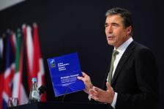
Alliance Maritime Strategy
Reference: MCM-0058-2012
(…), the world’s oceans and seas are an increasingly accessible environment for transnational criminal and terrorist activities, including the transport and deployment of weapons of mass destruction and associated materials.
The potential role of the Alliance’s maritime forces in missile defence may also become an important part of NATO’s response to the proliferation of weapons of mass destruction and their means of delivery.
Maintaining the ability of NATO’s maritime forces to undertake the full range of maritime interdiction missions, including in support of law enforcement and in preventing the transport and deployment of weapons of mass destruction.
http://www.nato.int/cps/en/SID-41426331-6494A785/natolive/official_texts_75615.htm
Notes:
The world population is reliant on the seas and oceans for international commerce, as a source of food and for vital supplies of oil and natural gas. It is NATO’s responsibility to help protect international commerce from potential threats, as well as its member countries’ maritime resources and territory from possible attacks that may come from the sea.
Since the launch of NATO’s first Article 5 operation - Operation Active Endeavour – in October 2001 and its counter-piracy operations in the Gulf of Aden and off the Horn of Africa (October 2008), it has drafted a new Alliance Maritime Strategy to further institutionalise operational flexibility and strengthen the ties between NATO countries and its partners. This strategy was adopted in January 2011, in full consistency with the 2010 Strategic Concept.
The strategy stipulates that NATO maritime forces will enhance the Alliance’s security by contributing to deterrence and collective defence, crisis management, cooperative security and maritime security.

Slide 9


2009 STRAS-BOURG / KEHL
2002 PRAGUE
1999 WASHING-TON
WMD Initiative
Prague Capabilities
2010 LISBON
2012 CHICAGO
Comprehensive WMD/CBRN Policy
LISBON Tasking

Slide 10
OUTLINE
Lisbon Tasking how NATO can Better Counter the Proliferation of WMD
Strategic Concept for the Defence and Security of The Members of the NATO
NATO’s Comprehensive, Strategic-Level WMD/CBRN Defence Policy
Conclusion
Defence and Deterrence Posture Review

Slide 11
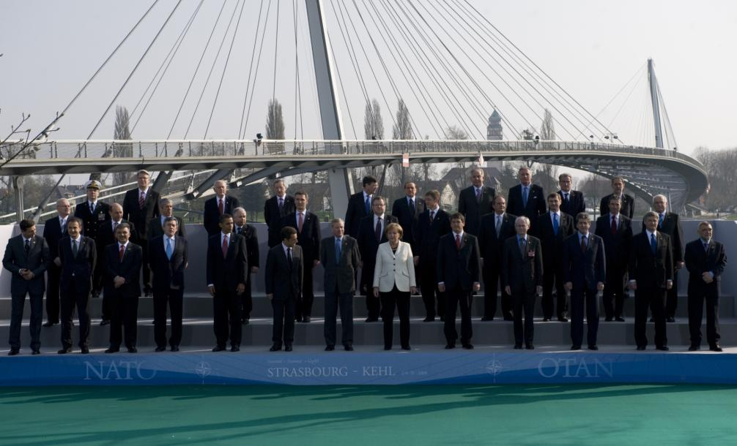
Strasbourg / Kehl Summit Declaration
Issued by the Heads of State and Government Participating in the Meeting of the North Atlantic Council in Strasbourg / Kehl
(…) We will intensify our efforts to prevent state and non-state actors from accessing WMD and their means of delivery.
In this regard, we endorse NATO’s comprehensive strategic-level policy for preventing the pro-liferation of WMD and defending against Chemical, Biological, Radiological and Nuclear threats. (…)
http://www.nato.int/cps/en/natolive/news_52837.htm?mode=pressrelease

Slide 12
NATO’s Comprehensive, Strategic-Level Policy for Preventing the Proliferation of Weapons of Mass Destruction (WMD) and Defending against Chemical, Biological, Radiological and Nuclear (CBRN) Threats
VISION
The Alliance - its populations, territory and forces - will be secure from CBRN threats, including WMD; and its members will not be coerced by those posing such threats.
MISSION STATEMENT
(…) NATO will work actively to prevent the proliferation of WMD by State and non-State actors, to protect the Alliance from WMD threats should prevention fail, and be prepared for recovery efforts should the Alliance suffer a WMD attack or CBRN event, (…) through a comprehensive political, military and civilian approach.

Slide 13
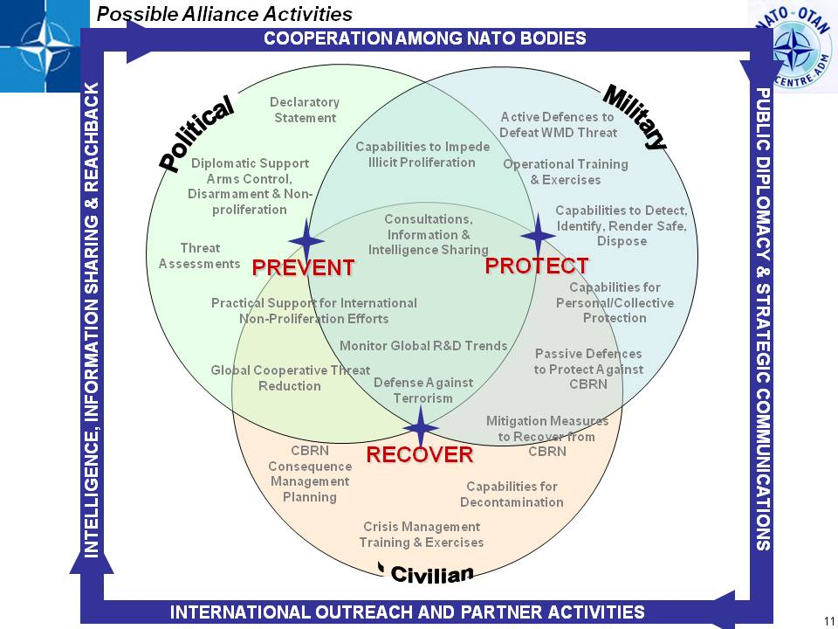

Slide 14
OUTLINE
Lisbon Tasking how NATO can Better Counter the Proliferation of WMD
Strategic Concept for the Defence and Security of The Members of the NATO
NATO’s Comprehensive, Strategic-Level WMD/CBRN Defence Policy
Conclusion
Defence and Deterrence Posture Review

Slide 15
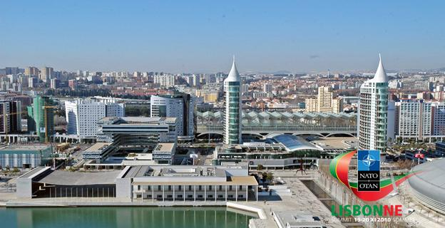
Lisbon Summit Declaration
Issued by the Heads of State and Government Participating in the Meeting of the North Atlantic Council in Lisbon
We continue to be concerned about the proliferation of weapons of mass destruction.
We will continue to implement NATO’s (Comprehensive) Strategic-Level Policy for Preventing the Proliferation of WMD and Defending against CBRN Threats.
We task the Council to access and report, before the meeting of Defence Ministers in June 2011, on how NATO can better counter the proliferation of WMD and their means of delivery.
http://www.nato.int/cps/en/natolive/official_texts_68828.htm

Slide 16
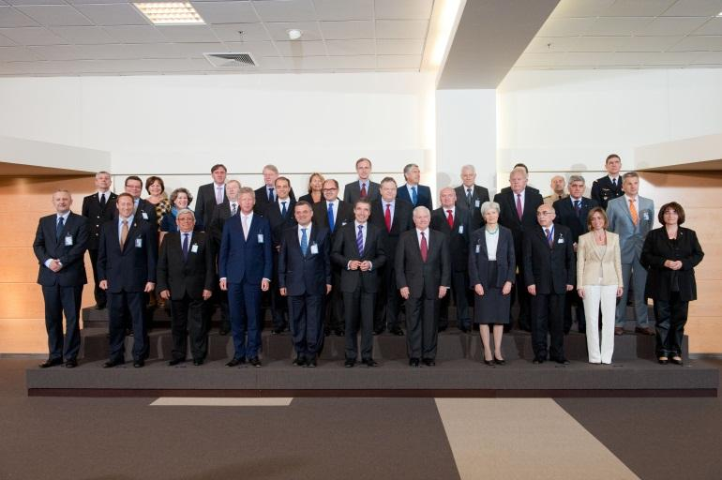
LISBON SUMMIT TASKING TO ACCESS AND REPORT HOW NATO CAN BETTER COUNTER THE PROLIFERATION OF WEAPONS OF MASS DESTRUCTION (WMD) AND THEIR MEANS OF DELIVERY ^{*)}
C-M(2011)0041 DATED 7 JUNE 2011
^{*)} Endorsed by the Defence Ministers [C-DS(2011)0071 (Item 1.7)]

Slide 17
REPORT IN IMPLEMENTATION OF THE LISBON SUMMIT TASKING ON ASSESSING HOW NATO CAN BETTER COUNTER THE PROLIFERATION OF WEAPONS OF MASS DESTRUCTION (WMD) AND THEIR MEANS OF DELIVERY
REFERENCE: APPENDIX 2 TO C-M(2011)0041 DATED 7 JUNE 2011
NB: CLASSIFIED AS „NATO RESTRICTED“
OUTLINE:
I. INTRODUCTION AND BACKGROUND
II. SCOPE
III. PLANNING
IV. TRAINING/EXERCISES
V. OPERATIONS/CAPABILITIES
VI. RECOMMENDATIONS/PATH AHEAD
VII. RESOURCING

Slide 18
Legally Available Options for Countering Proliferation of WMD and Related Materials
REFERENCE: ACC/333-N(2012)0012-REV3 DATED 31 AUGUST 2012
NB: CLASSIFIED AS „NATO RESTRICTED“
Legal Basis for Potential NATO Actions to Counter WMD Proliferation in the Maritime Environment.
Reflection of the alliance View of Such Legally Available Operational Opttions, Should the Alliance Decide to Include a WMD Interdiction Tasking in Any Maritime Interdiction in the Future.
Used to Facilitate any WMD Interdiction Training and Exercises to Ensure NATO‘s Operational Readiness.

Slide 19
OUTLINE
Lisbon Tasking how NATO can Better Counter the Proliferation of WMD
Strategic Concept for the Defence and Security of The Members of the NATO
NATO’s Comprehensive, Strategic-Level WMD/CBRN Defence Policy
Conclusion
Defence and Deterrence Posture Review

Slide 20

Defence and Deterrence Posture Review
Nuclear weapons are a core component of NATO’s overall capabilities for deterrence and defence alongside conventional and missile defence forces.
The review has shown that the Alliance’s nuclear force posture currently meets the criteria for an effective deterrence and defence posture.
As long as nuclear weapons exist, NATO will remain a nuclear alliance.
http://www.nato.int/cps/en/natolive/official_texts87597.htm

Slide 21
Chicago Summit Declaration
Issued by the Heads of State and Government Participating in the Meeting of the North Atlantic Council in Chicago on 20 May 2012
We continue to be deeply concerned about the proliferation of nuclear weapons and other weapons of mass destruction (WMD), as well as their means of delivery.
We will continue to implement NATO’s Strategic-Level Policy for Preventing the Proliferation of WMD and Defending Against Chemical, Biological, Radiological and Nuclear (CBRN) Threats. We will ensure NATO has the appropriate capabilities, including for planning efforts, training and exercises, to address and respond to CBRN attacks.
http://www.nato.int/cps/en/natolive/official_texts87593.htm

Slide 22
OUTLINE
Lisbon Tasking how NATO can Better Counter the Proliferation of WMD
Strategic Concept for the Defence and Security of The Members of the NATO
NATO’s Comprehensive, Strategic-Level WMD/CBRN Defence Policy
Conclusion
Defence and Deterrence Posture Review

Slide 23
CJ-CBRND-TF Structure
CLOSE COORD
Joint Assessment Team
No C2
relationship
Commander
Investigations, research and advice to JTF CDR/HQ Staffs
C2 and support of units, operational support to employed forces
CBRN BN HQ
SUPPORT COY
HR RESPONSE COY
NC RECCE COY
DECON COY LIGHT
CBRN DEPLOYABLE LABs
BIO DETECTION COY
DECON COY HEAVY
MILITARY CAPABILITIES
Notes:
This slide visualizes the main elements of the CJ-CBRND-TF.
This slide depicting the CJ-CBRND-TF main elements:
highlights the core tasks of the Joint Assessment Team and the Battalion,
shows the relationship between both (which is close coordination) and
points to the difference in size (the JAT consisting of 20 subject matter experts and the Battalion of approximately 1000 personnel - depending on the company/platoon structures and additional national support elements of the Troop Contributing Nations).
Usually the Battalion would be providing e.g. detection results, samples
and decontamination services while the Joint Assessment Team will then
interpret the findings and deliver assessment, advice and recommen-
dations to NATO commanders and their staffs.
However, please note that the Joint Assessment Team and the Battalion
may work and be deployed independently of each other (even
independently from the NRF).
CBRN Defence support to
Non-combatant Evacuation Operations (NEO).
Embargo Operations (EO).
Initial Entry Force Operations (IEF).
Crisis Response Operations (CRO).
Deterrence Force Operations (DF).
Consequence Management Operations (CM).
Counter-Terrorism Operations (CT).

Slide 24
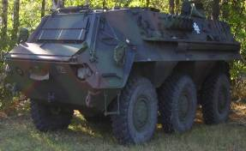
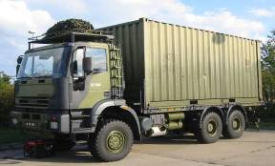
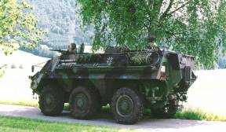
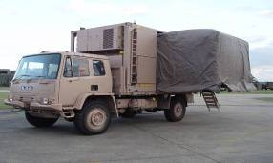
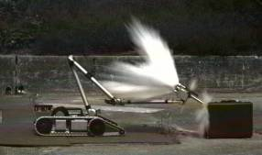
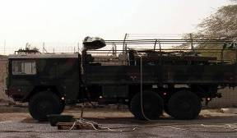
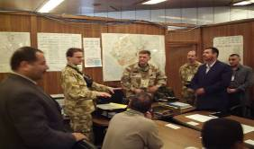
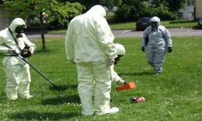
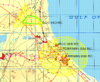




CJ-CBRND-TF Capabilities
C² capability under CBRN conditions
CBRN Warning & Reporting
CBRN Warning & Reporting
Chemical, Biological and Radiological laboratory analysis
Radiological/Chemical
Reconnaissance
Biological Monitoring
systems
CBRN EOD
Decontamination
CBRN Assessment and
Advice
SIBCRA
Notes:
In those pictures you will recognize spectrum of CBRN capabilities available within the structure presented on previous slide.

Slide 25
Challenges & Priorities
CHALLENGES
Complacency on CBRN Threats
Resource Constraints
Ensure Comprehensive Approach
PRIORITIES
CBRN Reachback & Fusion Capability
Training & Exercises
Outreach and International Cooperation
Amb. Jacek Bylica / Head/WMD Non-Proliferation Centre, CP(DEF) Steering Committee Meeting at NATO HQ on 30 May 12

Slide 26
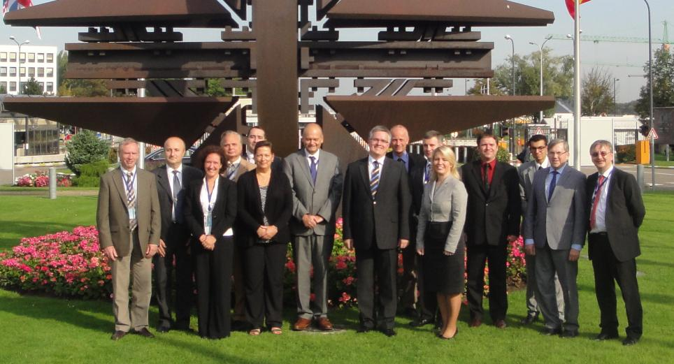
Questions ???
LtCol (DEU-AR) Bernd Allert
WMD Non-Proliferation Centre, NATO HQ Brussels
Tel.: +32 2 707 1903
Email: Allert.Bernd@hq.nato.int

