Slide 1
International Conference on Nuclear Threats and Security
Session II: Nuclear Energy and Nuclear Weapons - Inter/Intra State Conflicts and WMD - The Role of NATO
The role of nuclear energy
Prof.dr.sc. Neven Duić, University of Zagreb
Faculty of Mechanical Engineering and Naval Architecture (UNIZAG FSB)

Slide 2
EU energy context
Security of energy supply
  Import dependence from 50% to 70% by 2030
Employment and regional development policies
  Deindustrialization and trade liberalization
  “Boosting growth and jobs by meeting our climate change commitments”
Mitigation of global warming
Environmental protection
Sustainable development

Slide 3
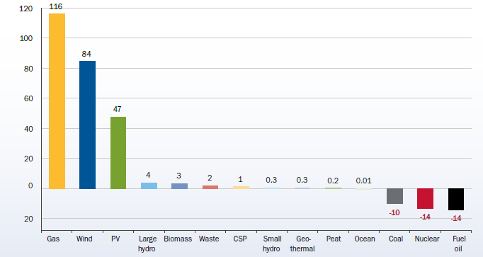
RES Directive actually works
EU electricity generation installed capacity net change, 2000-2011 [GW], EWEA

Slide 4
The role of nuclear
Nuclear in energy system
  Base load due to low flexibility, high investment cost and low fuel cost

Slide 5
The role of wind
Wind in energy system
  Cheapest RES power
  Plentifully available nearly anywhere
  Intermittent:
    15-20% yearly penetration possible without storage
    approximately 100% momentaneous penetration

Slide 6
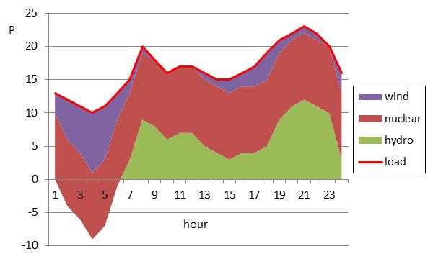
Nuclear + wind

Slide 7
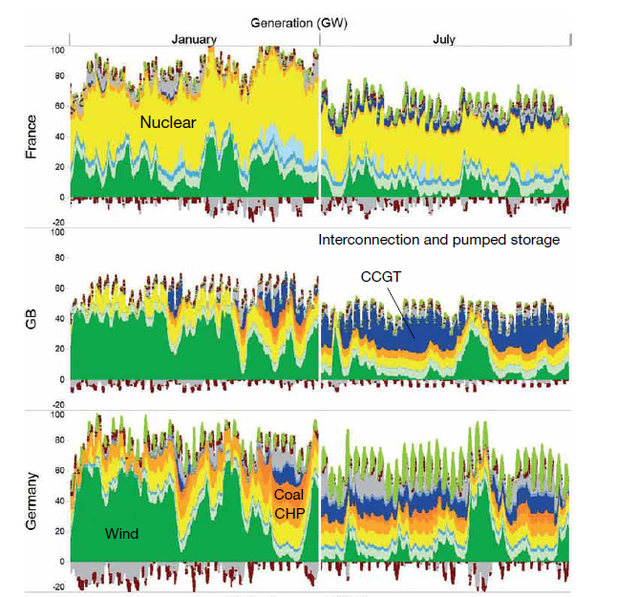
Nuclear + wind 2030
Pöyry

Slide 8
Nuclear + wind
Nuclear is technically not very flexible
  We need a completely new approach to power systems
  Demand side management
  Integration of power, heating and transport
  Electrification of transport
  Storage!
    We already store energy why not power?

Slide 9
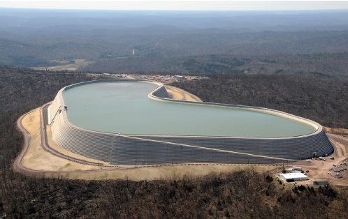
Pumped hydro storage
David Connolly: The Integration of Fluctuating Renewable Energy Using Energy Storage

Slide 10
Storage
Storage technologies
    Heat storage is cheapest
    Pump storage – how to finance it?
      Market arbitrage
      Capacity market
      Feed in tariff
    Batteries too expensive to invest, but if already there? Transport electrification!

Slide 11
Nuclear energy
There is place for nuclear in future but the energy system has to be completely overhauled
Since it will anyway have to happen, nuclear sector should push for early adoption
Keeping nuclear energy is a way to pay for continued safeguarding of fissile material

Slide 12
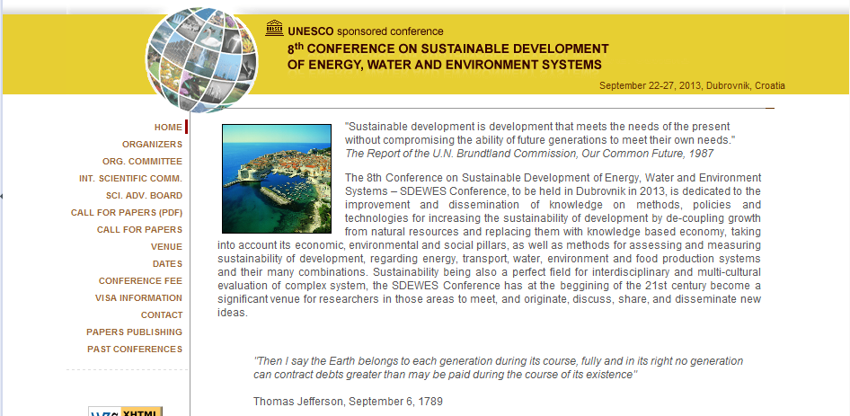
8th Conference on Sustainable Development of Energy, Water and Environment Systems, Dubrovnik, September 22-27, 2013
http://www.dubrovnik2013.sdewes.org

Slide 13
THANK YOU FOR YOUR ATTENTION!
Neven.Duic@fsb.hr

