Slide 1
Bankrupting Nature –
how can we secure equitable sharing of the world´s natural resources?
Comments by Anders Wijkman, co-president of the Club of Rome, at UNOG-WAAS Conference

Slide 2
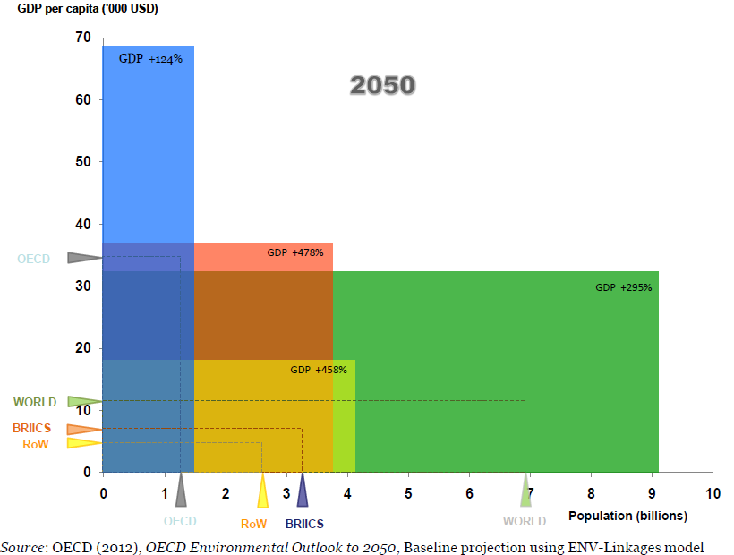

Slide 3
Conventional economy is on a collission course with Nature
Overuse of Nature is serious, as shown by
- Climate Change,
- Ecosystem decline – 2/3 of the most important ecosystems used beyond capacity, like soils, freshwater, tropical forests, marine resources
- Transgressing Planetary Boundaries and
- Resource Constraints, Crude Oil, Phosphorus, Rare metals

Slide 4
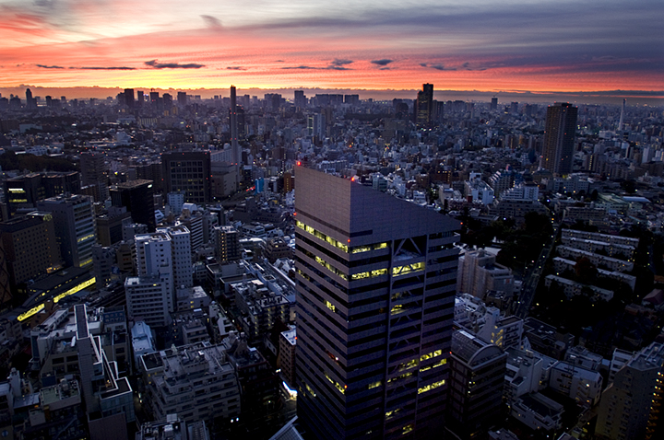
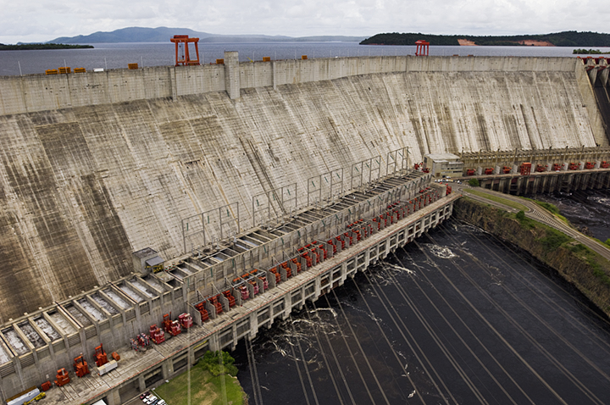
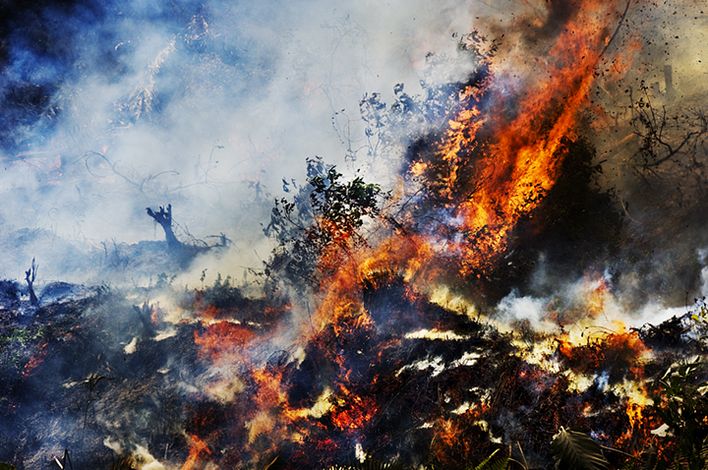
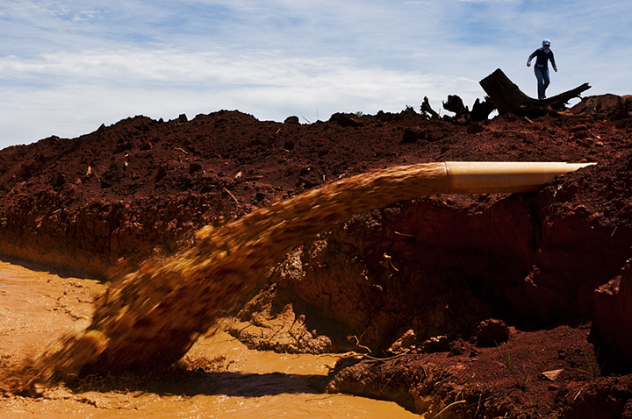
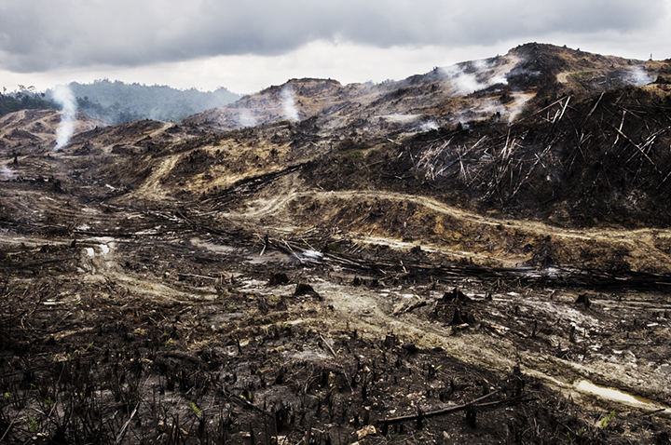
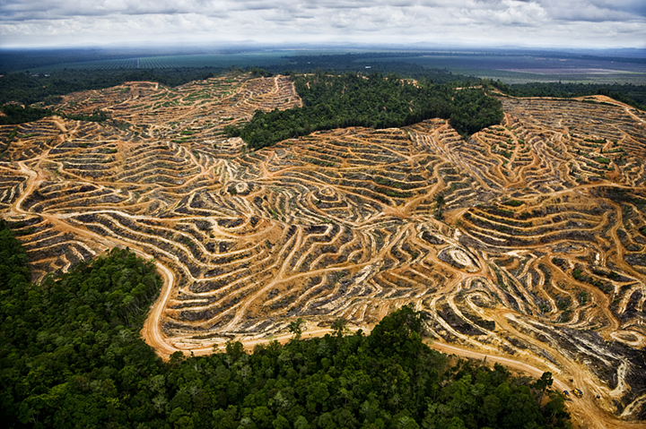
3-6-9
4
Photos: Mattias Klum

Slide 5
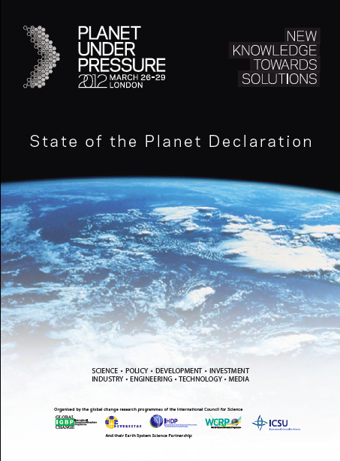
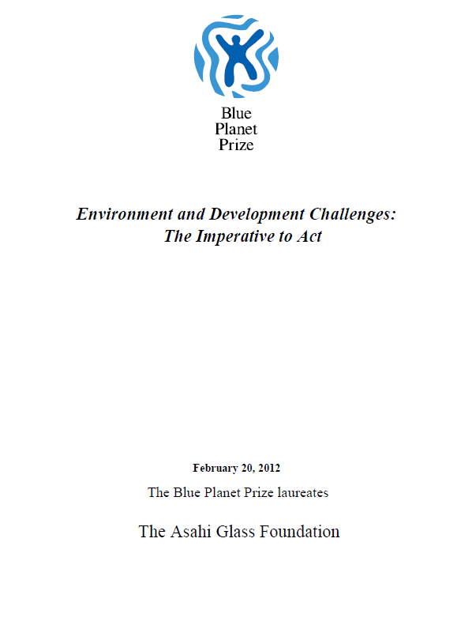
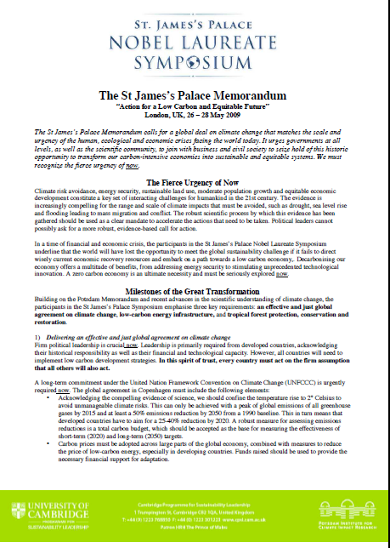
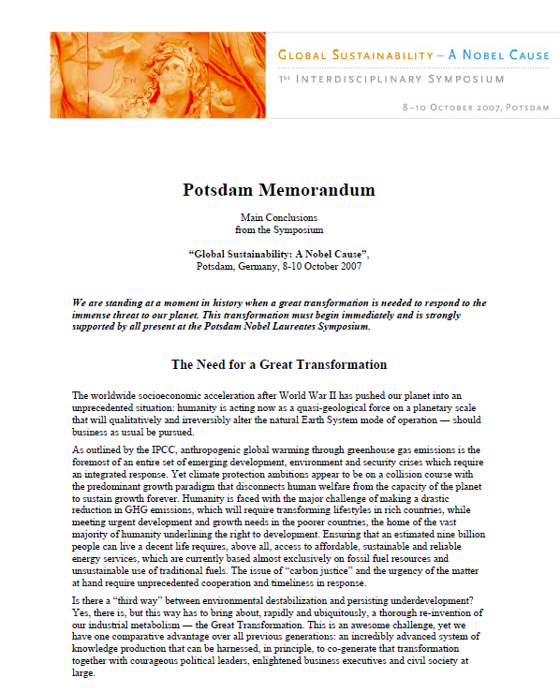
Humanity has reached a planetary saturation point
The Human ability to do has vastly outstripped our ability to understand
A resilient biosphere the basis for humen development
Fierce urgency of now
A great transformation to global sustainability necessary, possible, and desirable

Slide 6
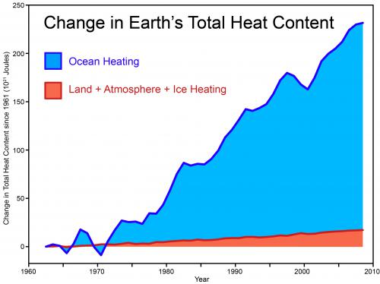
Climate
Global Warming did not stop in 1998 - as many deniers claim
Source: Skeptical Science, Church et al 2011

Slide 7
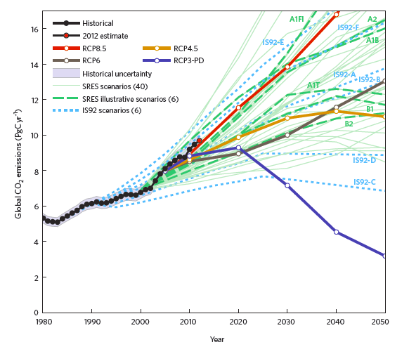
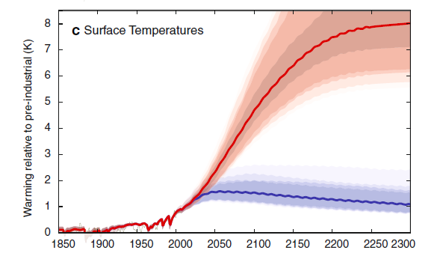
Tipping the Scales towards a stable future basis for humanity
A1F1 → mean average temperature increase of 4.2 – 5.0 °C by 2100 (range 3.5 – 6.2 ° C

Slide 8
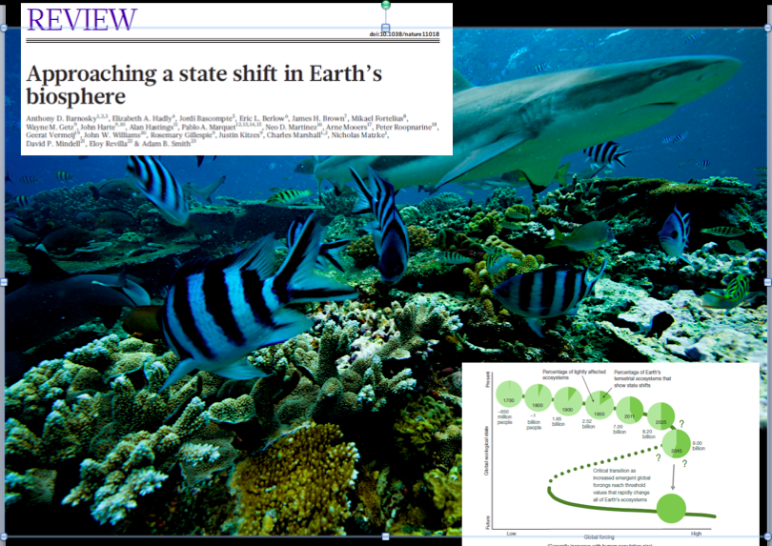

Slide 9
Multiple Interacting driving forces pushing systems towards tipping points
Natural Fire regimes
Biomass burning
Palm-oil expansion
El Nino
El Nino goes from regenerative to destructive force
Breaking millennia long Fire-El Nino relationship for Dipterocarp trees

Slide 10
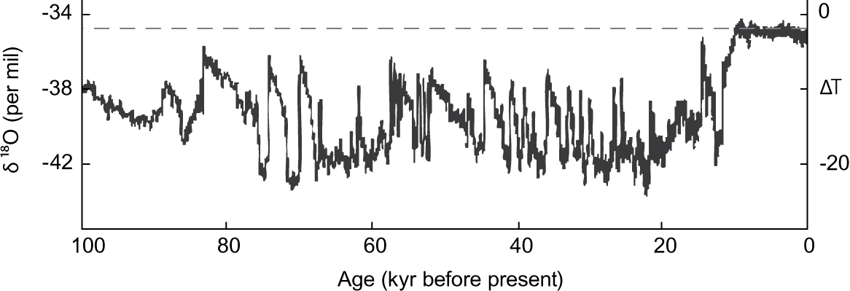
Humanity’s 10,000 years of grace

Slide 11
Ozone
depletion
Climate
change
Atmospheric
aerosol loading
Biogeochemical loading:
Global N & P cycles
Ocean
acidification
Planetary
Boundaries
Rate of
biodiversity loss
Global
freshwater
use
Land system
change
Chemical
pollution

Slide 12
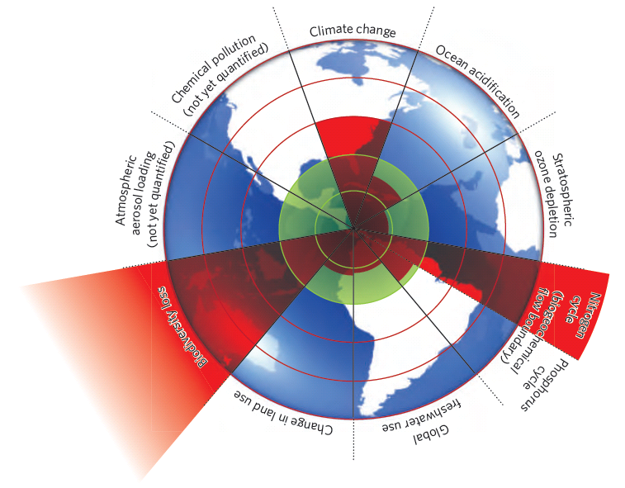
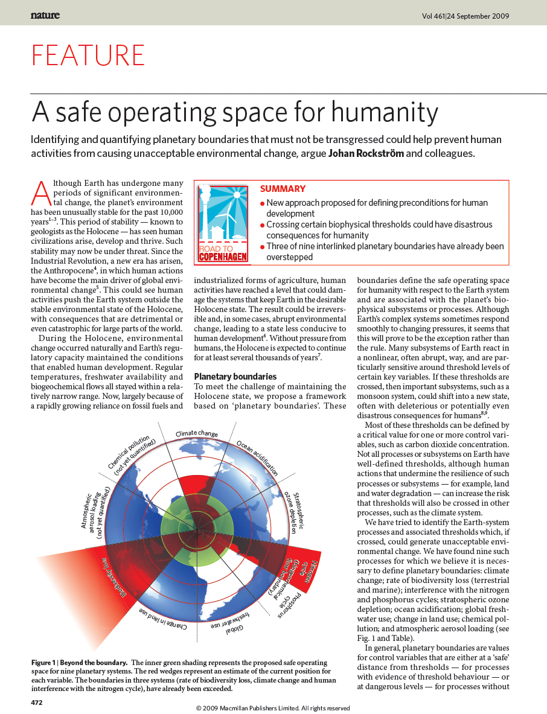
Transgressing safe boundaries
Global fresh-
water use
…
Rockström et al. 2009 Nature, 461 (24): 472-475
Notes:
12

Slide 13
Interactions among Planetary Boundaries
10
9
Resilience of the Earth system
8
7
ocean
6
Gt Carbon/yr
5
land
4
3
2
1
atmosphere
0
Adapted from Canadell et al., 2007

Slide 14
”Peak oil” major threat to prosperity
Cheap oil is the main reason behind rapid increase in standard-of-living
Projected increase in demand will require a new Saudi every third year, posing risk of gap between demand and supply
Serious consequences for world economy – Energy transition takes time; We have started too late
Military Think Tanks express concerns
Hype around shale oil and shale gas – great uncertainties re possible reserves to extract, the economics of extraction and environment and climate risks; leakage from shale gas appear large

Slide 15
Real commodity prices, 1980-2011*
Note: 2011 is Jan-Feb average

Slide 16
In a resource-constrained world
Competition for water, land, energy and materials will be fierce
Investments in resource-efficiency and renewables must have top priority
Management of land, forests and oceans KEY
R&D must be aiming at sustainable innovation

Slide 17
Major shortcomings in conventional economic policy framework
Short-termism
Natural capital and ecosystem services have no value
GDP growth confused with increase in welfare
Natural resources treated as if easy to substitute
Externalities not accounted for + Perverse Subsidies
Time lag to change energy system not recognized
Financial system ignores climate and environment risks
The role of the corporation too limited
Social challenges poorly addressed as well
Education of economists leaves a lot to be desired

Slide 18
Merchants of Doubt
Tobacco, Acid rain, CFC and now Climate change – the same tactics
Financed by oil and coal lobby, but – as well – by right-wing think tanks, who view every attempt of gvt regulation of the economy as a threat to Freedom
Ideology blocks new
knowledge – ex Kahan´s
study

Slide 19
How to move forward?
We need a vision for a sustainable society
How much is lagom – sufficiency ?What is QoL?
Analyze carefully the necessary transition
Apply a system´s approach within the Planetary Boundaries
Merge the agendas of finance, economy, employment, climate change, pollution and resource depletion and constraints
The financial crisis is not about money alone – it is as much about natural resources

Slide 20
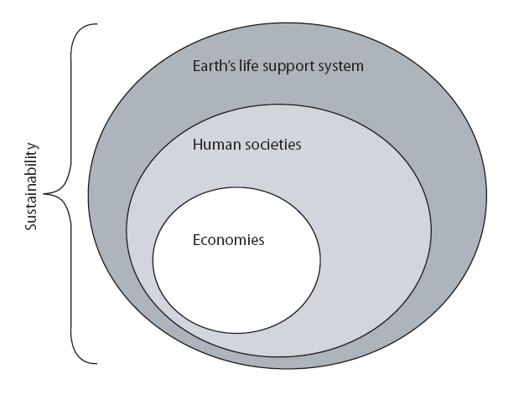
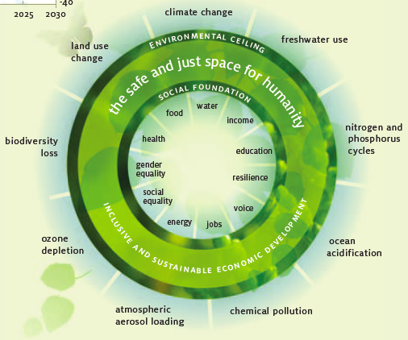
A old/new economic paradigm

Slide 21
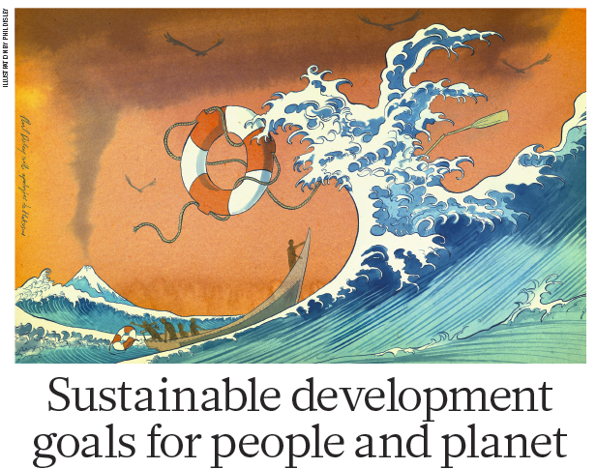
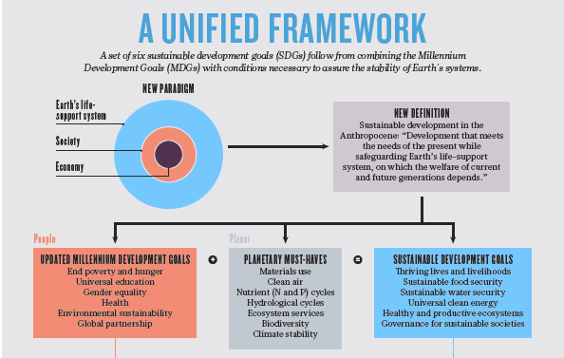
Reaching Twin-objectives of global sustainability and Eradicating Poverty

Slide 22
Strategy for Sustainability
Priority to transdisciplinary science and education
Reform economic and finance policy frameworks
Address short-termism in all its aspects
Replace Economic Growth w specific welfare goals instead
Assign a value to Natural Capital
Carbon tax + invest in renewables and efficiency
Circular Economy – tax resource use; low or no tax on labor
Land use critical
Biomimicry – Do more with less/Blue Economy
Stabilise population
Public Procurement proactive role in transformation
Rethink the company laws
Strengthen Global Governance

Slide 23
Move towards a circular economy
Products designed to last longer
Reuse, recycling and reconditioning of materials
Service economy for maintenance and repair = jobs
Requires new business models for HQ service and performance
Promoted by tax reform; raising taxes on use of virgin materials while lowering taxes on labour
Means less pressure on resources – both finite and renewables
Will lead to significantly lower GHG emissions
The EU Commission Roadmap for a Resource-Efficient Europe!

Slide 24
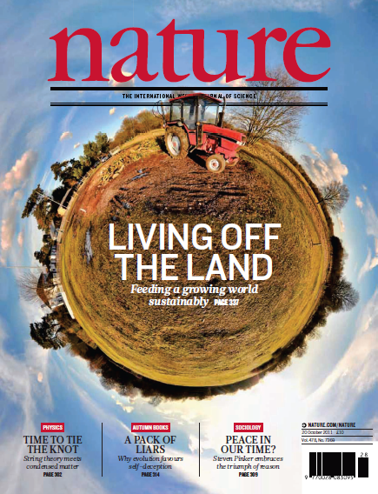
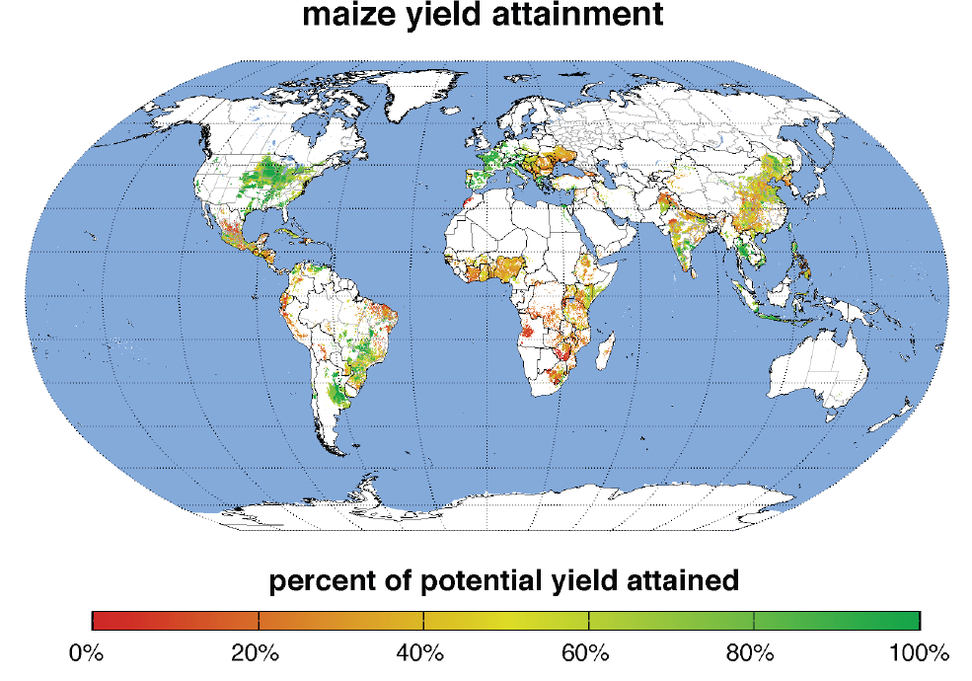

Slide 27
Labour productivity has increased twentyfold since 1850. It is not utopian to think of resource productivity increasing tenfold in 100 years and fivefold in 50 years!
For that to happen, policy frameworks must change and Business Models undergo significant change, giving real priority to alternative energy as well as energy and resource efficicency

