Slide 1
International cooperation in science as a model for other global activities
Herwig Schopper
University Hamburg and CERN
Member of Board of Trustees WAAS
Opportunities and Challenges for the 21th Century
Conference organised by United Nations and World Academy of Arts & Sciences
Geneva, Palais des Nations , 3 June 2013

Slide 2
The realisation of large scale facilities in science has lead to new kinds of international cooperation
Some general views have been presented by Rolf Heuer, Director General of CERN, at the opening session
Here some specific conditions will be discussed which contributed to the success of CERN and some of which could be useful for other global co-operations.

Slide 3
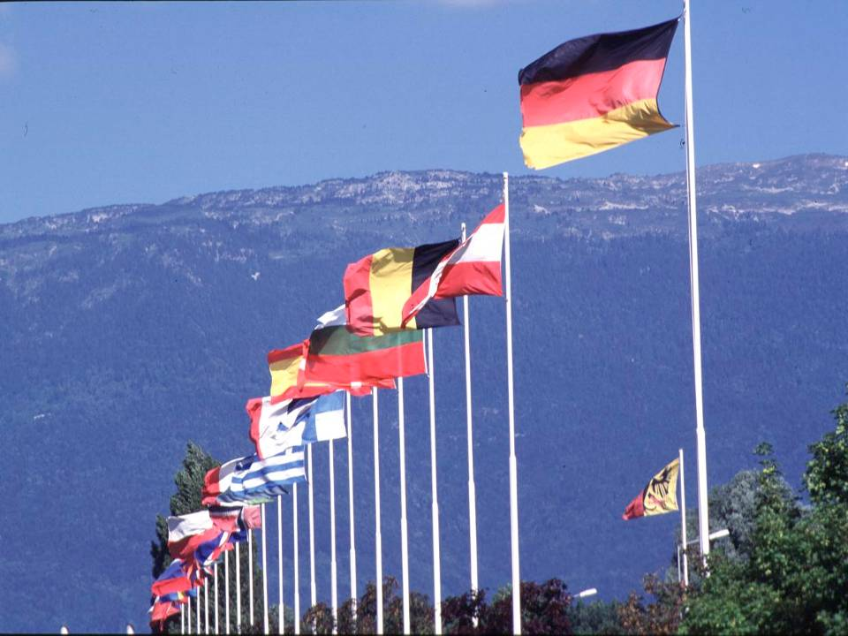

CERN was founded 1954: 12 European States
“Promote Science and bring countries together”
Today: 20 Member States
~ 2300 staff
~ 1050 other paid personnel
~ 11000 users
Regular Budget (2012) ~1000 MCHF
Member States: Austria, Belgium, Bulgaria, the Czech Republic, Denmark, Finland, France, Germany, Greece, Hungary, Italy, the Netherlands, Norway, Poland, Portugal, Slovakia, Spain, Sweden, Switzerland and the United Kingdom
Candidate for Accession: Romania
Associate Members in the Pre-Stage to Membership: Israel, Serbia
Applicant States: Cyprus (agreement signed), Slovenia, Turkey
Observers to Council: India, Japan, the Russian Federation, the United States of America, Turkey, the European Commission and UNESCO
3
Notes:
3

Slide 4
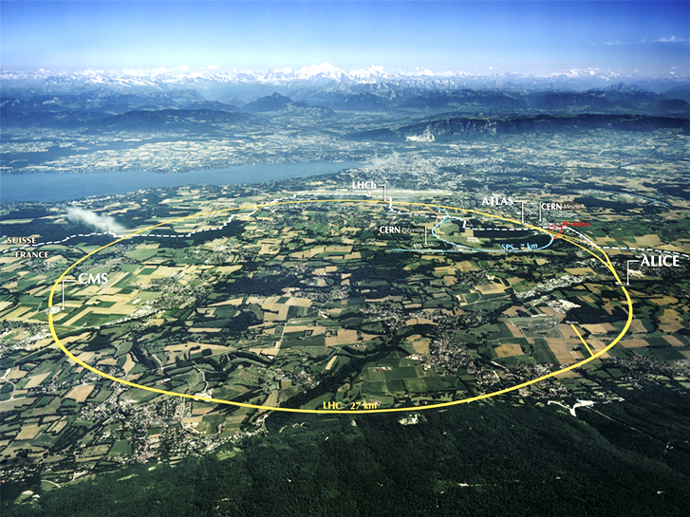
Mont Blanc
Airport

Slide 5


the Large Hadron Collider (LHC)
Largest scientific instrument ever built,
27km of circumference
reused for second large project (LEP,LHC)
Collides protons to
- Investigate buildingblocks of matter
and forces between them
    - To reproduce conditions
    at the birth of the
Universe...
...mini- big bangs
at Accelerating Science and Innovation
Notes:
5

Slide 6
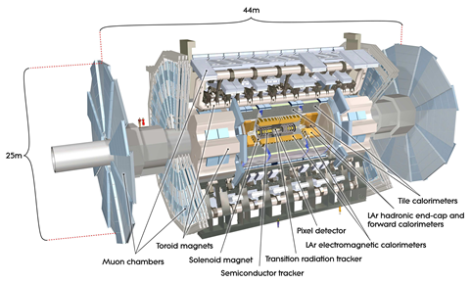
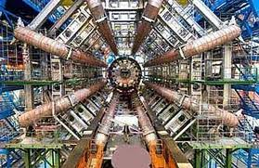
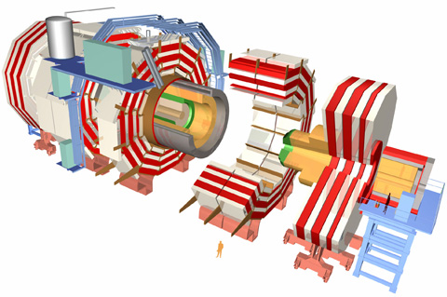
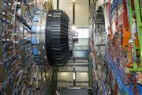
The 2 large ‘experiments’ at LHC
each designed and built by more than 3000 scientists
ATLAS
CMS
person

Slide 7
Science at CERN
Science is performed by outside groups (‘users’)
About 11000 users from whole world
Only about 100 scientists among 2500 CERN staff
Reservoir for permanent rejuvenation of staff
CERN (‘service station’ ) provides
- facilities, accelerators (technical competence)
- overall coordination of
international co-operations

Slide 8
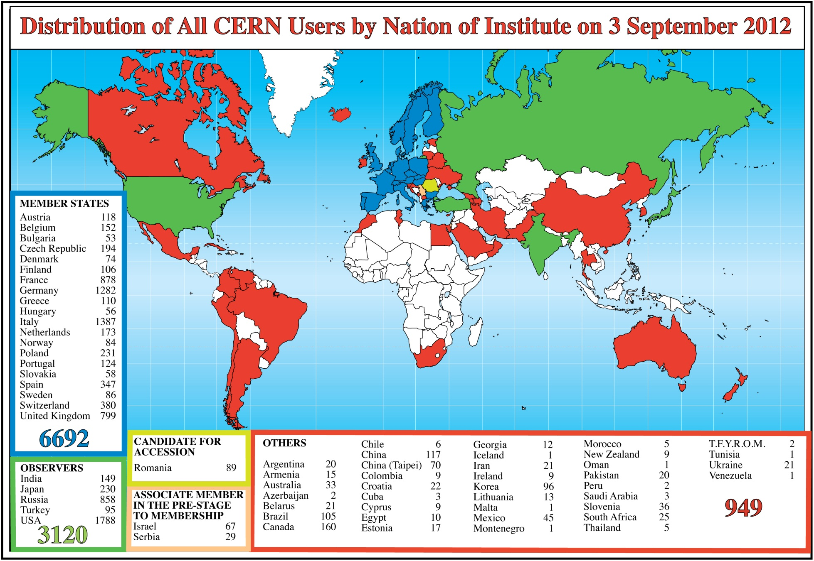
Science is getting more and more global

Slide 9
Governing Structure of CERN
Governing body:
Council
2 delegates/country (government representative, scientist)
each Member State has one vote (independent of size)
No ‘overruling’ votes, consensus seeking
Director General appointed by Council
Only he can propose programmes and
the structure of the organisation
(Directors, Departments, Divisions, etc)
Proposals from users and filtered through committees
Bottom-up approach
No political ‘missions’ by Council !! t

Slide 10
Other Reasons for CERN’s Success
1.Principles for Selection of staff:
scientific or technical competence is decisive
no national quota for scientists from Member states
every scientist is welcome, if he/she provides positive contributions ds, Division leaders
2. Selection of projects (experiments)
initiatives and scientific evaluation from the base
(advisory committees) ‘bottom-up approach’
no national quota for experiments , no "buy-in”
Projects and programs are ambitious, but realistic
- at frontier of world standards
- attracting best scientists and engineers

Slide 11
3. Management
Long-term planning of projects (more than 10 years ahead)
Budget stability, yearly approval of budget
Practically constant since 1983 (inflation partially compensated)
in spite of mega-projects LEP and LHC
Follow-up of Projects controlled by laboratory,
keeps responsibility for outside industrial contracts
(no general contractors!)
( big projects within constant budget and time scales)
Extremely shallow hierarchy
Everybody is listened to, arguments count, not status
Truly world-wide projects with no dominating country,
all are respected partners

Slide 12
Large ‘independent’ Projects , e.g. ATLAS, CMS
International organisations of their own
each with more than 3000 scientists from many countries
Own Budgets several 100 million $ each
No hierarchical structure (no legal boss!)
coordination committee, resources committee,
Spokesperson elected for several years (no executive power)
Objectives defined bottom-up, consensus seeking
Components constructed in various countries
(contributions in kind), delivery in time, must fit together and work
CERN provides frame for overall coordination

Slide 13
Miracle that it works. Why?
Common success is overriding motivation
In spite of personal ambitions
Cooperation and competition coexist! !
‘Coopetition’ = cooperation + competition
Personal financial interests and status symbols
are only secondary
CERN model discussed at
2013 World Economic Forum at Davos
Model for World Bank and other global activities?
CERN Observer at UN since December 2012 (only scientific organisation)

Slide 14
Can CERN be repeated?
CERN cannot easily be repeated as such
although it became a model for ESO and EMBL
However, many specific experiences from CERN
could be applied, to other world-wide activities
One CERN off-spring: SESAME

Slide 15
SESAME
Synchrotronlight for Experimental
Science and
Application in the
Middle
East
‘Door opener’
An International Center for Research and Advanced Technology for Middle East and Mediterranean Basin
In Jordan with a 2.5 GeV electron ring for
synchrotron radiation, strong light source for research in physics, biology, medicine, archaeology, material science,…..
Created under the auspices of UNESCO
according to CERN model:
Promote science and bring nations together

Slide 16
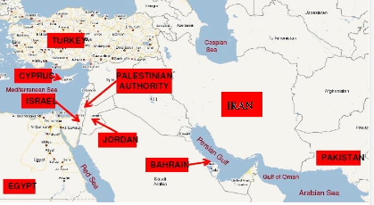
Member States
Observers (2012): France, Germany, Greece, Italy, Japan, Kuwait, Portugal, Russian Federation, Sweden, Switzerland, the United Kingdom, and USA. China applied. Interest by Brazil, India.

Slide 17
Created by UNESCO
First proposal to F.Mayor (UNESCO) in 1999
Mai 2002 Unanimous approval as international organisation
“Quintessential UNESCO project combining capacity building with vital peace-building through science.”
(Interim) Council set – up 2000
chair Herwig Schopper,
followed 2008 by Sir Ch. Llewellyn-Smith
SESAME Convention = CERN Convention
Site selected in Jordan:
Condition: all scientists of world have access

Slide 18
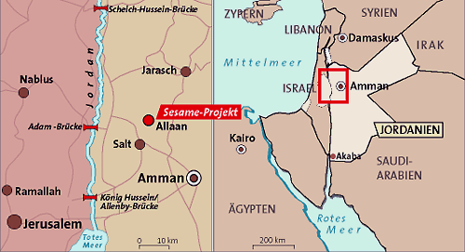
Location of SESAME(I)
Within easy reach of Jordan, Israel, Palestinians.
Samples/equipment/people can in principle be transported by car.

Slide 19
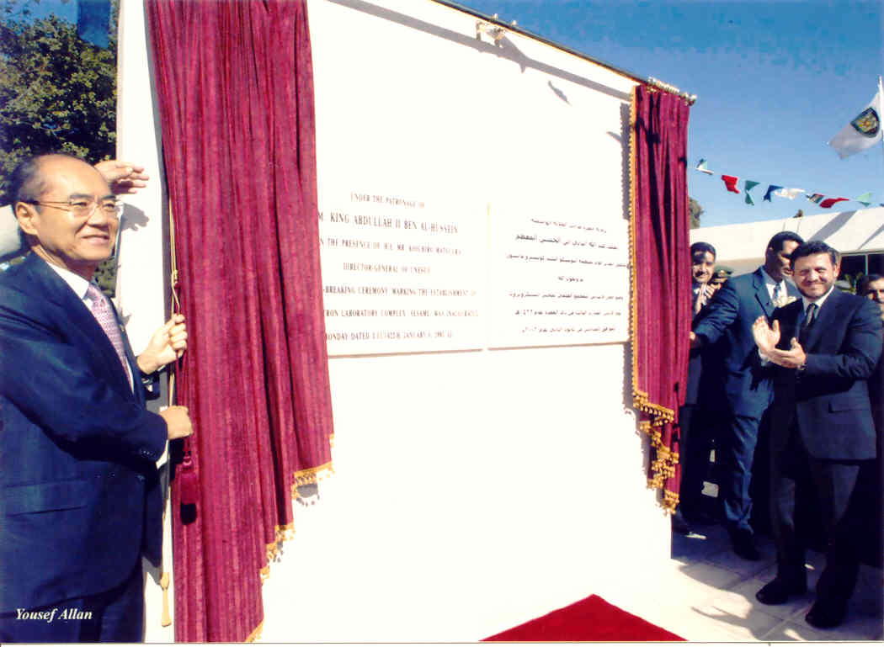
H.M.King Abdullah II and UNESCO DG Matsuura unveiling marble plate, at foundation of SESAME and Groundbreaking, January 2003

Slide 20
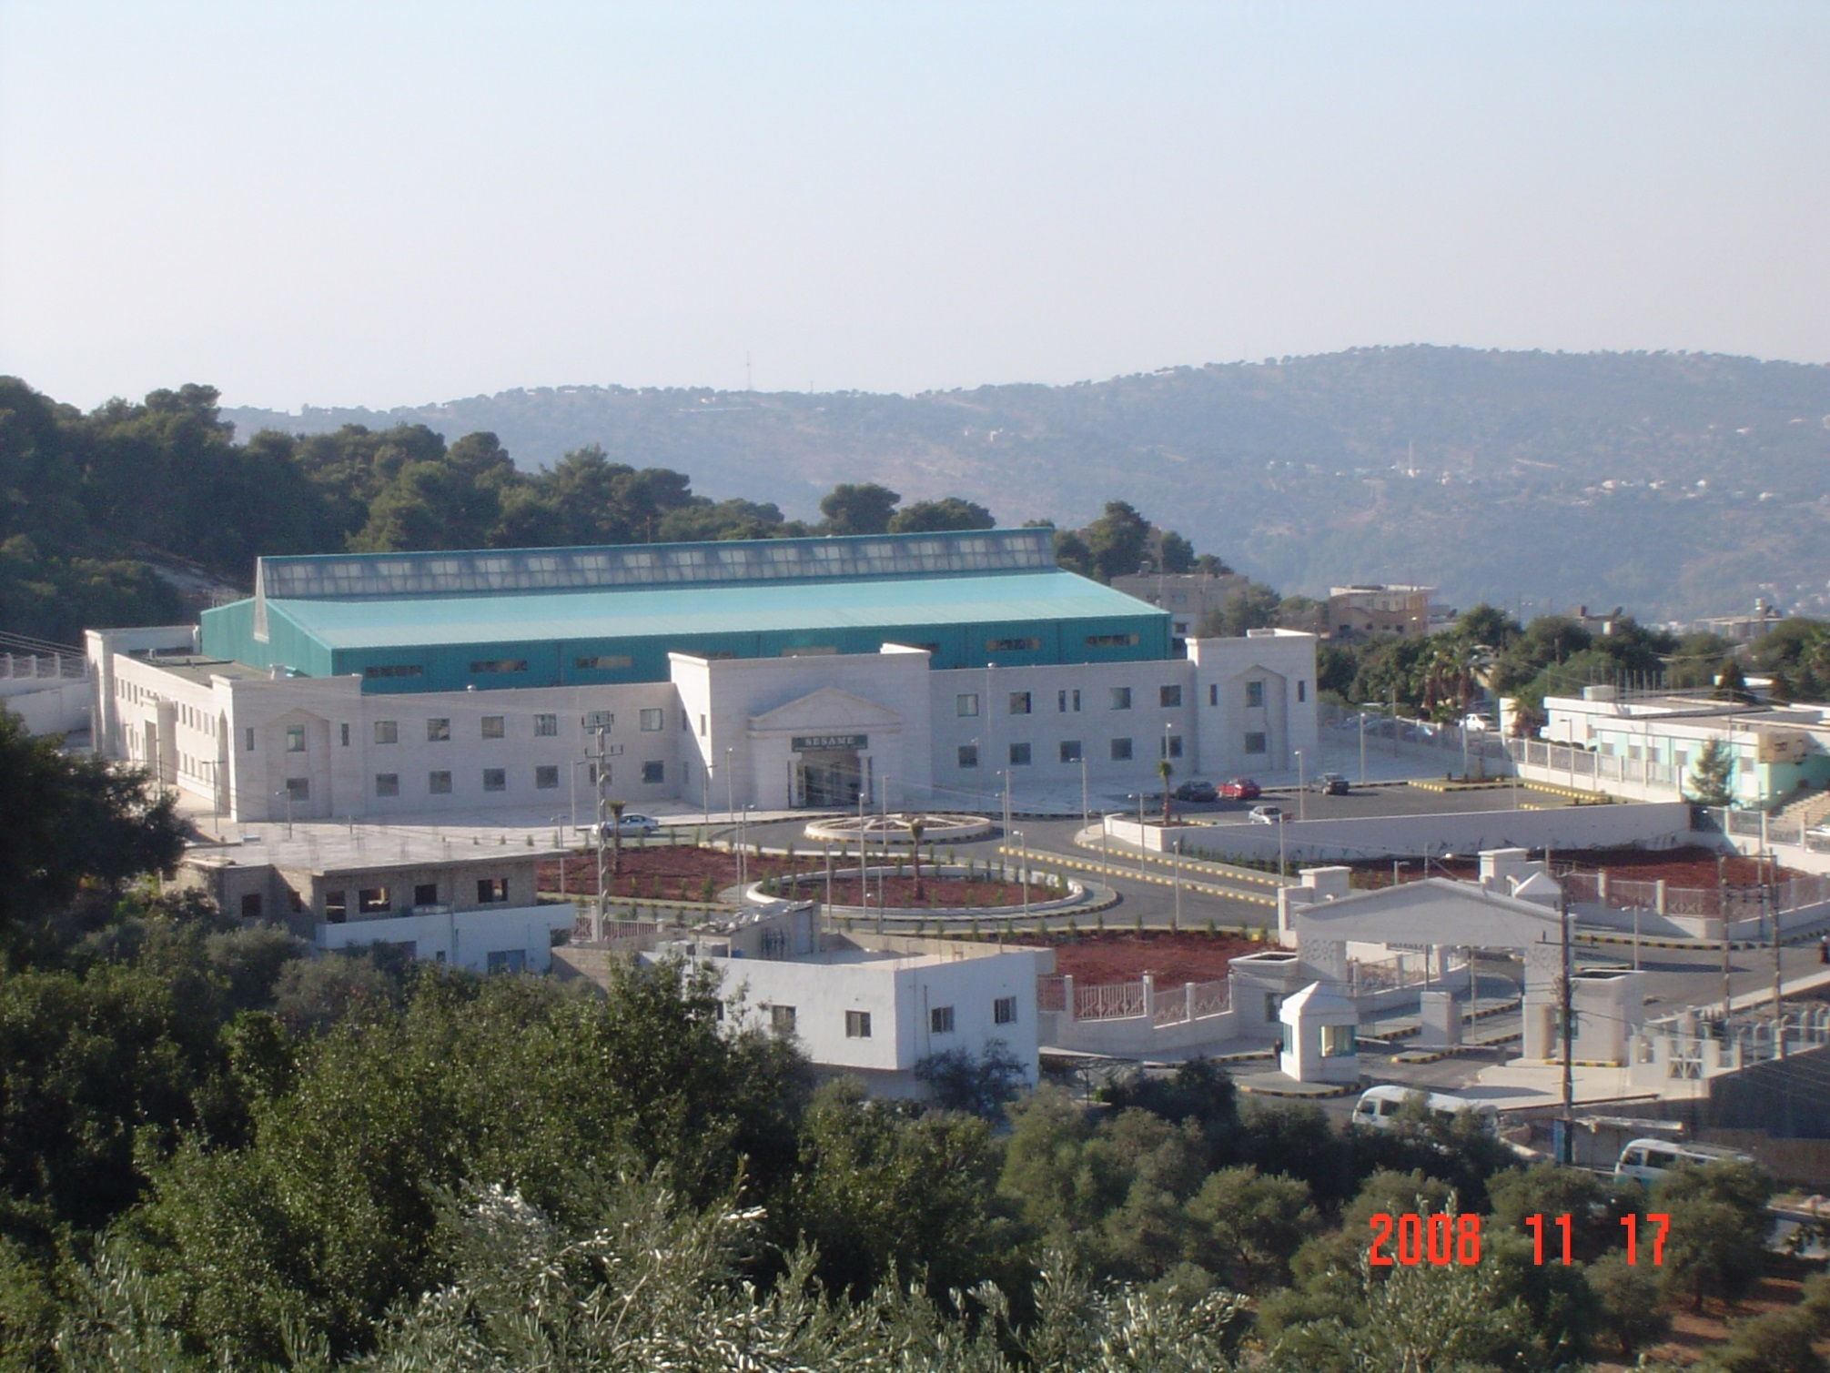

Slide 21
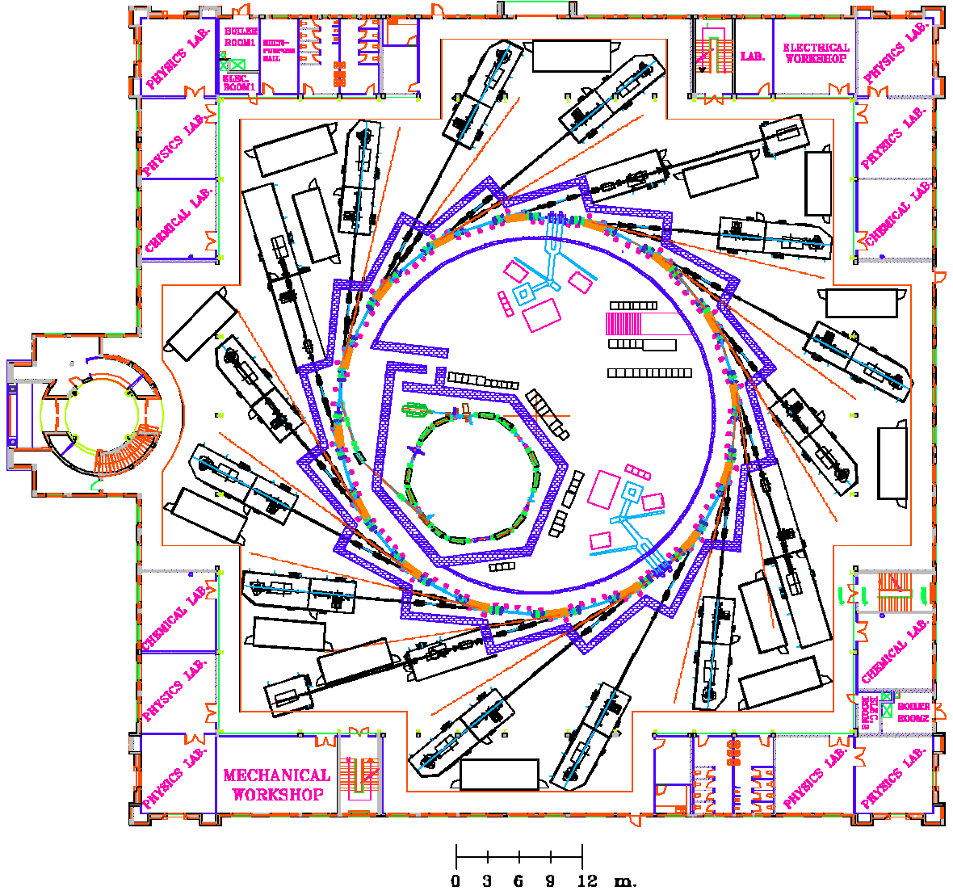
SESAME is a 2.5 GeV electron storage ring (133m in circumference), which can accommodate up to 12 wigglers and undulators, making it a third generation light source.
Physics,
Material science,
biology, archaeology, medicine
Beamlines:
a possible layout.
Up to 16 lines can be accomodated.
4 beam lines on ‘day-one’
Gift from Germany

Slide 22
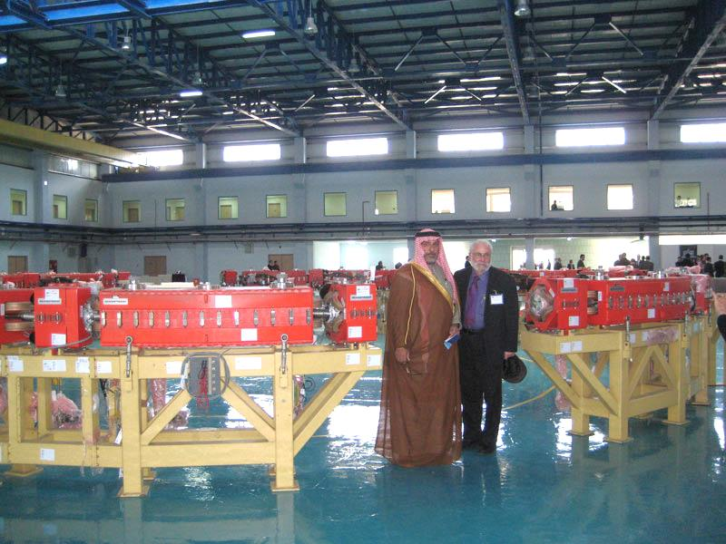

Slide 23
SESAME is on its way!
Council on 28/29 Mai 2013, Vienna at IAEA
All major hurdles (financial) have been taken
Hopefully to start operation in 2015
New Member States welcome
A dream of 1001 nights will become true

Slide 24
Thank you

